Slide 1

Anchorage Women’s Golf Association Team-Play Tournament Tracker - Instructions -

Slide 2
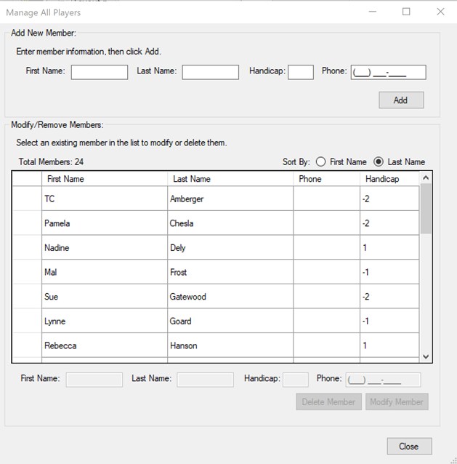
How To: - Add Members -
Members must first be added to the Member pool. This is the collection of all members who can be assigned to team-play events. After adding a member to the pool, you do not need to enter their information again – they can now be assigned to any number of events. To add members, navigate to Manage->Members and use the resulting dialog box. You may also select an existing member from the list to modify them, or remove them from the pool completely.

Slide 3
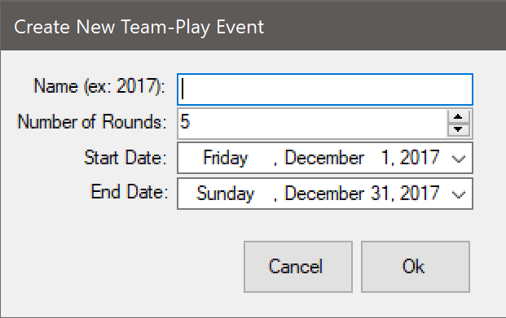

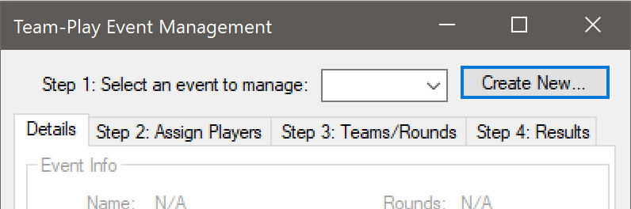
How To: - Create an Event -
Events must be created before they can be managed. To add an Event, navigate to Manage->Events and click “Create New…”, fill out the event details, and Click “OK”. The event may now be selected in the event selection dropdown box.

Slide 4
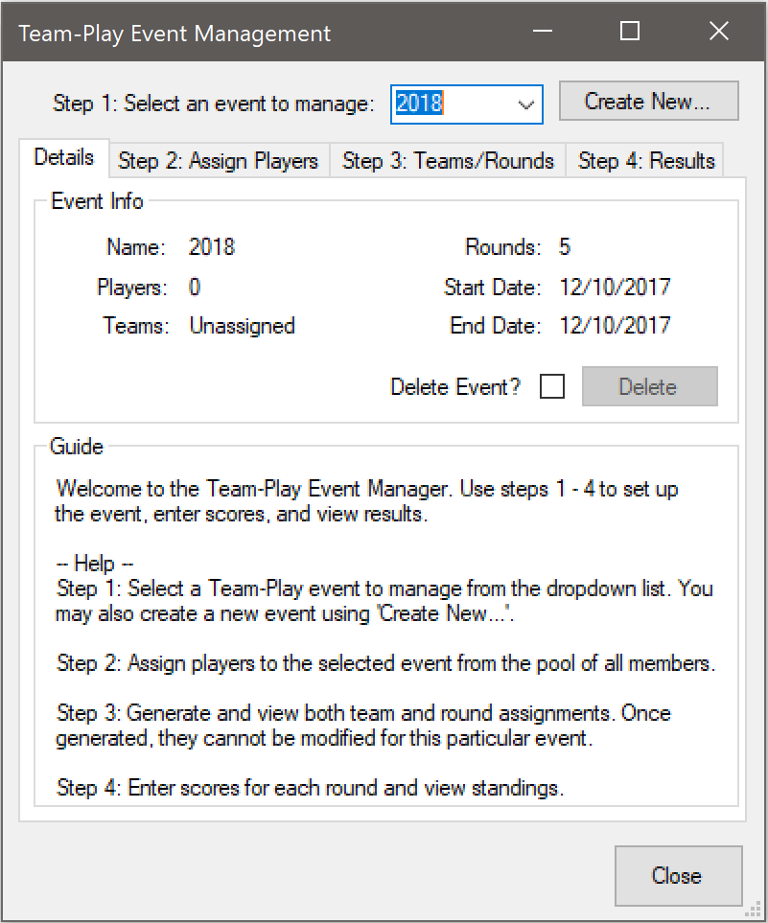
How To: - Manage an Event: Step 1 -
Step 1: Select an Event to manage from the event dropdown box. The Event details will then be populated and Steps 2 – 4 become available. The event may also be deleted from this screen at any time by checking “Delete Event?” and clicking “Delete”.

Slide 5
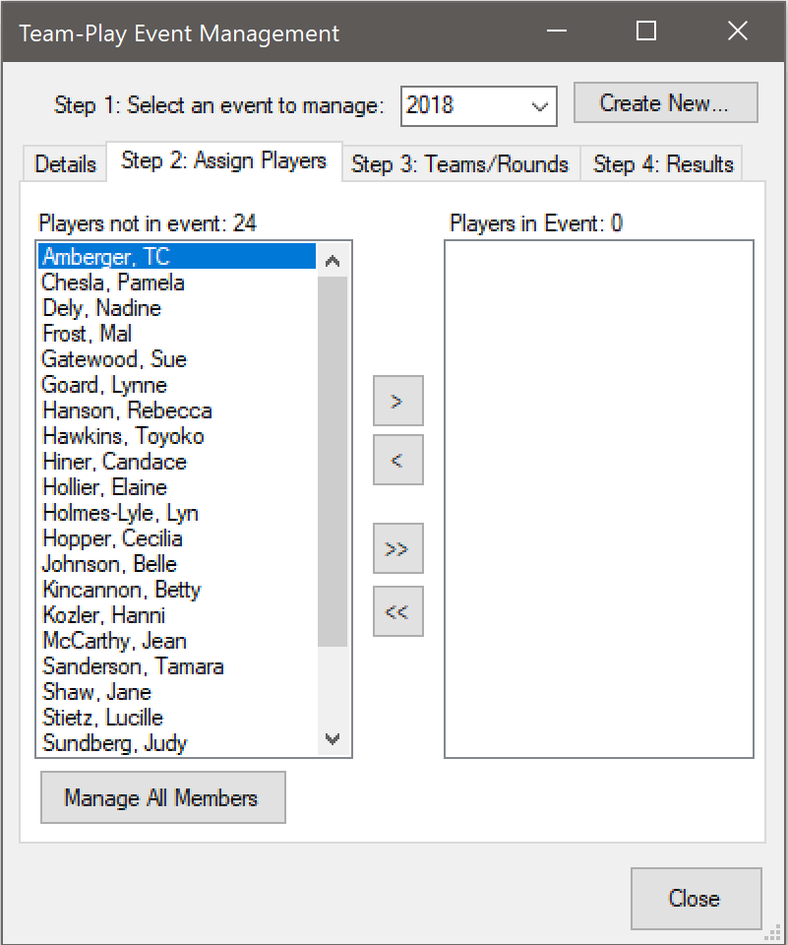
Application Demonstration: - Manage an Event: Step 2 -
Step 2: Assign players to the event by clicking the tab labeled “Step 2: Assign Players”. Use the arrow buttons to add or remove players to the event from the members pool on the left. If a member is not found in the pool, you may click “Manage All Members” to open the Manage Members tool (described previously) and add them.

Slide 6
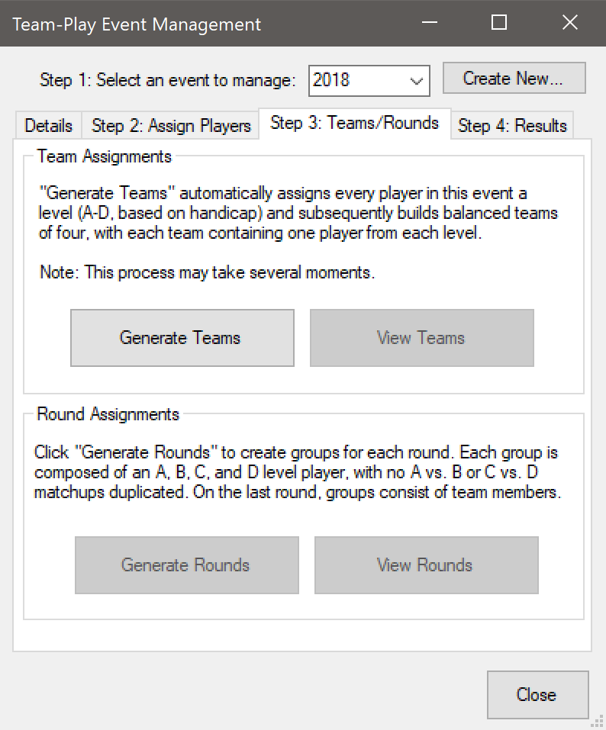
Application Demonstration: - Manage an Event: Step 3 -
Step 3: Create teams and rounds for the event by clicking the tab labeled “Step 3: Teams/Rounds”. Click “Generate Teams” to create teams for the event using the players current handicap. The “View Teams” button will then become available – click it to open a spreadsheet of the teams in your default spreadsheet application.
After teams have been created, create rounds/groups for the event by clicking “Generate Rounds”. After this process completes, you may view round/group assignments via “View Rounds”.
Note: Team/Round Generation is final and the results cannot be modified. If a mistake was made, the event must be deleted and re-created.

Slide 7
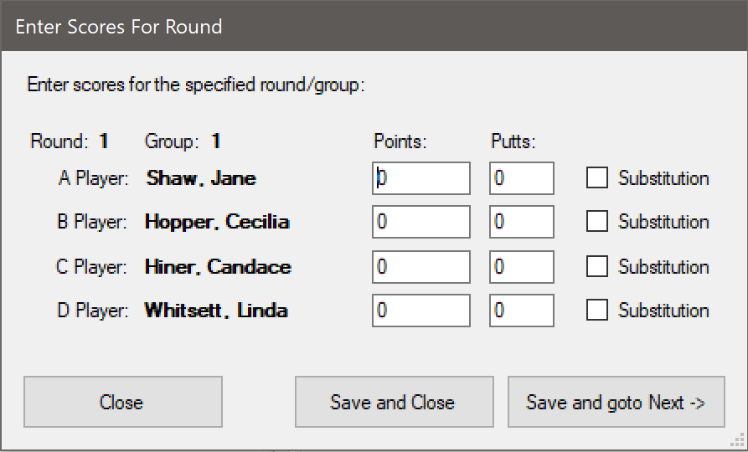
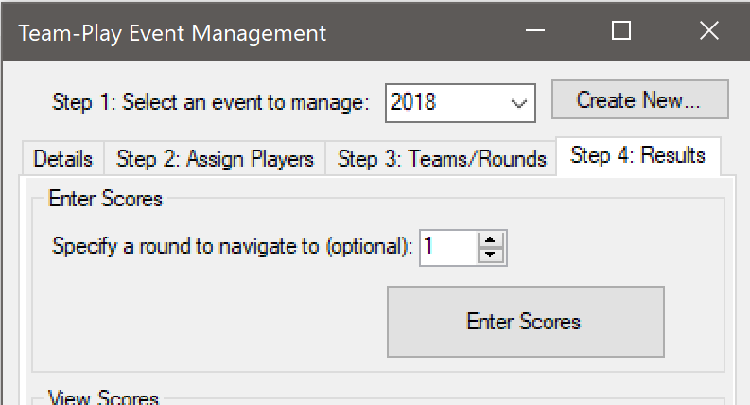
Application Demonstration: - Manage an Event: Step 4 -
To enter scores and view standings/results, click “Step 4: Results”. Click “Enter Scores” to fill out scorecards for each round, by group.
Substitutions may be denoted here as well. If a player had a substitution in any round, they are not eligible for Points or Putts awards. However, their points are still used in calculating the Team award Clicking “Save and go to Next ->” will save the current input and take you to the scorecard for the next group.

Slide 8
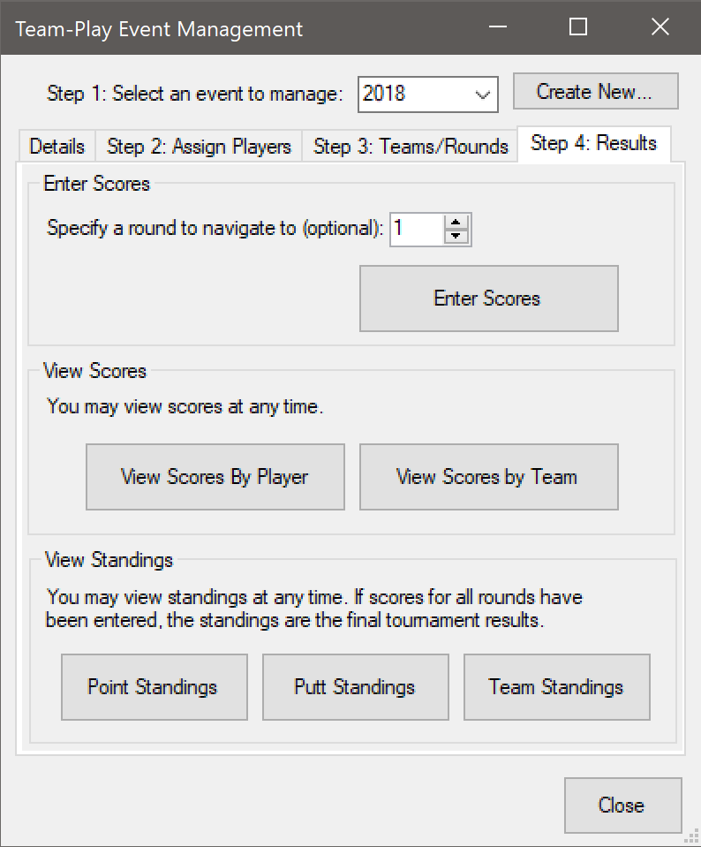
How To: - Manage an Event: Step 4 -
Also available under the “Step 4: Results” tab, are the score and standings reports. These are opened in your default spreadsheet program upon clicking the appropriate button. At any time, you may click to view scores by player or team, or to see standings for each award category. If all scores have been entered for the event, standings reflect the final tournament results.

