Slide 1



Anchorage Women’s Golf Association Team-Play Tournament Tracker
Dustin Fast, Tricia Reilley, Brooks Woods
Fall 2017, CSCE A401

Slide 2
Overview
Background Information/Objectives
Project Challenges
Development Process Assessment
Goals vs. Accomplishments.
Testing Process and Results
Lessons Learned
Application Demonstration

Slide 3
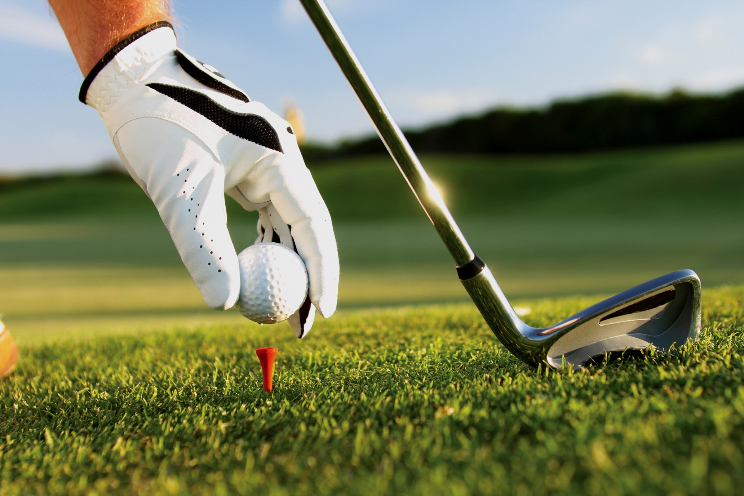
Background Information and Objectives
Problem:
A yearly tournament is held, but event structure creation and accounting tasks are laborious and error-prone when done manually.
Solution: Automation of tasks -
Construct balanced teams by player handicap.
Creation of unique player matchups across all rounds.
Track player points and putts for each round.
Allow denoting of substitutes in scores.
Determine final tournament winners.
Maintain records of previous tournament data.

Slide 4
Project Challenges
Learning curve of unfamiliar technologies
Git, C#, Windows Forms Development, SQL, etc.
Collaborative Development
Readability, abstraction, and merging.
Working on assumptions. Ex: My component requires your component, but development is parallel.
Coordination with client
Client doesn’t speak the same “language”.
Not always responsive
Estimation of development time

Slide 5
Development Process Assessment
Describe our development process

Slide 6
Goals vs. Accomplishments
Completed Goals:
Construct balanced teams by player handicap.
Creation of unique player matchups across all rounds.
Track player points and putts for each round.
Allow denoting of substitutes in scores.
Determine final tournament winners.
Maintain records of previous tournament data.
Happy client.
Incomplete Goals:
None!

Slide 7
Testing Process and Results
Negative Testing was performed:
Invalid/out of bounds input - Ex: an integer is expected, but a larger number or alphabetic character was received.
Incomplete input - Ex: unpopulated required input fields.
Out of order operations – Ex: expecting the user to follow processes A, B, then C, but the user attempts B, A, then C.
Results:
All pre-conceived user interaction handled gracefully.

Slide 8
Testing Process and Results
Positive Testing was performed:
Obtained prior-year tournament data (i.e. players, team/round structure, scores, and final results.
Constructed test tournaments in the application using prior-year data.
Ensured application output matched prior-year results.
Results:
Application produced expected results.

Slide 9
Lessons Learned
Collaboration is hard
Group Dynamics.
Appreciating the work of others when you might accomplish the same task differently.
Merging files that have been modified independently.
New tools can be difficult to adopt.
Ex: Git

Slide 10
Application Demonstration
Add “Members”

