Slide 1



Anchorage Women’s Golf Association Team-Play Tournament Tracker
Dustin Fast, Tricia Reilley, Brooks Woods
Fall 2017, CSCE A401

Slide 2
Overview
Background Information/Objectives
Project Challenges
Development Process Assessment
Goals vs. Accomplishments.
Testing Process and Results
Lessons Learned
Application Demonstration

Slide 3

Background Information and Objectives
Problem:
A yearly tournament is held, but event structure creation and accounting tasks are laborious and error-prone when done manually.
Solution: Automation of tasks -
Construct balanced teams by player handicap.
Creation of unique player matchups across all rounds.
Track player points and putts for each round.
Allow denoting of substitutes in scores.
Determine final tournament winners.
Maintain records of previous tournament data.

Slide 4
Project Challenges
Learning curve of unfamiliar technologies
Git, C#, Windows Forms Development, SQL, etc.
Collaborative Development
Readability, abstraction, and merging.
Working on assumptions. Ex: My component requires your component, but development is parallel.
Coordination with client
Client doesn’t speak the same “language”.
Not always responsive
Estimation of development time

Slide 5
Development Process Assessment
The Agile development process was used
Two week sprints
Bugs found in completed stories were generally fixed in the next iteration.
Git, GitHub, and Pivotal Tracker were used for version tracking and collaboration.

Slide 6
Goals vs. Accomplishments
Completed Goals:
Construct balanced teams by player handicap.
Creation of unique player matchups across all rounds.
Track player points and putts for each round.
Allow denoting of substitutes in scores.
Determine final tournament winners.
Maintain records of previous tournament data.
Happy client.
Incomplete Goals:
None!

Slide 7
Testing Process and Results – Negative Testing
Negative Testing was performed:
Invalid/out of bounds input - Ex: an integer is expected, but a larger number or an alphabetic character was received.
Incomplete input - Ex: unpopulated required input fields.
Out of order operations – Ex: expecting the user to follow processes A, B, then C, but the user attempts B, A, then C.
Results:
All pre-conceived user interaction handled gracefully.

Slide 8
Testing Process and Results – Positive Testing
Positive Testing was performed:
Obtained prior-year tournament data (i.e. players, team/round structure, scores, and final results.
Constructed test tournaments in the application using prior-year data.
Ensured application output matched prior-year results.
Results:
Application produced expected results.

Slide 9
Lessons Learned
Collaboration is hard
Group Dynamics.
Appreciating the work of others when you might accomplish the same task differently.
Merging files that have been modified independently.
New tools can be difficult to adopt.
Ex: Git

Slide 10
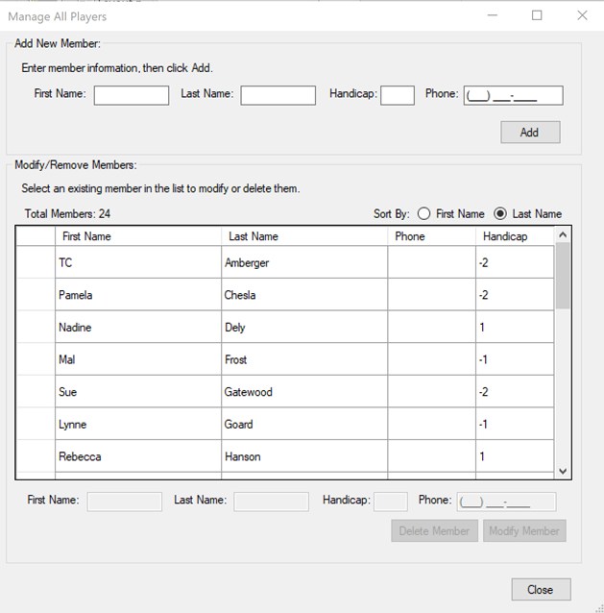
Application Demonstration: - Add Members -
Members must first be added to the Member pool. This is the collection of all members who can be assigned to an event. To add members, navigate to Manage->Members and use the resulting dialog box. You may also select an existing member from the list to modify them, or remove them from the pool completely.

Slide 11
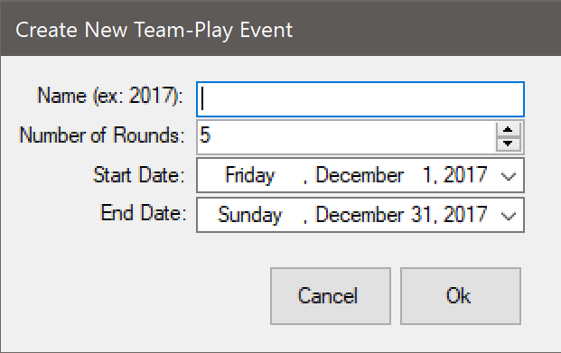

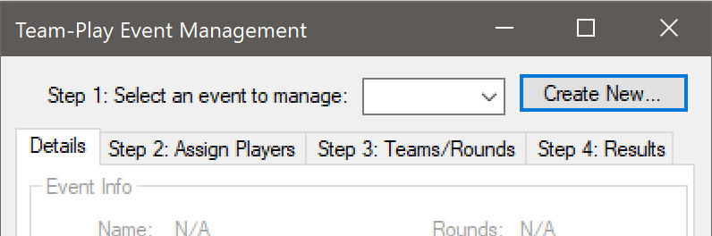
Application Demonstration: - Create an Event -
Events must be created before they can be managed. To add an Event, navigate to Manage->Events and click “Create New…”, fill out the event details, and Click “OK”. The event may now be selected in the event selection dropdown box.

Slide 12
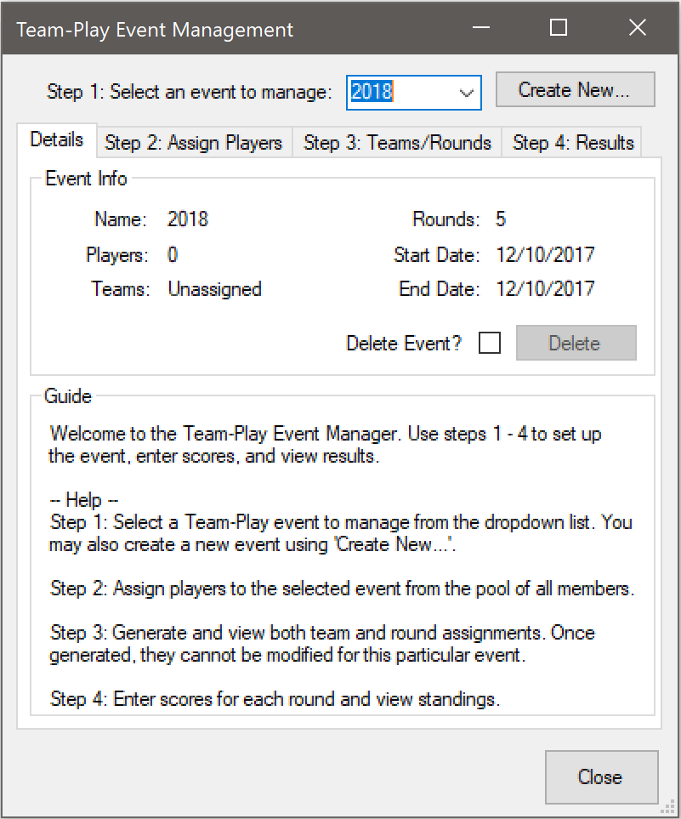
Application Demonstration: - Manage an Event: Step 1 -
Select an Event to manage from the event dropdown box. The Event details will then be populated and Steps 2 – 4 become available. The event may also be deleted from this screen at any time by checking “Delete Event?” and clicking “Delete”.

Slide 13
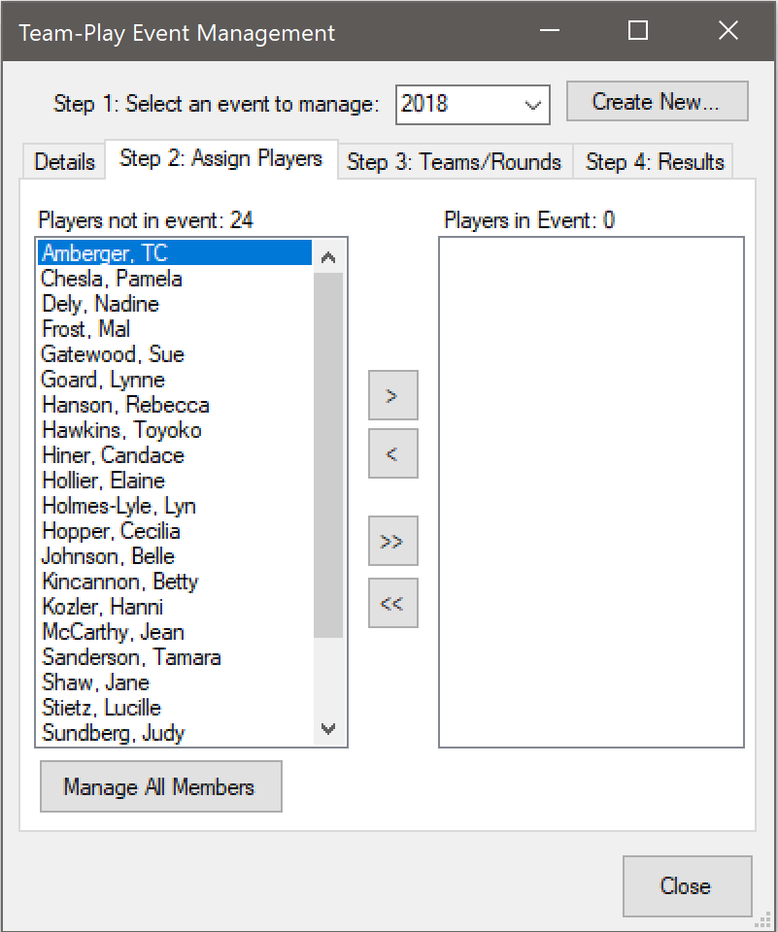
Application Demonstration: - Manage an Event: Step 2 -
To assign players to the event, click the tab labeled “Step 2: Assign Players”. Use the arrow buttons to add or remove players to/from the event. The list on the left reflects the members pool. If a member is not found in the list, you may click “Manage All Members” to open the Manage Members tool described previously, and add them.

Slide 14
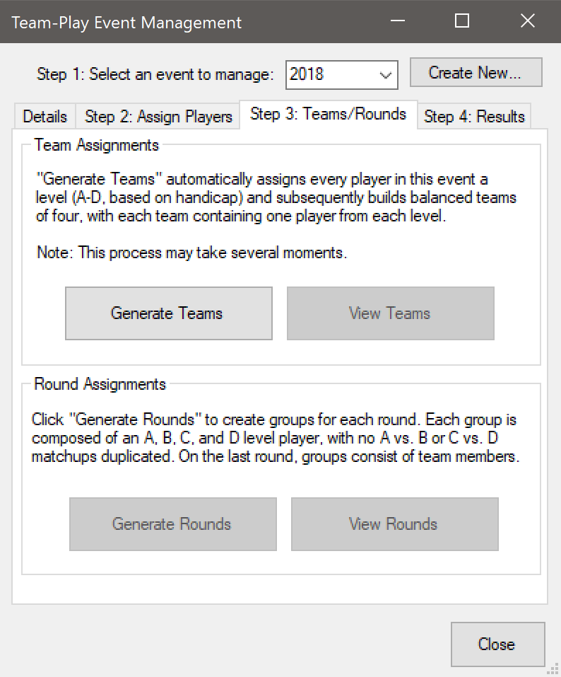
Application Demonstration: - Manage an Event: Step 3 -
To create teams and rounds for the event, click the tab labeled “Step 3: Teams/Rounds”. Click “Generate Teams” to create teams for the event. The “View Teams” button will then become available – click it to open a spreadsheet of the teams in your default spreadsheet application.
After teams have been created, create rounds/groups for the event by clicking “Generate Rounds”. After this process completes, you may view round/group assignments via “View Rounds”.
Note: Team/Round Generation is final and the results cannot be modified.

Slide 15
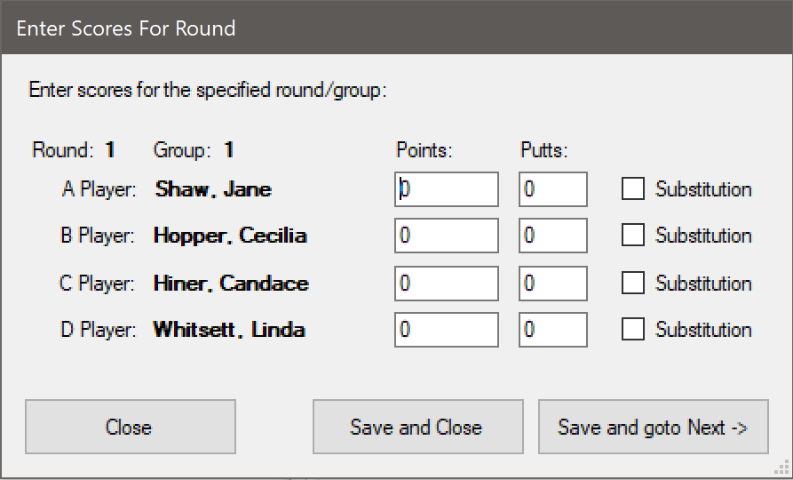
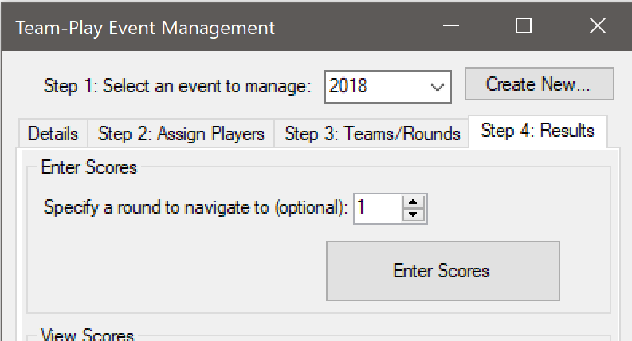
Application Demonstration: - Manage an Event: Step 4 -
To enter scores and view standings/results, click “Step 4: Results”. Click “Enter Scores” to fill out scorecards for each round by group.
Substitutions may be denoted here as well. If a player had a substitution in any round, they are not eligible for Points or Putts awards. However, their points are still used in calculating the Team award

Slide 16
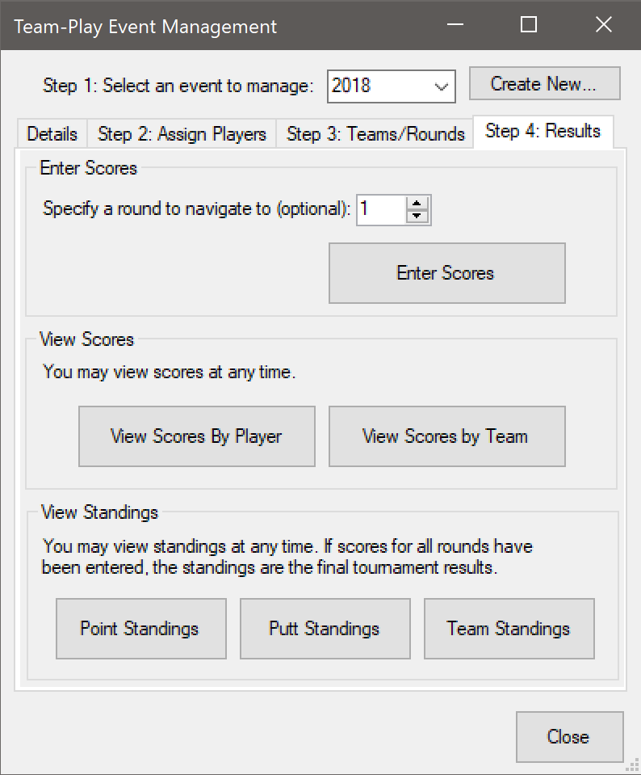
Application Demonstration: - Manage an Event: Step 4 -
Also available under the “Step 4: Results” tab, are the score and standings reports. These are opened in your default spreadsheet program upon clicking the appropriate button. At any time, you may click to view scores by player or team, or to see standings for each award category. If all scores have been entered for the event, standings reflect the final tournament results.

