Slide 1

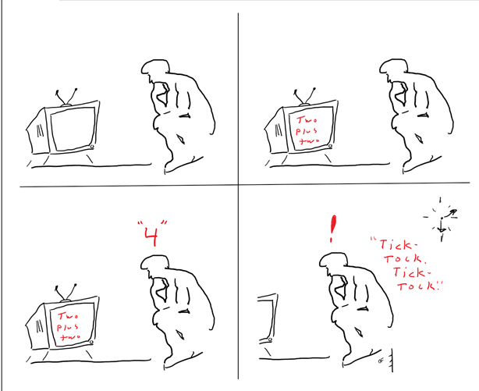
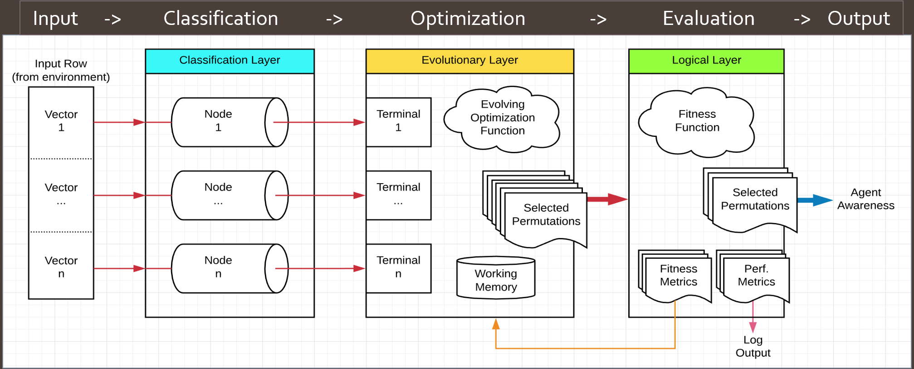
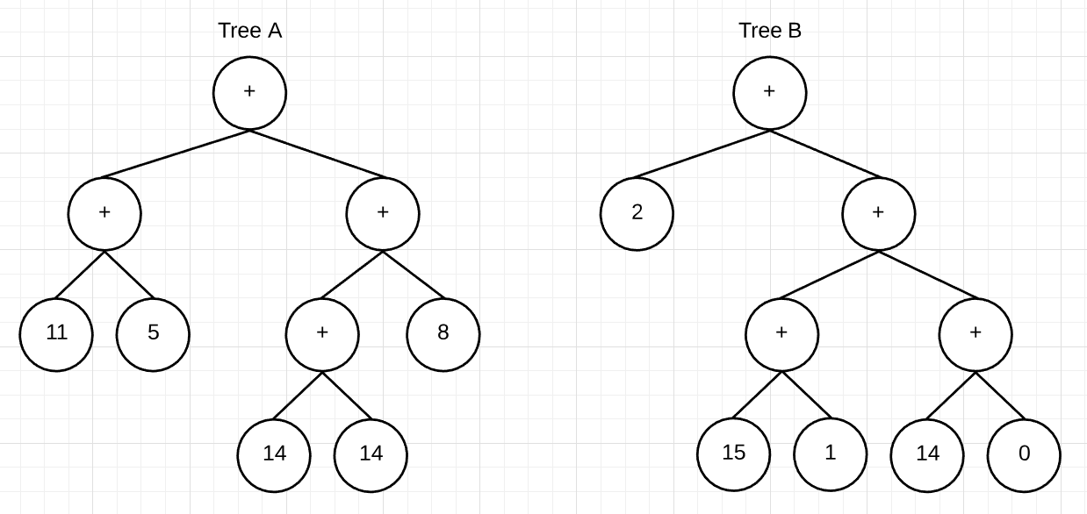
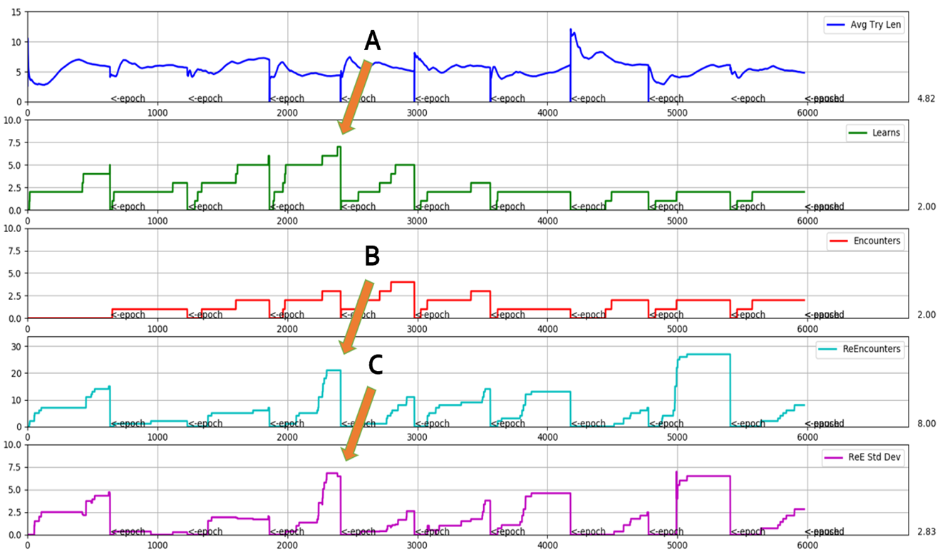
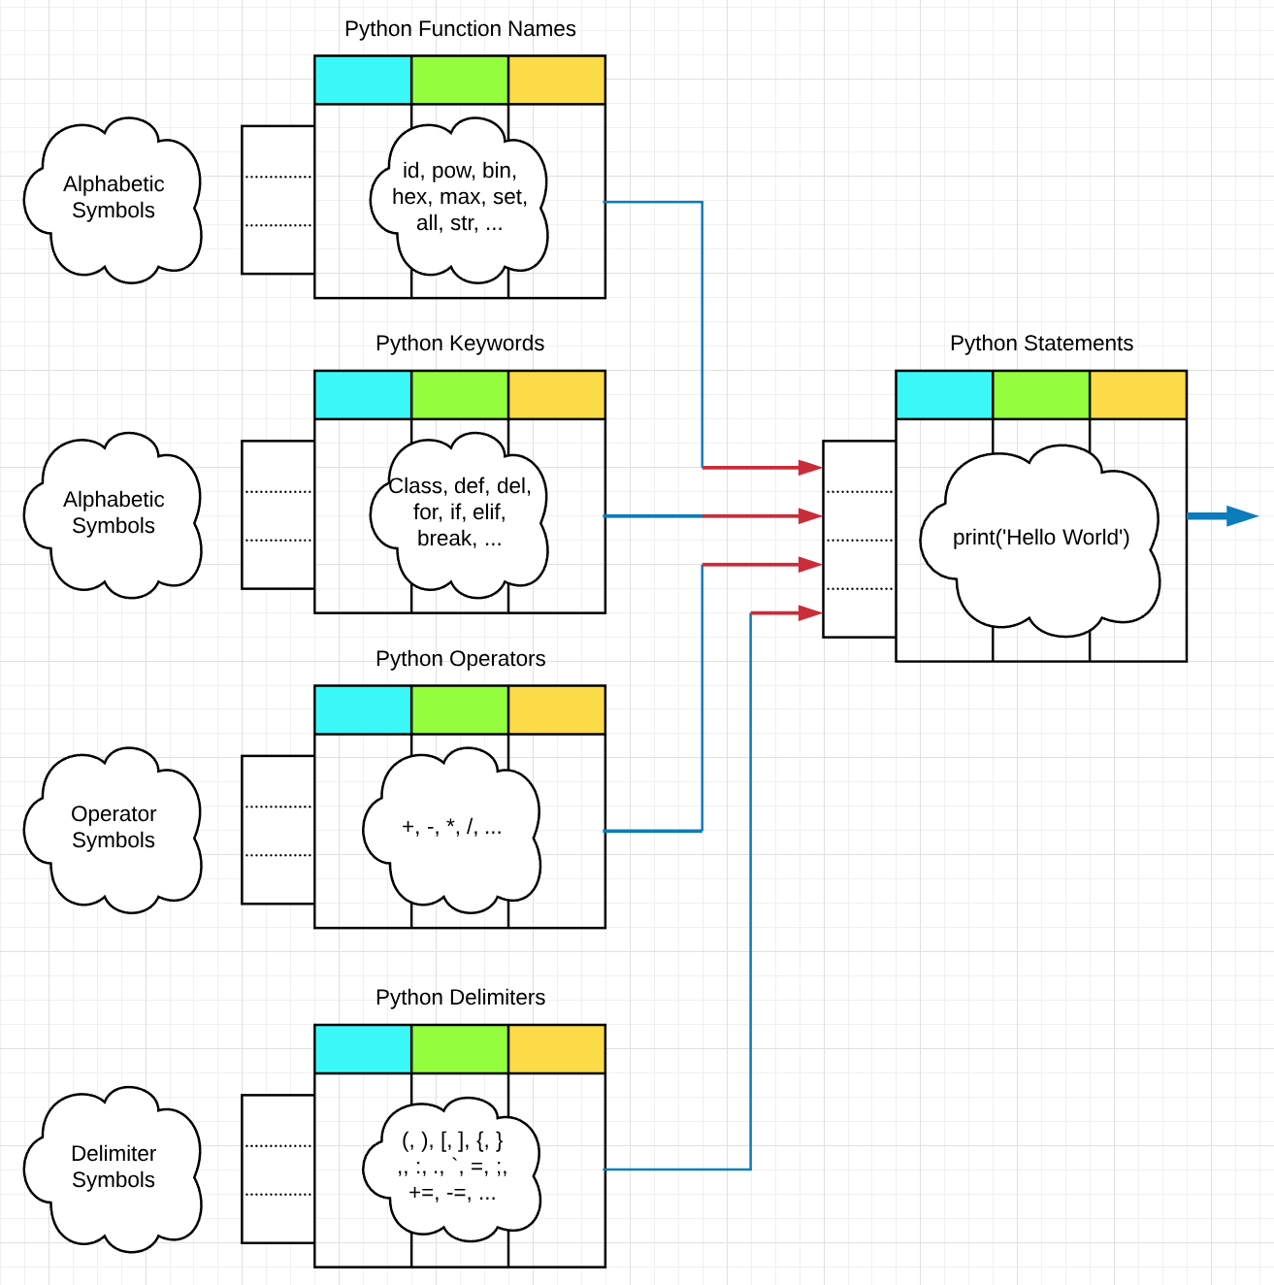
On The Modeling of Intuition
Dustin Fast
Computer Science, University of Alaska, Anchorage
Abstract
The Intuitive Model
Data Campaign
General intelligence of the type we possess exists exclusively, for now, in the domain of the conscious human. Therefore, an understanding of the mechanisms leading to our conscious experience may be required if an artificial general intelligence is to one day be realized.
One defining aspect of our intelligence is the ability to subconsciously form new connections between abstract concepts which seem to “bubble up” into our awareness. This phenomenon, commonly called intuition, is responsible, not only for our most profound "Aha!" moments, but also for the sudden, seemingly-arbitrary changes in awareness we routinely experience of, say, the ticking of a clock on the wall.
An ensemble learning system was developed to explore mechanisms through which this intuitive behavior might emerge. For validation purposes, the system’s agent was subsequently applied to the task of classifying known search-space symbols and stochastically optimizing a combinatorial generator in order to quickly find the logical connections among them according to a predefined context.
Agent Task
Learn to optimally generate Python programming language function names from an input set of hand-written alphabetic character features**.
Performance
An examination of data points A, B, and C, noted on the agent’s output graphs below, gives an indication of performance as the agent learns in an online fashion.
  A. The agent encounters a progressively larger number of functions over epochs 1
  through 4, suggesting a period of increasing optimization.
  B. A high number of “re-encounters” begin to occur near the conclusion of epoch 4,
  denoting repeat encounters with names previously seen at least once.
  C. A high standard deviation among re-encounters followed by a steep reduction at
  epoch 5 suggests an elitist gene pool with insufficient genetic variety.
Description
Agent Performance (10 Epochs)
Input
  Represents environmental input/stimuli.
  Formatted as a row S of n feature-vectors.
Classification
  Represents our ability to classify patterns based on prev. experience.
  Implemented as a set of n artificial neural network classifiers.
Optimization
  Represents our ability to create new concepts from existing symbols.
  Implemented as a population of genetically evolving expressions.
Evaluation
  Represents our ability to query our environment for feedback.
  Back-propagates fitness according to the current context C.
Output
  Represents information bound for conscious awareness.
  A collection of the k permutations showing logical connectedness.
Design Paradigm
Although intuition exists inside us as a “black box” (we cannot consciously observe its decision-making processes), evolutionary programming techniques implemented according to observations of our behavior and biology may allow us to converge on an approximate solution. Towards this end, a model of intuition was conceived, based on the following assumptions -
Some system, operating at the sub-conscious level, exists for selectively serving information into awareness.
Awareness and intuition exist in a feedback loop, each influencing the other.
Intuition is not perfect.
Mistakes have evolutionary utility.
The subconscious is likely optimized by processes that are Darwinian in nature.
An agent possessing an intuition may naturally act to explore, and seek to understand, its environment.
In this context, intuition can be thought of as a sixth sensory organ*, different from the first five in that the information it serves is pre-processed by the sub-conscience and carries with it contextual meaning and symbolic comprehension; ideas composed by filtering sensory information through the sieve of one’s accumulated life experiences.
Expression Trees: Leaf nodes denote evolutionary-layer symbol string permutations, by terminal index.
For example, if
S = {‘D’, ‘R’, ‘W’, ‘V’, ‘U’, ‘E’, ‘G’, ‘T’,
‘O’, ‘A’, ‘F’, ‘H’, ‘K’, ‘S’, ‘L’, ‘O’}
C = is_noun()
Then
Tree A denotes the string HELLO,
Tree B denotes the string WORLD, and
fitness_{C} = {0, 1}
Runtime (seconds)
. **University of California, Irvine, Machine Learning Repository, Letter Recognition Data Set
Next Steps
The agent was designed to scale from a single agent to a node in a hierarchy of agents in order to bootstrap an increasingly advanced intuition. In this way, a sufficiently complex agent might come to write its own programs and/or re-write itself according to search-heuristics in real-time via Python’s capability for reflection.
Conclusion
This project introduced an ensemble learning system that stochastically optimizes a combinatorial search via genetically evolving expression trees, where each tree generates some arrangement of symbols for evaluation. After validating the algorithm in a test campaign, the model shows promise but is prone to overtraining early in its execution. Experimentation with learning parameters may later improve this condition.
* No supernatural connotation intended

