Slide 1
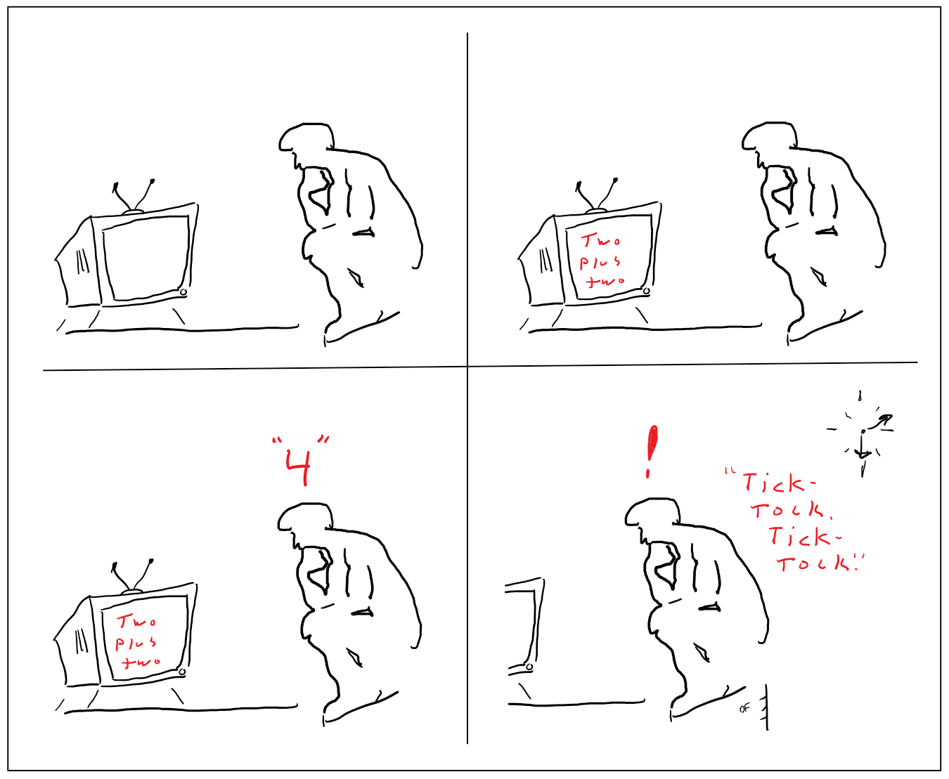

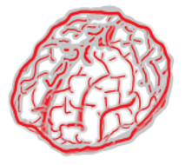
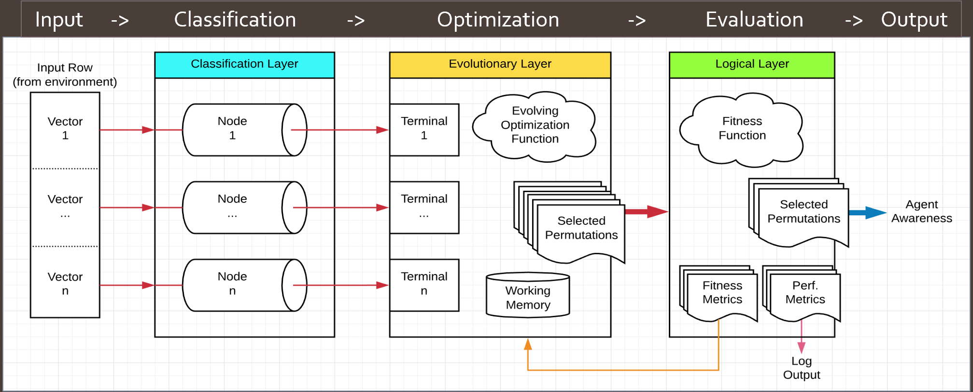
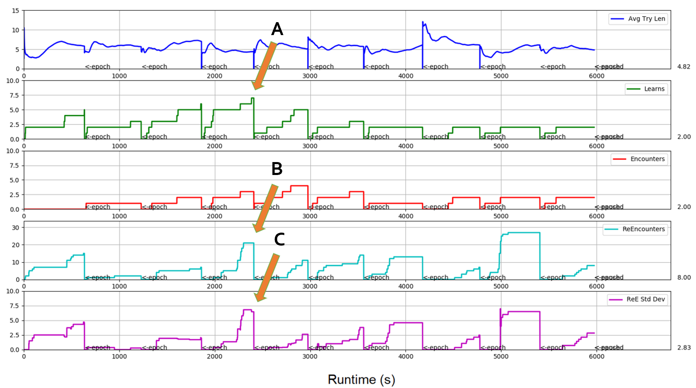
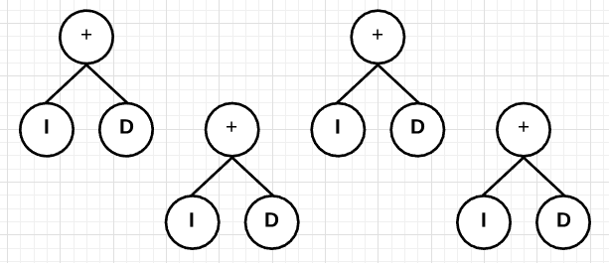
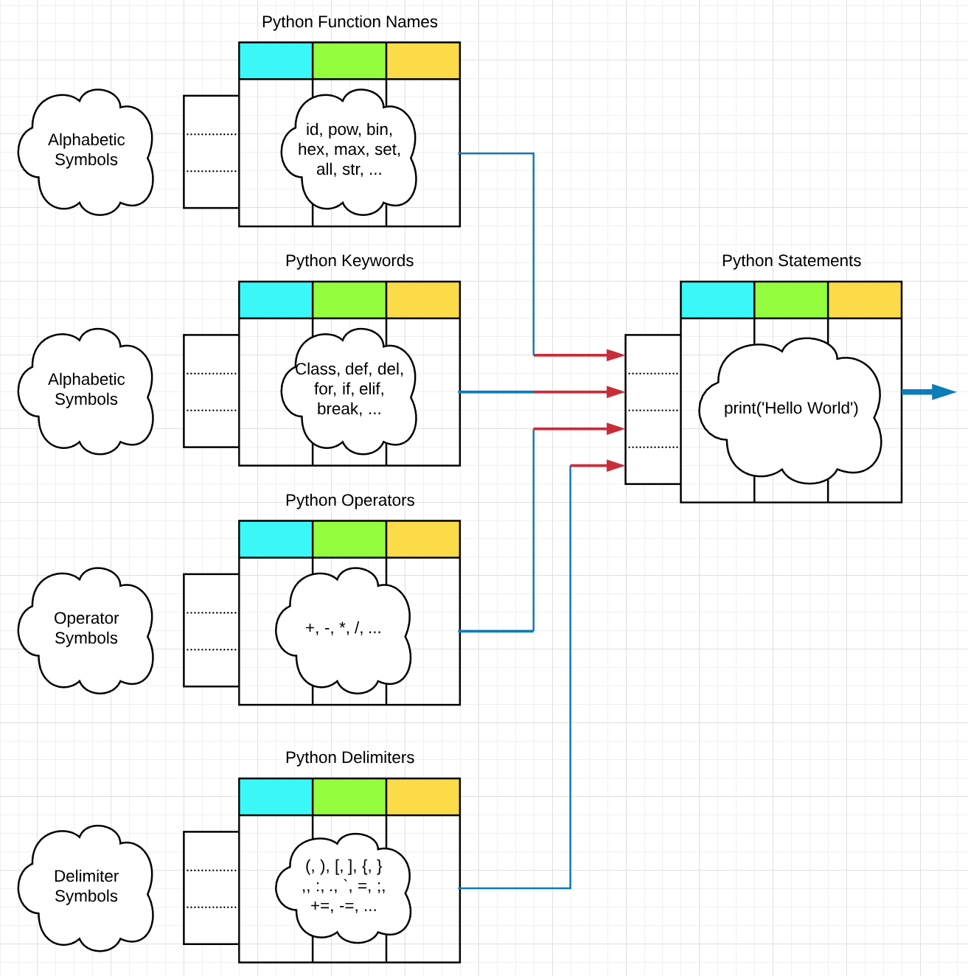
On The Modeling of Intuition
Dustin Fast
Computer Science, University of Alaska, Anchorage
Abstract
The Model
Results
General intelligence of the type we possess exists exclusively, for now, in the domain of the conscious human. Therefore, an understanding of the mechanisms leading to our conscious experience may be required if an artificial general intelligence is to one day be realized.
One defining aspect of human intelligence is the ability to subconsciously form new connections between abstract concepts which seem to "bubble up" into our awareness. This phenomenon, referred to here as intuition, is likely responsible for not only our most startling and profound "Aha!" moments, but also for the seemingly arbitrary changes in our awareness of, say, the ticking of a clock on the wall.
With this in mind, an ensemble learning system was developed for exploring possible underlying mechanisms for intuition.
The intuitive model consists of 3 layers, labeled Classification, Evolutionary, and Logical.
The “Sixth Sense”
Walkthrough
Input
  A row of n feature-vectors representing environmental input/stimuli.
Classification
  Represents our ability to classify patterns based on previous experience.
  Implemented as a set of n pre-trained artificial neural network classifiers.
Optimization
  Represents our ability to form new symbolic connections between existing symbols.
  Implemented k genetically evolving binary expression trees denoting k output permutations.
Evaluation
  Represents our ability to seek feedback/validation from the environment
  Implemented according to some problem domain. Propagates tree-fitness backwards.
Output
  Represents information bound for conscious awareness.
Intuition exists inside us as a “black box” (we can’t conscious access to its decision-making processes), but the ways in which we experience it (unwillingly and "out of the blue“) provide powerful clues to its underlying mechanisms. .. In this way it can be thought of as a sixth sene.
, where the agent’s awareness is directed according to some optimization function (an intuition) with the goal of recognizing symbols in its search-space and forming new symbolic connections between them.
Observations/ Conclusions
Build a system of binary images
  The system is unbiased, i.e. images are randomly selected
Perform a frequency analysis on 8x8 blocks of the system images
Identify blocks that occur more than once
Build correct Huffman codes for the most frequent blocks
The resulting codebook is a fixed-to-variable dictionary containing 6952 entries
The Agent
Problem Domain
Preprocessing
  Perform color separation into binary layers
  Make layer dimensions divisible by 8
A universal codebook
  Designed by studying a relatively large sample of randomly chosen binary images
  Huffman coding applied on 8x8 blocks of a binary image
The Row-Column Reduction Coding
  Attempts to compress 8x8 blocks which are not found in the codebook
  Checks for identity between rows and columns
Conclusions
What’s Next?
In this paper, we introduced a fast and highly efficient hybrid compression scheme for map images with predefined number of discrete colors. The proposed scheme contains three steps. The first step is to divide the map image into as many bi-level layers as the number of colors. The second step is to implement the proposed scheme on the 8×8 bit blocks of the map bi-level layers. The proposed scheme scored a high compression of 0.036 bits per pixel which is higher than JBIG as well as many other compression algorithms. This scheme is simple, fast and can be used for real time applications.

