Slide 1




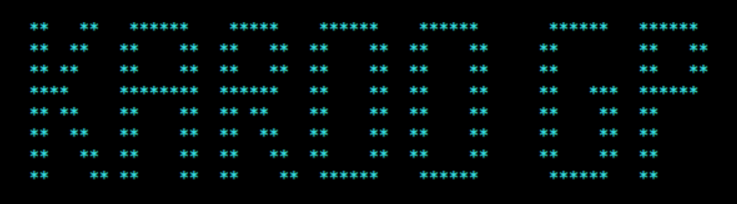
On the Modeling of Intuition
Dustin Fast, CSCE A470, Fall 2018

Slide 2
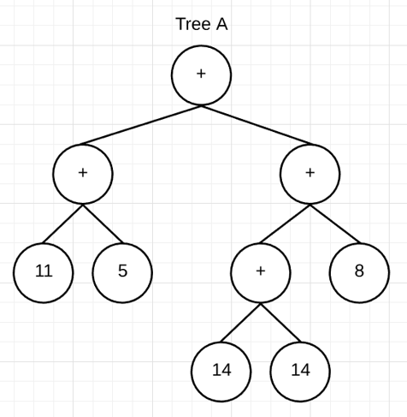
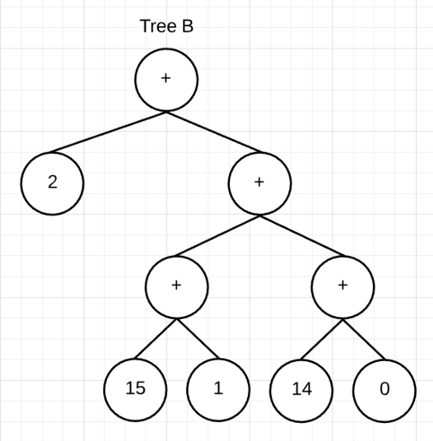
We will discuss…
Introduction -
Problem space.
What is intuition. Examples?
An intuitive model.
Results.
What’s Next?

Slide 3
Observation
The “Black Box” Problem -
We are the only known example of generalized intelligence.
Modeling our experience may be required for the realization of an artificial general intelligence.
The subconscious processes contributing to our conscious experience are a “black box”.
Develop a framework for exploring ideas about the subconscious based on behavioral clues.
Implication
Problem
Solution

Slide 4
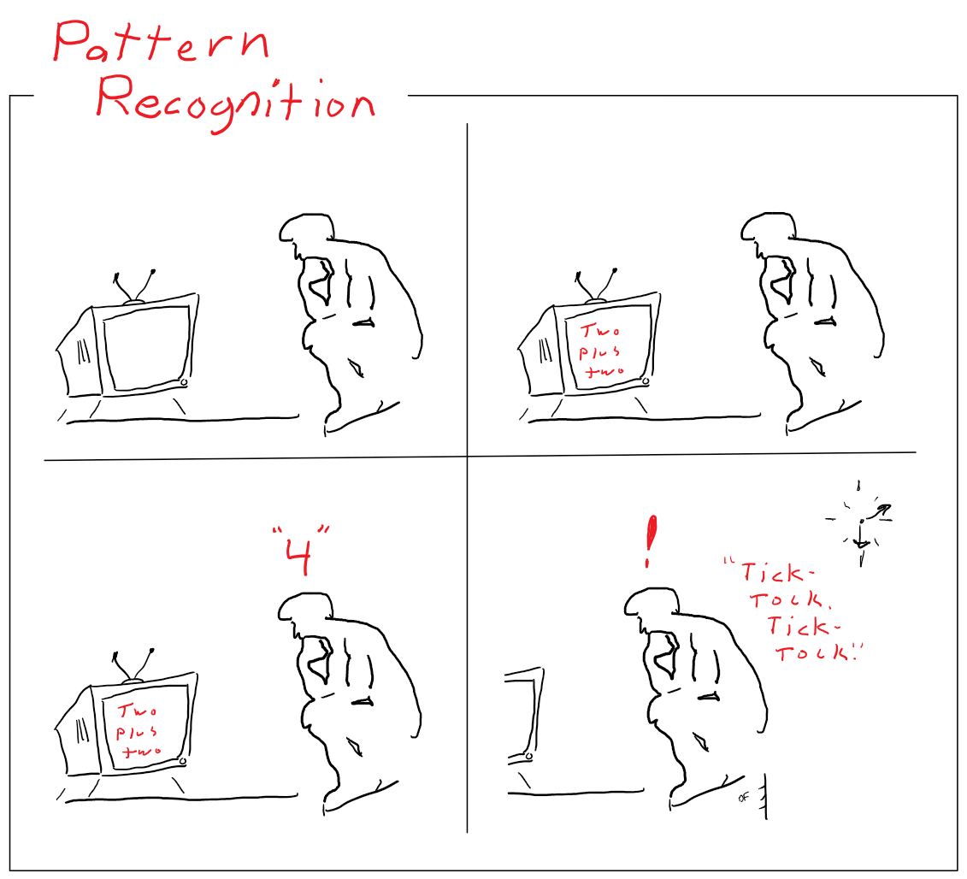
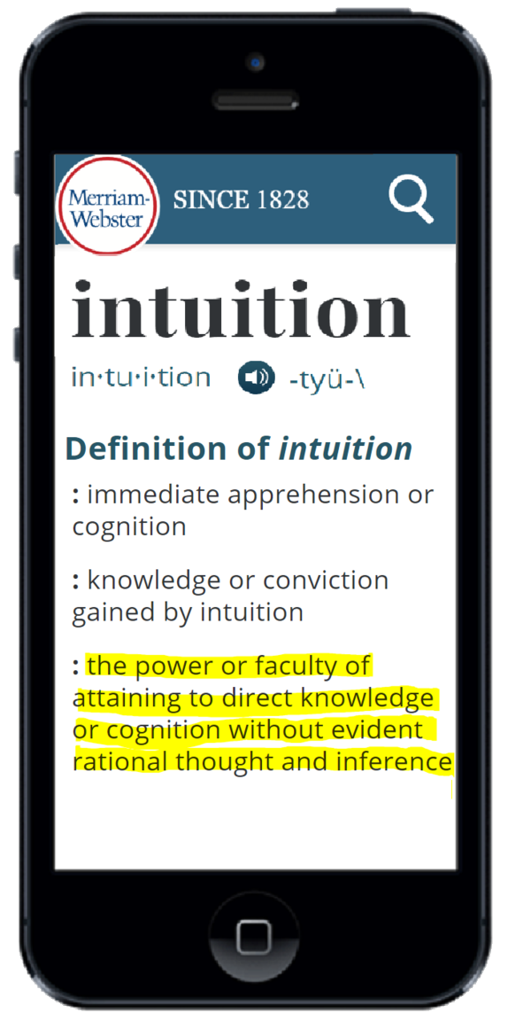
The Subconscious: Intuition – What is it?

Slide 5
The Subconscious: Intuition – What is it?
“Aha!” Moments
Suggests intuition serves connections between existing ideas.
“Gut” Feelings
Suggests intuition has competitive utility.
Pattern Recognition
Suggests intuition performs classification.
“Black Box”
The realization that these things come from outside our awareness suggests an “intuitive” system.

Slide 6
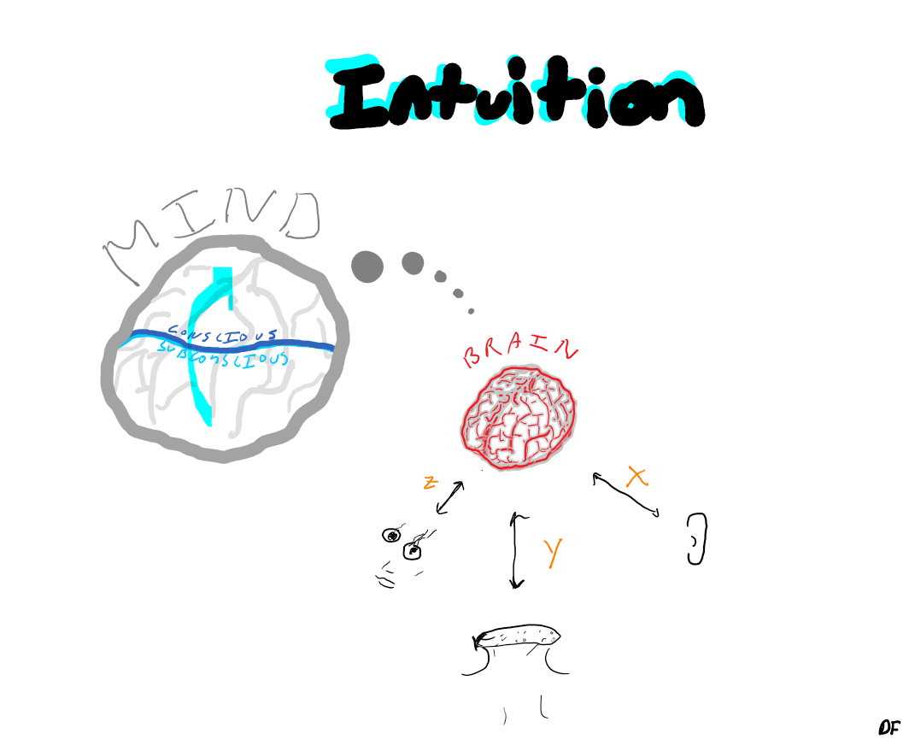
The Subconscious: Intuition – A “Sixth Sense”*
Quick association of stimuli w/knowledge (i.e. "two plus two”).
Represents subconscious pre-processing.
Serves information into conscious awareness.
Evolved through evolutionary processes.
* No supernatural connotation intended.

Slide 7
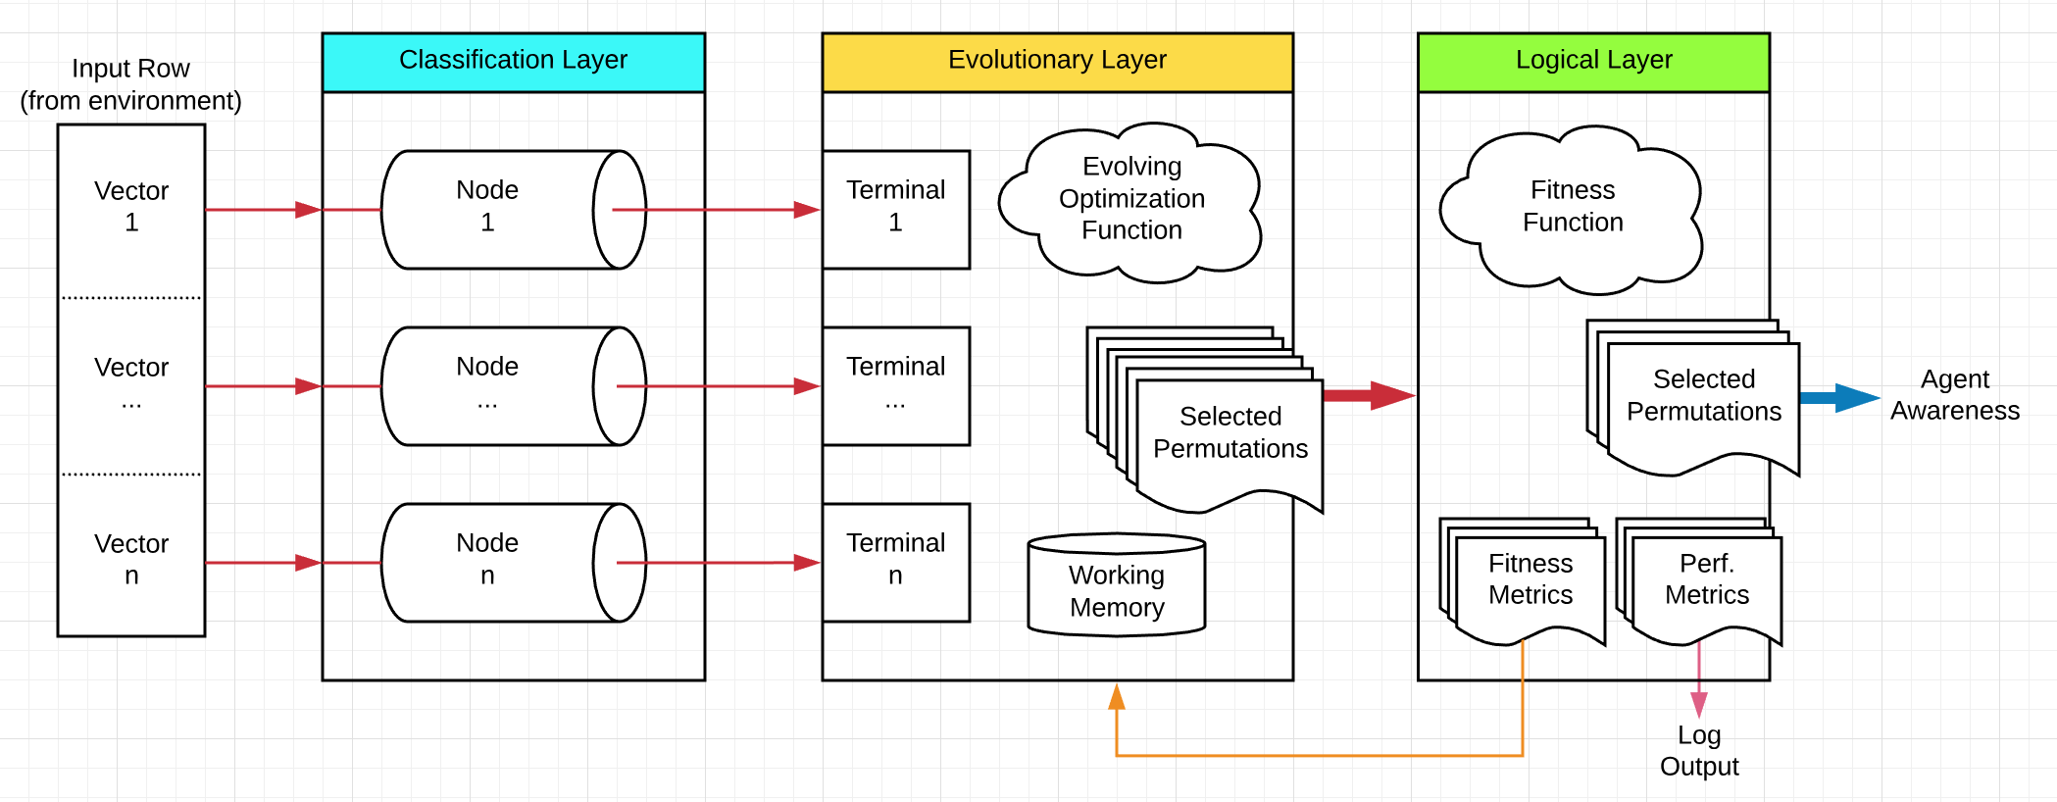
The Intuitive Model - Overview
Fast classification of inputs (via pre-trained classification-layer nodes).
Represents subconscious pre-processing.
Serves symbols into agent’s “awareness”.
Evolves via genetic programming techniques (online).
Input -> Classification -> Optimization -> Evaluation -> Output

Slide 8
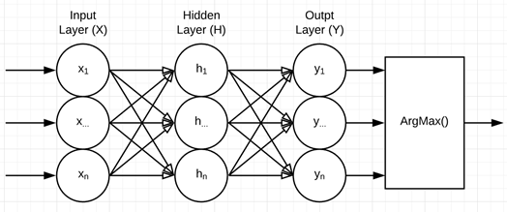
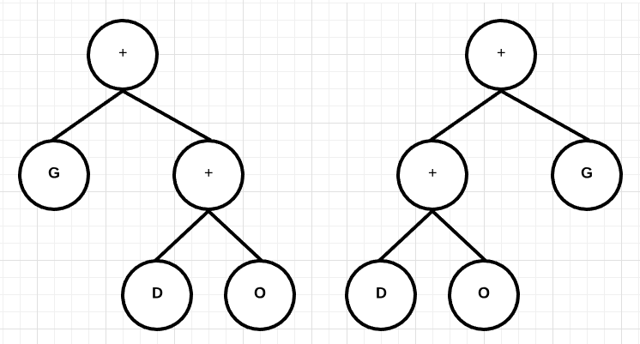
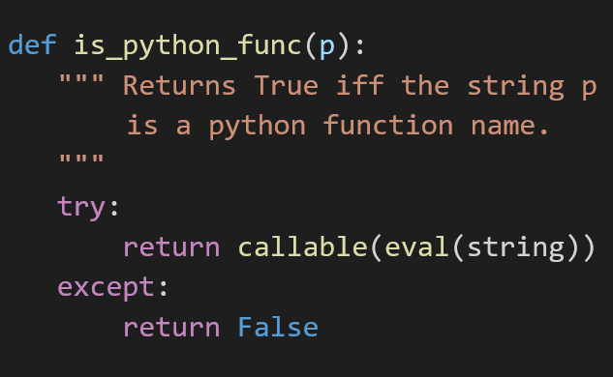
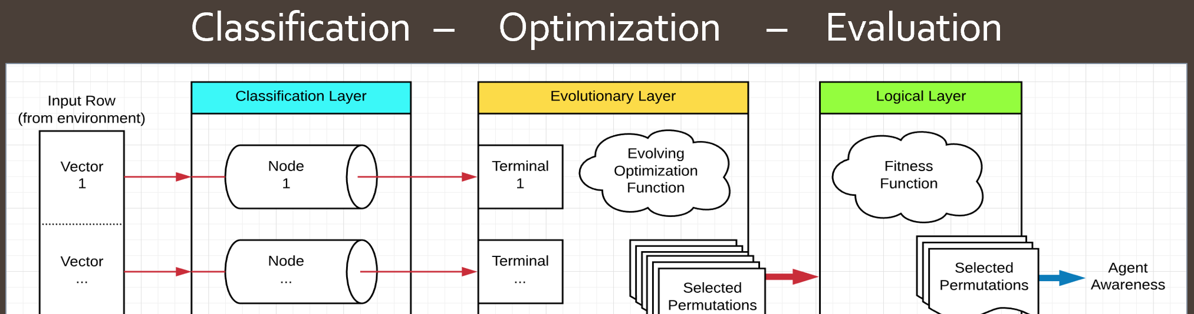
The Intuitive Model - Operation
Artificial Neural Networks (pre-trained)
Evolving Expression Tree Population
Fitness Function

Slide 9
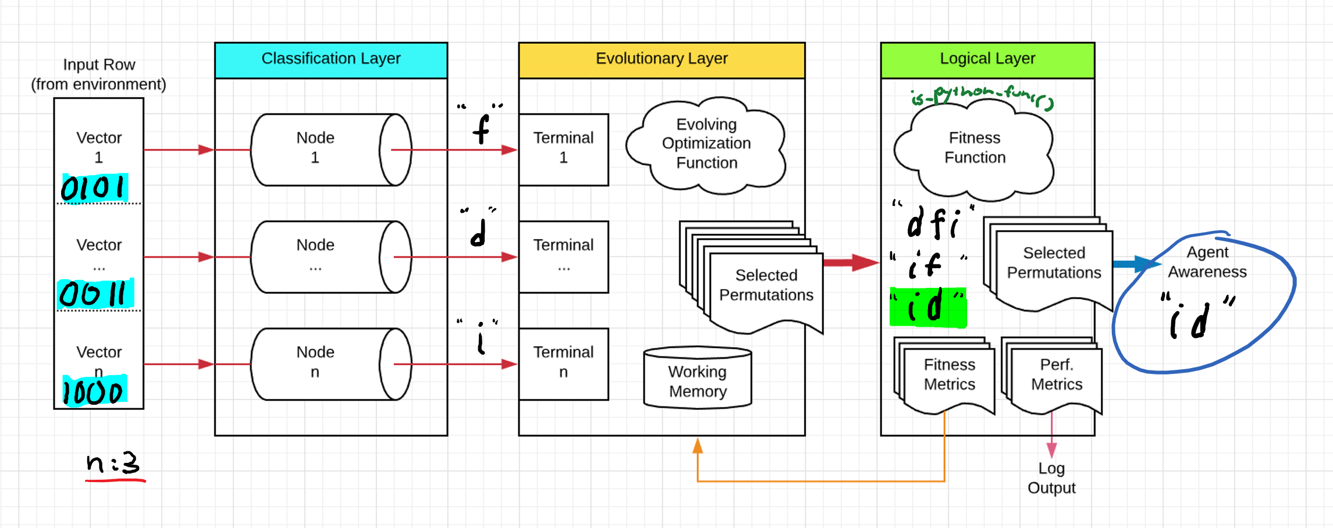
The Intuitive Model – Test Campaign
An agent was developed to utilize the model and was subsequently tested in the following way -
Input -> Classification -> Optimization -> Evaluation -> Output

Slide 10
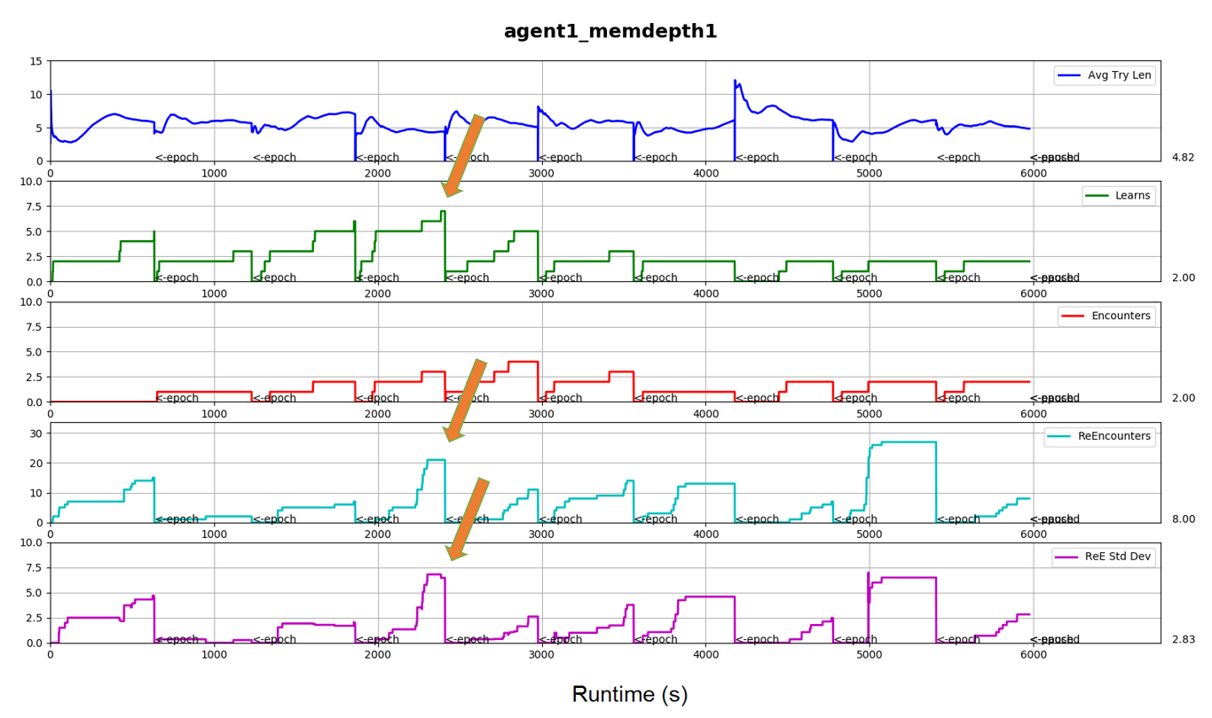
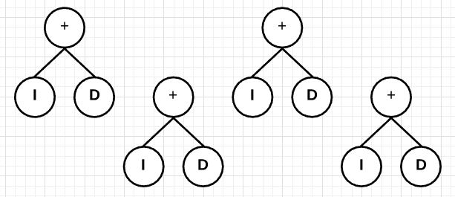
The Intuitive Model – Test Campaign: Results
Agent extracts progressively larger number of Python function names over epochs 1 – 4 (suggests evolving optimally).
By the end of epoch 4, high number of “re-encounters” (suggests little learning this epoch).
By the end of epoch 4, high std. deviation of “re-encounters” (suggests elitist gene pool).
A
B
C
Agent Output
Elitist / Over-trained Gene Pool

Slide 11
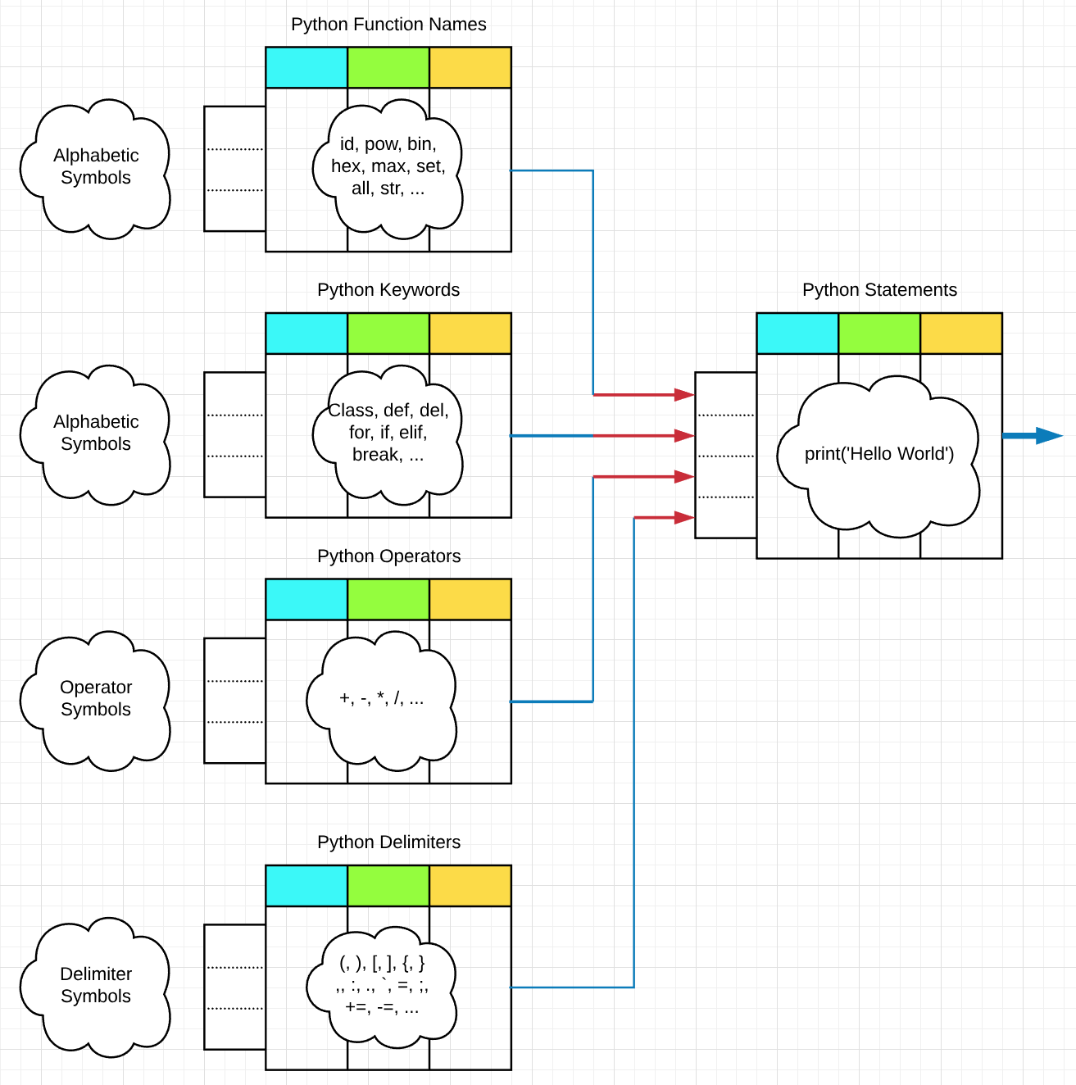
The Intuitive Model – What’s Next?
Verify results.
Refine model / parameters.
Extend into hierarchal network of agents for greater symbolic complexity.

Slide 12
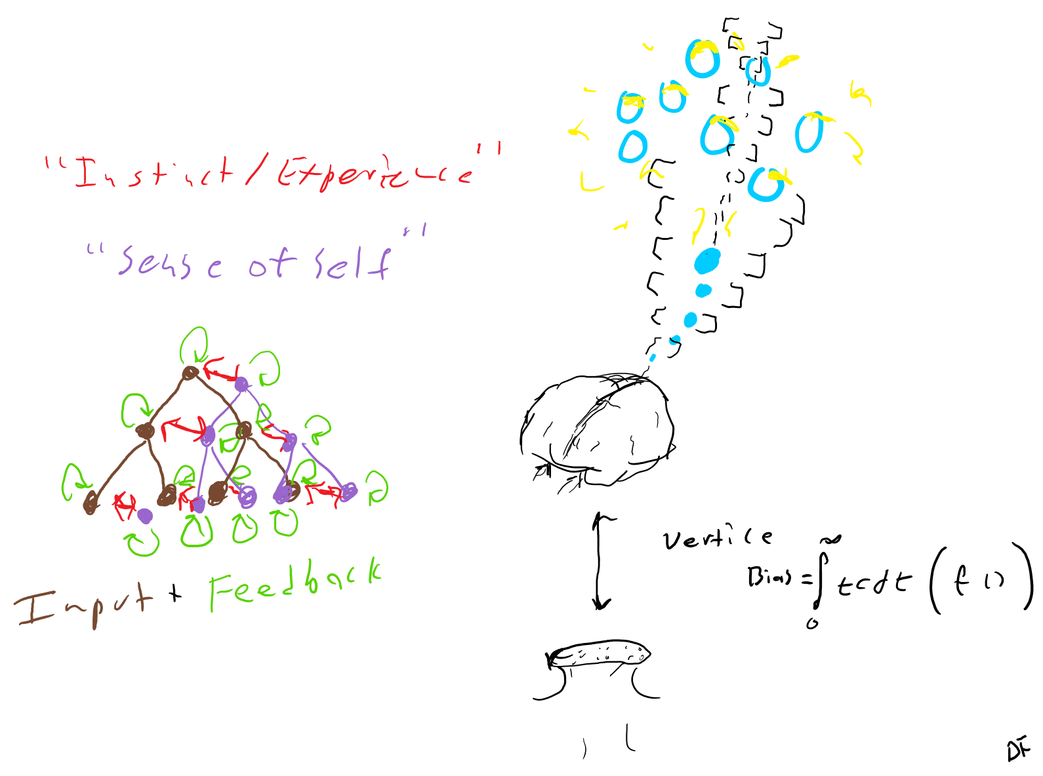
Questions?

