Slide 1

BioLink
AI-Powered Drug Repurposing Discovery
Progress Report — AAI 595
Dustin Haggett | Kera Prosper | Mia Braun
March 2026

Slide 2




What is BioLink?
0.947
7,164
A drug repurposing discovery tool that uses knowledge graph AI to find new therapeutic uses for existing drugs.
AUC-ROC
Drugs Scored
Patient types
a disease
AI maps to
medical entity
Model scores
7,164 drugs
Ranked results
with evidence

Slide 3

Model Architecture
MLP Network
Embeddings
Input Layer — 800 dim
BioWordVec
[drug | disease | |diff| | product]
Pretrained on PubMed + MIMIC-III clinical notes
200-dimensional vectors
Tokenize → lookup → mean-pool per entity
Hidden Layer — 256 units
BatchNorm → ReLU → Dropout(0.3)
Training Config
Data Source
CTD (Comparative Toxicogenomics DB)
Pairs
~78K (1:1 pos/neg ratio)
Output — 1 logit
Split
70% train / 15% val / 15% test
BCEWithLogitsLoss
Optimizer
Adam (lr = 1e-3)
Epochs
10
Batch Size
256
Seed
42

Slide 4
Performance & Calibration
Model Performance
Temperature Calibration
Why calibrate?
0.947
0.949
87.6%
Raw model outputs are overconfident.
A predicted 90% should mean the model
is right 90% of the time.
AUC-ROC
Avg Precision
Accuracy
T = 1.384
Precision@K
calibrated_prob = sigmoid(logit / T)
@10
1.000
@50
1.000
@100
1.000
Confidence Tiers
Top-ranked predictions are highly reliable
Strong
Moderate
Speculative
>= 80%
50-80%
< 50%

Slide 5
System Architecture
Intent Mapping
Claude API resolves free-text
to CTD disease entity
Tech Stack
Python + PyTorch
BioWordVec (200-dim)
Claude API (Sonnet)
Streamlit UI
PubMed + OpenFDA APIs
Hugging Face Spaces
MLP Inference
BioWordVec embeddings +
trained model scores all drugs
Calibration
Temperature scaling
(T=1.38) for honest probs
Enrichment
PubMed evidence counts +
FDA approval status
Explanation
Claude generates
plain-English summaries

Slide 6



Build Progress
Data assets & val set
UI design mockups (Google Stitch)
Core model (MLP + BioWordVec)
Enrichment layer (PubMed + FDA)
Temperature calibration
Explanation layer (Claude)
Intent mapper (Claude API)
Streamlit UI build
End-to-end inference pipeline
Tests + deployment
60% Complete

Slide 7
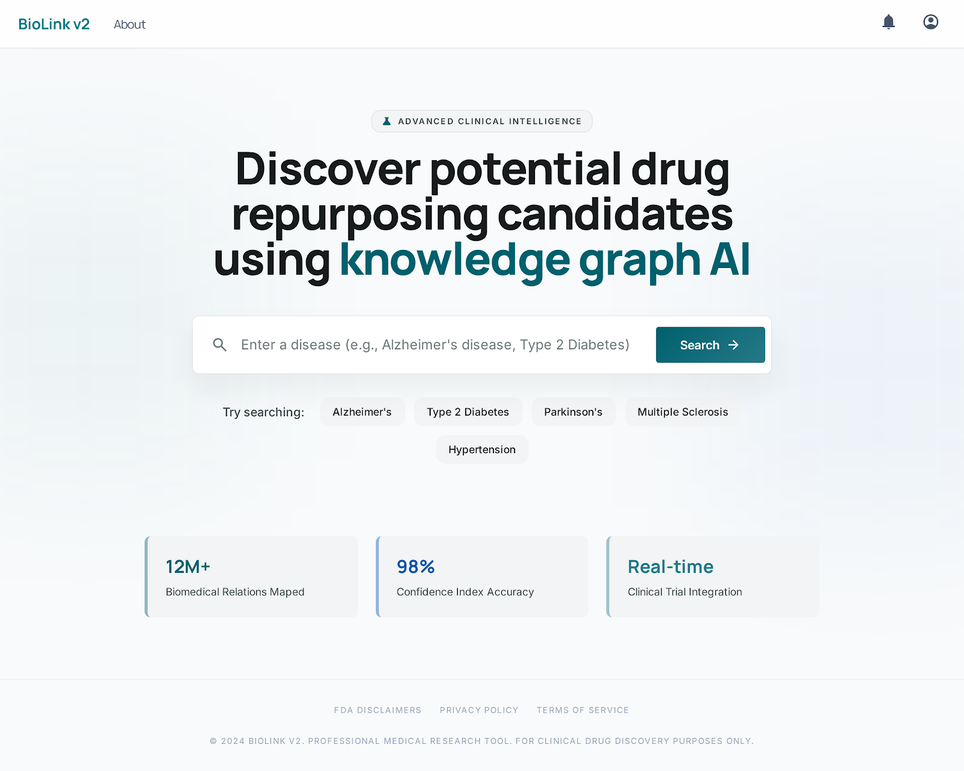
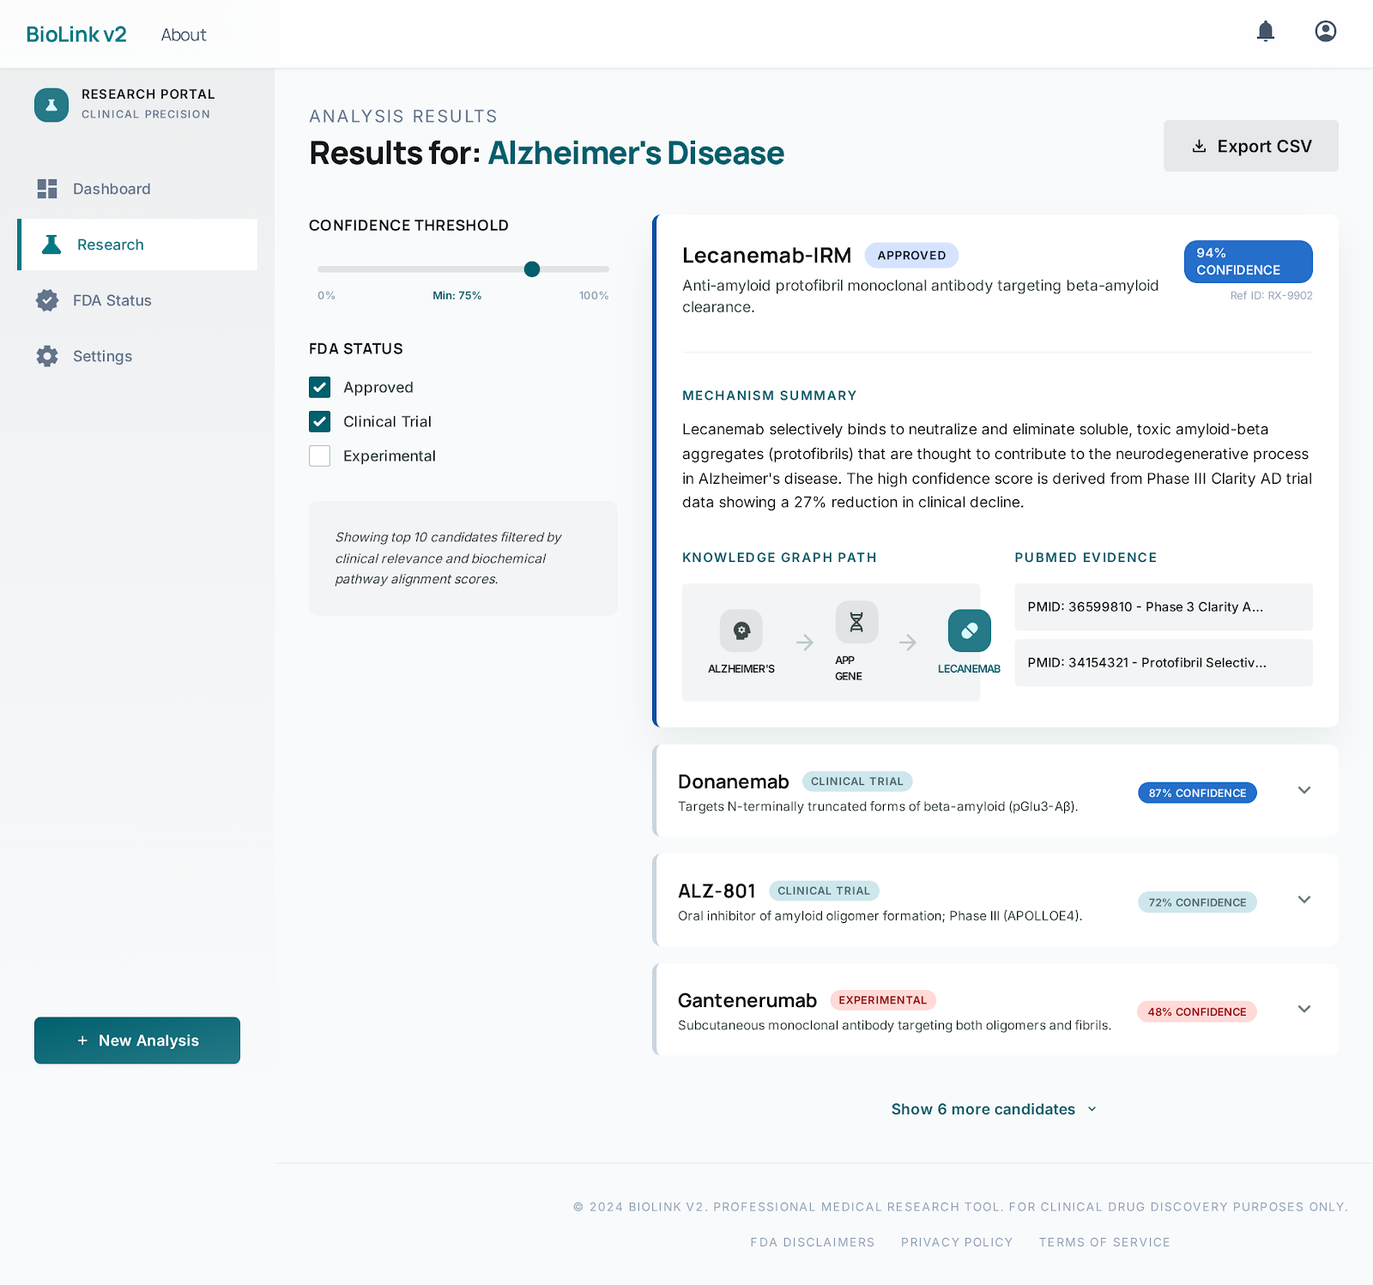

UI Design Preview
Designed in Google Stitch — mockups guide our Streamlit build
Search
Results

Slide 8


Team & Next Steps
Dustin Haggett
Kera Prosper
Mia Braun
Lead — Core pipeline,
calibration, architecture
Explanation layer,
tests
Enrichment layer
(PubMed + FDA)
Immediate Next Steps
Build enrichment layer — async PubMed & OpenFDA lookups
Build explanation layer — Claude-generated plain-English summaries
Implement Streamlit UI from Google Stitch mockups
Unit tests with mocked APIs, then deploy to Hugging Face Spaces
Repo is public with branch protection — all contributions via PRs with code review

Slide 9
Questions?
github.com/dustinhaggett/biolink-v2
Dustin Haggett | Kera Prosper | Mia Braun

