Slide 1

EDA: Gun Murders in America
By Dustin White

Slide 2
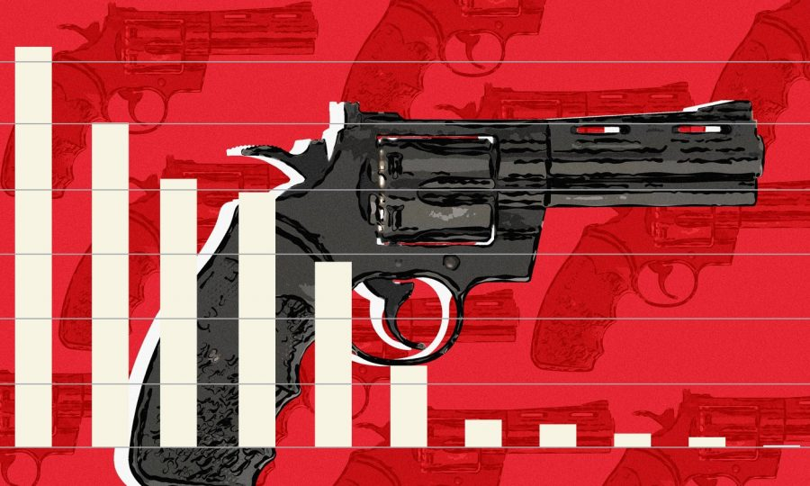
Contents
01
Introduction
U.S. and World Gun Facts
02
Hypotheses
Graphs and Analyses
03
Hypotheses’ Outcomes
Results
04
Conclusion

Slide 3

Canadian vs American Homicide Disparity

Slide 4
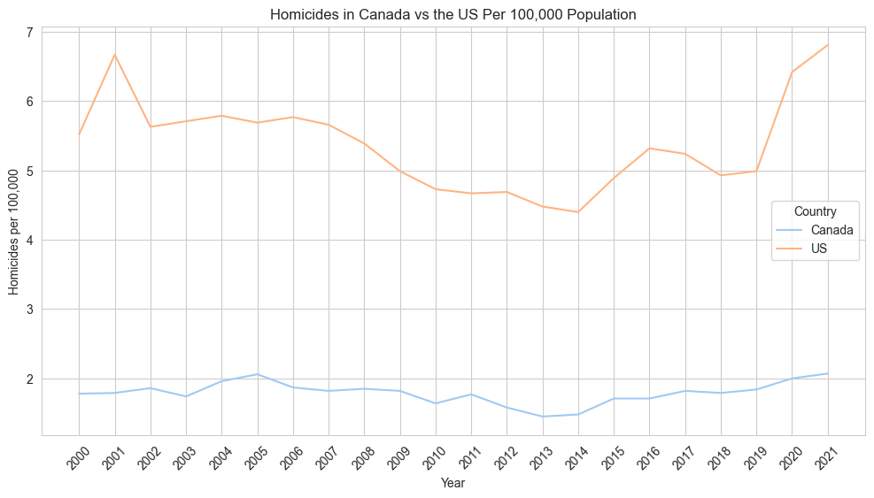

Slide 5

Gun Facts about the U.S.
45,000 people die annually
.
390+ Million Guns
There are 120 guns for every 100 people in the U.S.
Cost: $280 Billion annually

Slide 6
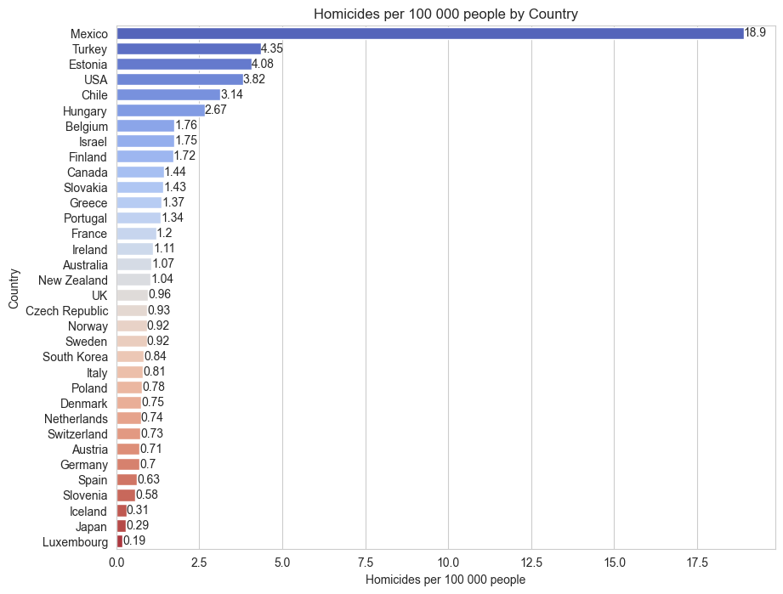

Slide 7
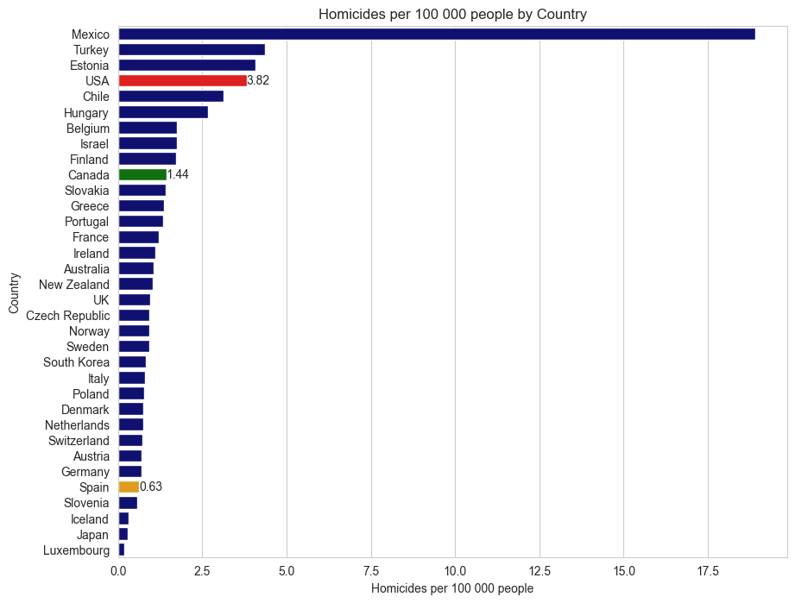

Slide 8

What explains the US’s high rates of gun deaths?
Hypothesis 1: High rates of gun deaths can be explained by high levels of registered guns.
Hypothesis 2: High rates of gun deaths can be explained by low levels of gun regulation.
Hypothesis 3: High rates of gun deaths can be explained by poverty rates.

Slide 9
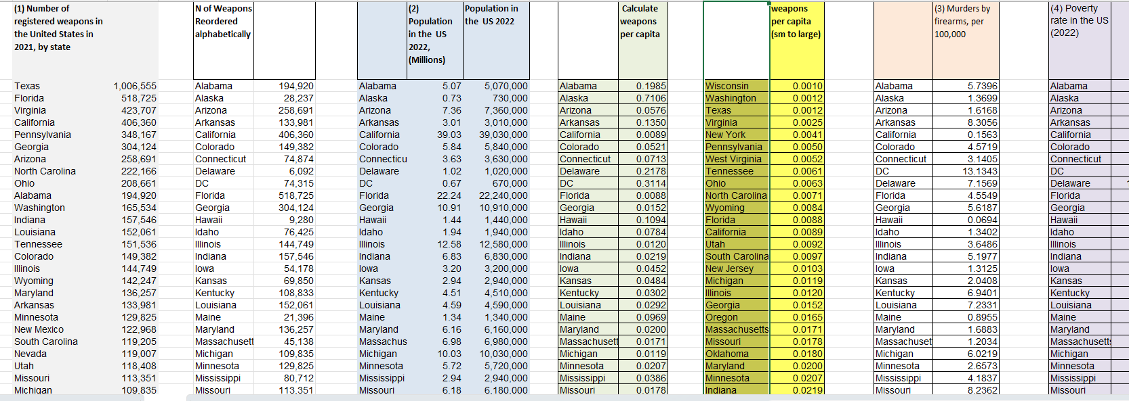
DATA SETS

Slide 10





Levels of Registered Guns
Has one of the highest per capita gun ownership rates in the world, of 120 guns per 100 residents.
Gun ownership is about 35 guns per 100 residents.
Gun ownership is reported to be about 10.4 guns per 100 residents.

Slide 11
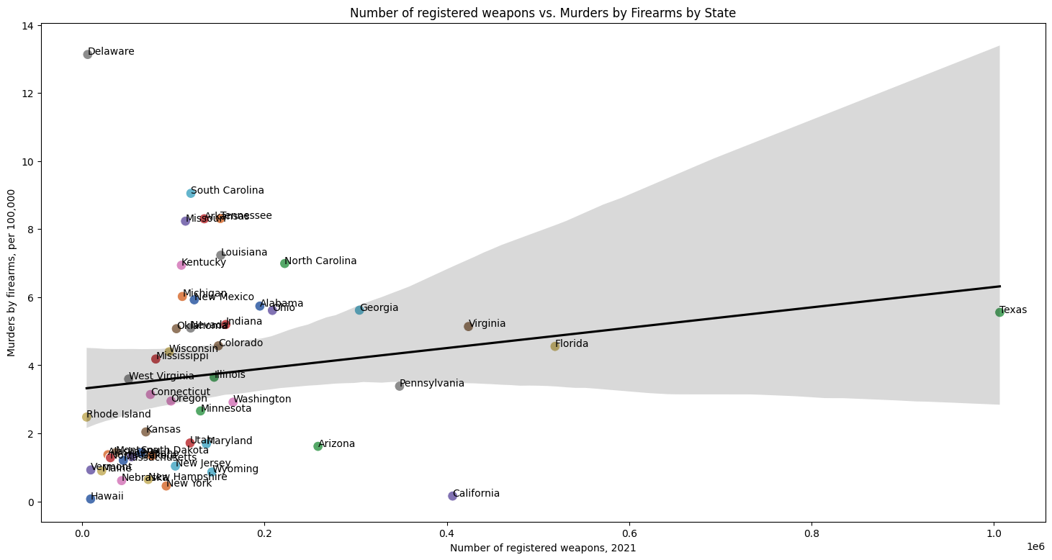

Slide 12

Hypothesis 1: U.S. Registered Weapons vs Homicides by State
My analysis suggests that as the number of registered firearms increases, homicides by firearms per 100,000 inhabitants also tend to increase, although not strongly enough to confirm the hypothesis
Result: Hypothesis rejected.
Possible Explanation: The United States is thought to have very high levels of illegal guns.

Slide 13
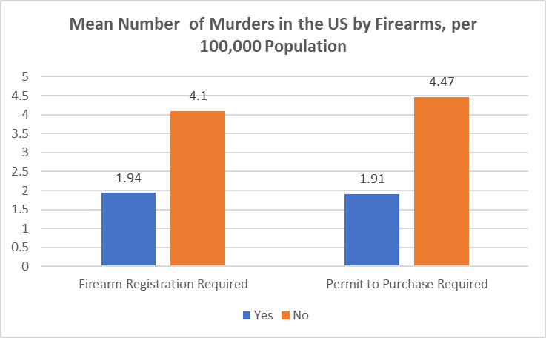

Slide 14
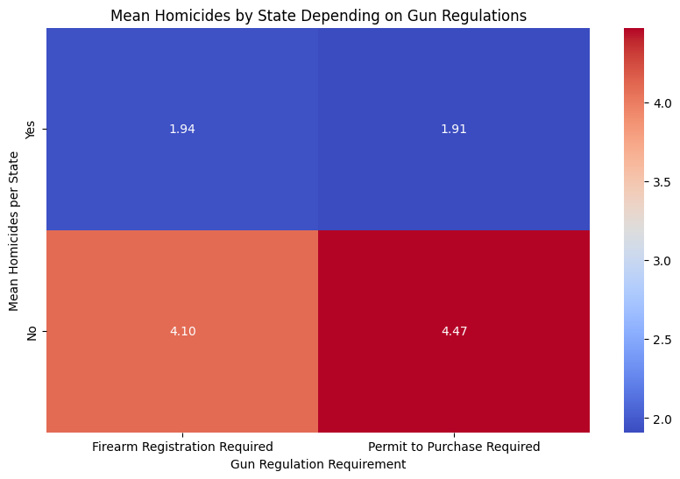

Slide 15

Hypothesis 2: Gun Regulations vs. Gun Murders
The analysis suggest that, on average, the states with gun regulations have a much lower number of murders by firearms per 100,000 population than states that do not have gun regulations
Result: Hypothesis accepted.

Slide 16
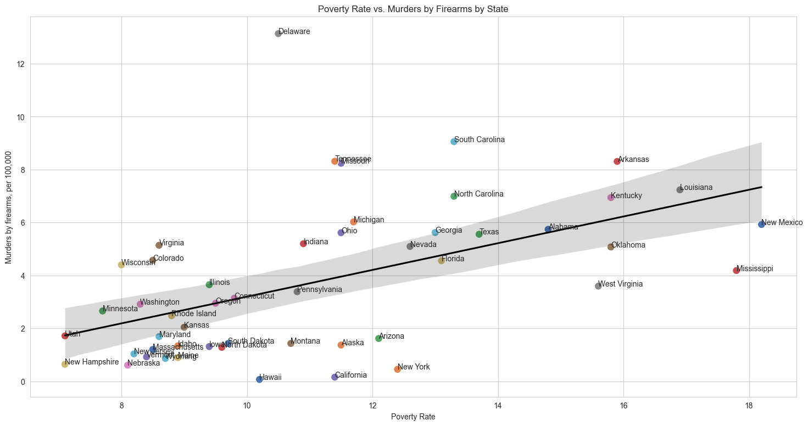

Slide 17
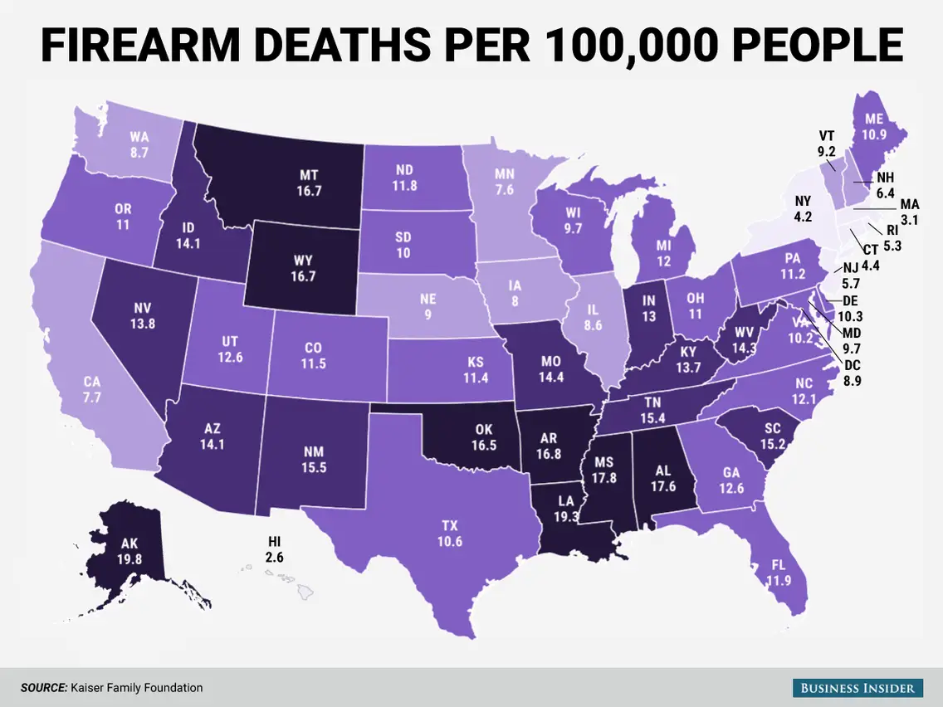
Hypothesis 3: Poverty Rates vs. Gun Murders
The evidence suggests that states with higher poverty rates have higher levels of gun violence.
Result: Hypothesis accepted.
Possible Explanation: Poverty increases desperate behaviour, resulting in increased crime rates. With easy access to guns, American criminals in states with higher poverty tend to commit more gun crimes.

Slide 18

Conclusion
I can conclude that gun regulations do make a difference, but overall, the evidence suggests that poverty may be an even stronger influence on gun deaths.
Hypothesis 1: High rates of gun deaths can be explained by high levels of registered guns.
Hypothesis 2: High rates of gun deaths can be explained by low levels of gun regulation.
Hypothesis 3: High rates of gun deaths can be explained by poverty rates.

Slide 19




Data Sources

