Slide 1

EDA: Gun Deaths in America
By Dustin White

Slide 2
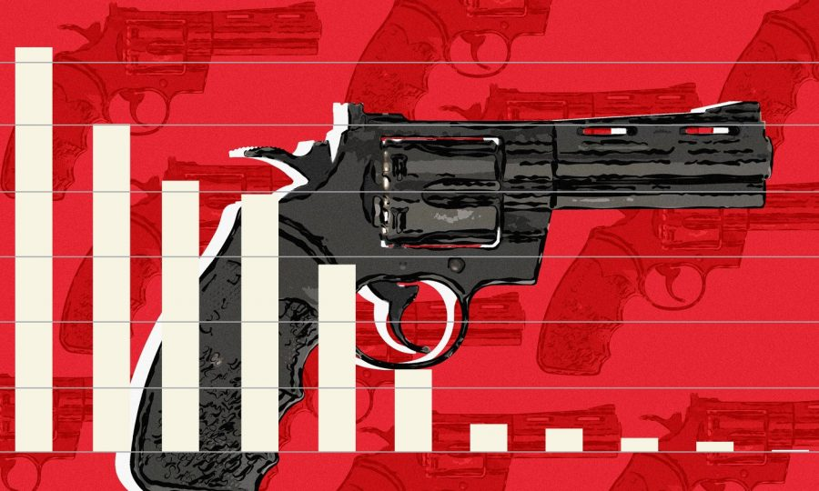
Contents
01
Introduction
U.S. and World Gun Facts
02
Hypotheses
Graphs and Analyses
03
Hypotheses’ Outcomes
Results
04
Conclusion

Slide 3
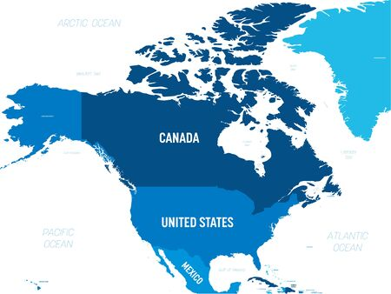
Canadian vs American Homicide Disparity

Slide 4

Gun Facts about the U.S.
45,000 people die annually
.
More guns than people
There are 120 guns for every 100 people in the U.S.
390+ Million Guns
Cost: $280 Billion annually
Gun Violence Cost:
Medical, Employer, Police and Criminal Justice

Slide 5
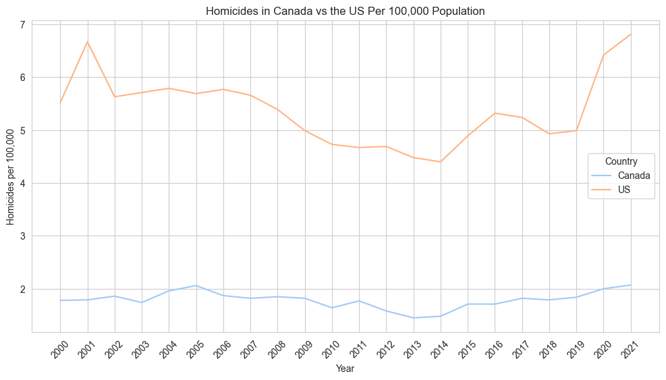

Slide 6
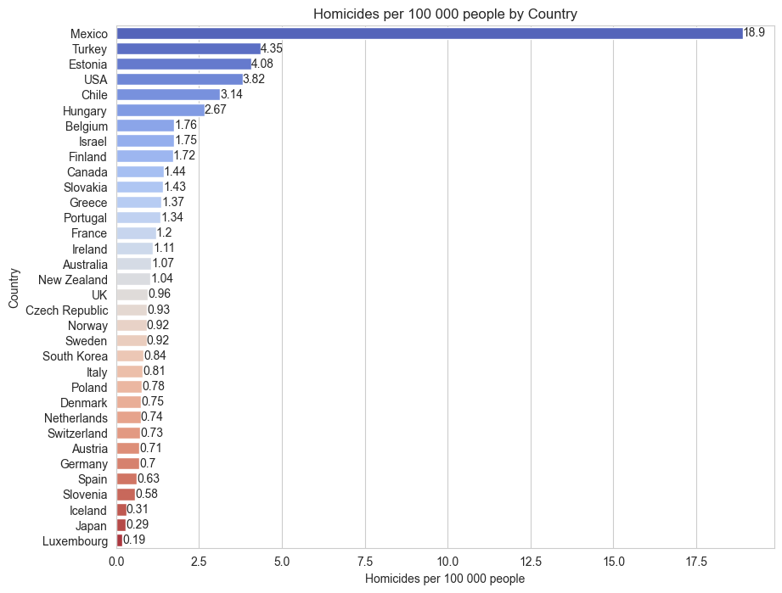

Slide 7
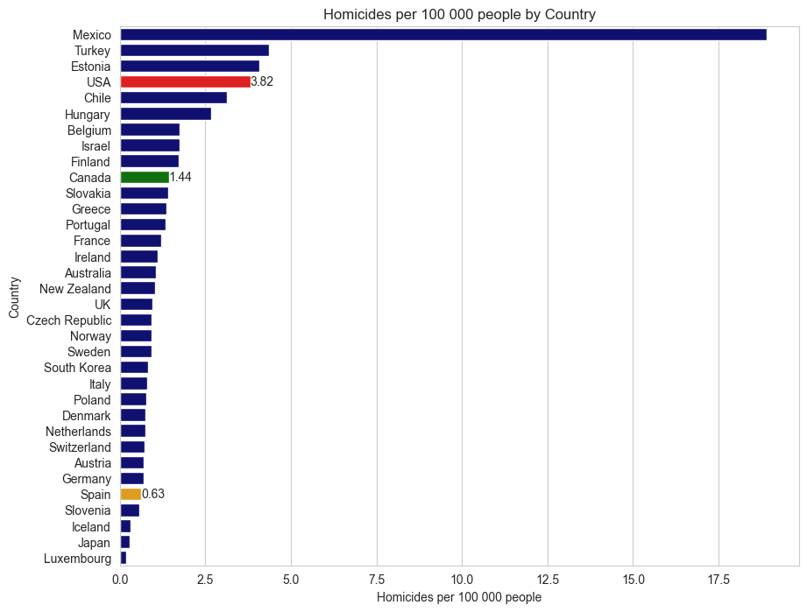

Slide 8

What explains the US’s high rates of gun deaths?
Hypothesis 1: High rates of gun deaths can be explained by high levels of registered guns.
Hypothesis 2: High rates of gun deaths can be explained by low levels of gun regulation.
Hypothesis 3: High rates of gun deaths can be explained by poverty rates.

Slide 9
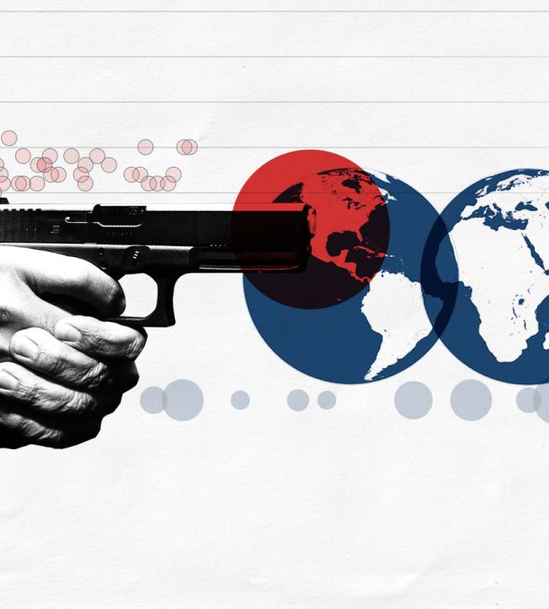

U.S. Levels of Registered Guns
United States: Has one of the highest per capita gun ownership rates in the world, of 120 guns per 100 residents.
Canada: Gun ownership is about 35 guns per 100 residents.
Spain: Gun ownership is reported to be about 10.4 guns per 100 residents.

Slide 10
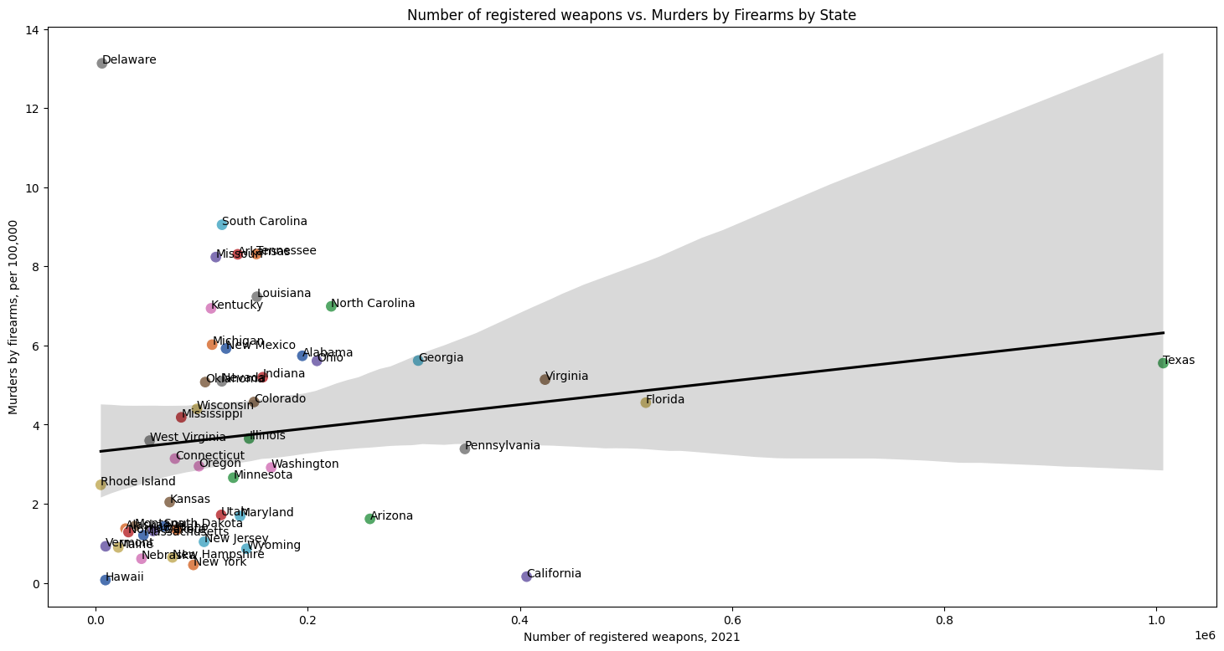

Slide 11

U.S. Registered Weapons vs Homicides by State
Correlation between number of registered weapons and Murders by firearms, per 100,000 is 0.174
Direction: Since 0.174 is positive, it suggests that as the number of registered weapons increases, the murders by firearms per 100,000 also tend to increase, although not strongly.
Result: Hypothesis mostly rejected.
Possible Explanation: The United States is thought to have very high levels of illegal guns.

Slide 12
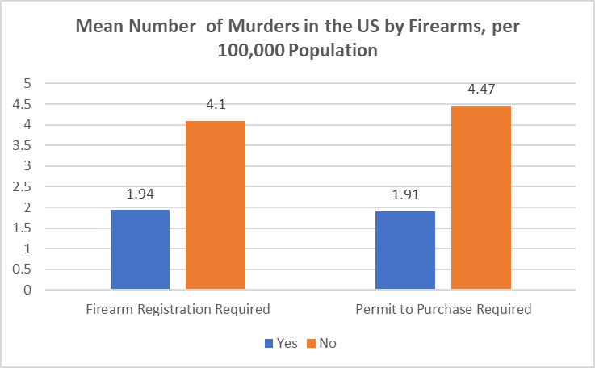

Slide 13
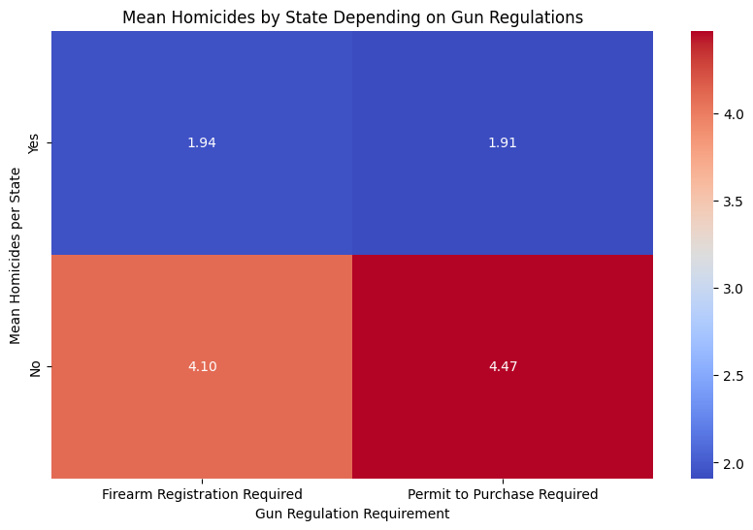

Slide 14

Gun Regulations vs. Gun Deaths
The t-test suggests a statistically significant difference in murder rates by firearms per 100,000 between the two groups being compared, with firearm registration influencing the rates.
Murders and Firearms registration requirement:
T-statistic: 2.57 , P-value: 0.023
Murders and Permit required to purchase:
T-statistic: 3.75, P-value: 0.00059
Result: Hypothesis accepted.

Slide 15
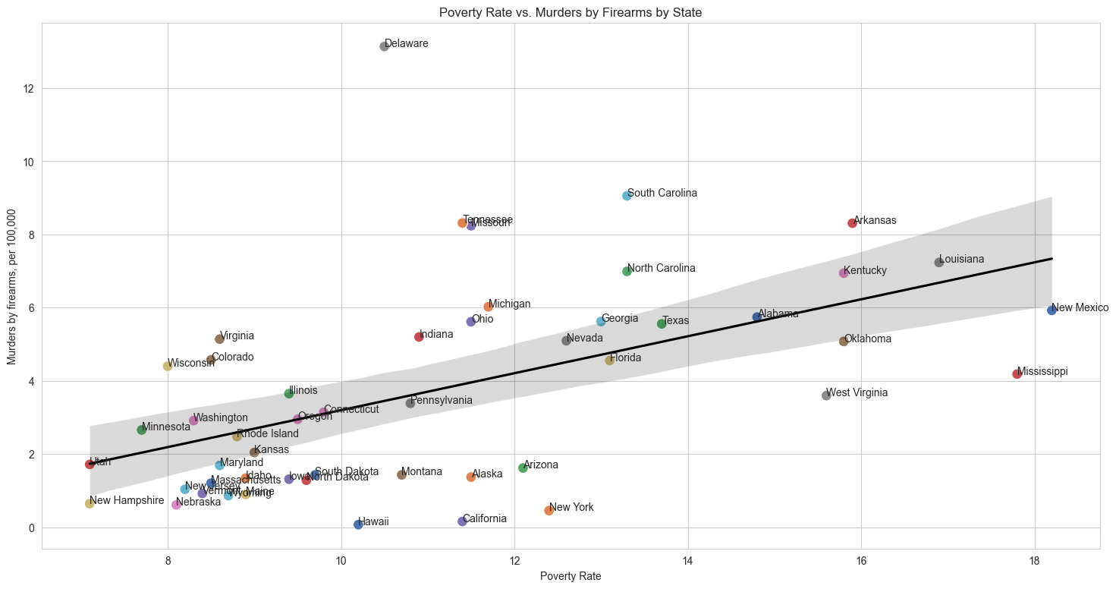

Slide 16
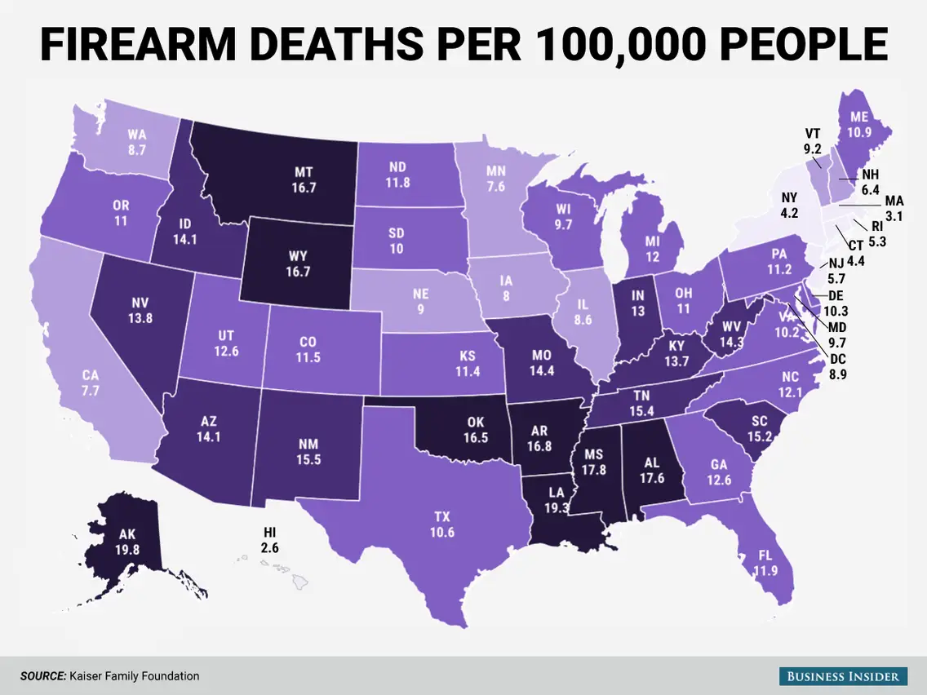
Poverty Rates vs. Gun Deaths
Correlation between poverty rates and Murders by firearms, per 100,000 is 0.52
Direction: Since 0.52 is positive, it suggests that poverty rate increases, the murders by firearms per 100,000 also tend to increase.
Result: Hypothesis accepted.
Possible Explanation: Poverty increases desperate behaviour, resulting in increased crime rates. With easy access to guns, American criminals in states with higher poverty tend to commit more gun crimes.

Slide 17
Conclusion
I can conclude that gun regulations do make a difference, but overall, the evidence suggests that poverty may be an even stronger influence on gun deaths.
Hypothesis 1: High rates of gun deaths can be explained by high levels of registered guns.
Hypothesis 2: High rates of gun deaths can be explained by low levels of gun regulation.
Hypothesis 3: High rates of gun deaths can be explained by poverty rates.

Slide 18




Data Sources

