Slide 1
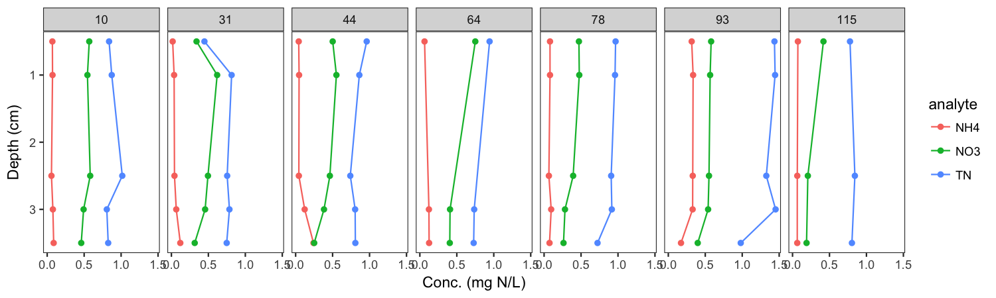
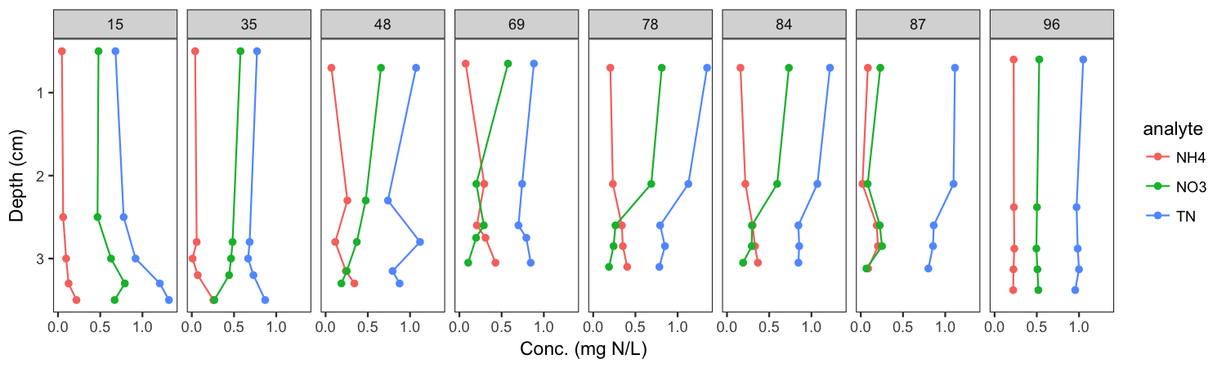
Missisquoi Bay – Winter 2014 & 2015 Comparison - Nitrogen
Frozen
Thaw
Notes:
Comparison of 2014 & 2015 data show that extremely cold, ice-covered periods in 2015 promote benthic nitrate depletion. The proceeding two thaw events in 2015 were minor and cold meltwater failed to promote mixing in the bay by skimming across the surface of the bay. Would need to show temperature and oxygen profiles.

Slide 2
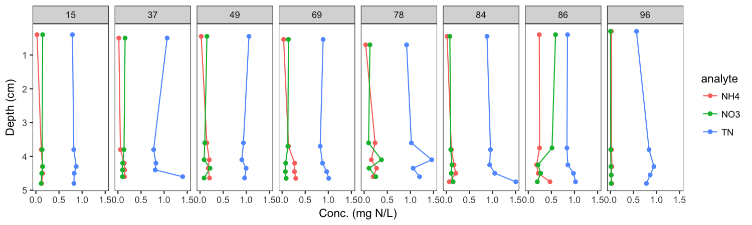
Missisquoi Bay – each panel is a different sampling day; dashed lines are thaw events
Frozen
Thaw
Shelburne Pond

Slide 3
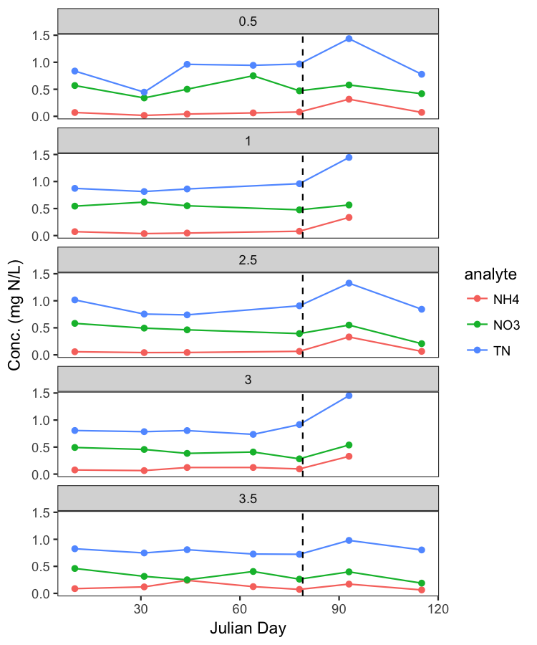
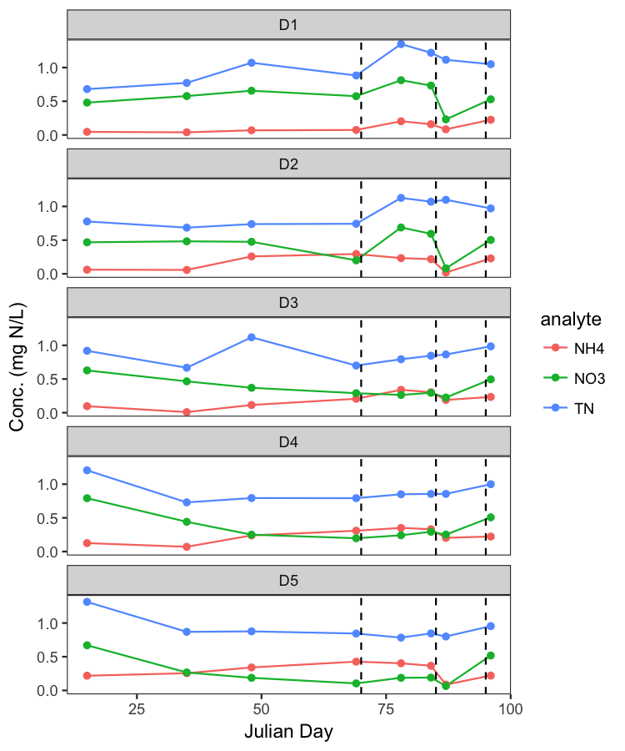
Missisquoi Bay – Winter 2014 & 2015 Comparison - Nitrogen
Same data over time and grouped by depth (D1 = top, D5 = bottom)
2014
2015

Slide 4
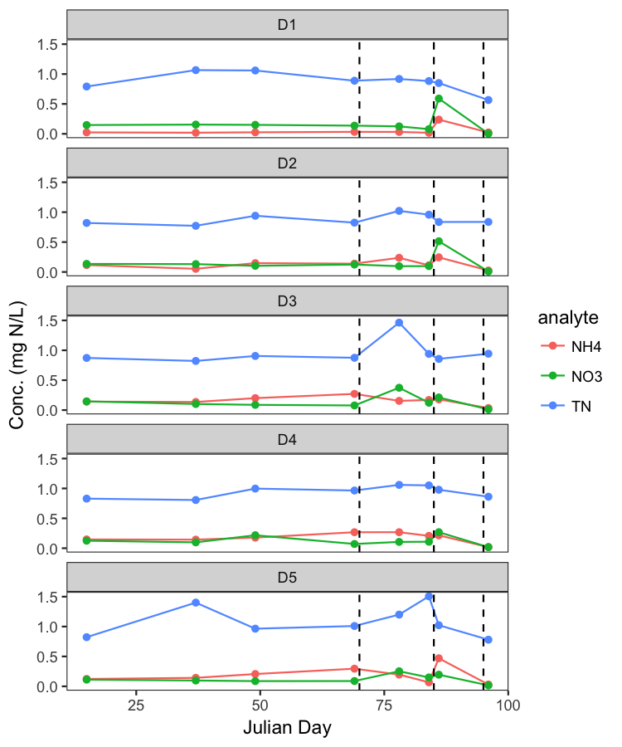
Same data over time and grouped by depth (D1 = top, D5 = bottom)
Missisquoi
Shelburne

