Slide 1
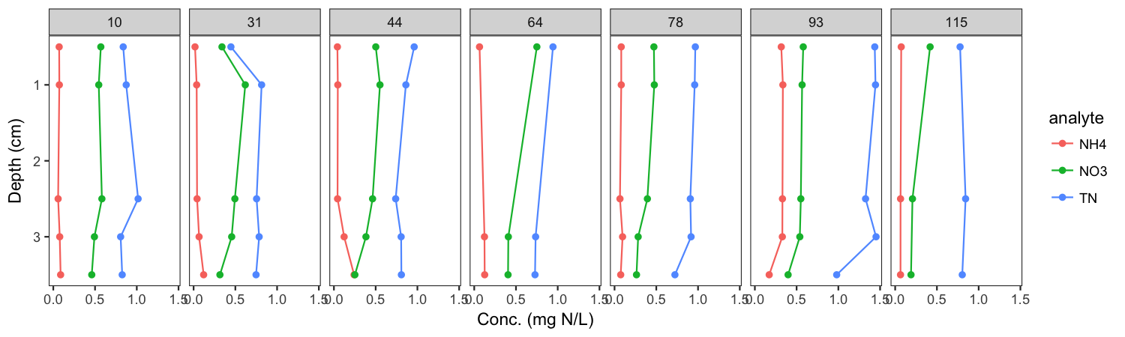
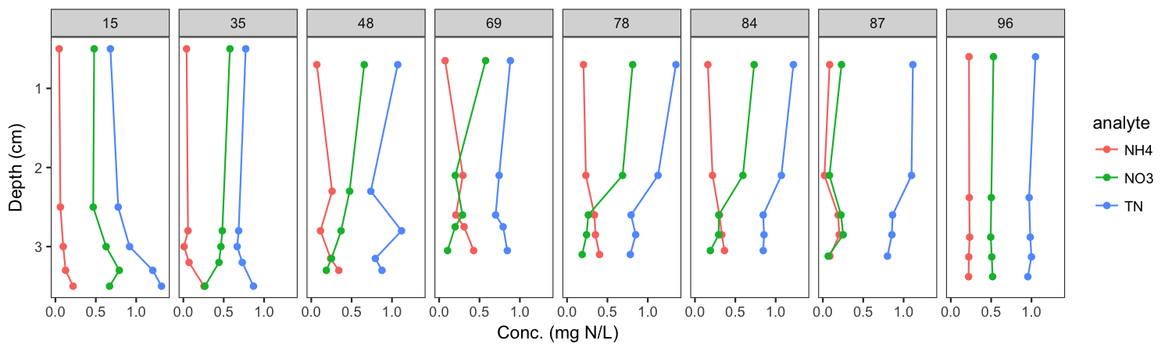
Missisquoi Bay – Winter 2014 & 2015 Comparison - Nitrogen
Frozen
Thaw

Slide 2
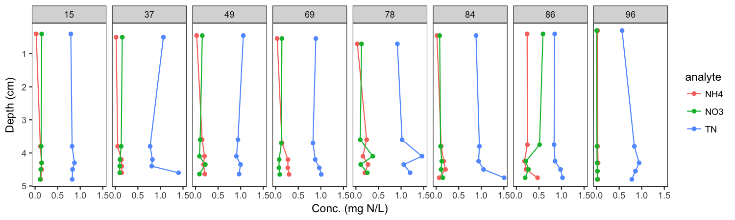
Missisquoi Bay – each panel is a different sampling day; dashed lines are thaw events
Frozen
Thaw
Shelburne Pond

Slide 3
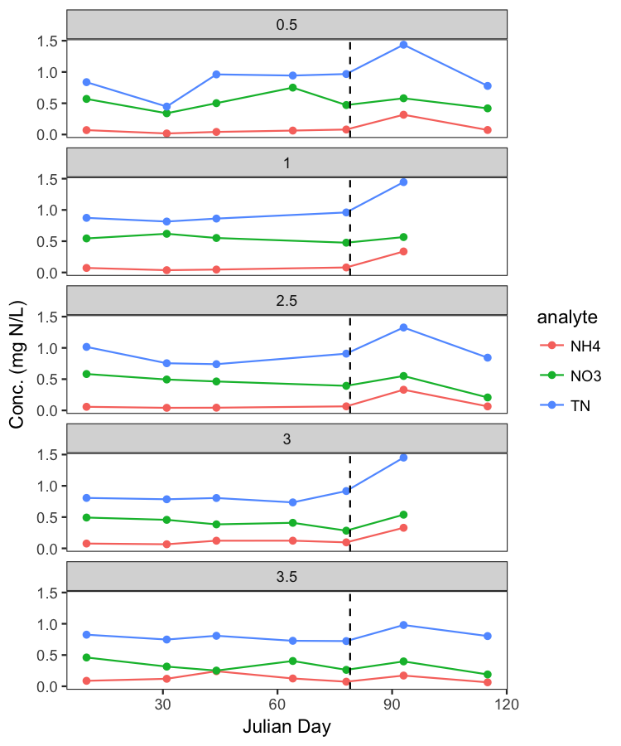
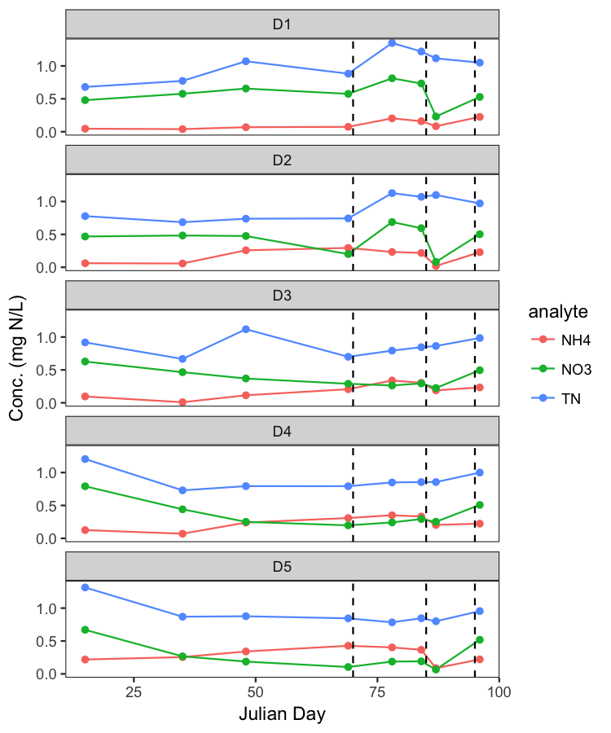
Missisquoi Bay – Winter 2014 & 2015 Comparison - Nitrogen
Same data over time and grouped by depth (D1 = top, D5 = bottom)
2014
2015

Slide 4
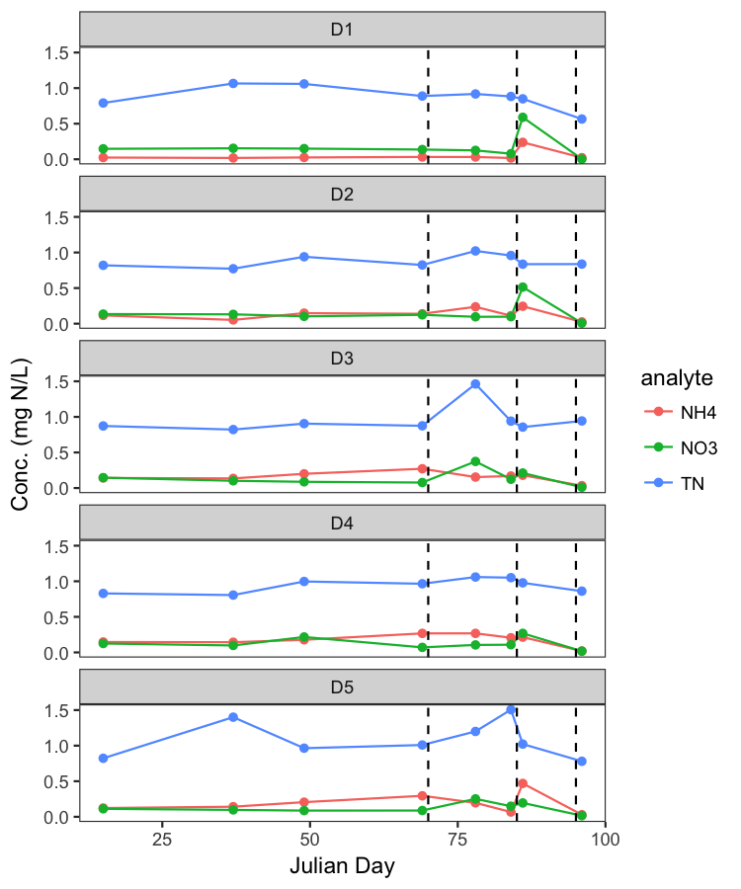
Same data over time and grouped by depth (D1 = top, D5 = bottom)
Missisquoi
Shelburne

