Slide 1
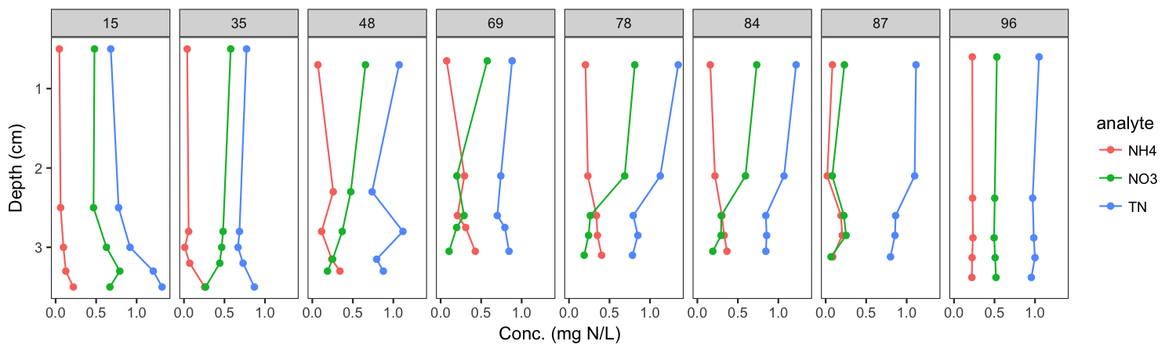
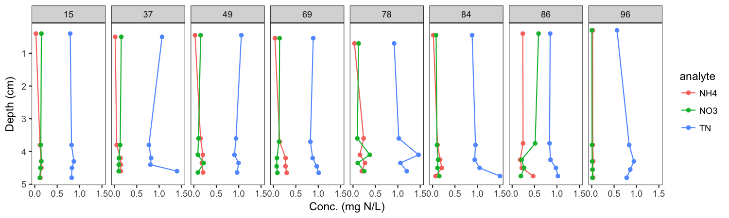
Missisquoi Bay – each panel is a different sampling day; dashed lines are thaw events
Frozen
Thaw
Shelburne Pond

Slide 2
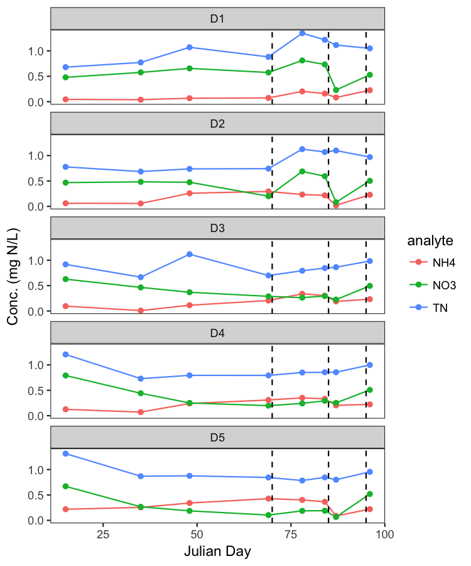
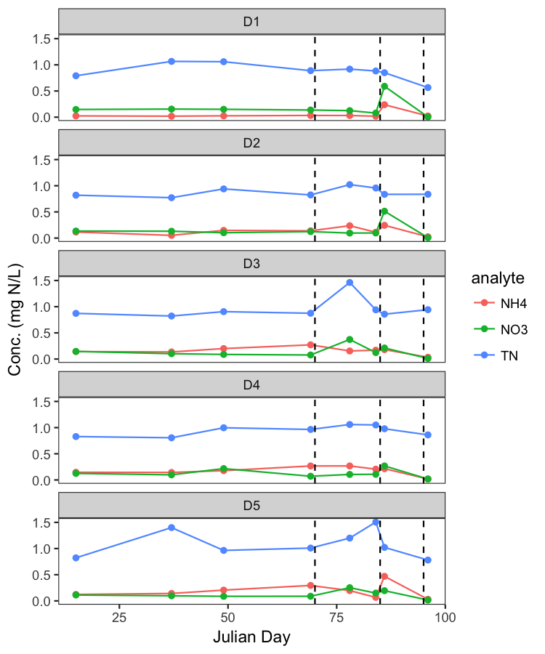
Same data over time and grouped by depth (D1 = top, D5 = bottom)
Missisquoi
Shelburne

