Slide 1
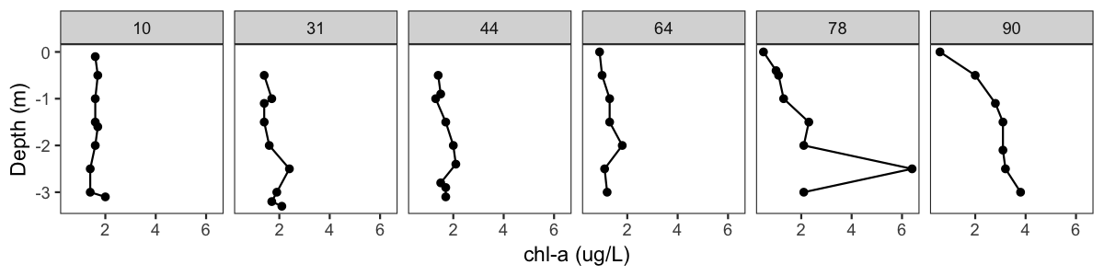
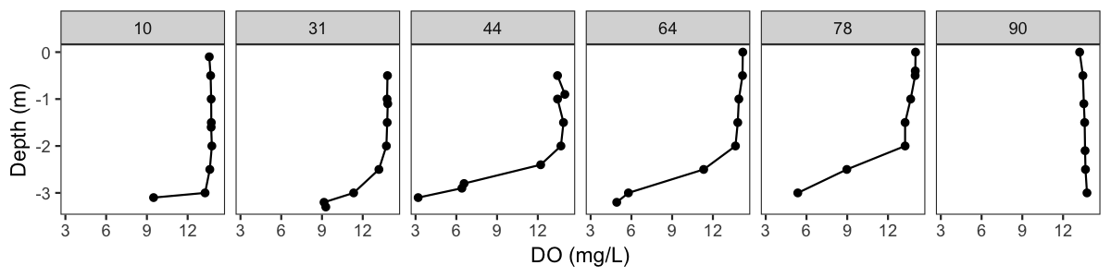
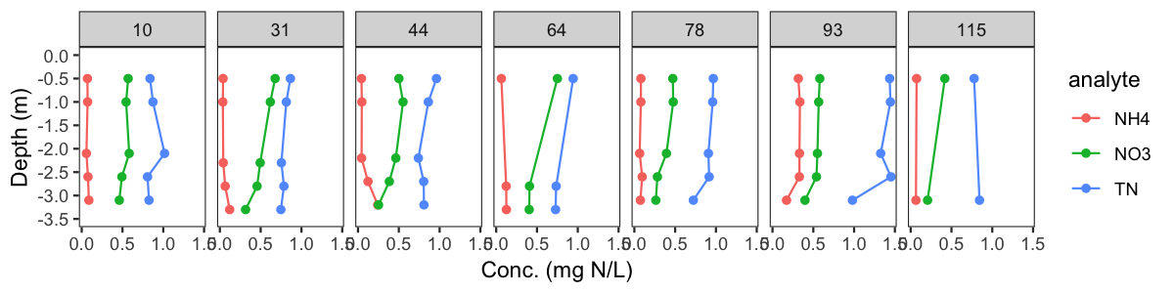
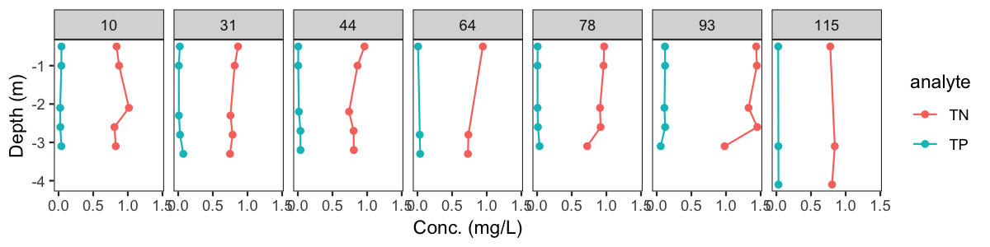
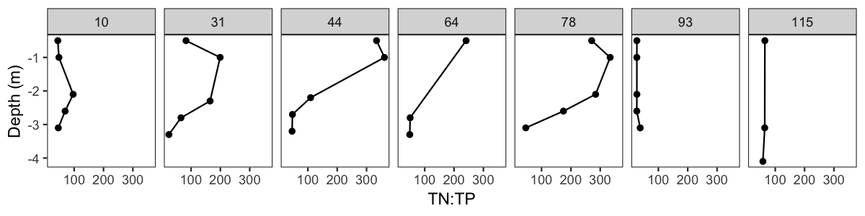
Missisquoi Bay
Winter 2014

Slide 2
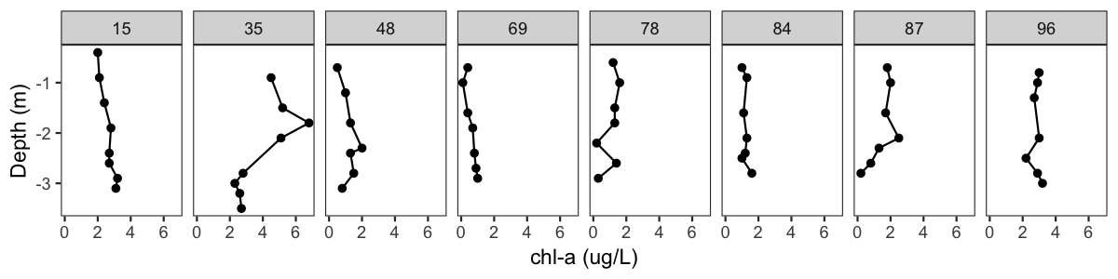
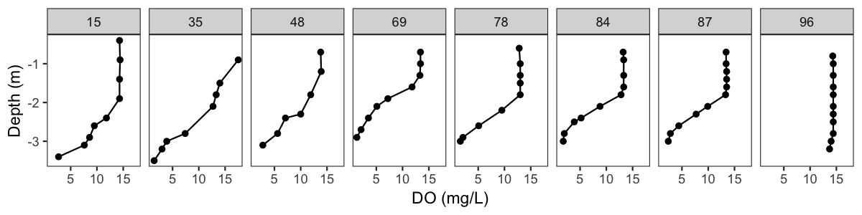
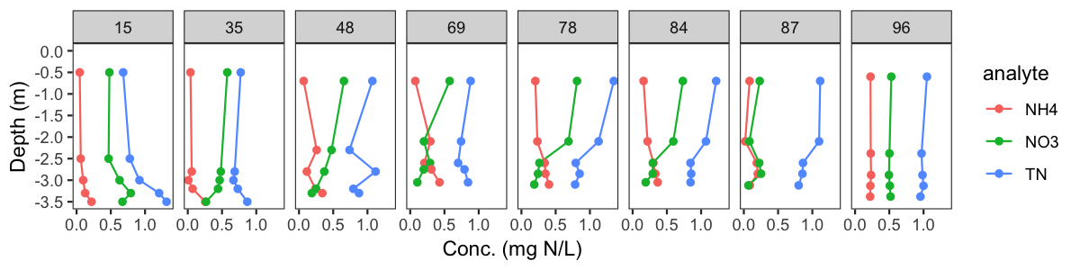
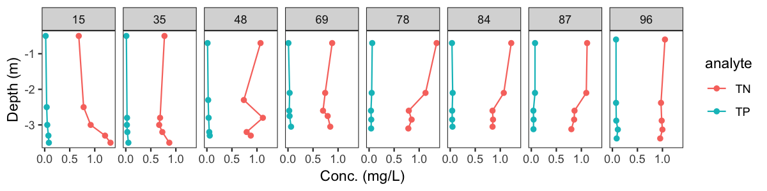
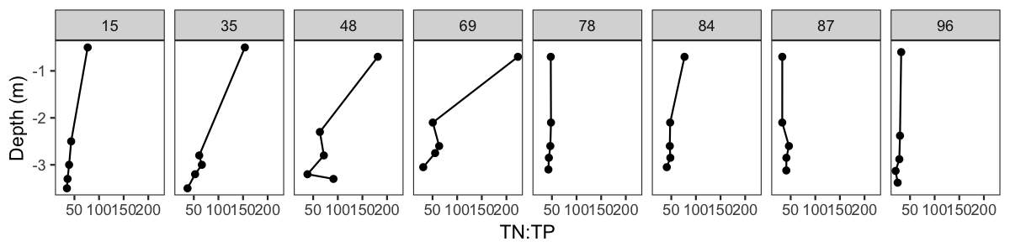
Missisquoi Bay
Winter 2015

Slide 3
Shelburne Pond
Winter 2015

Slide 4
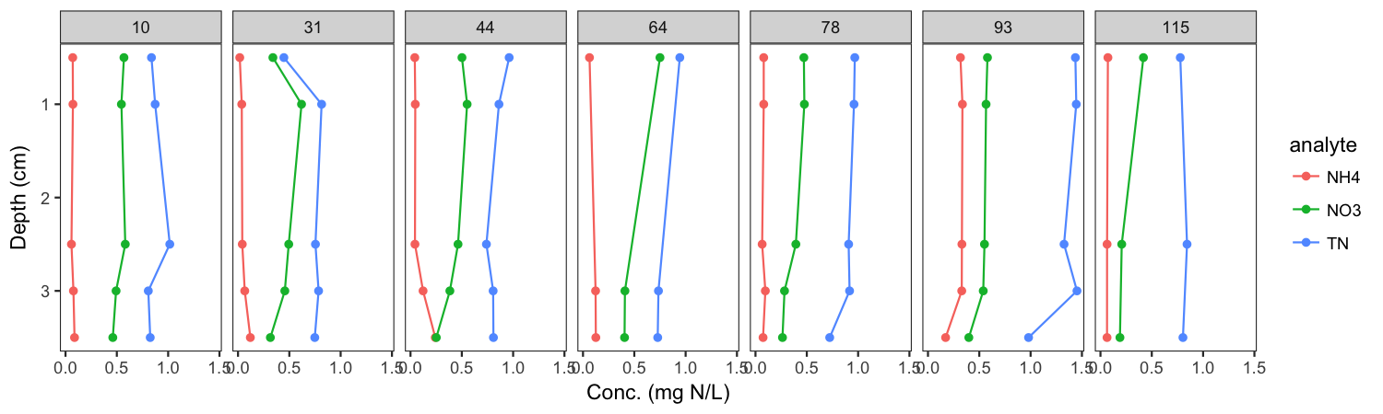
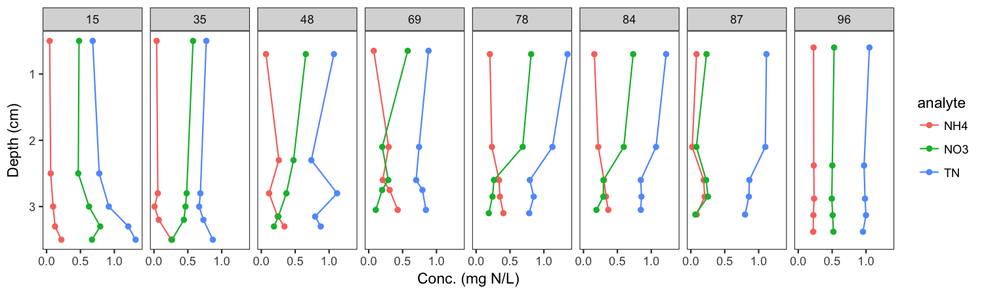
Missisquoi Bay – Winter 2014 & 2015 Comparison - Nitrogen
Frozen
Thaw

Slide 5
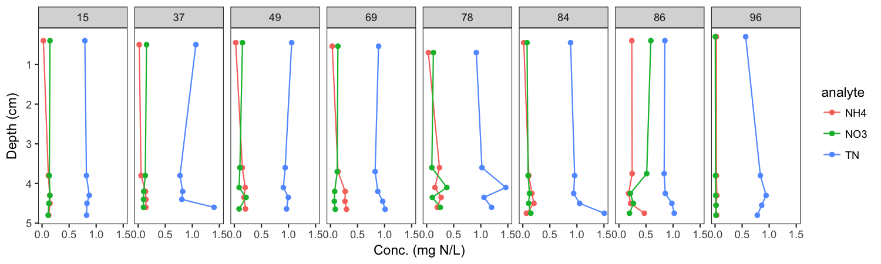
Missisquoi Bay – each panel is a different sampling day; dashed lines are thaw events
Frozen
Thaw
Shelburne Pond

Slide 6
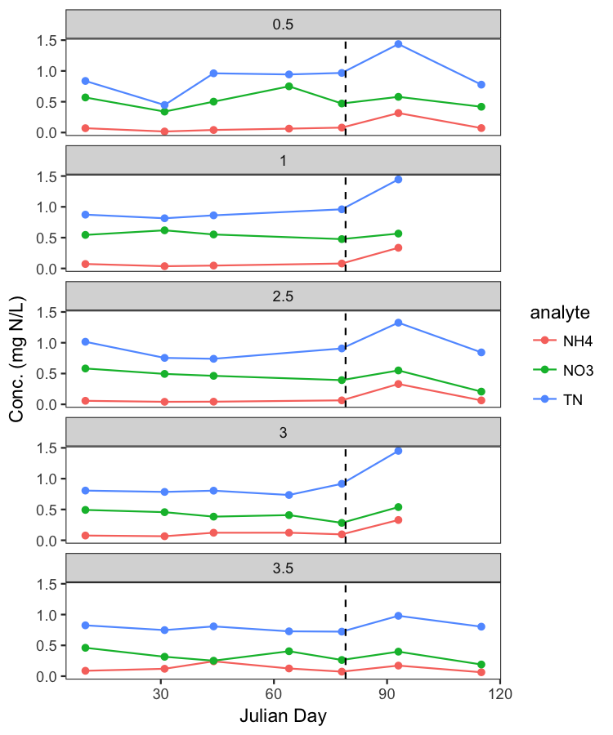
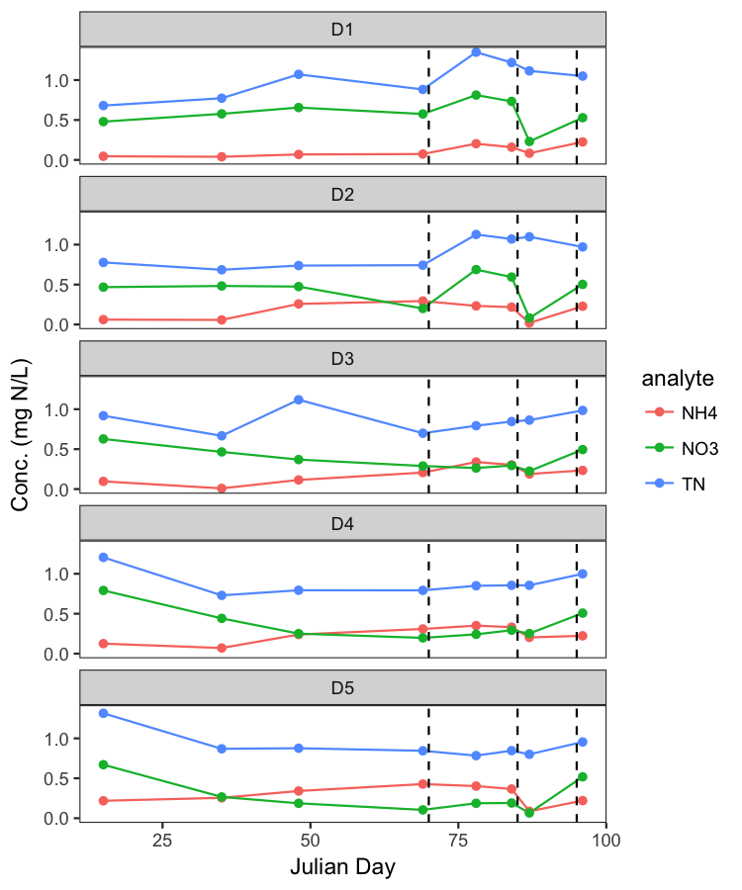
Missisquoi Bay – Winter 2014 & 2015 Comparison - Nitrogen
Same data over time and grouped by depth (D1 = top, D5 = bottom)
2014
2015

Slide 7
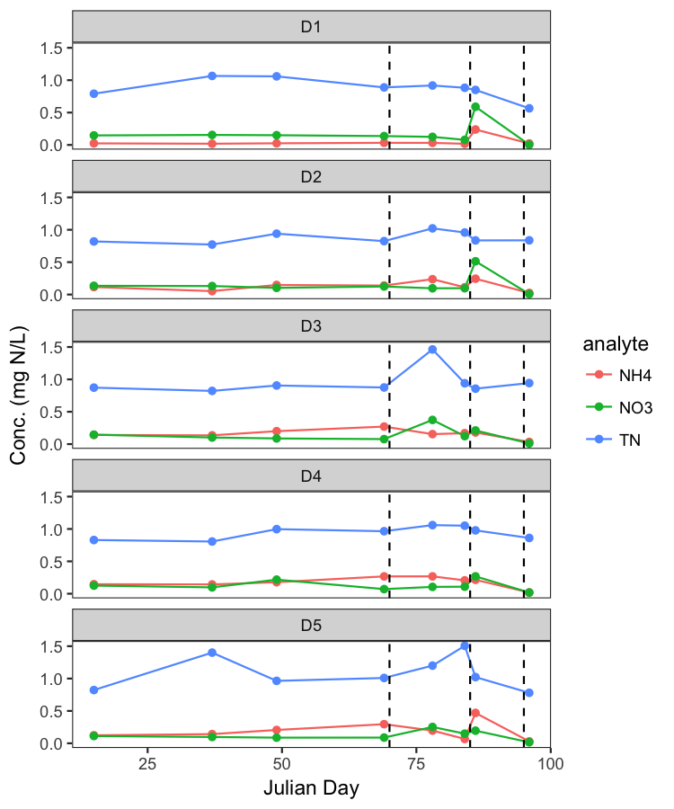
Same data over time and grouped by depth (D1 = top, D5 = bottom)
Missisquoi
Shelburne

