Slide 1
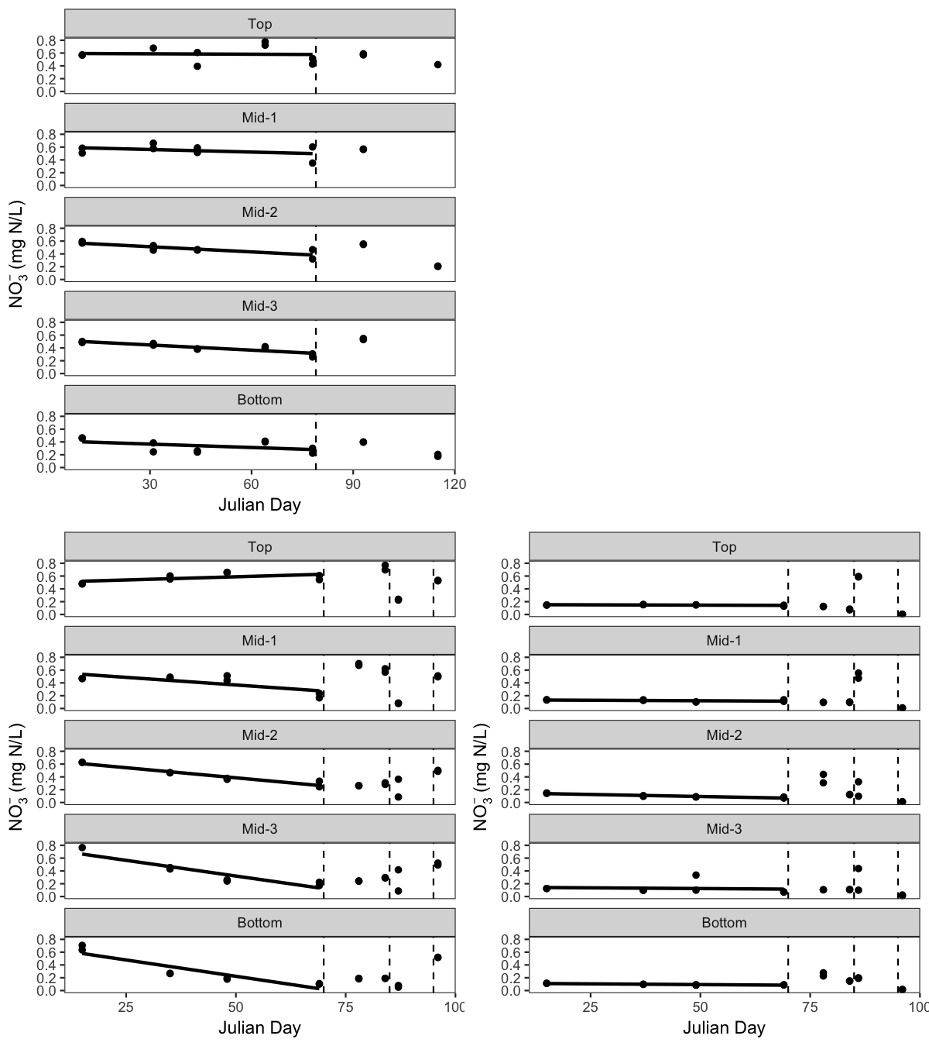
MB 2014
-0.0027x, p < 0.01
-0.0027x, p < 0.001
MB 2015
SP 2015
-0.0048x, p = 0.03
-0.0063x, p < 0.001
-0.0013x, p < 0.001
-0.0112x, p < 0.001
-0.0102x, p < 0.01
-0.0005x, p < 0.01
Notes:
Andrew says there was one thaw in 2014 that I should note (see his ES&T paper); as for MB & SP comparison, to get at what the TN pool contains (particulate N vs. DON, use turbidity concentrations and PC conc.); look at riverine concentrations of N, why don’t concentrations in top layer respond more? Maybe also look at N:P ratios in frozen vs thaw, but maybe also look at C:N or C:P ratios where we have DOC data; get 2014 sonde data from Andrew and graph DO & CHLA data, make figures like Ocean Data View

