Slide 1
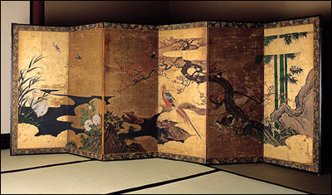
Byobu
An Enhancement of GNU Screen by the Ubuntu Server Team
屏風 byo-bu: Japanese word for a decorative, multi-panel screen that serves as an elegant folding room divider

Slide 2
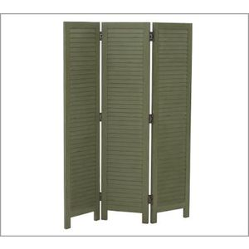
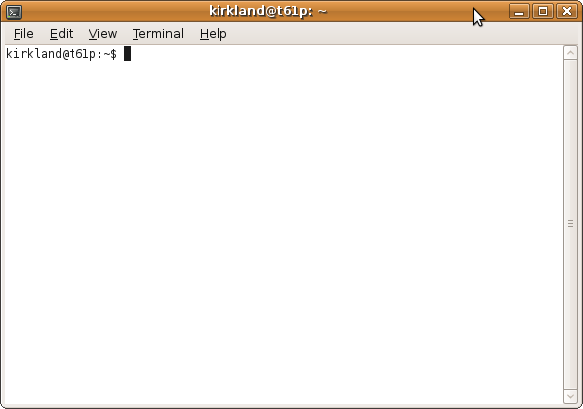
GNU Screen
Venerable text-only,
window manager
Plain, functional
Multiple windows
Attach/detach/share
sessions
Very configurable,
powerful
Complex key sequences
Complex configuration
Manpage is ~3000 lines

Slide 3
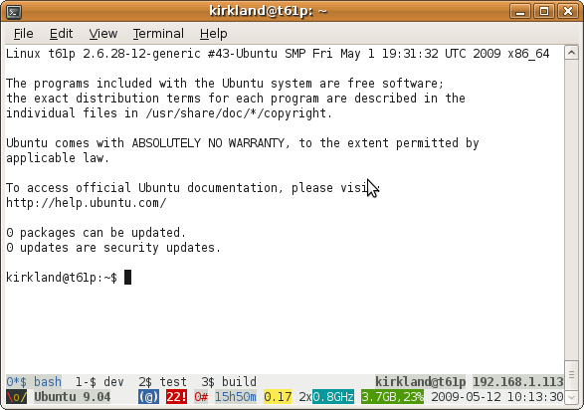
Byobu
Advanced tweaks,
helpers, and extensions
of GNU Screen
Convenient keybindings
Curses configuration app
Dynamic, colorful,
intuitive, toggle-able
status panel
Detailed status callout
Tabbed window panel
Multiple backgrounds
Profile export utility

Slide 4
GNU Screen Keybindings
Screen key bindings, page 1 of 3.
Command key: ^A Literal ^A: a break ^B b license , removebuf = clear C lockscreen ^X x reset Z colon : log H screen ^C c copy ^[ [ login L select ' detach ^D d meta a silence _ digraph ^V monitor M split S displays * next ^@ ^N sp n suspend ^Z z dumptermcap . number N time ^T t fit F only Q title A flow ^F f other ^A vbell ^G focus ^I pow_break B version v hardcopy h pow_detach D width W help ? prev ^H ^P p ^? windows ^W w history { } quit \ wrap ^R r info i readbuf < writebuf > kill K k redisplay ^L l xoff ^S s
Too complex?

Slide 5
Byobu Keybindings
Byobu Default Hotkeys
F2 Create a new window
F3 Go to the previous window
F4 Go to the next window
F5 Reload profile
F6 Detach from the session
F7 Enter scrollback mode
F8 Re-title a window
F9 Configuration
F12 Lock this terminal
Much simpler!

Slide 6
GNU Screen Configuration
startup_message off vbell off msgwait 1 backtick 99 86400 86400 $HOME/.byobu/byobu-status logo backtick 100 3600 3600 $HOME/.byobu/byobu-status release backtick 101 10 10 $HOME/.byobu/byobu-status updates-available
... backtick 123 86400 86400 $HOME/.byobu/byobu-status disk-available backtick 124 2 2 $HOME/.byobu/byobu-status disk-used hardstatus alwayslastline termcapinfo xterm* ti@:te@ altscreen on defscrollback 10000 register n "^a^c" bindkey -k k2 process n bindkey -k k3 prev bindkey -k k4 next register r "^a:source $HOME/.byobu/profile^M" bindkey -k k5 process r bindkey -k k6 detach bindkey -k k7 copy register t "^aA^aa^k^h" bindkey -k k8 process t bindkey -k F2 lockscreen bind $ screen -t status 0 byobu-status-detail caption always "%{wK}%?%-Lw%?%{bw}%n*%f %t%?(%u)%?%{wK}%?%+Lw%? %= %{= Kw}%110`%109`%122`%111`" hardstatus string '%99`%{= Kw} %100`%112`%= %102`%101`%114`%115`%108`%113`%119`%117`%118`%116`%106`%104`%103`%105`%107`%123`%124`%120`%121`'
Too Complex!

Slide 7
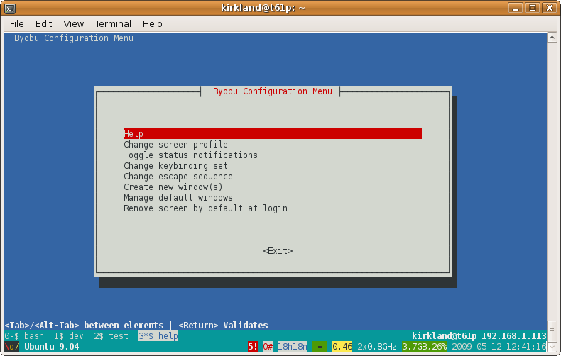
Byobu Configuration
<F9>

Slide 8
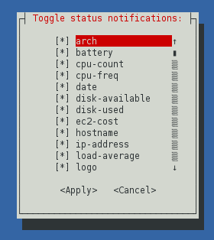
Byobu Status Notifications
arch
battery
cpu-count
cpu-freq
date
disk-available
disk-used
ec2-cost
hostname
ip-address
load-average
logo
mem-available
mem-used
menu
network-down
network-up
processes
reboot-required
release
time
updates-available
uptime
users
whoami
wifi-quality

Slide 9
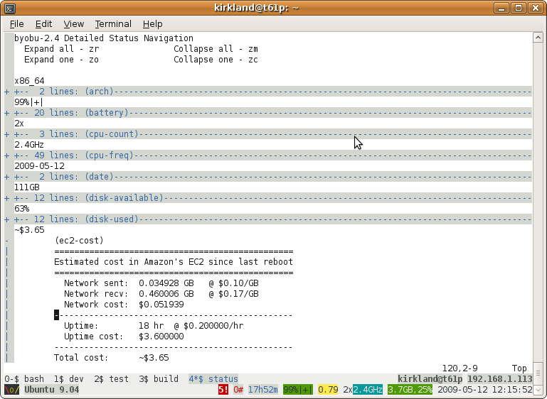
Byobu Detailed Status Folding Panel

Slide 10
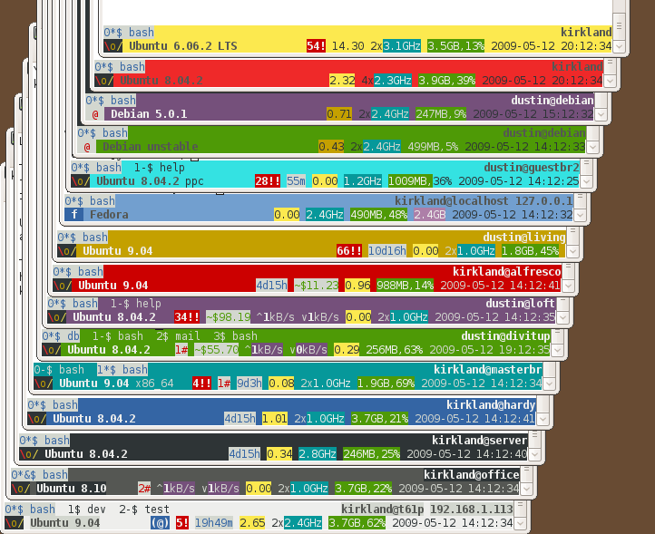
Byobu Colored Backgrounds
Color code each host for visual cues
Stack or tab your ssh sessions to each host

Slide 11
Launch Byobu at Login
Byobu can be configured to launch automatically on local or remote login
Ensure that you can attach/detach to/from your session later
Useful for unreliable client connections like remote wifi
Useful long running commands, like rsync's, wget's, and make's

Slide 12
Byobu Export
kirkland@t61p:~$ byobu-export -c light
Success!
Profile : [light]
Archive : [/tmp/byobu.AZJaNC.tar.gz]
Extract the archive in your home directory on the target system.
byobu-export: creates a tarball that you extract in your home directory on systems where screen is installed, but you don't have administrative privilege (to install byobu itself)

Slide 13
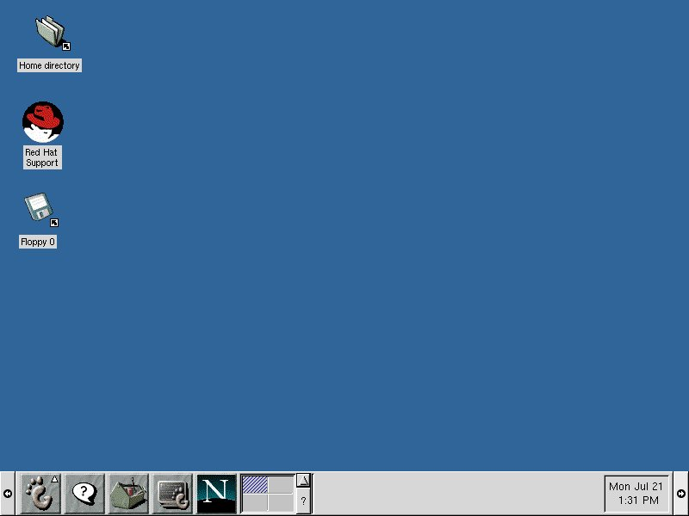
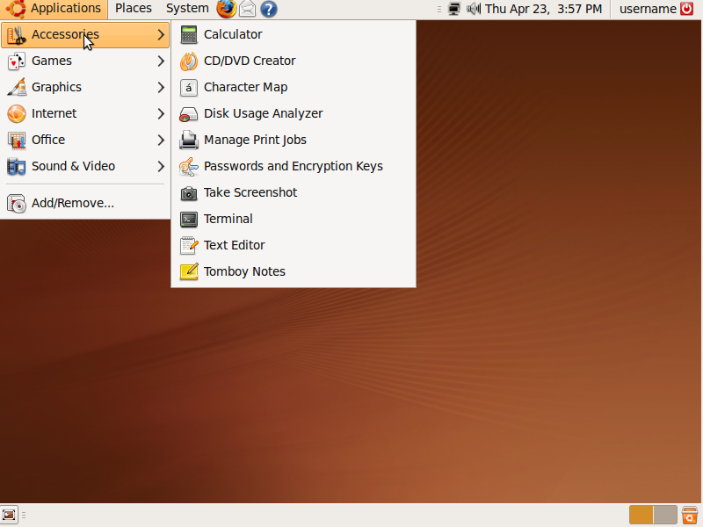
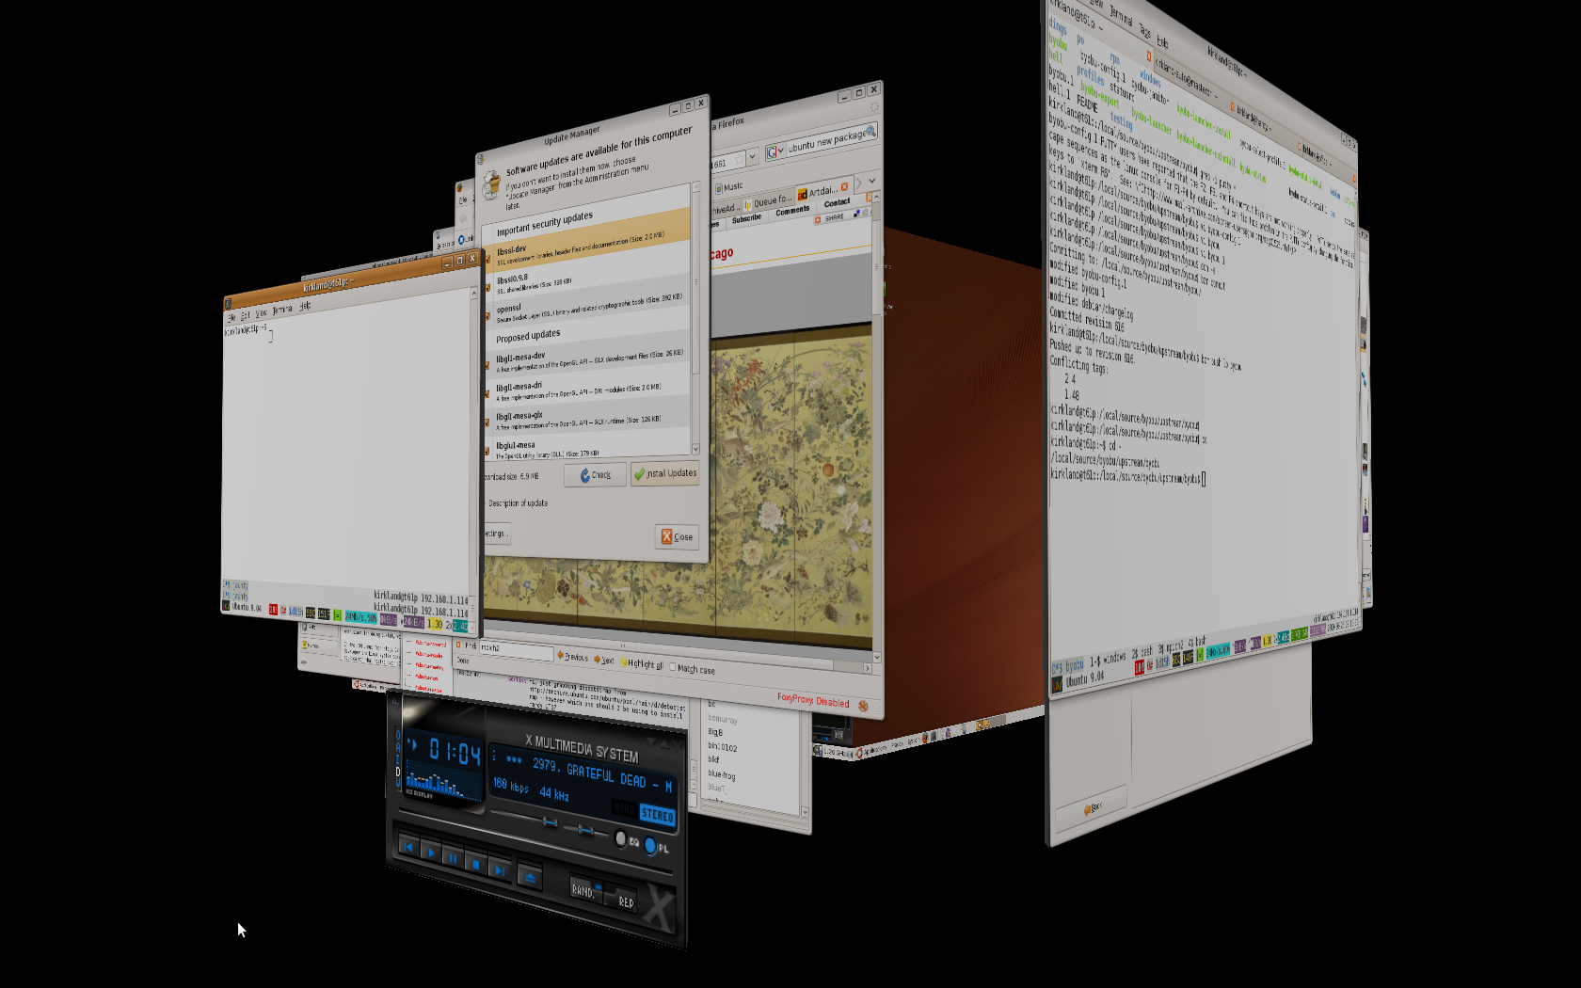
The Desktop, Gnome + Compiz

Slide 14
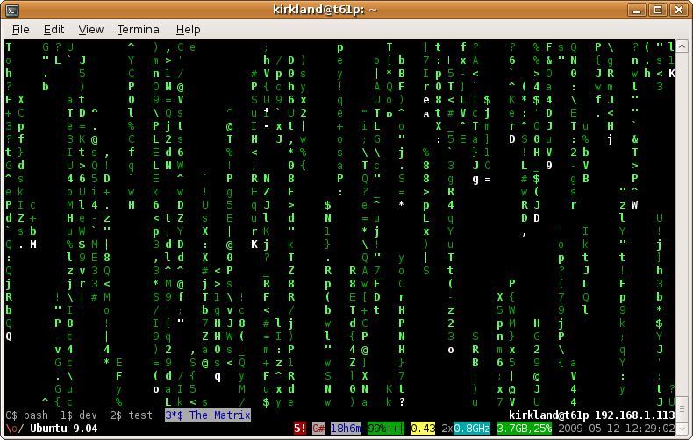
The Server, GNU Screen + Byobu

