Slide 1
Classification of Seizures from One Second EEG Samples by K-means and Expectation Maximization
Dustin McAfee
CS 594 / 690

Slide 2
EEG (Electroencephalography) is a monitoring method to record electrical activity in the brain.
The measurements can be used to diagnose conditions, such as epilepsy and sleep disorders.

Slide 3
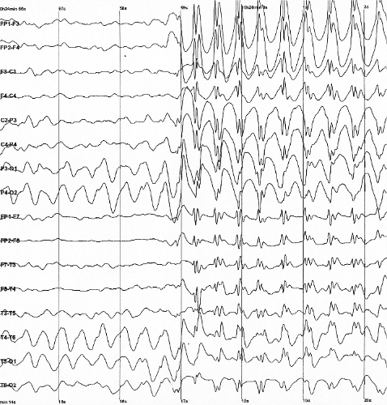
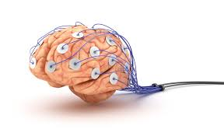

Slide 4
Motivation
Given a time-series dataset of EEG recordings and a binary label indicating a seizure, is is possible to build a clustering algorithm to serve as a predictive model for seizures?
One could look at multiple k clusterings (I.e. two or three clusters: low/high risk, or low/medium/high risk).

Slide 5
Contributions
A K-means++ and Expectation Maximization (E-M) with Gaussian Clusters have been implemented for generic input data and k values.
Both algorithms are implemented in pyspark for parallelism.
The entire dataset is projected onto the first 40 Principal Components, which make up over 95% of the variance.

Slide 6
Contributions
10-20% of the dataset is taken to be the testing dataset: The dataset that is visualized in the first 3 Principal Components.
Each algorithm reports its own clustering metric: Dunn Index for K-means++, and Silhouette Index for E-M.
Predictions on the testing set is compared to the actual prediction values for both algorithms. Confusion matrices will be produced

Slide 7
Background and Related Work
The K-means++ algorithm is essentially the same as K-means, except with a smarter way to choose the initial centroids.
The algorithm uses the distance from each previously selected centroid as weights in a probability distribution in order to choose a clustering that is highly likely to be spread out.
The implemented E-M algorithm also uses this initialization technique to seed the algorithm.
Figures are plotted in LaTeX

Slide 8
Methodology
The data is from 500 individuals with 23.5 second EEG readings. The data is formatted to have 11500 rows containing about 1 second per row. This turns out to have 178 columns, with the 179th column to be the class that is meant to be predicted.
The data is first z-normalized, and Principal Component analysis is run to reduce the 178 column dataset to 40 columns, which covers about 95.88% of the variance.

Slide 9
Methodology
K-means and E-M is run on the projected dataset with k=2 and k=3, reporting their respective performance metrics, along with the percent error, false positives, false negative, true positives, and true negatives for the testing dataset.
The results are analyzed for resemblance of categories representing as low/medium/high risk categories.
The low risk categorizations should correspond to no seizures, while the high risk categorizations should correspond to the instances of seizures.

Slide 10
Results
The programs were implemented in pyspark, using python 2.7.6+ and run on Ubuntu 14.04.
The data matrix is clustered using K-means and E-M (Gaussian Mixtures).
The Dunn Index (0 to 1) measures how well the clustering are formed for K-means, 0 for not well, and 1 for very well.
The Silhouette Index (-1 to 1) measures how well the clustering are formed for clusters that do not have sparse correlation matrices, and do not share the same correlation (i.e. the clusters are not the same size, nor hyperspheroidal).

Slide 11
Results
Input: input/train/Training_Data.txt and input/test/Testing_Data.txt; standardized and projected onto the first 40 PC's
Kmeans++, K = 2, output: output/Data_Kmeans_2.txt and output/TestingData_Kmeans_2.txt
Kmeans++, K = 3, output: output/Data_Kmeans_3.txt and output/TestingData_Kmeans_3.txt
EM, K = 2, output: output/Data_EM_2.txt and output/TestingData_EM_2.txt
EM, K = 3, output: output/Data_EM_3.txt and output/TestingData_EM_3.txt

Slide 12
Results
Confusion Matrices and Projected datasets should go here, In this order:
3D scatter plot Projection of testing dataset color coded to correct categorical values.
3D scatter plot Projection of testing dataset color coded to predicted values from K-Means for K=2. *
Confusion Matrix from previous line. *
3D scatter plot Projection of testing dataset color coded to predicted values from EM for K = 2. *
Confusion Matrix from previous line. *
* Repeat for K = 3; Confusion matrices should consider med/low risk as one category.

Slide 13
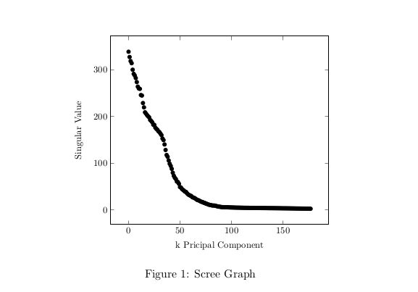
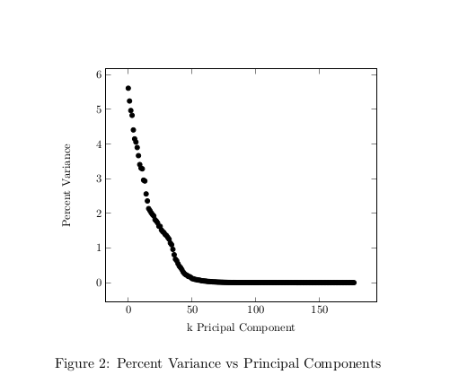
Results

Slide 14
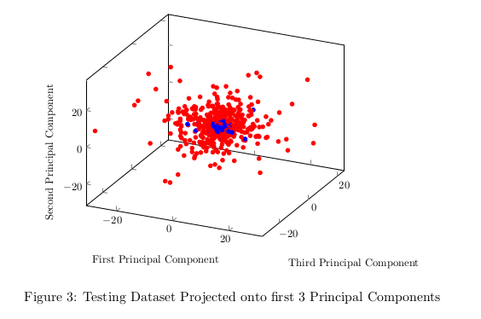
Results
(This slide should be in Methods?)
Testing Dataset Projected onto first 3 Principal Components. Blue dots represent moments of Seizure, while red indicate no seizure is happening.

Slide 15
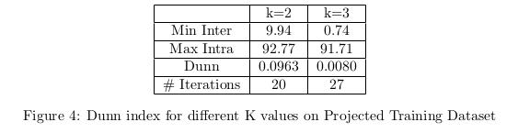
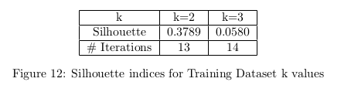
Results
The Dunn index (0 to 1) is used to measure how well the clusters are spread for Kmeans Clustering, and the Silhouette index (-1 to 1) is used to measure how well the clusters are spread for the Gaussian Clusters

Slide 16
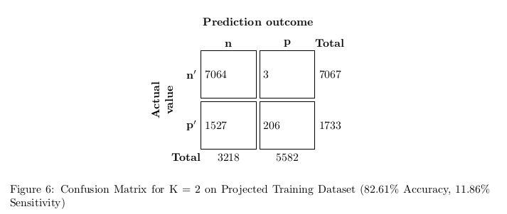
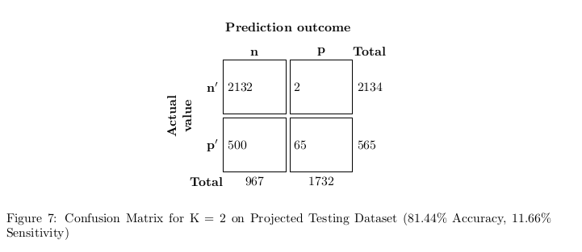
Results
TODO: Add accuracy, precision, sensitivity, etc measurements to slides (See files kmeans_out and em_out)
Confusion Matrix for Kmeans K=2 on Training Dataset
Confusion Matrix for Kmeans K=2 on Testing Dataset

Slide 17
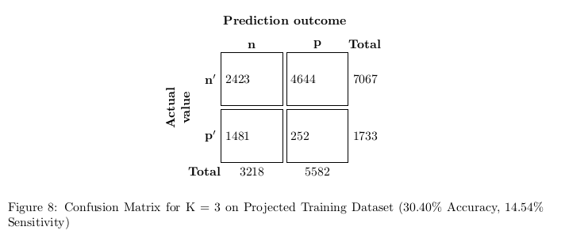
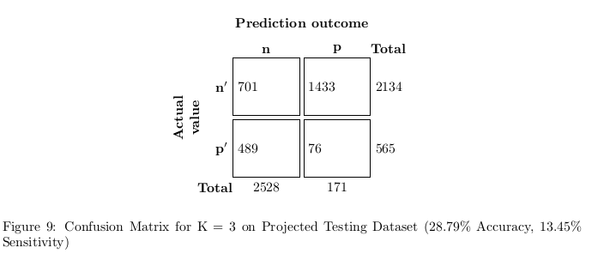
Results
TODO: Add accuracy, precision, sensitivity, etc measurements to slides (See files kmeans_out and em_out)
Confusion Matrix for Kmeans K=3 on Training Dataset
Confusion Matrix for Kmeans K=3 on Testing Dataset

Slide 18
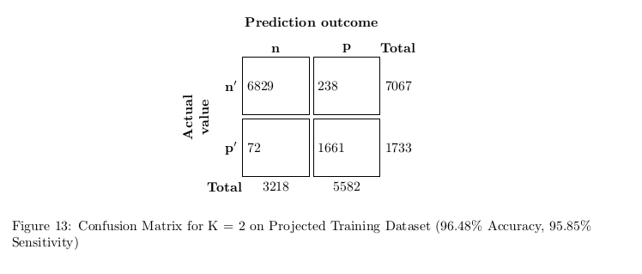
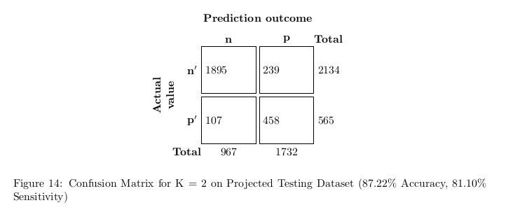
Results
TODO: Add accuracy, precision, sensitivity, etc measurements to slides (See files kmeans_out and em_out)
Confusion Matrix for Expectation Maximization K=2 on Training Dataset
Confusion Matrix for Expectation Maximization K=2 on Testing Dataset

Slide 19
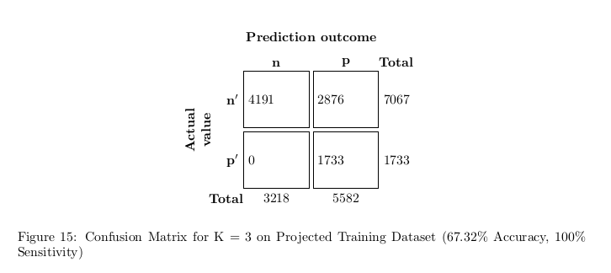
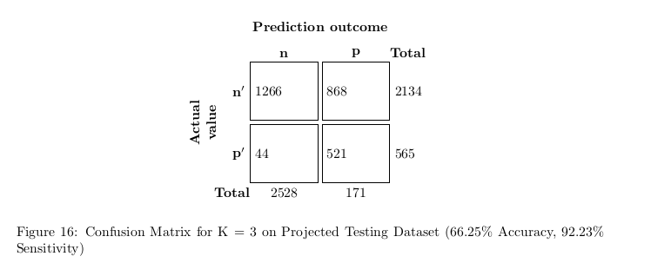
Results
TODO: Add accuracy, precision, sensitivity, etc measurements to slides (See files kmeans_out and em_out)
Confusion Matrix for Expectation Maximization K=3 on Training Dataset
Confusion Matrix for Expectation Maximization K=3 on Testing Dataset

Slide 20
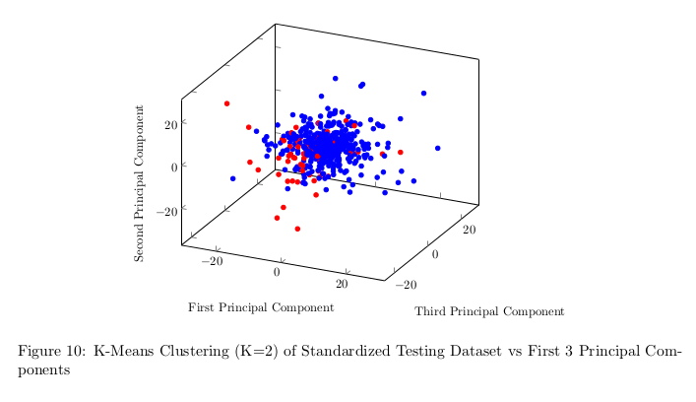
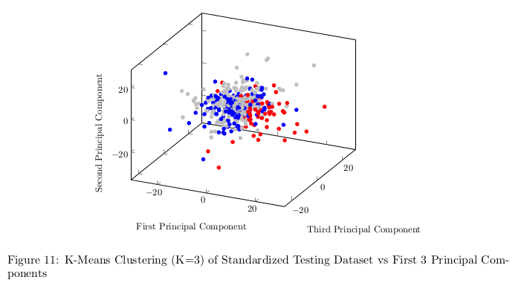
Results
Scatter plot of Testing Dataset color coded to the predictions from Kmeans with K = 2
Scatter plot of Testing Dataset color coded to the predictions from Kmeans with K = 3

Slide 21
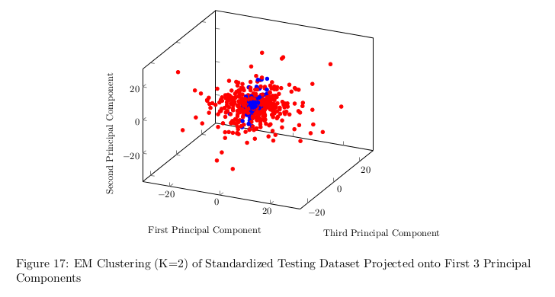
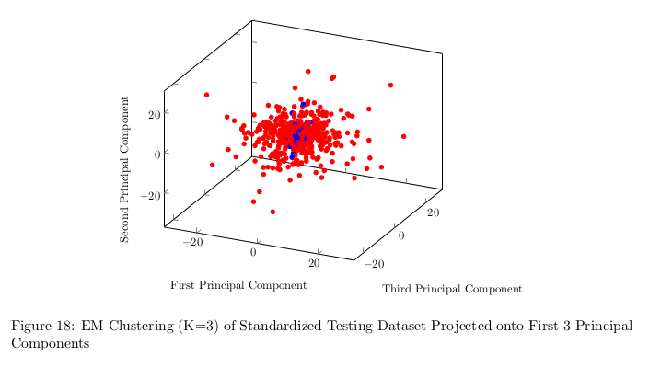
Results
Scatter plot of Testing Dataset color coded to the predictions from Expectation Maximization with K = 2
Scatter plot of Testing Dataset color coded to the predictions from Expectation Maximization with K = 3.
One can see here the third Cluster disappears completely during the likelihood maximization of the Gaussian Clusters

Slide 22
Lessons Learned and Future Work
Kmeans Clustering was not nearly as effective as Expectation Maximization (EM) with Gaussian Clusters.
Clustering with EM using 3 starting clusters yields two ending clusters with higher sensitivity and less accuracy.
Other Spectral Clustering methods could be used in the future in order to yield more accurate clusters.

Slide 23
Revision of your Slides
Go back to Slide 2 and review each one of your slides
Can you replace any text part with one or more figures?
Can you simplify / reduce any sentences?
Are there clear connections between consecutive slides?

Slide 24
NEVER end your presentation with
a slide with “Thank you"

