Slide 1

Support Vector Machines (SVM) and
Support Vector Regression (SVR)
Dustin McAfee
02/12/19

Slide 2
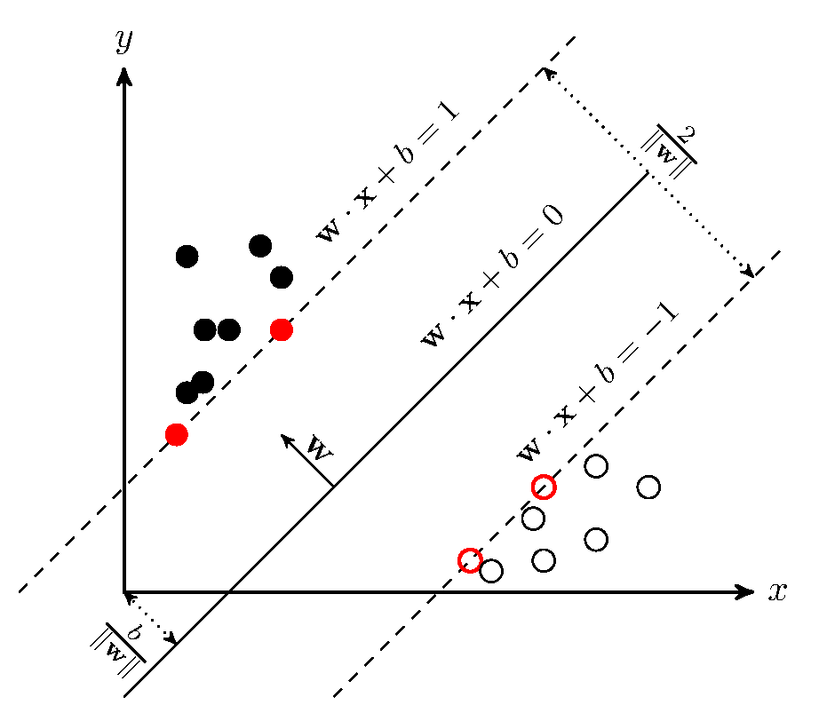
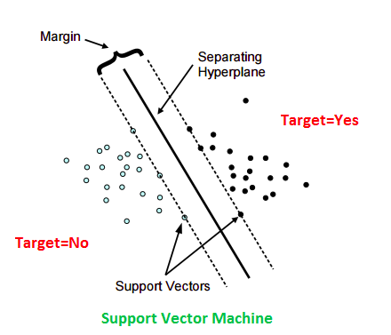
Support Vector Machine
Maximize Margins = Maximizing
= Minimizing
https://github.com/EvEng/papers/blob/master/SVMandSVR.md

Slide 3
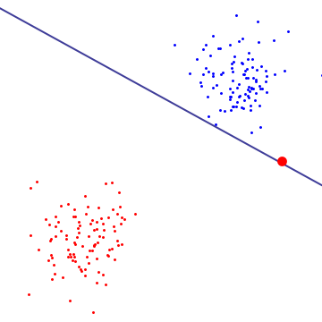
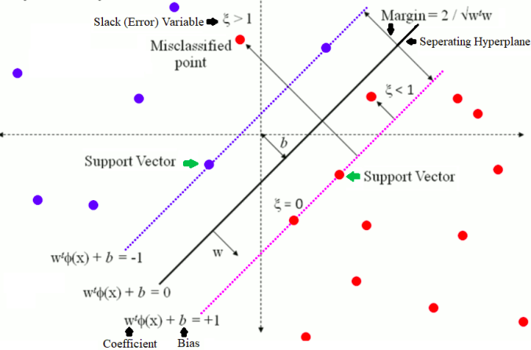
Hard/Soft Margins
https://stackoverflow.com/questions/4629505/svm-hard-or-soft-margins
https://www.datasciencecentral.com/profiles/blogs/implementing-a-soft-margin-kernelized-support-vector-machine
In order to maximize the margin and minimize error, we must minimize:
Subject to:
, where C is the complexity factor (otherwise known as penalty). This is called the Primal Problem.

Slide 4
Dual Problem
Solving for the Lagrangian dual of this problem obtains the simpler problem (Note the lack of dependence on w and b):
The equation is called the kernel, and when taken as a literal dot product, creates a linear hyperplane discriminant (separating hyperplane).
A widely used kernel used is called the radial basis function (RBF): ,
where is a hyper-parameter. Small Gamma means a Gaussian discriminant hyper-plane with a large variance, which means the influence of spans far in the hyper-space (and vice versa for small Gamma).

Slide 5
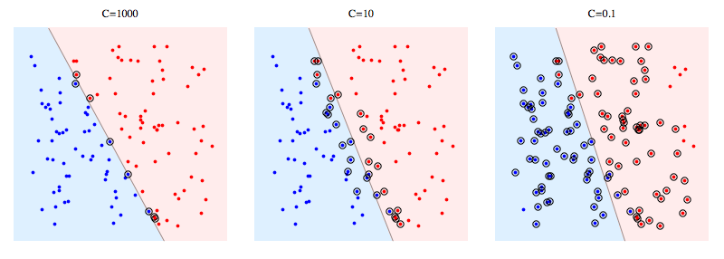
Hyper-parameters:
Penalty (C): Increasing C makes the model move closer to hard-margin. It optimizes how much you would want to avoid misclassifying each training example.
https://github.com/EvEng/papers/blob/master/SVMandSVR.md
Kernel Function: Determines the shape of the discriminating hyper-plane.
  Linear:
  Polynomial (degree d):
  Radial Basis Function (extra hyper-parameter Gamma):
  Sigmoid Function (extra hyper-parameters Gamma and r):
    Sigmoid Function is equivalent to a two-layer ANN

Slide 6
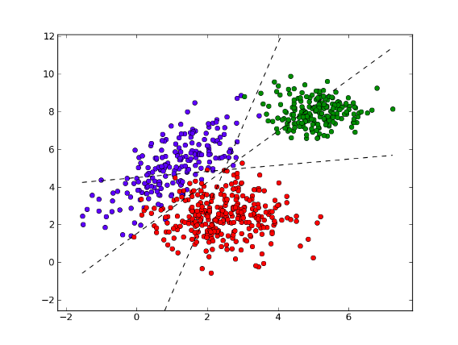
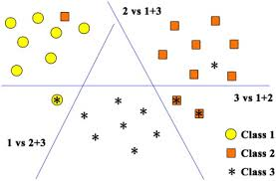
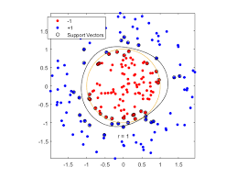
Multi-Classification
OVO
OVR
http://www.writeopinions.com/multiclass-classification
https://doi.org/10.1016/j.neucom.2011.04.024
Gaussian RBF Kernel:
https://it.mathworks.com/examples/statistics/mw/stats-ex18316588-train-svm-classifiers-using-a-gaussian-kernel

Slide 7
Grid Searches
Coarse Grain:
  Train with a large-step range of hyper-parameters, such as C = [0.1, 1, 10, 100, 1000, 10000].
  Compare performance results such as Area Under Curve (AUC) Receiver Operating Characteristics (ROC) in order to find a smaller range of hyper-parameters to test.
  Perform fine grain grid search next with all appropriate ranges of hyper-parameters.
  Fine Grain:
    With prior knowledge of which hyper-parameters perform best on the training dataset, train with a small-step range of hyper-parameters centered around what is guessed to perform the best. Example range would look like C = [0.1, 0.2, 0.3, 0.4, 0.5, 0.6, 0.7, 0.8, 0.9, 1].
  For each choice hyper-parameter C, say 0.1, the SVM must be trained with different values of the kernel hyper-parameter (degree, Gamma, etc.) according to the ranges chosen for the grid search.

Slide 8
Practical Applications
Laufer et al. [1] used an SVM classifier to distinguish between heart and kidney tissues using electrical measurements from the area around the tissues. The tissue type was correctly determined with a specificity of over 90 percent [2].
Tabesh et al. [2] used an SVM classifier with trial and error approach to tuning hyper-parameters for distinguishing heart disease using medical data (ECG data, blood sugar, chest pain, etc.) and medical meta-data (Sex, Age, Ethnicity, etc.).
  The initial experiment had about 65.8% accuracy: 82% accurate on categorical data, and 55% accurate on continuous data.
  Continuous tuning of the hyper-parameters for the Gaussian RBF Kernel and SVM eventually yielded an overall accuracy of 84%.
I trained an SVM classifier using grid searches for linear, polynomial, and RBF Kernels for the vowel-context dataset (digitally recorded vowel sounds) to see what kind of precision I could accomplish (without over-generalization).
  C = 2 and Gamma = 5 results in 94.2% precision and 97.6% ROC AUC for the testing dataset
  97.7% precision and 98.9% ROC AUC for the training dataset
  Implies unbiased generalization.

Slide 9
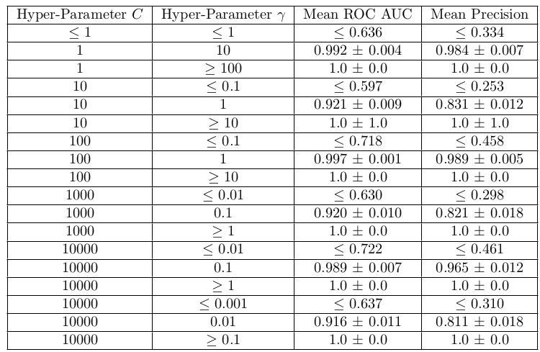
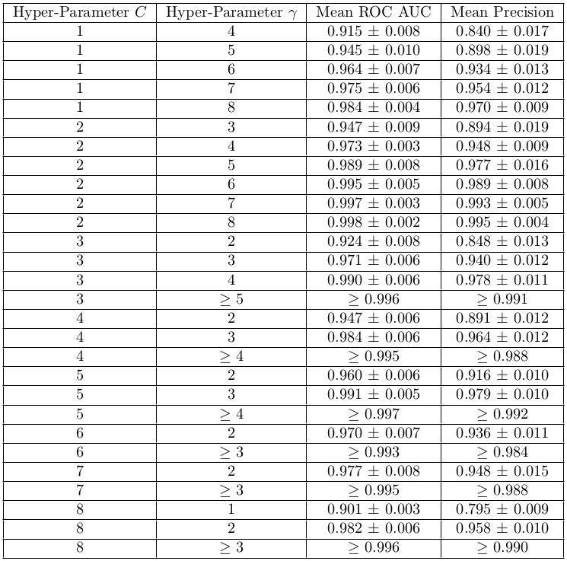
What a Grid Search Looks Like
Coarse Grid Search
Fine Grid Search
  Find the “elbow point”: Where the performance measurements stop increasing drastically, and start leveling off.

Slide 10
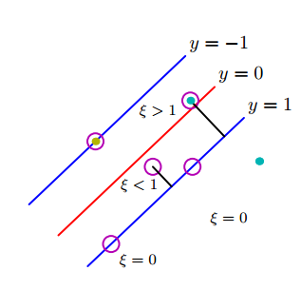
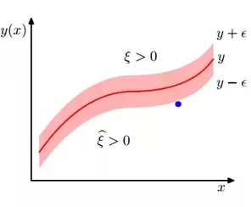
Support Vector Regression (SVR)
SVM
SVR
For SVR we still want to maximize the margin (in order to find the line of best fit).
However, measuring the error is now equivalent to measuring the distance of the points outside of the margin (opposite of SVM).
https://www.quora.com/What-is-the-main-difference-between-a-SVM-and-SVR
In order to maximize the margin and minimize error, we must minimize:
Subject to: and

Slide 11
Useful Python Libraries
from sklearn import preprocessing # For standardizing
from sklearn import svm # For OVO, SVM, and SVR
from sklearn.multiclass import OneVsRestClassifier # For OVA
from sklearn import model_selection # For Grid Search
from sklearn.model_selection import cross_validate # For Cross-Validation
from sklearn.metrics import make_scorer # For Creating Custom Performance Metrics
from sklearn.metrics import average_precision_score # For Calculating Average Precision
from sklearn.metrics import f1_score # For using F1 Score Metric
from sklearn.metrics import roc_auc_score # For using ROC AUC Metric
And of course, import numpy

Slide 12
Relevant Papers
[1] Laufer S, Rubinsky B (2009) Cellular Phone Enabled Non-Invasive Tissue Classifier. PLOS ONE 4(4): e5178. https://doi.org/10.1371/journal.pone.0005178
[2] Tabesh, Pooya & Lim, Gino & Khator, Suresh & Dacso, Clifford. (2010). A support vector machine approach for predicting heart conditions. Full copy available at: https://www.researchgate.net/publication/290542607_A_support_vector_machine_approach_for_predicting_heart_conditions

