Slide 1
Project 3 - msr Ninja-build
Natalie Simtion, Dustin Nguyen, Sawyer Jones & Youa Yang

Slide 2

Agenda
Stage 1 – Issues
Stage 2 – Commits
Stage 3 – Code-size
Stage 4 – Issue Density

Slide 3

Introduction
Our repository for this project is Ninja-Build
https://github.com/ninja-build/ninja
Ninja is a small build system with focus on speed
10+ years on GitHub

Slide 4
issues

Slide 5
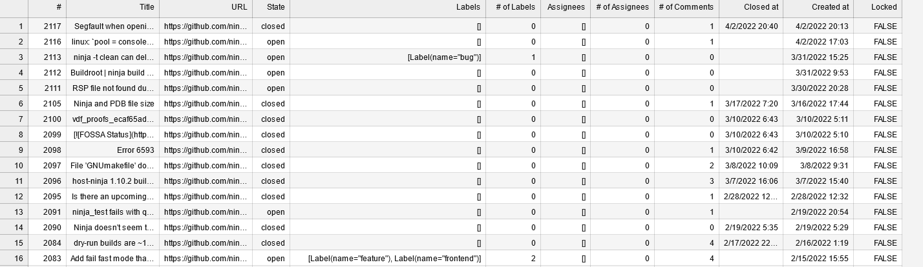
Table – slice of issues data

Slide 6
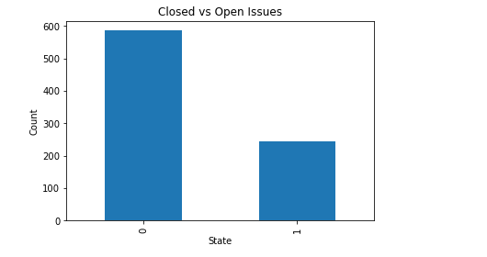
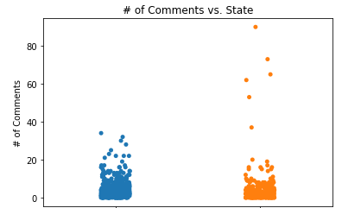
State (0= Closed, 1= Open)
There are more closed issues (>2X) than open issues
Aside for those “few” outliers the # of comments doesn’t seem significant whether an issue is closed or open
Our repo did not have data for assignees or # of assignees for issues

Slide 7
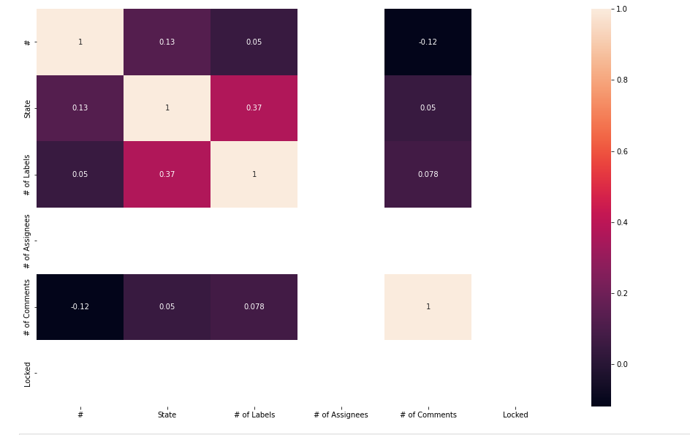
CORRELATION HEATMAPS
Correlation heatmap for all numeric attributes
Heatmaps could indicate relationships of attributes to each other
Heatmap for our datea indicates a positive relationship between State (Open/Closed) and # of Labels
Note: not all correlation may be meaningful
Notes:
Relationships of attributes to each other, only for numerical attributes. Seems that the # of Labels have a correlation to the State.

Slide 8
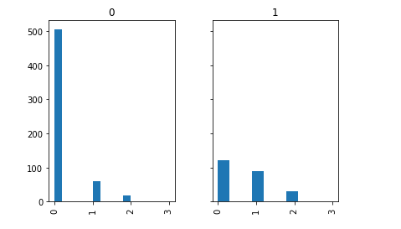
State vs # of labels
State (0= Closed, 1= Open)
Overall are a lot of Closed and Open issues without labels
More Open issues have more labelling

Slide 9
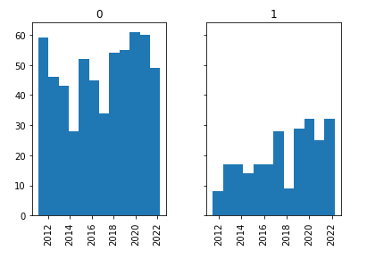
Issues state over project lifetime
Overall, there doesn’t appear to be a trend for closed issues over the lifetime of the project
There is a positive trend in number of open issues over the lifetime of the project

Slide 10
commits

Slide 11
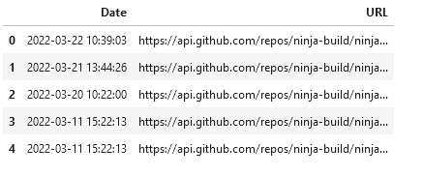
Table – slice of commits data

Slide 12
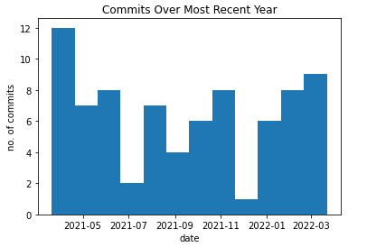
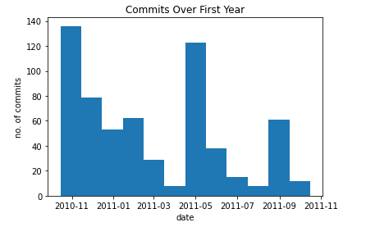
COMMITS
YTD – No obvious pattern
FIRST YEAR – Repeated downward trend with spikes

Slide 13
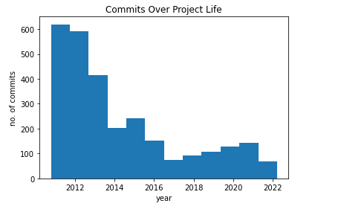
COMMITS
DOWNWARD TREND OF NUMBER OF COMMITS AS THE PROJECT AGED

Slide 14
Code size

Slide 15
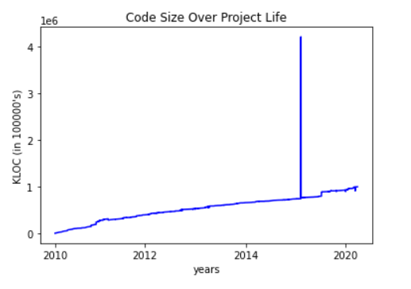
Code Size
Upward trend in code size as commits are published
Code Size anomalies:
2017-04-12 4215484 lines
2017-04-12 4215477 lines
Fairly monotonic
Domain of date/time
Codomain of KLOC

Slide 16




QUESTIONS?

