Slide 1
Exploratory Data Analysis (EDA) in Regression
Purpose, tools, and role in regression modeling

Slide 2
Purpose of EDA
Understand structure and scale of variables
Detect anomalies and data quality issues
Assess plausibility of regression assumptions
Inform model specification and transformations

Slide 3
EDA vs Regression Modeling
EDA: descriptive, flexible, model-free
Regression: inferential or predictive, formal
EDA should precede model fitting and inference

Slide 4
Univariate EDA: Response Variable (Y)
Examine distribution and scale of the response
Identify outliers or extreme values
Assess suitability for linear modeling

Slide 5
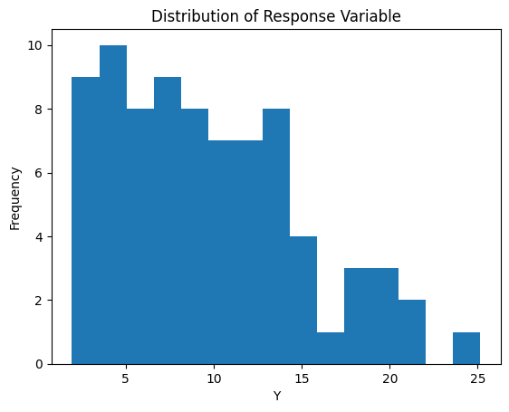
Histogram of Response Variable

Slide 6
Univariate EDA: Predictor Variables (X)
Check ranges and plausibility of predictors
Identify skewness and leverage risks
Determine variable type (continuous vs categorical)

Slide 7
Bivariate EDA: Predictor–Response Relationships
Scatterplots assess linearity and association
Reveal curvature, heteroskedasticity, and clusters
Most important EDA tool for regression

Slide 8
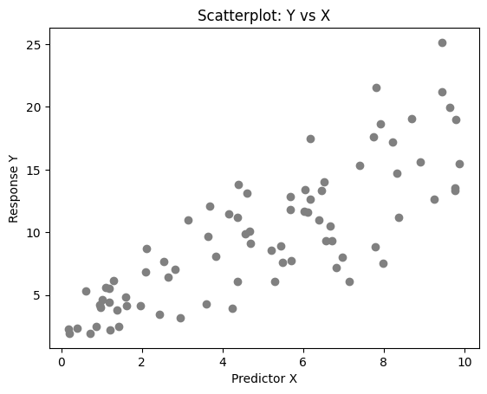
Scatterplot for Linearity Assessment

Slide 9
Grouped and Conditional Plots
Reveal interactions or effect modification
Assess whether a single regression line is appropriate

Slide 10
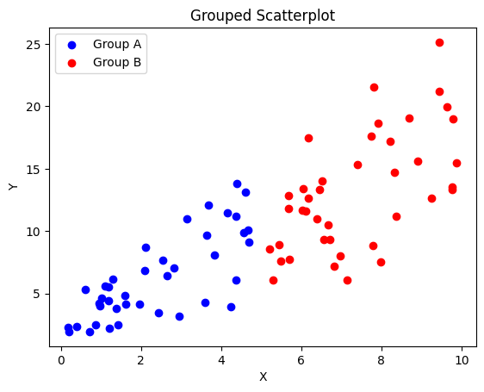
Grouped Scatterplot Example

Slide 11
EDA for Assumption Assessment (Pre-Model)
Linearity: shape of Y vs X relationship
Constant variance: visual spread across X
Independence: temporal or spatial structure

Slide 12
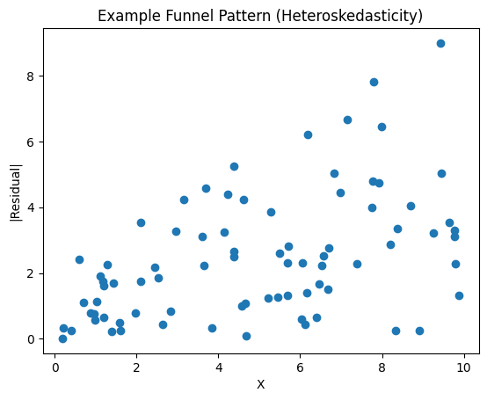
Example of Non-Constant Variance

Slide 13
EDA and Transformations
Log or square-root transforms for skewness
Centering or scaling predictors
Choose transforms before formal inference

Slide 14
EDA vs Regression Diagnostics
EDA uses raw data; diagnostics use residuals
EDA is model-free; diagnostics are model-dependent
Both are necessary but answer different questions

Slide 15
EDA in the Regression Workflow
Data cleaning
Exploratory Data Analysis
Model specification and fitting
Diagnostics and inference

Slide 16
Common Pitfalls in EDA
Over-interpreting visual patterns
Letting EDA drive inference
Failing to document EDA-driven decisions

Slide 17
Summary
EDA is essential for understanding data structure
Helps anticipate assumption violations
Improves regression when used as a guide, not a substitute for inference

