Slide 1

Clotho
Meredith White
Dustin Ruck
Soliloquy Yarrow

Slide 2
Background
Peer-to-peer marketplace app like the fashion platform Depop
Buy and sell on the same platform
Make purchases from multiple sellers

Slide 3
Depop Features
Complex searching
Suggestions
Promotions
Product likes
User follows
Seller shops
Seller reviews
Purchasing options
Buy now or offers
Payment options

Slide 4
Clotho Features
Users:
Sign up, log in/out
Browse products
Search and filter results
Browse seller shops
Place orders
Post items for sale
Manage profile
Admins:
Log in/out
Manage user accounts
View charts
View product tables

Slide 5
Our approach
Initial roles:
Meredith: back end
Soli: front end
Dustin: cloud technologies
Later:
Task rotation

Slide 6
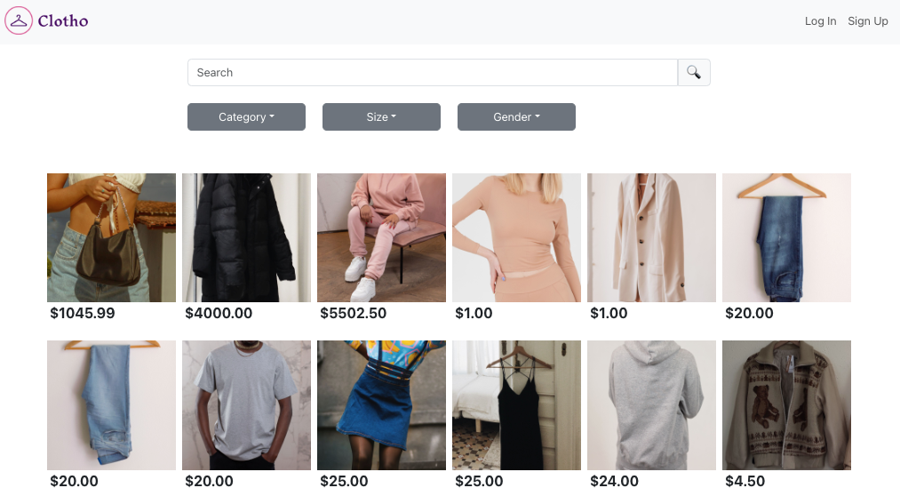
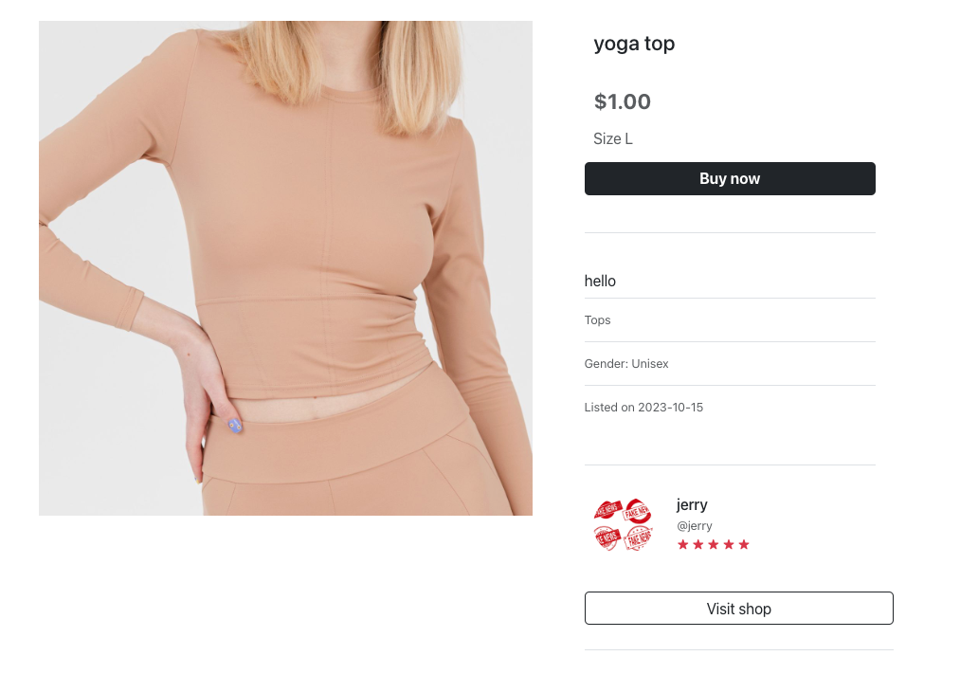
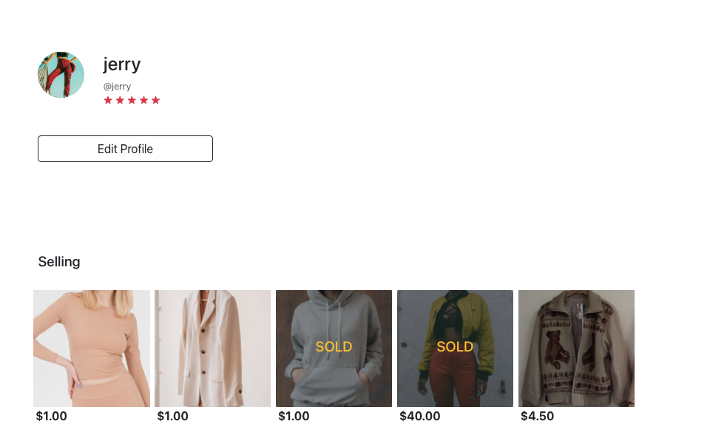
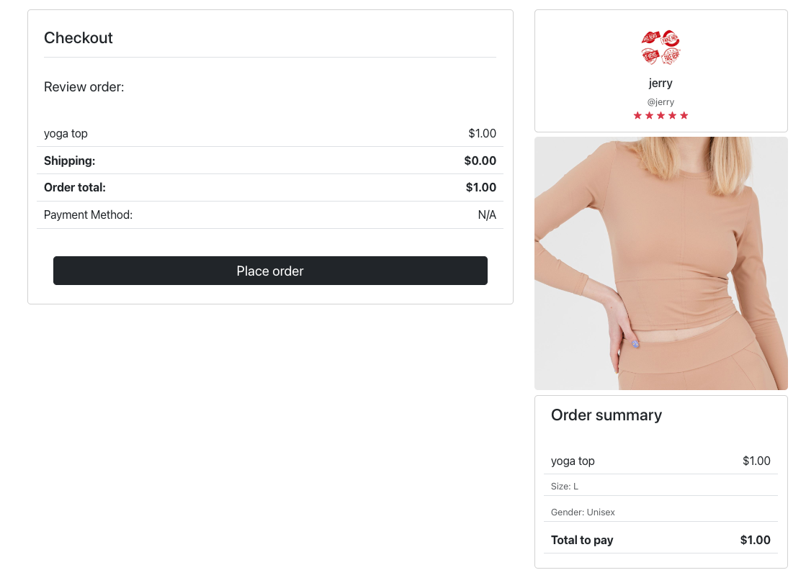

Slide 7
Challenges & Solutions

Slide 8
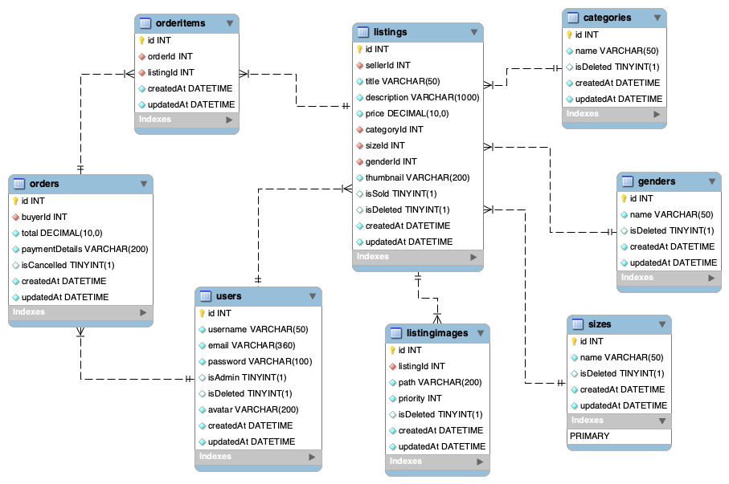

Slide 9
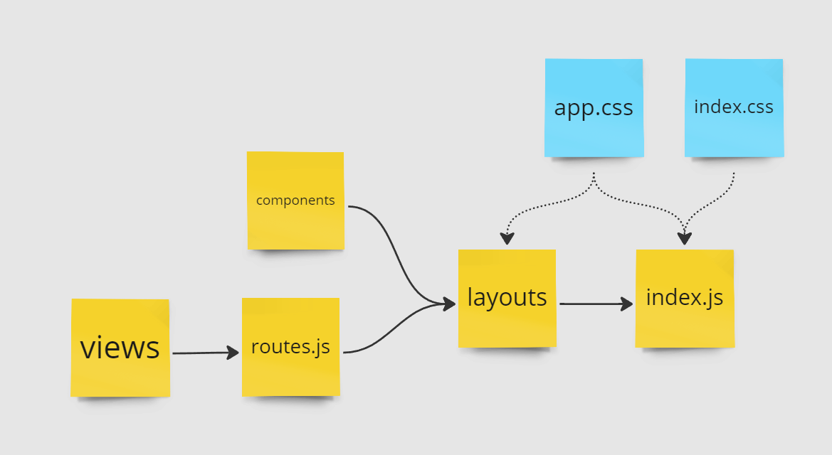
Challenge: Props & routing

Slide 10
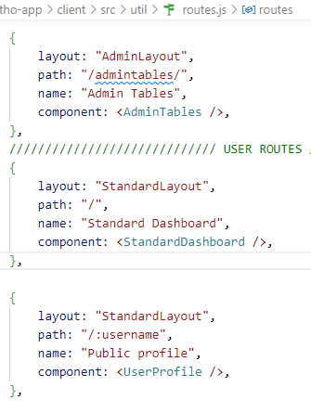
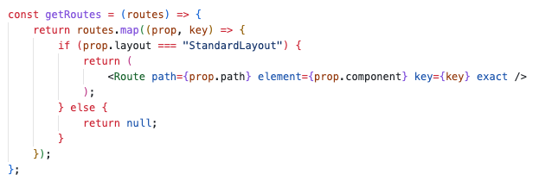
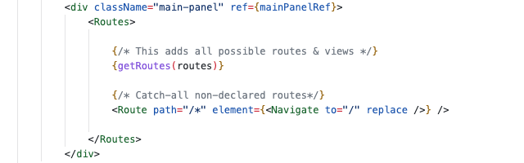
Layout
Routes.js
Route map

Slide 11
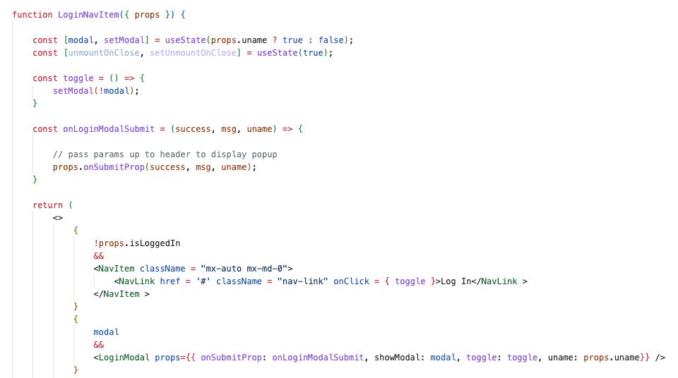
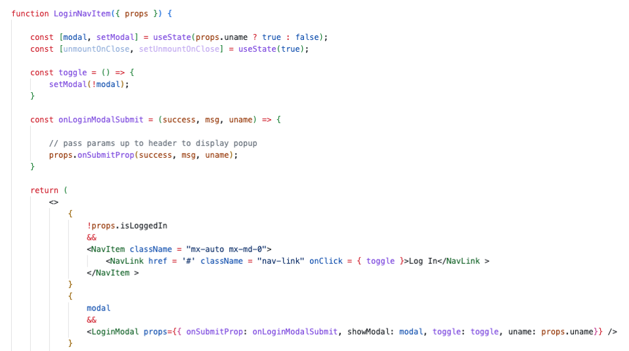
Functions as Props
Flash Message
Autofill
Login Form

Slide 12
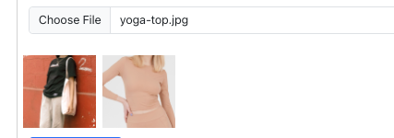
Challenge: s3 Images
Neither files nor URLs stored in database
Saving and exposing images requires sequential requests

Slide 13
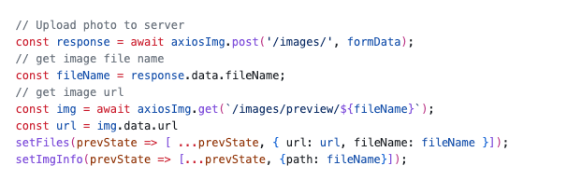
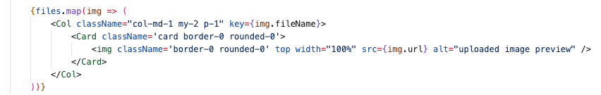
Images Solution

Slide 14
New learning

Slide 15
Meredith: request & response intercepts
Users are given two tokens on login
Expired tokens do not grant access
Expired tokens need to be refreshed by API via ’/refresh’
Intercepting requests with expired tokens allow refreshes happen seamlessly

Slide 16
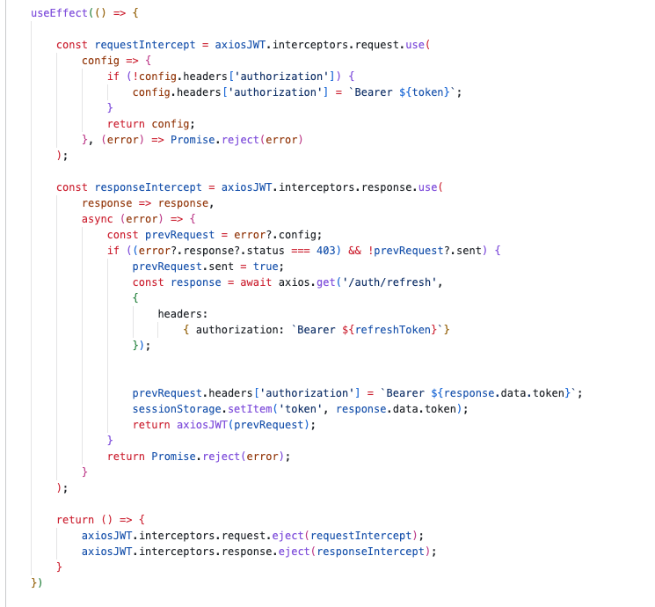
Intercepting requests & responses

Slide 17
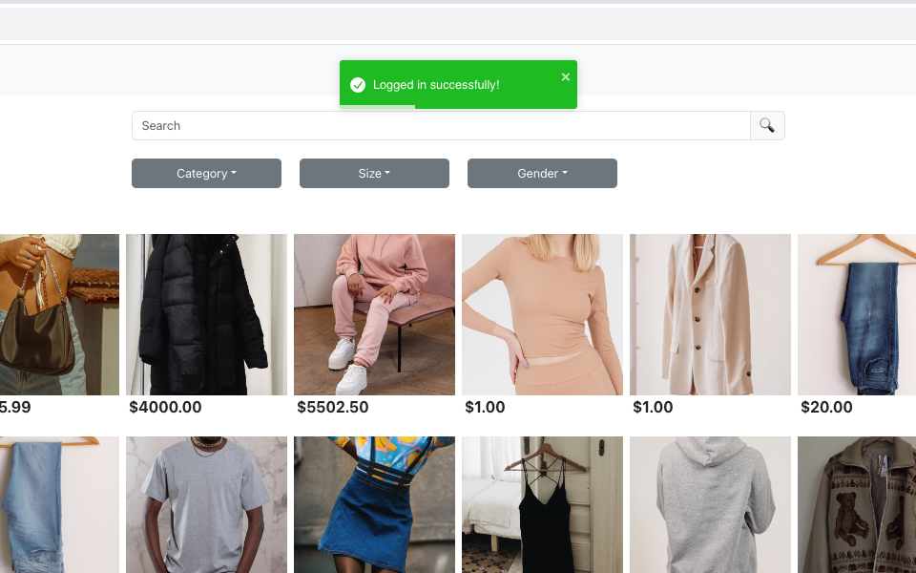
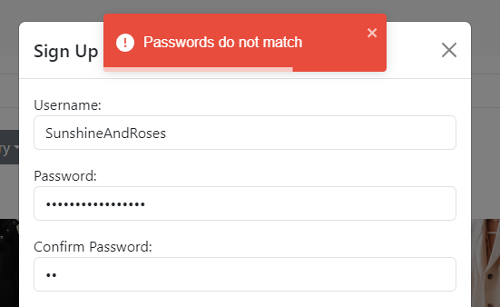
Soli: Flash Messages

Slide 18
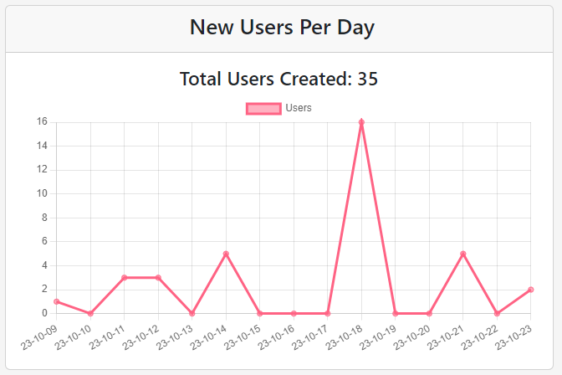
Soli: Charts

Slide 19
Future work
Additional features:
Shopping carts
Stripe payments
Likes, follows, messages

Slide 20
Summary
Successes:
Simple yet cohesive
Realistic look and feel
Quality over quantity

