Slide 1
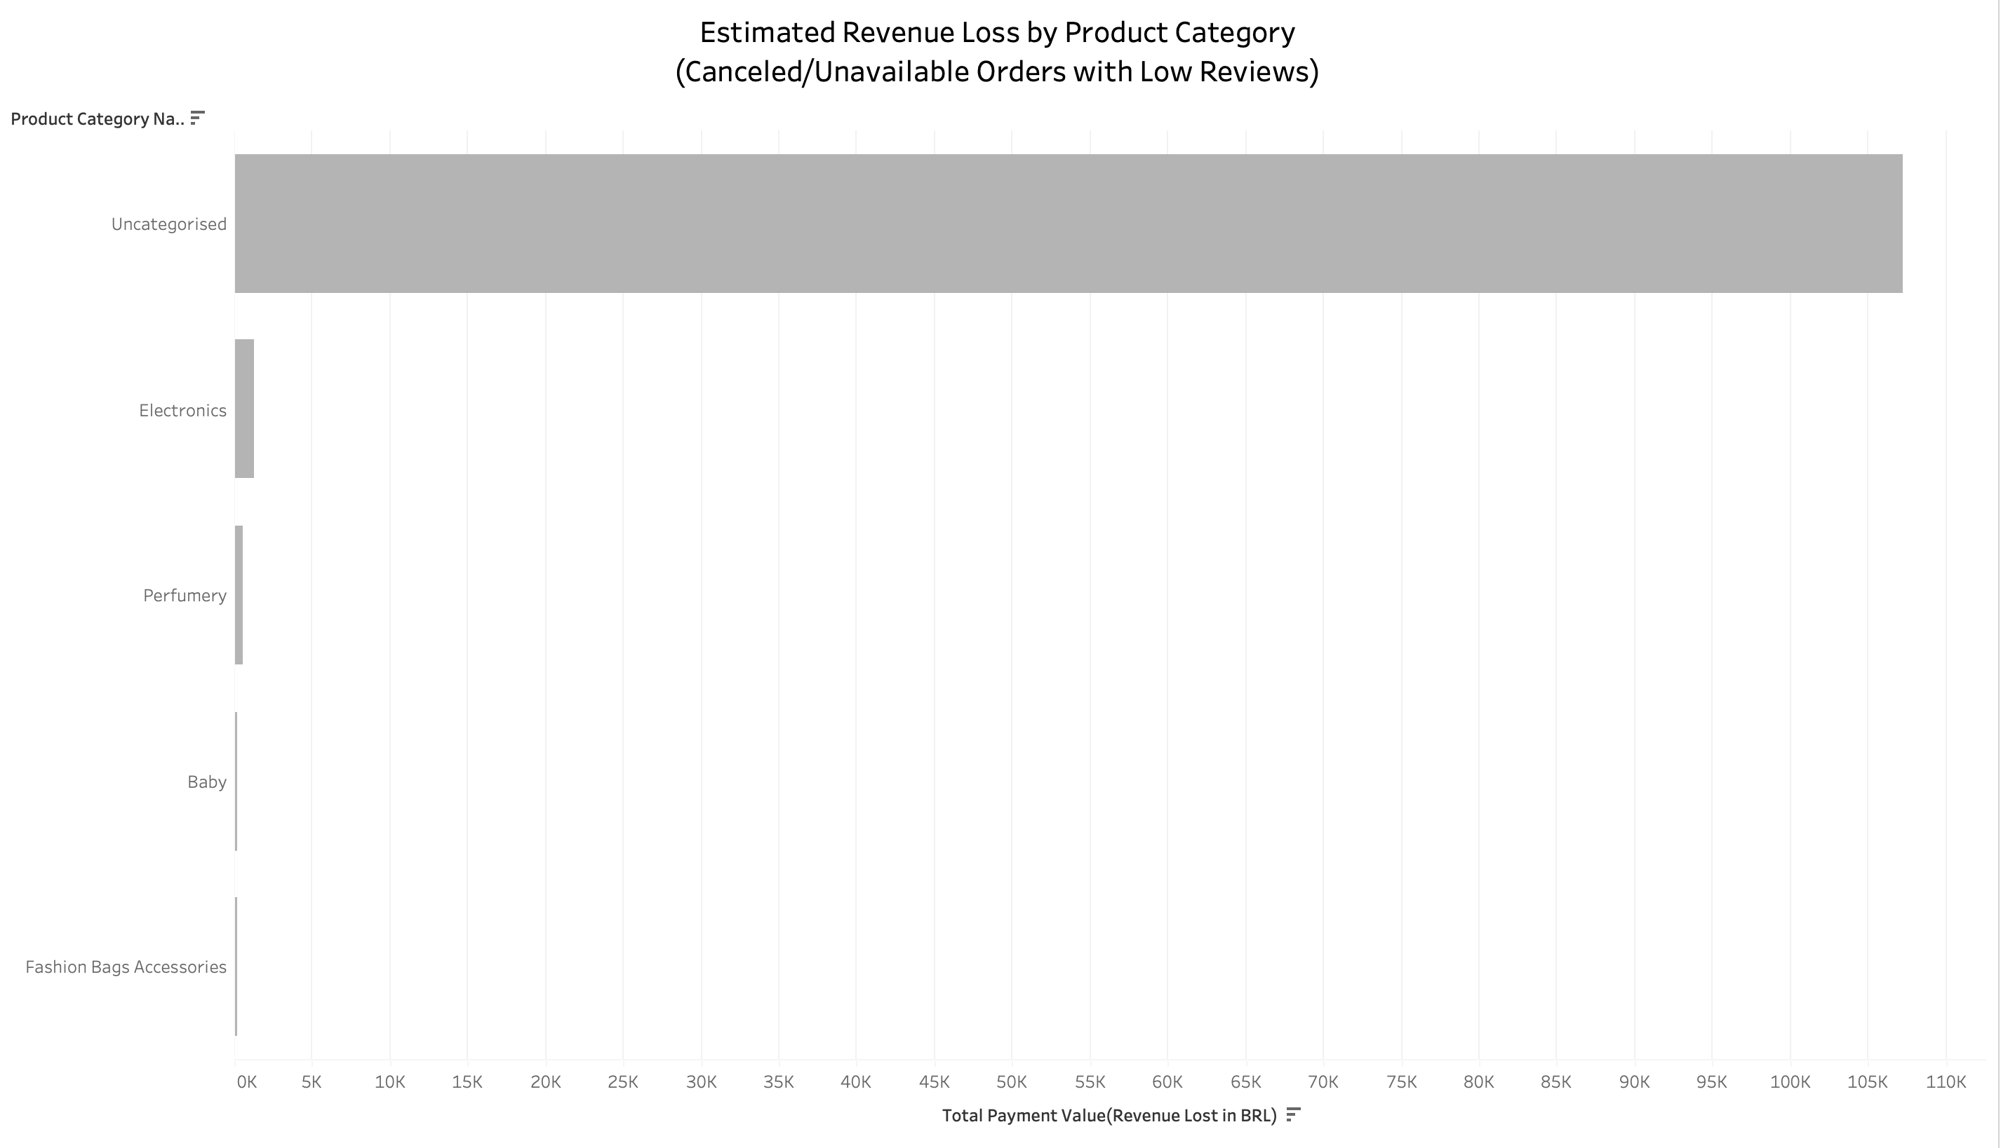
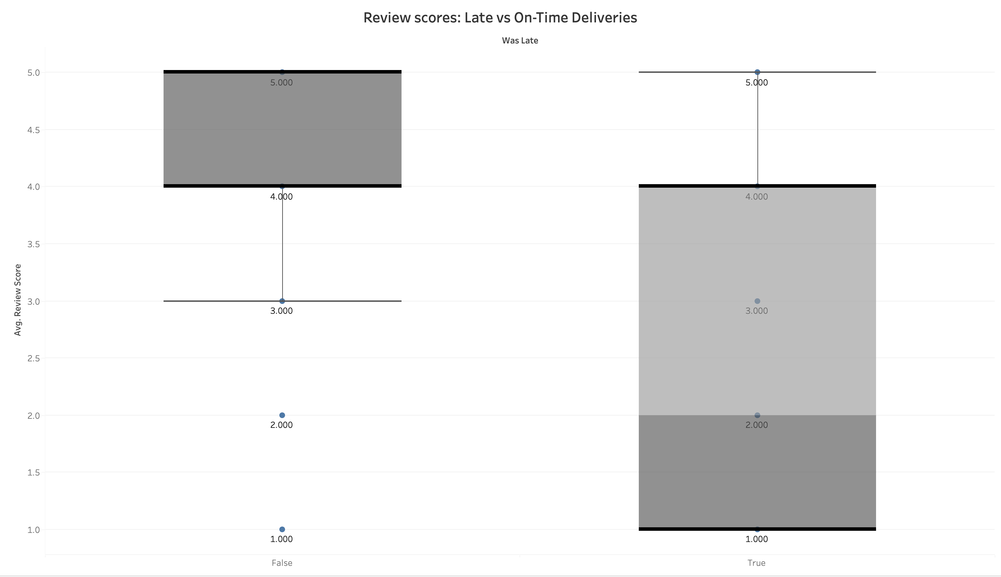
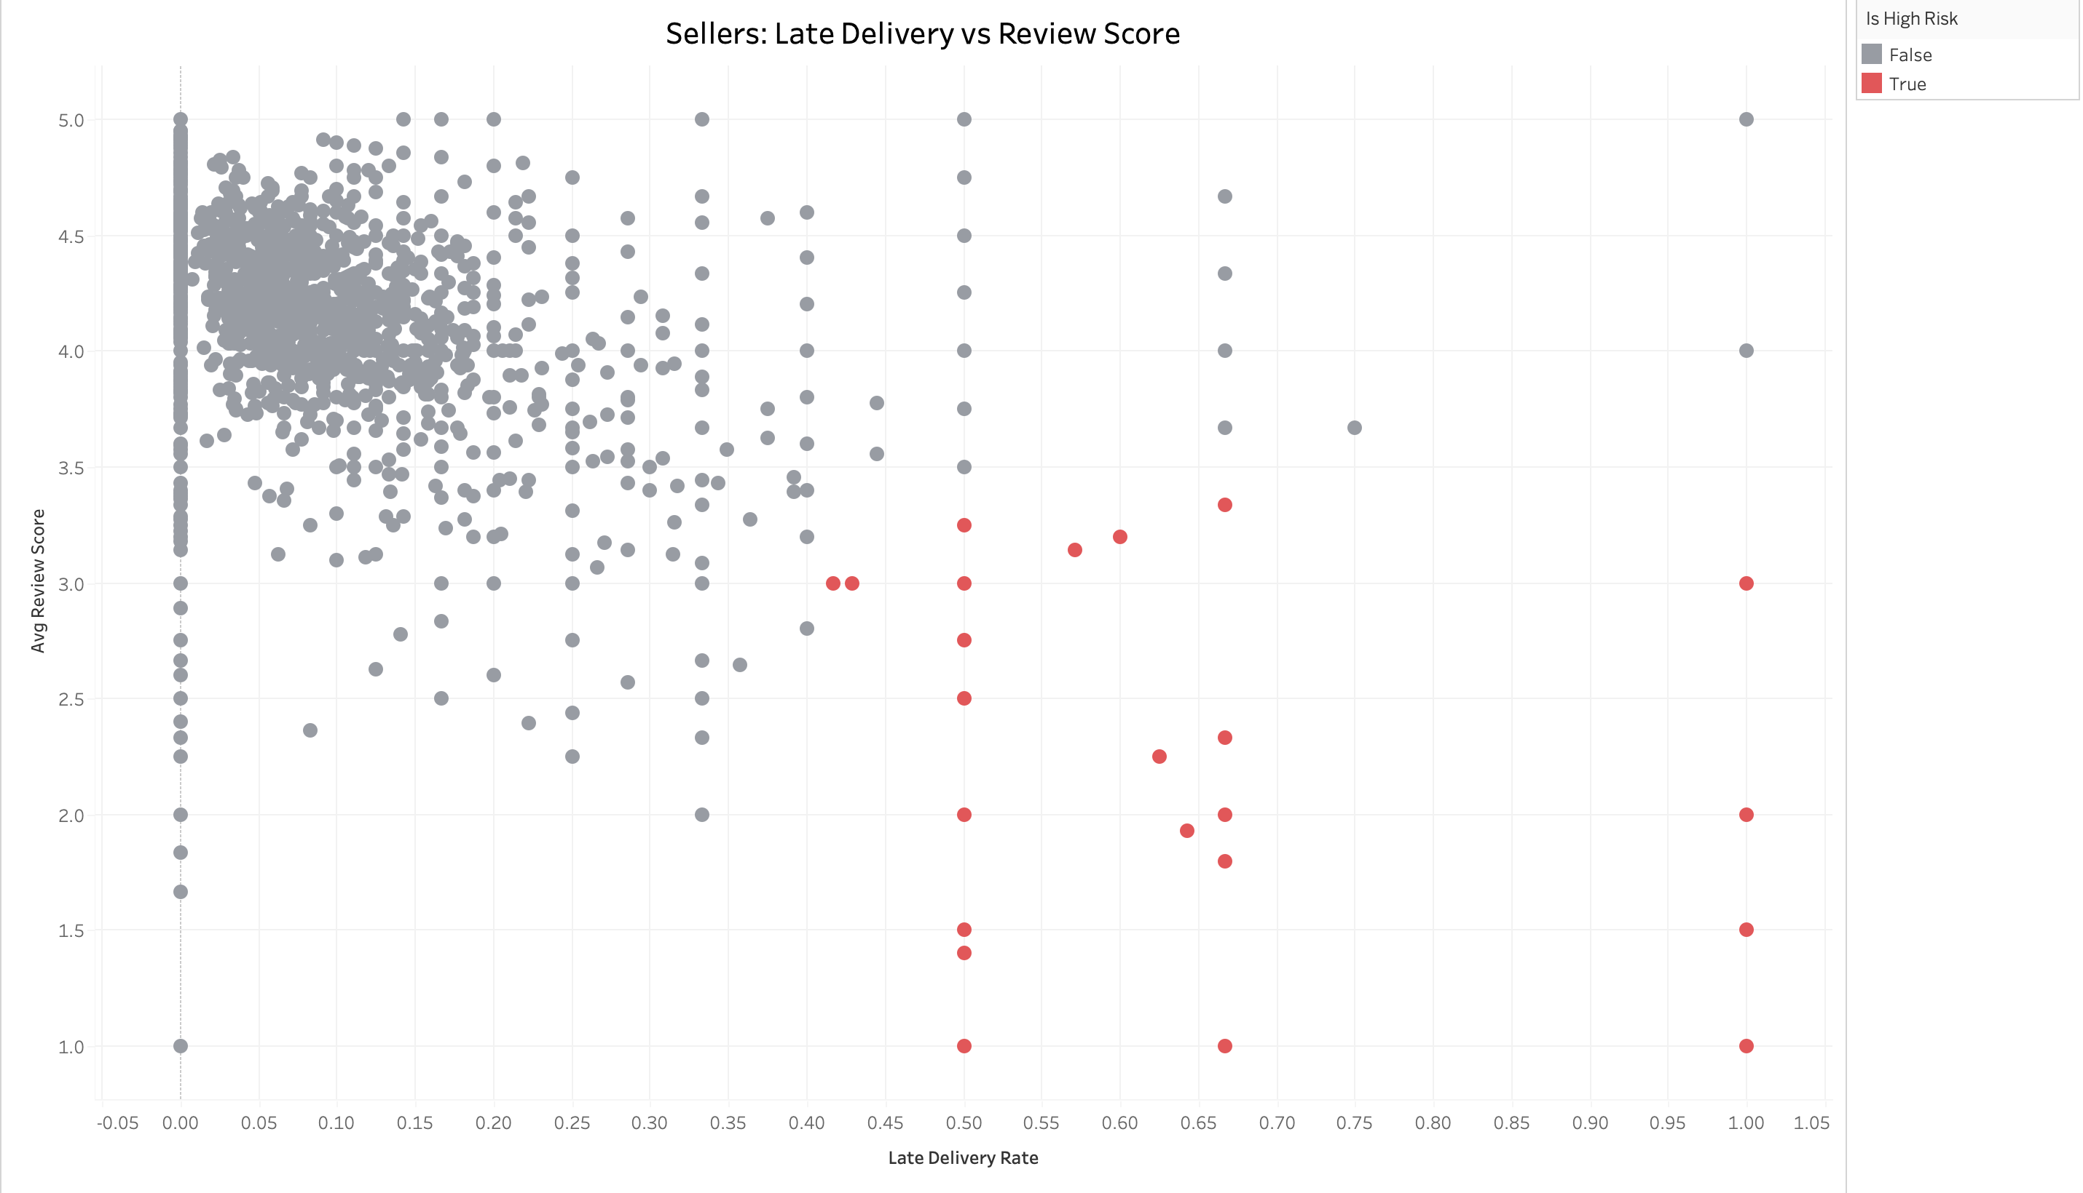
Return-Driven Revenue Loss: A Brazilian
E-Commerce Olist Store Analysis
BY DUSTIN SHERRATT
TOTAL ORDERS
95,697
AVERAGE REVIEW SCORE 2.56 (LATE)
HIGH RISK SELLERS
76
BUSINESS CONTEXT
Olist, a large Brazilian e-commerce marketplace, partners with thousands of third-party sellers to deliver products to customers across the country. Despite strong order volume, the platform faces a recurring challenge: a significant portion of orders are either cancelled, unavailable, or lead to customer dissatisfaction due to delayed delivery or poor seller behaviour.
These fulfilment failures not only result in revenue loss, but also erode customer trust and lead to increased returns, support costs, and negative reviews.
This analysis investigates the root causes of these failed transactions-highlighting key risk areas across delivery performance, product categories, seller reliability, and geographic distribution-so that Olist can optimize platform operations, improve customer experience, and reduce return-driven losses.
METHODS
Tools Used: Python (Pandas, Seaborn), Tableau,
Excel, Google Colab
Data Source: Olist Brazilian E-commerce Dataset
(Kaggle) – 9 linked CSV files
Merges: Joined on order_id, customer_id, seller_id,
zip_code_prefix
Data Cleaning & Preparation:
Removed duplicate orders and reviews
Standardized inconsistent city/state names using
fuzzy matching
Mapped ZIP codes to most frequent cities and
full state names
Translated product categories to English and filled
missing values
Filtered orders with valid chronological timestamps
and key fulfilment statuses
ANALYSIS
Approximately 8% of all curated orders were marked as cancelled or unavailable, directly contributing to lost revenue. These failures were concentrated in categories like Uncategorised, Electronics and Perfumery, highlighting operational friction.
Using a binary flag ‘was_late’, it was found that late orders received 1.5 fewer stars on average compared to on-time ones. This confirms that delivery delays are a strong predictor of negative customer sentiment.
Some sellers had Late delivery rates > 40% and Average review scores below 3.5. By combining these two metrics, we identified a group of 76 high-risk sellers responsible for a disproportionate share of low satisfaction orders.
States like São Paulo and Rio de Janeiro had higher concentrations of problematic orders, likely due to volume and logistics complexity.
CONCLUSION
This project revealed the key operational breakdowns driving revenue loss on the Olist platform. Through curated and merged datasets, we found that:
Late deliveries significantly reduce customer satisfaction, often resulting in poor reviews.
A small group of high-risk sellers consistently contribute to delayed, low-rated, and uncategorised orders.
Certain product categories are more prone to fulfilment issues.
Poor product listing practices, like using “uncategorised” labels, hurt discoverability and trust.
By targeting these risk points, Olist can take data-driven action to:
Prioritize logistics performance
Flag or retrain low-performing sellers
Enforce better product categorization
Explore the interactive visualizations : Tableau

