Slide 1
ARL RFE Project
Group: F15.D4
Devs : Micah Ramirez, Dustin Stone, Sean Cascketta

Slide 2
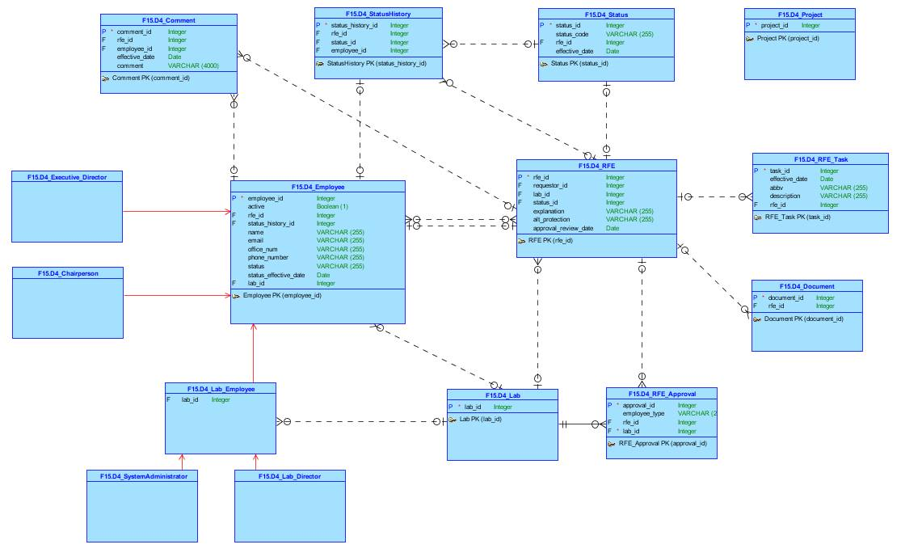
Conceptual Model

Slide 3
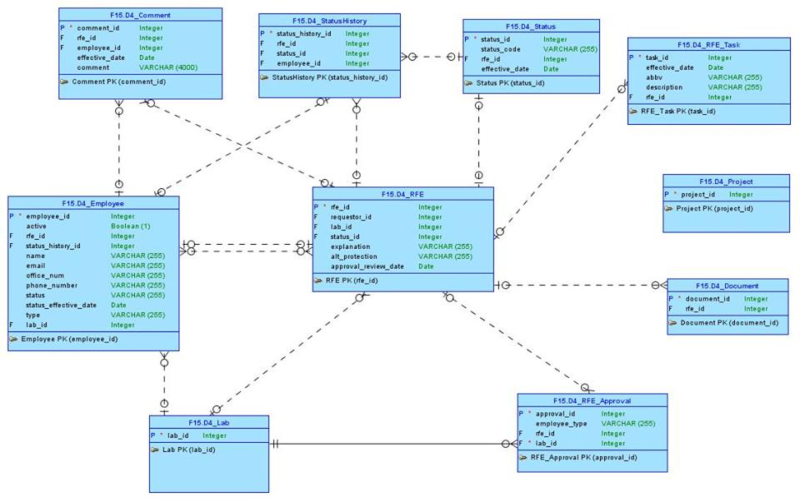
Logical Model

Slide 4
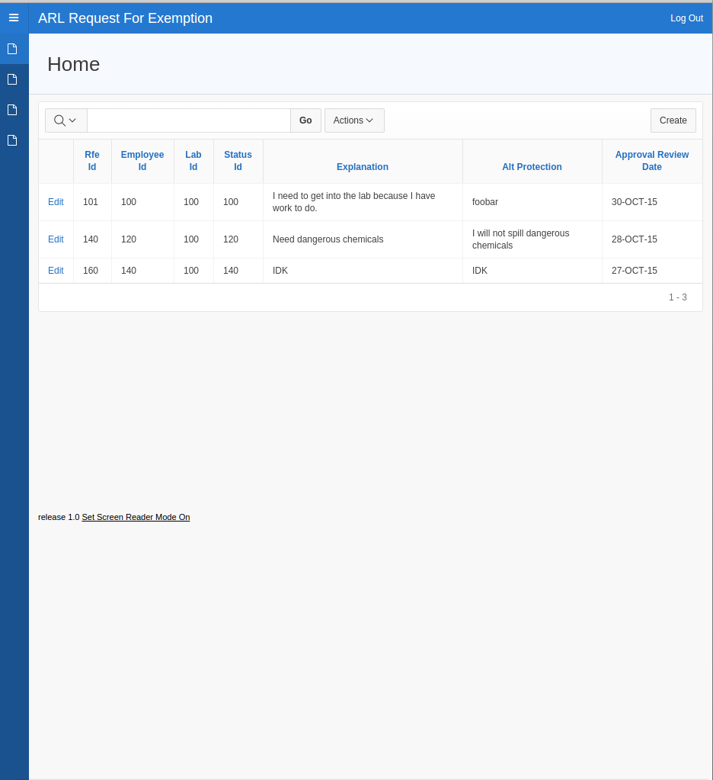
Apex Application

Slide 5
Questions for Customer
Should anyone be able to make an RFE request (Chair person, Exec director, etc)?
What are the responsibilities for a contact ?
What is an FYI Reviewer? What can they do? Similar to a CC email?
What information is necessary for a system admin, lab director, chair person, or executive director to make a decision on whether or not to approve a person?
2-3 more concrete examples of RFE requests?
Beyond 'Inbox', 'Previous RFEs', and 'ADV Search', what else would a user with approval privileges want to see?

Slide 6
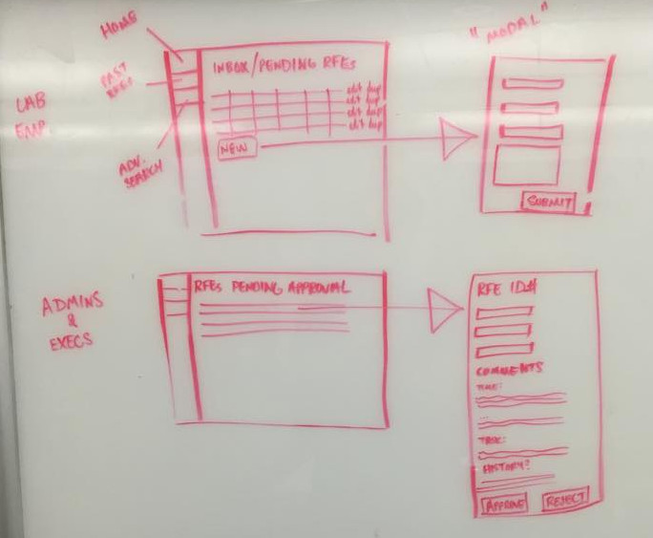
User Workflow

Slide 7
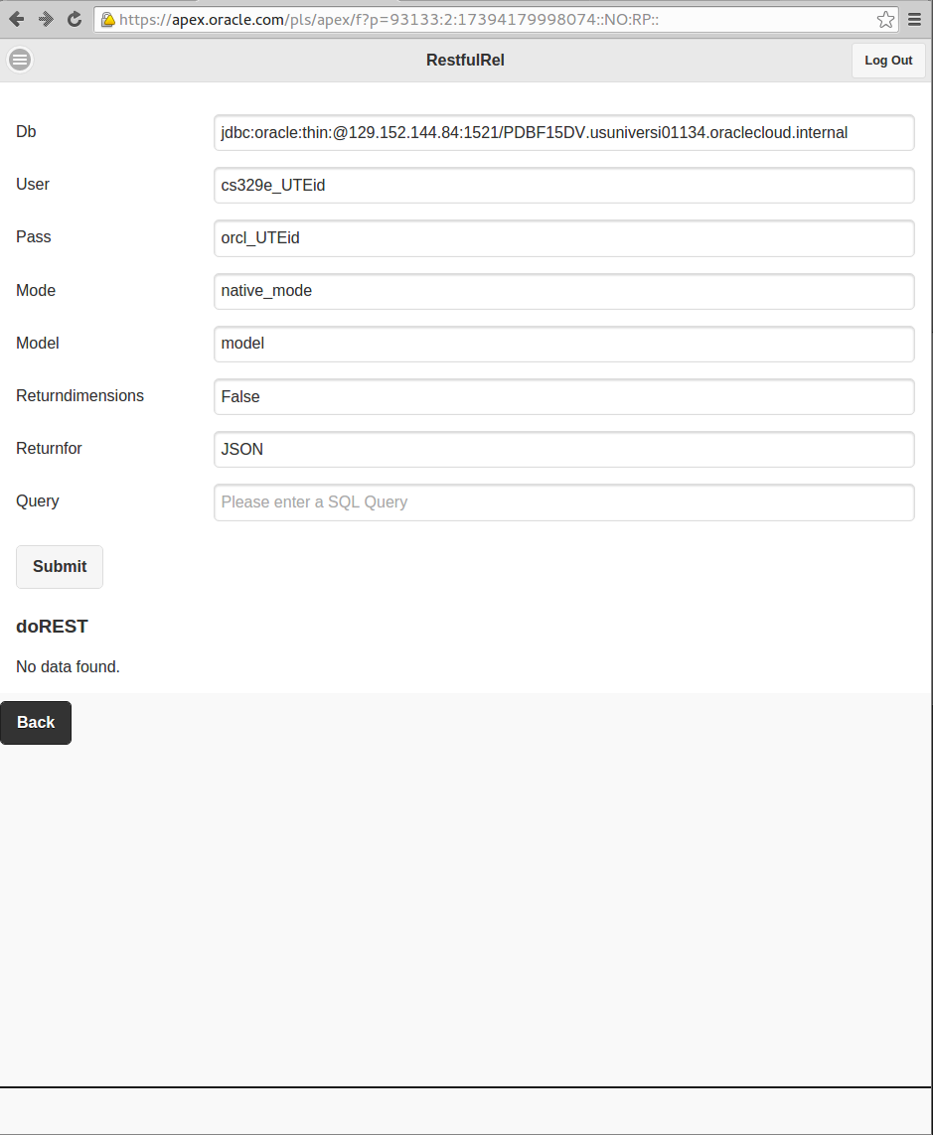
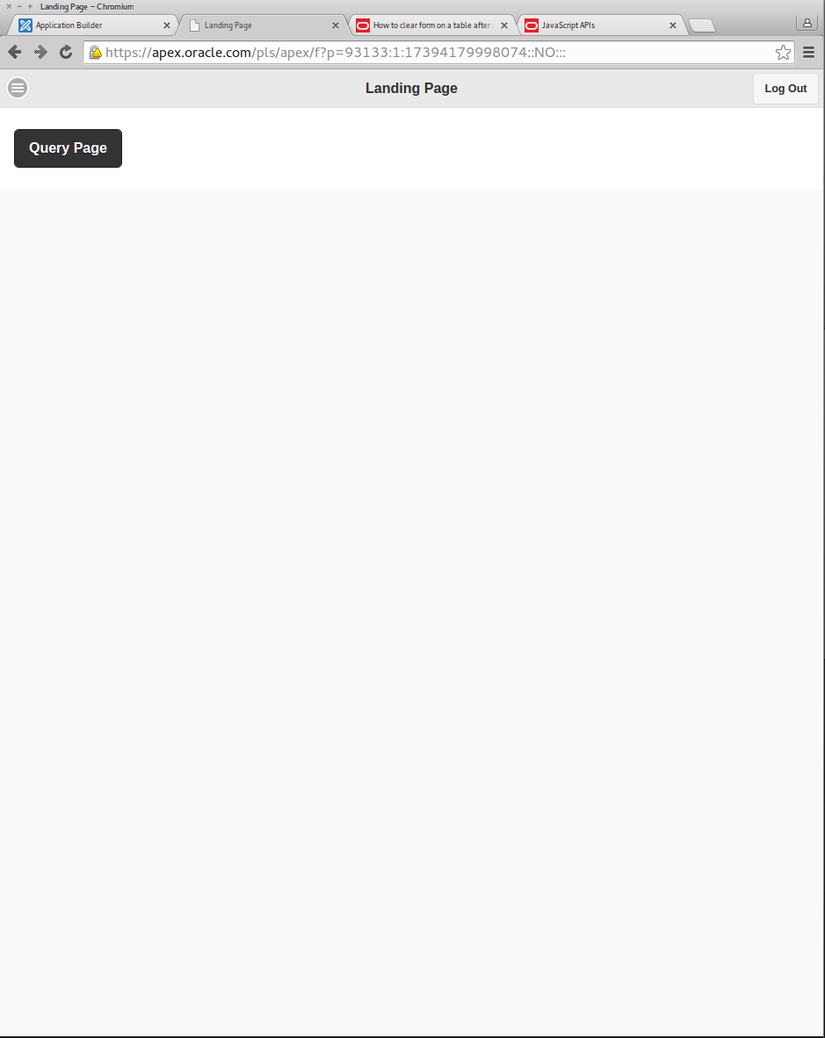
RESTful Mobile App

Slide 8
Questions?

