Slide 1

FastAI 101
Dustin VanStee - Data Scientist
Bob Chesebrough -Data Scientist
AI Center of Compentency
IBM Worldwide Client Experience Centers
AI Immersion

Slide 2
FastAI 101 - Agenda
Why FastAI ?
FastAI Concepts
Databunch
Learner
LRFind /One Cycle Learning
Transfer Learning
Interpretation

Slide 3

a few words on FastAI Cofounder Jeremy Howard

Slide 4
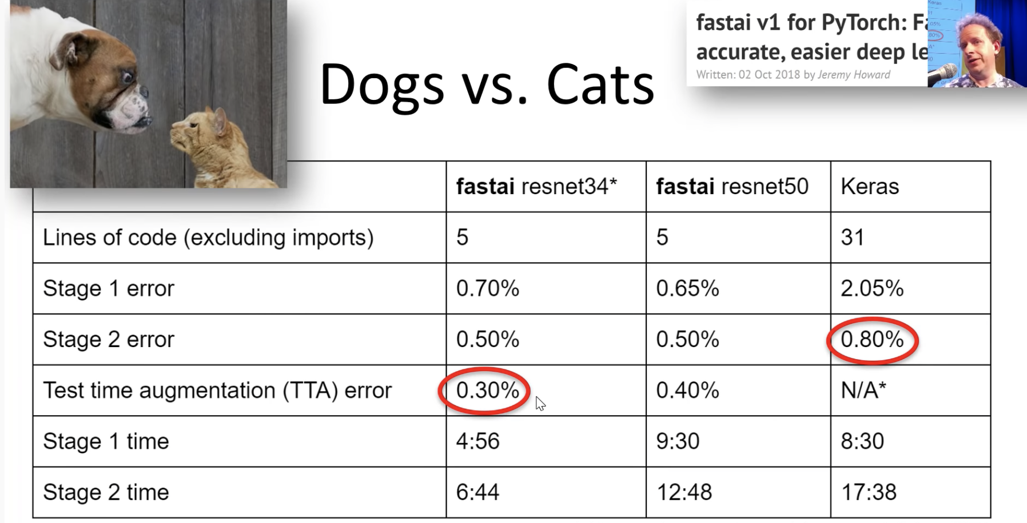
What is FastAI?
Deep Learning Framework built on top of PyTorch
Incorporates best practices learned from experts (training / simplicity)
Easy to use examples
World class results!
Flexibility to extend to custom problems
Built on top of PyTorch framework
Vibrant user community
Excellent educational material
videos : https://course.fast.ai/
repo : https://github.com/fastai/course-v3
Notes:
learning leverages a top down approach. get results relatively quickly, and then peel back the onion successively for more and more understanding

Slide 5
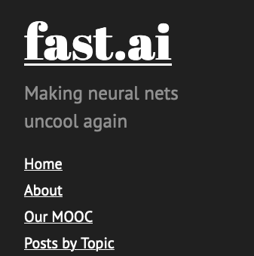
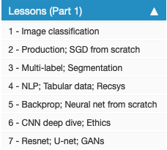
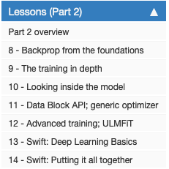

Slide 6
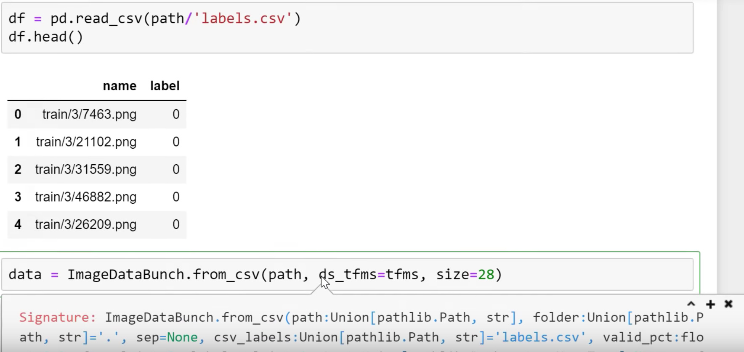
FastAI Concepts – Databunch
Abstraction that helps manage train / validation datasets
Supports all types of data (Image / text / tabular)
Flexible to support meta data files that contain labels

Slide 7
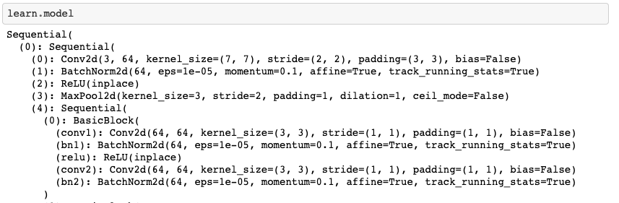
FastAI Concepts – Learner
Learner is fastAI abstraction that holds the neural network architecture and the methods to train it

Slide 8
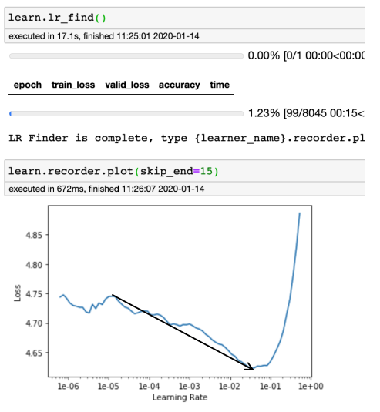
FastAI Concepts – Learning Rate Find
According to Jeremy Howard the most important hyper-parameter to tune of any NN model is the learning rate. FastAI implements an lr find algorithm that steps through different learning rates and plots losses. For detailed information look here https://sgugger.github.io/how-do-you-find-a-good-learning-rate.html
This method is somewhat empirical, but in practice works very well.
Goal on any plot is to find the longest downward slope and use thes as bounds for fit one cycle

Slide 9
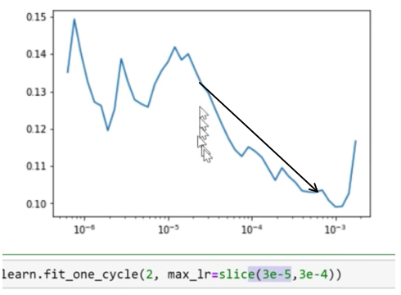
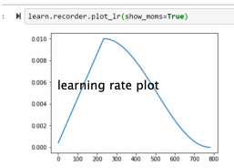
FastAI Concepts – One Cycle Learning
Traditional training methods use a fixed learning rate or learning rate schedules to find a decent solution to the NN optimization problem. Issues here the speed at which you find the minimum, and how close the local minimum is to global minimum.
Fit one cycle takes a different approach. They sweep learning rates as show above right to find optimal solution. Why does this work ? -> (https://arxiv.org/abs/1506.01186)
Notes:
An intuitive understanding of why CLR methodswork comes from considering the loss function topology.Dauphinet al. [4] argue that the difficulty in minimizing theloss arises from saddle points rather than poor local minima.
Saddle points have small gradients that slow the learningprocess. However, increasing the learning rate allows morerapid traversal of saddle point plateaus. A more practicalreason as to why CLR works is that, by following the meth-ods in Section 3.3, it is likely the optimum learning rate willbe between the bounds and near optimal learning rates willbe used throughout traini
in other words the small LR starts us in the right direction and continual growing accelerates us in right direction, until point where we need to decay to stabilize...
Faster convergence and better training results are the end product of the algorithm and its what FastAI implements

Slide 10
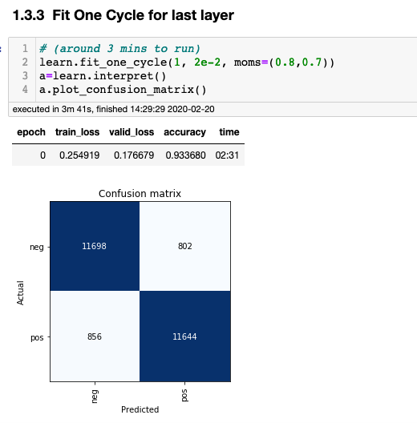
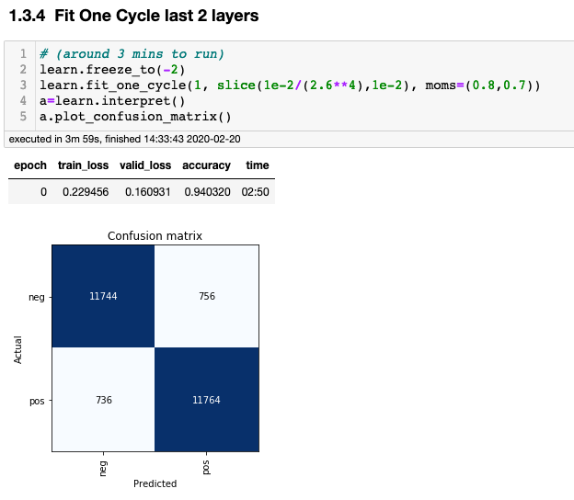
FastAI Concepts – Transfer Learning / Unfreeze layers
FastAI leverages transfer learning for most of its examples, and employs a couple of other tricks along the way. One example of this is layer unfreezing ...
NLP example showing successive layer “unfreezing” – provides incrementally better accuracy

Slide 11
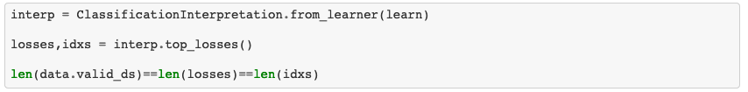
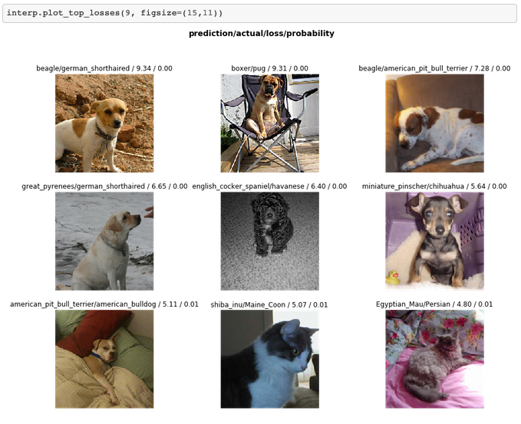
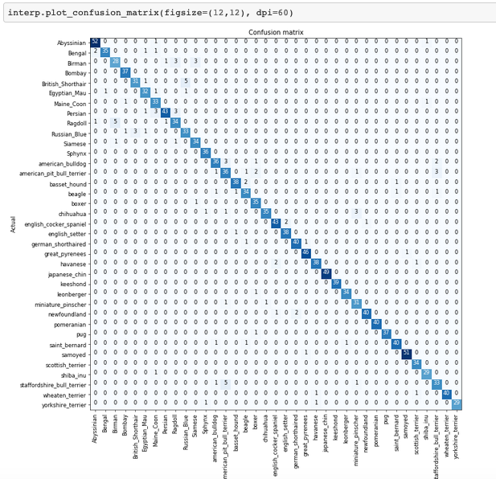
FastAI Concepts – Plot Top Losses / Confusion Matrix

Slide 12
FastAI Concepts – Put it all together with a demo!

