Slide 1

NLP 101
Dustin VanStee - Data Scientist
Bob Chesebrough -Data Scientist
AI Center of Compentency
IBM Worldwide Client Experience Centers
AI Immersion

Slide 2
Agenda
NLP 101 – Sentiment Analysis
Using natural language to classify
sentiment analysis using IMDB
-- apply xfer learning with wiki text 103
build a language model first
-- language model (being able to predict the next word probablistically
-- then tune using IMDB corpus
-- finally classify!
Notes:
(add commentary on how IBM power can accelerate usage of pytorch)

Slide 3
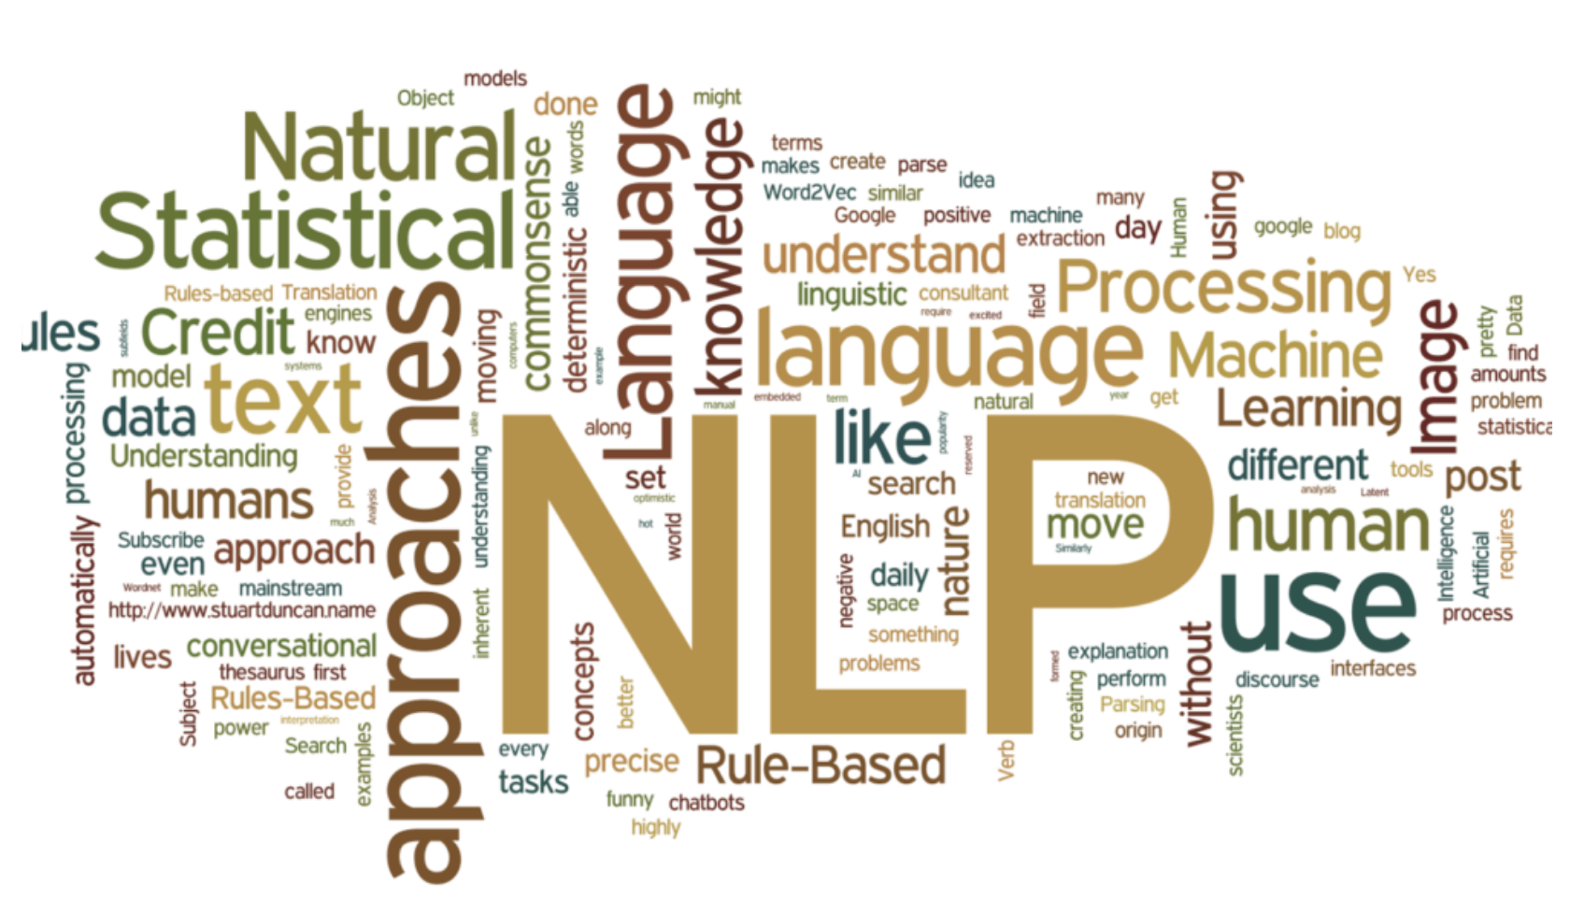
NLP Use Cases
Classical Method Used
Naive Bayes
SVM
Logistic Regression
Tree Methods
Uses
Sentiment Analysis
Document classification
Spam filtering
Topic modelling
Word Embeddings
The issue with these methods is that they don’t know anything about the English language!
Can we apply large data, transfer learning and deep learning neural networks in this space ??
YES!

Slide 4
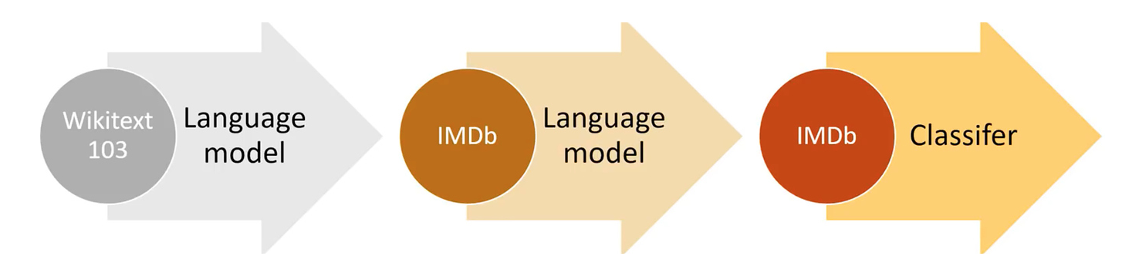
Transfer Learning with NLP – motivating example
MovieLens dataset
Contains movie ratings data from users
100k ratings
The issue here is that there isn’t enough data to sufficiently learn language subtleties
What if we first train NN to “learn” english semantics using a much larger corpus of data (like wikipedia) ?
Then ”fine tune” language model with our data ..
Then take the knowledge [embeddings] from the language and use for classification

Slide 5
NLP – Whats an embedding
example : 10000 word dictionary
select encoding dimension ~ 50
create an index for each word in the corpus eg. a-1, add-2, addendum-3 ....
encode each word as a one hot vector and build a NN
shortcut due to one hot implementation allows us to represent each word as a direct lookup into embedding matrix
Word Index
0 1 ... 49
a
add
addendum
..
..
..
zap
zebra
zero
0
1
2
..
..
..
9997
9998
9999
...
Diagram of Embedding matrix
Notes:
mention... whats interesting here is that embeddings encode semantic infromation!

Slide 6
NLP -Preprocessing
Tokenization to Numericalization
The process of taking a sentence and splitting it into words.
Also includes handling of unknown words, contractions, upper case, repeated words and so forth

Slide 7
Language Model Data
The goal of the language model is for the model to predict then next word ...
In this case the “target” variable is a corpus documents is just the next word in the sentence
To build this model, fastAI employs the AWD-LSTM implementation

Slide 8
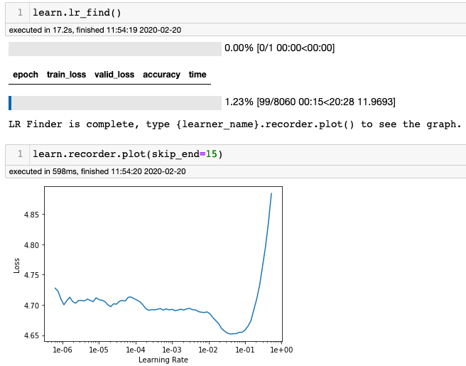
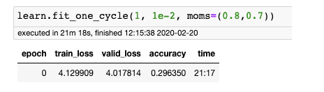
Language Model Training using fit_one_cycle
Notes:
mention... whats interesting here is that embeddings encode semantic infromation!

Slide 9
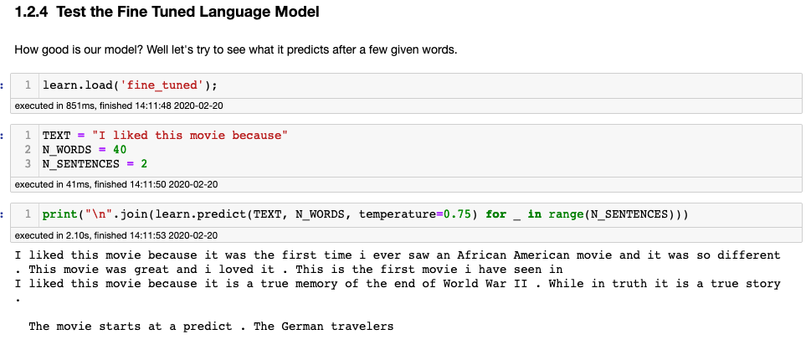
Language Model : Test it ...

Slide 10
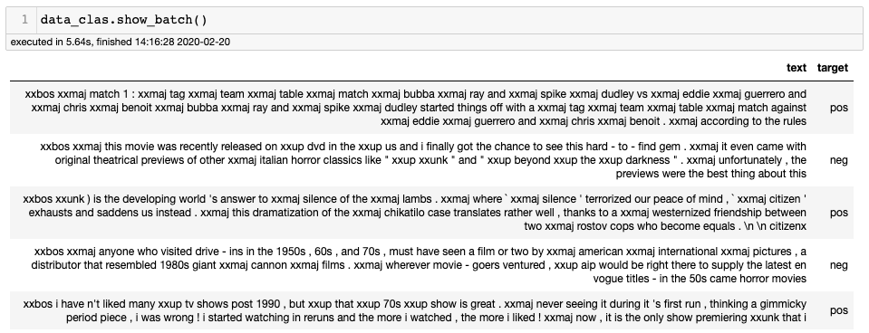
Classifier Model Data
The goal of the classifier model is to use the description to predict the target. This model also leverages the AWD_LSTM model, but in a slightly different method. Instead of trying to predict the next word, its just trying to make a classification.
To build this model, fastAI employs the AWD-LSTM implementation
Notes:
mention... whats interesting here is that embeddings encode semantic infromation!

Slide 11
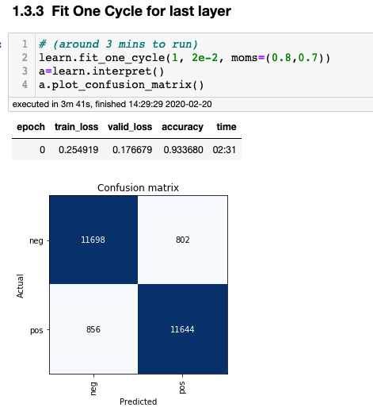
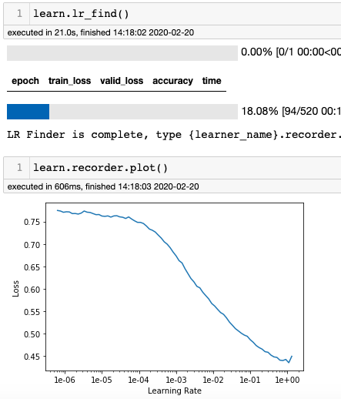
Classifier training using fit_one_cycle

