Slide 1
Business Problem
I want to build a times series data set, and experiment to see how i can custom build an RNN / LSTM using FastAI to train and predict a series. Completely exploratory work
UC1 : Predict a column of data that I synthetically create via simple rules

Slide 2
LSTM / RNN - Data Preparation Details
LSTM/RNN implementations in Pytorch always require Rank3 tensors when called
Seq_len aka Tx
Batch size
InputSize aka Number of Features , Num Cols
# Instantiate model
rnn_mdl = nn.RNN(input_size,hidden_size,num_layers)
# called during runtime
input dimensions = (seq_len, batch, input size)
hidden dimensions = (num_layers * num_directions, batch, hidden_size)
output, hidden = rnn_mdl(input, hidden)
InputSize
0 | 1 | 2 |  |  |  | N | Y
1
2
M
InputSize
Time
Series
Data
0 | 1 |  |  |  |  | N-1 | N
1
2
3
0 | 1 |  |  |  |  | N-1 | N
2
3
4
Tx
0 | 1 |  |  |  |  | N-1 | N
3
4
5
0 | 1 |  |  |  |  | N-1 | N
M-2
M-1
M
M-Tx samples
Each batch, is a subset of these samples

Slide 3
PYTORCH RNN details

Slide 4
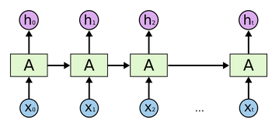
LSTM / RNN - Data Preparation Details
example dimensions
hidden_size = 5
batch = 1
Tx = 10
num_features = 2
input – 10 x 1 x 2
nn.RNN(2,5,1)
output – 10 x 1 x 5
hidden_out – 1 x 1 x 5
# Instantiate model
rnn_mdl = nn.RNN(input_size,hidden_size,num_layers)
# called during runtime
# input dimensions = (seq_len, batch, input size)
# hidden dimensions = (num_layers * num_directions, batch, hidden_size)
output, hidden = rnn_mdl(input, hidden)
yhat vs tgt
fc
output(Tx,batch_num,hidden_size)
last_output(1,batch_num,hidden_size)
dim=1,bn,hidden
hidden_init
(1, batch_num,hidden_size)
hidden
(1, batch_num,hidden_size)
num_features
Tx
input dim ~ (Tx, batch, num_features)
Notes:
NumFeat = 1
Tx = 10
hidden =
data ~ 1000000 x 1
inp1 = 10 x 1 x 1 ~ data[0:9]
inp2 = data[1:10]

Slide 5
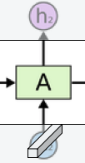
RNN - Cell Details
# Instantiate model
rnn_mdl = nn.RNN(input_size,hidden_size,num_layers)
# called during runtime
# input dimensions = (seq_len, batch, input size)
# hidden dimensions = (num_layers * num_directions, batch, hidden_size)
output, hidden = rnn_mdl(input, hidden)
out_{t}
Wih
dims [hs x hs]x [hs x bn] = hs x bn
hidden_size
MM
Wih*hidden_{in}
+
nonlinearity
g(Wih*h + Wix *X0 + b)
hidden_{in}
dims~ = hs x bn
hidden_{out}
Wix
MM
Wix* X_{t}
dims~ [hs x nf] x [nf x bn] = hs x bn
num_features
X_{t}
Note : dimensions need to be reordered to be compliant with pytorch
input(Tx, batch, num_features)
Notes:
NumFeat = 1
Tx = 10
hidden =
data ~ 1000000 x 1
inp1 = 10 x 1 x 1 ~ data[0:9]
inp2 = data[1:10]

Slide 7
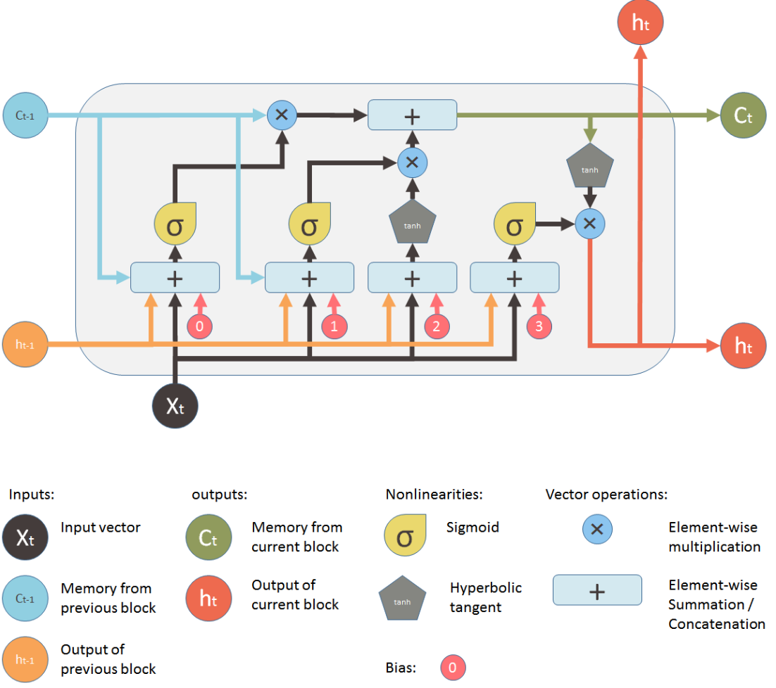
LSTM Quick Reference
Forget Gate –used to decide what values in cell state to forget
Input Gate – used to decide what values in cell state to update
Output Gate – used for output to next stage and predictions
LSTM is an architecture in the RNN Deep Learning Family
Its used for time series analysis, what sets it apart from RNN it has that has a forget / input / output gate that help it remember long term patterns and overcome vanishing gradient problems in traditional RNN architecture
Notes:
Has a notion of cell state… gates are used to modify cell state
Forget – eg, in NLP when a new subject is entered, forget pronoun of previous subject …

Slide 8
LSTM - Data Preparation Details
LSTM/RNN implementations in Keras always require Rank3 tensors
Batch size
Tx
Number of Features
NumFeatures
0 | 1 |  |  |  |  |  | N
1
2
M
NumFeatures
Time
Series
Data
0 | 1 |  |  |  |  | N-1 | N
1
2
3
0 | 1 |  |  |  |  | N-1 | N
2
3
4
Tx
0 | 1 |  |  |  |  | N-1 | N
3
4
5
0 | 1 |  |  |  |  | N-1 | N
M-2
M-1
M
M-Tx samples
Each batch, is a subset of these samples

Slide 9
LSTM Formulation
This is my current diagram for LSTM classifier ….
Anom / RT>X
Lagged N mins
A0
A1
A(Tx)
X0
X1
X
(Tx)
X is a vector of M features (PCA / Time of day / etc)
A is hidden State
Tx is number of samples in time
Y will be a lagged anomaly or large response time.
Goal is to see if there is any trend in this data that can be modelled.
Keras will be used as initial framework

Slide 10
LSTM - Data Preparation Details
LSTM/RNN implementations in Keras always require Rank3 tensors
Batch size
Tx
Number of Features
NumFeatures
0 | 1 |  |  |  |  | N-1 | N
1
2
M
Y
1
2
M
Time
Series
How do you turn this in a Rank3 tensor ?? Ideas?

Slide 11
LSTM – The code
Data Prep
X_train is a Rank2 array (M,N) …
this code creates Rank3 array (M-Tx,Tx,N) as shown on
previous chart
for i in range(lstm_samples) :
X_lstm_train[i] = np.array(X_train)[i:i+Tx,:]
Model
X = Input(shape=(Tx, n_values), name="layer0_input")
# LSTM will build a layer of Tx cells, with n_state nuerons per cell
lstm_out = LSTM(n_state, name='layer1_lstm')(X)
Y = Dense(2, activation='softmax',name='layer2_fc')(lstm_out)
#Y1 = Activation('softmax')(Y)
model = Model(inputs=X,outputs=Y)
Model Summary
Layer (type) Output Shape Param #
=================================================================
layer0_input (InputLayer) (None, 12, 41) 0
_________________________________________________________________
layer1_lstm (LSTM) (None, 20) 4960
_________________________________________________________________
layer2_fc (Dense) (None, 2) 42
=================================================================
Total params: 5,002
Trainable params: 5,002
Non-trainable params: 0

Slide 12
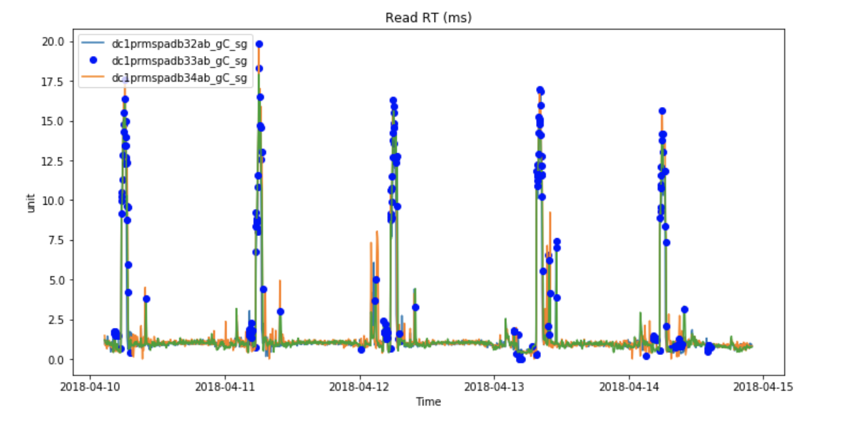
Overlay of anomaly on ‘Read response time’ time series
This method seems to highlight read response times that are high. The points where Read RT is not high is driven by other events.

Slide 13
Next steps
Predict drivers of high read response time and/or anomalies
(could use DL /ML . Probably will use simple LR /RF to start, and then a DL approach)
Use exponential moving averages to detect a longer running read response time

