Slide 1

FastAI 101
Dustin VanStee - Data Scientist
Bob Chesebrough -Data Scientist
AI Center of Compentency
IBM Worldwide Client Experience Centers
AI Immersion

Slide 2
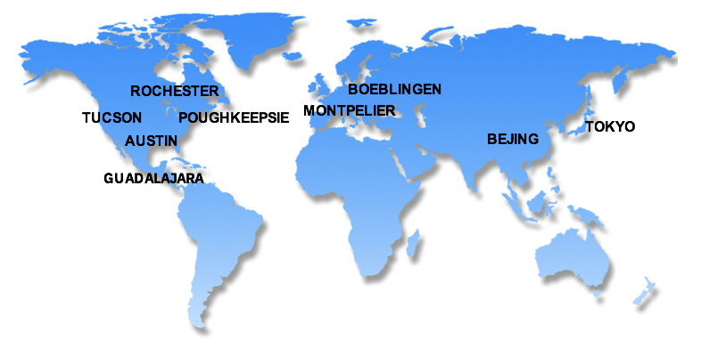
IBM Systems Worldwide Client Experience Centers
IBM Systems Worldwide Client Experience Centers maximize IBM Systems competitive advantage in the Cloud and Cognitive era by providing access to world class technical experts and infrastructure services to assist Clients with the transformation of their IT implementations..
9 Worldwide Locations (* also Infrastructure Hubs):
Austin TX , *Poughkeepsie NY, Rochester MN, Tucson AZ, *Beijing CHINA, Boeblingen GERMANY, Guadalajara MEXICO,*Montpellier FRANCE, Tokyo JAPAN
Client Experience
Tailored, in-depth technology
Innovation Exchange
Events
Relationship building
Demonstrations
Meetups
Solution workshops
Remote options
(Inbound & Outbound)
Architecture & Design
Advise clients, “Art of the Possible”
Discovery & Design Workshops, Consulting,
Showcases, Reference Architectures, Co-Creation of assets
(Inbound & Outbound)
Infrastructure
Solutions
Benchmarks, MVP & Proof of Technology
“Test Drives”
Demonstrations
Infrastructure Services
Certify ISV solutions
Hosting
Cloud Environment
(Inbound to Centers)
.
Content
Content Development
IBM Redbooks
Training Courses
Video courses
“Test Drives”
Demonstrations
NEW: Co-Creation Lab; CEC Cloud; RedHat Center of Competency
For further information, please contact the Centers via email at: ccenter@us.ibm.com
Notes:
ISCEP Link
2

Slide 3
Agenda
fast.ai 101
--https://forums.fast.ai/t/deep-learning-lesson-1-notes/27748
-- why FastAI ? [incorporates best practices gleaned from top experts into easy to use library]
-- good for beginners and experts alike !
-- fai vs keras
-- databunch - abstraction that holds all your data but takes care of train / test splitting ...
-- learner - abstraction that takes in a databunch and trains a DL model
-- FastAI with cifar10? simple sample
Notes:
(add commentary on how IBM power can accelerate usage of pytorch)

