Slide 1
Open Source Pursuit Demo
Dustin VanStee
Business Case
Architecture
Tools
Live Demo

Slide 2
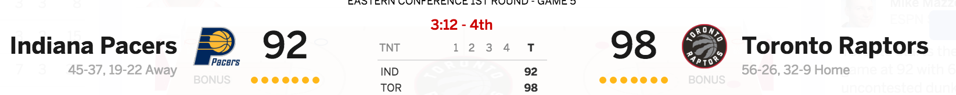
Use Case
Goal : To provide analytics for ”Acme Co” that takes current NBA game status and implements a real time win/loss prediction and probability system using machine learning
What is the probability the Raptors will win ? What if you’re a Pacers fan?
Are there other analytics we can show ….?

Slide 3


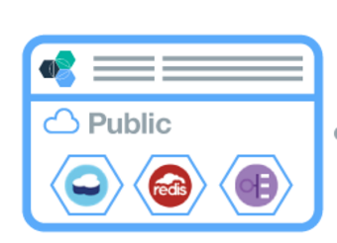


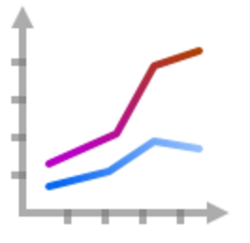

Architecture and Data Flow
Data Scientist
Workbench
Datasources
Prediction
Webservice API
Score
History
Node.js app
Continous sampling during games
Load
Export
Model
And refined
Data sets
publish
Odds
History
Once/day sample
Transformation, Analysis and
Modeling
Notes:
http://www.oddsmaker.ag/rss-feeds
http://www.referincome.com/odds/rss2/basketball_nba.xml
http://sports.espn.go.com/nba/bottomline/scores
For parsing espn scores, copied and modified a script by Josh Fuerst
Custom scripts to extract data run on local machine and copied to DSWB ..
Cue up these pages DSWB / BMIX dashboard / nba-rt-pred / localhost ….

Slide 4

Tooling
Data Acquisition | Analysis / Modelling | Operationalize
Custom scripts running on a server Python / Bash | Data Scientist Workbench Zeppelin Notebook Spark MLLIB + Logistic + Dataframe Scala | Bluemix Node.js Bootstrap Javascript

Slide 5
Odd History
Data Model .
Score history
Home Team | Home Score | Away Team | Away Score | Time Status String
Detroit | 89 | New York | 90 | 5:00 left in the 4th
Detroit | 95 | New York | 97 | Final
…
Home Team | Spread | Away Team | Spread
Detroit | -10 | New York | 10
Chicago | 5 | Portland | -5
…
1 record per game
100+ records per game
Machine Learning Data Set format
join
Home Team | Home Score | Away Team | Away Score | Time Status String | Final Score Home | Final Score Away | Winner | Spread (Home tea)
Detroit | 89 | New York | 90 | 5:00 left in the 4th | 95 | 97 | Knicks | -10
…
Approx 100 records per game

