Slide 1
Planning with Files
Image Gallery Presentation

Slide 2

Claude Skill

Slide 3

Mit License

Slide 4
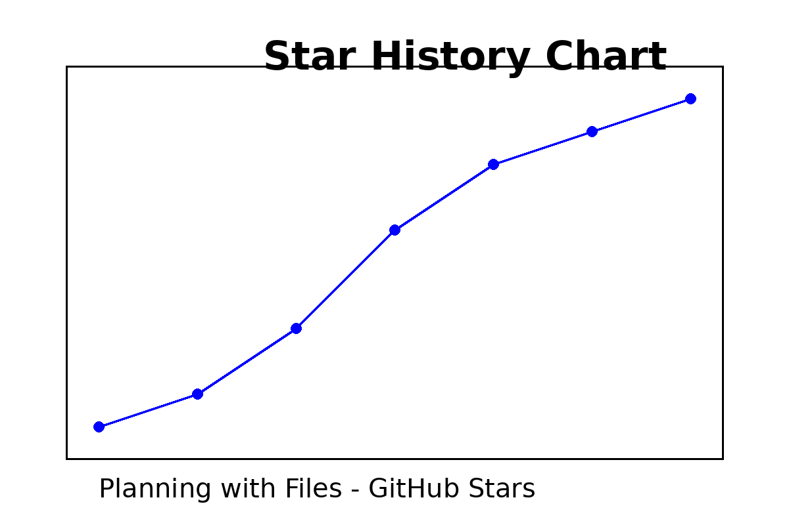
Star History

