Slide 1
COVID-19 Testing How testing strategies can be used to estimate prevalence of a highly communicable disease in closed populations.
Mid-Year Brief
CDT Madison Teague

Slide 2
Agenda
BLUF
Overview
COVID-19 States
Simulation
Way Ahead

Slide 3
BLUF
We will simulate the West Point population with adaptive sampling and determine an unbiased estimator for the pervasion of an infection within the ‘closed’ population.
We will also compare the effectiveness of West Point’s new approach to COVID-19 to the originally proposed adaptive testing strategy.

Slide 4
Overview
Sentinal COVID-19 Testing at USMA:
10% Cadet
2% Staff
20% Clinical Healthcare Staff
Current Tracing Strategy at USMA
Roommates straight to quarantine
Other contacts on hold, to quarantine, or tested
Adaptive Sampling – When a person tests positive, identify and test contacts until all test come back negative
Estimating Prevalence – Horwitz-Thompson Estimator

Slide 5
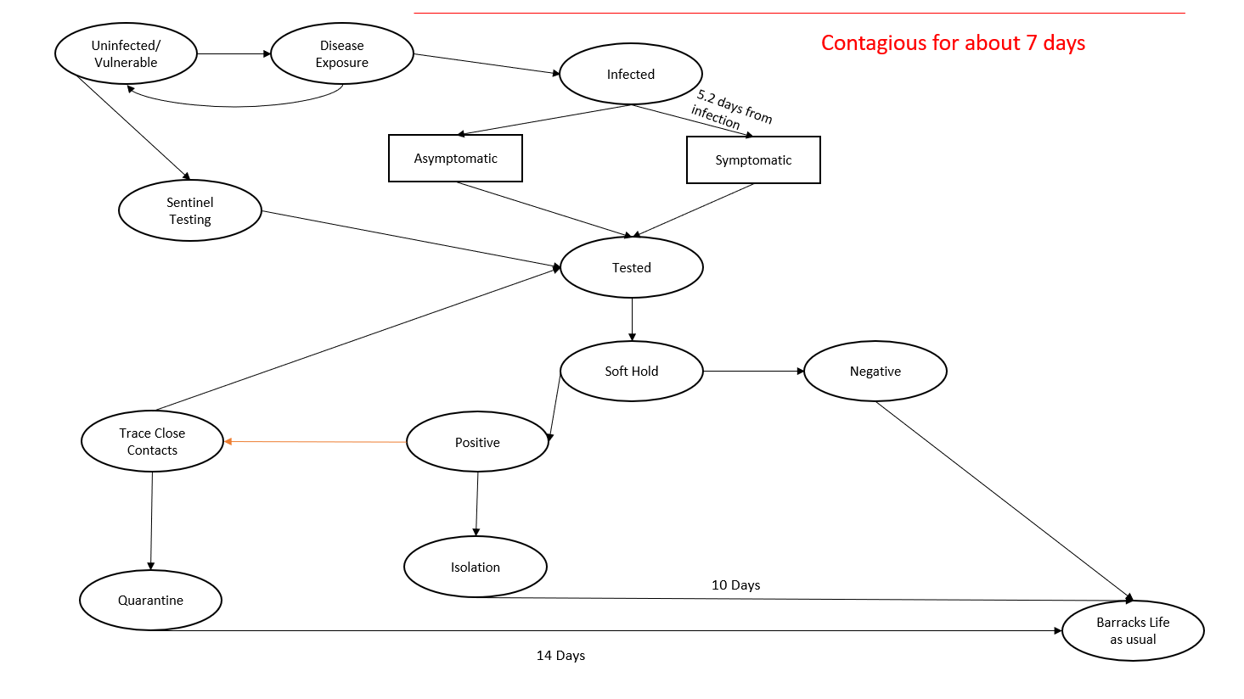
COVID-19 States

Slide 6
Simulation

Slide 7
Way Ahead
Finalize Simulation
Use data from West Point testing and simulation to fill in estimators
Adjust simulation to match current COVID-19 mitigation efforts at West Point

Slide 8
COVID-19 Testing How testing strategies can be used to estimate prevalence of a highly communicable disease in closed populations.
Mid-Year Brief
CDT Madison Teague

