Slide 1
MORS Emerging Techniques Tidymodels
MAJ Dusty Turner | Max Kuhn

Slide 2

Slide to Delete
Follow Along!

Slide 3
Who am I?
Army
Combat Engineer
Platoon Leader / XO / Company Commander
Geospatial / Sapper / Route Clearance
Hawaii / White Sands Missile Range / Iraq / Afghanistan
Education
West Point ’07
Operations Research, BS
Missouri University of Science and Technology ’12
Engineering Management, MS
THE Ohio State ’16
Integrated Systems Engineering, MS
Applied Statistics, Graduate Minor
Data Science
R User Since ’14
Catch me on Twitter @dtdusty
http://dusty-turner.netlify.com/

Slide 4
What am I assuming about you?
Data Science Background
Moderate R Background
Pretty much a ‘super nerd’
www.tenor.com

Slide 5

What are we going to talk about?
Lets talk about
Modeling in R the old way (caret)
Modeling in R the (very) new way (tidymodels)
Lets also weave in an example (Flying Hour Challlenge)

Slide 6
Background: Out with “The Old”
Caret
Classification And REgression Training
Functionality
Inpute Missing Data
Split Test/Train/Validate Set
Supports a Multitude of Modeling Techniques
Supports Cross Validation
Drawbacks
Requires unique syntax to support each package / imputation technique
Not ‘tidy’ compatible

Slide 7
Background: In with “The New”
tidymodels
Released in October 2019
Functionality
Inpute Missing Data
Split Test/Train/Validate Set
Supports a Multitude of Modeling Techniques
Supports Cross Validation
Supports model performance measurements
Advantages
Streamlines syntax for all model types / packages
‘tidy’ compatible
Easy to compare model performance

Slide 8
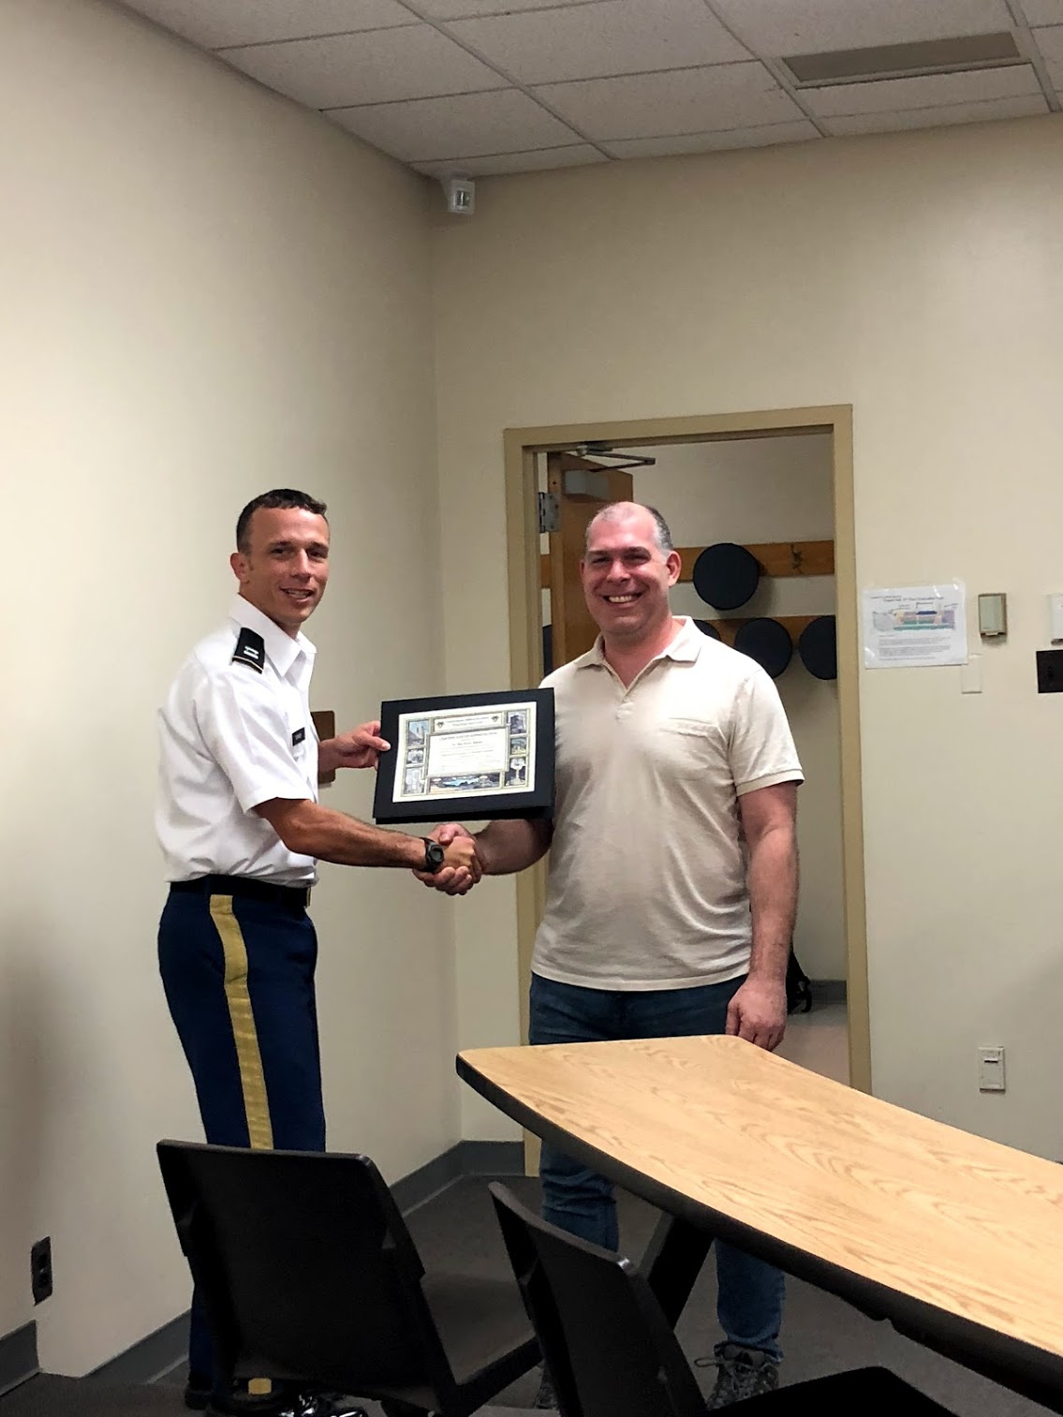
More details of tidymodels
From the documentation:
“tidymodels is a ’’meta-package” for modeling and statistical analysis that share the underlying design philosophy, grammar, and data structures of the tidyverse."
https://github.com/tidymodels/tidymodels
install.packages("tidymodels")
Author is Max Kuhn of RStudio @topepo
Max Kuhn at West Point Fall 2018

Slide 9
The Modeling Process

Slide 10
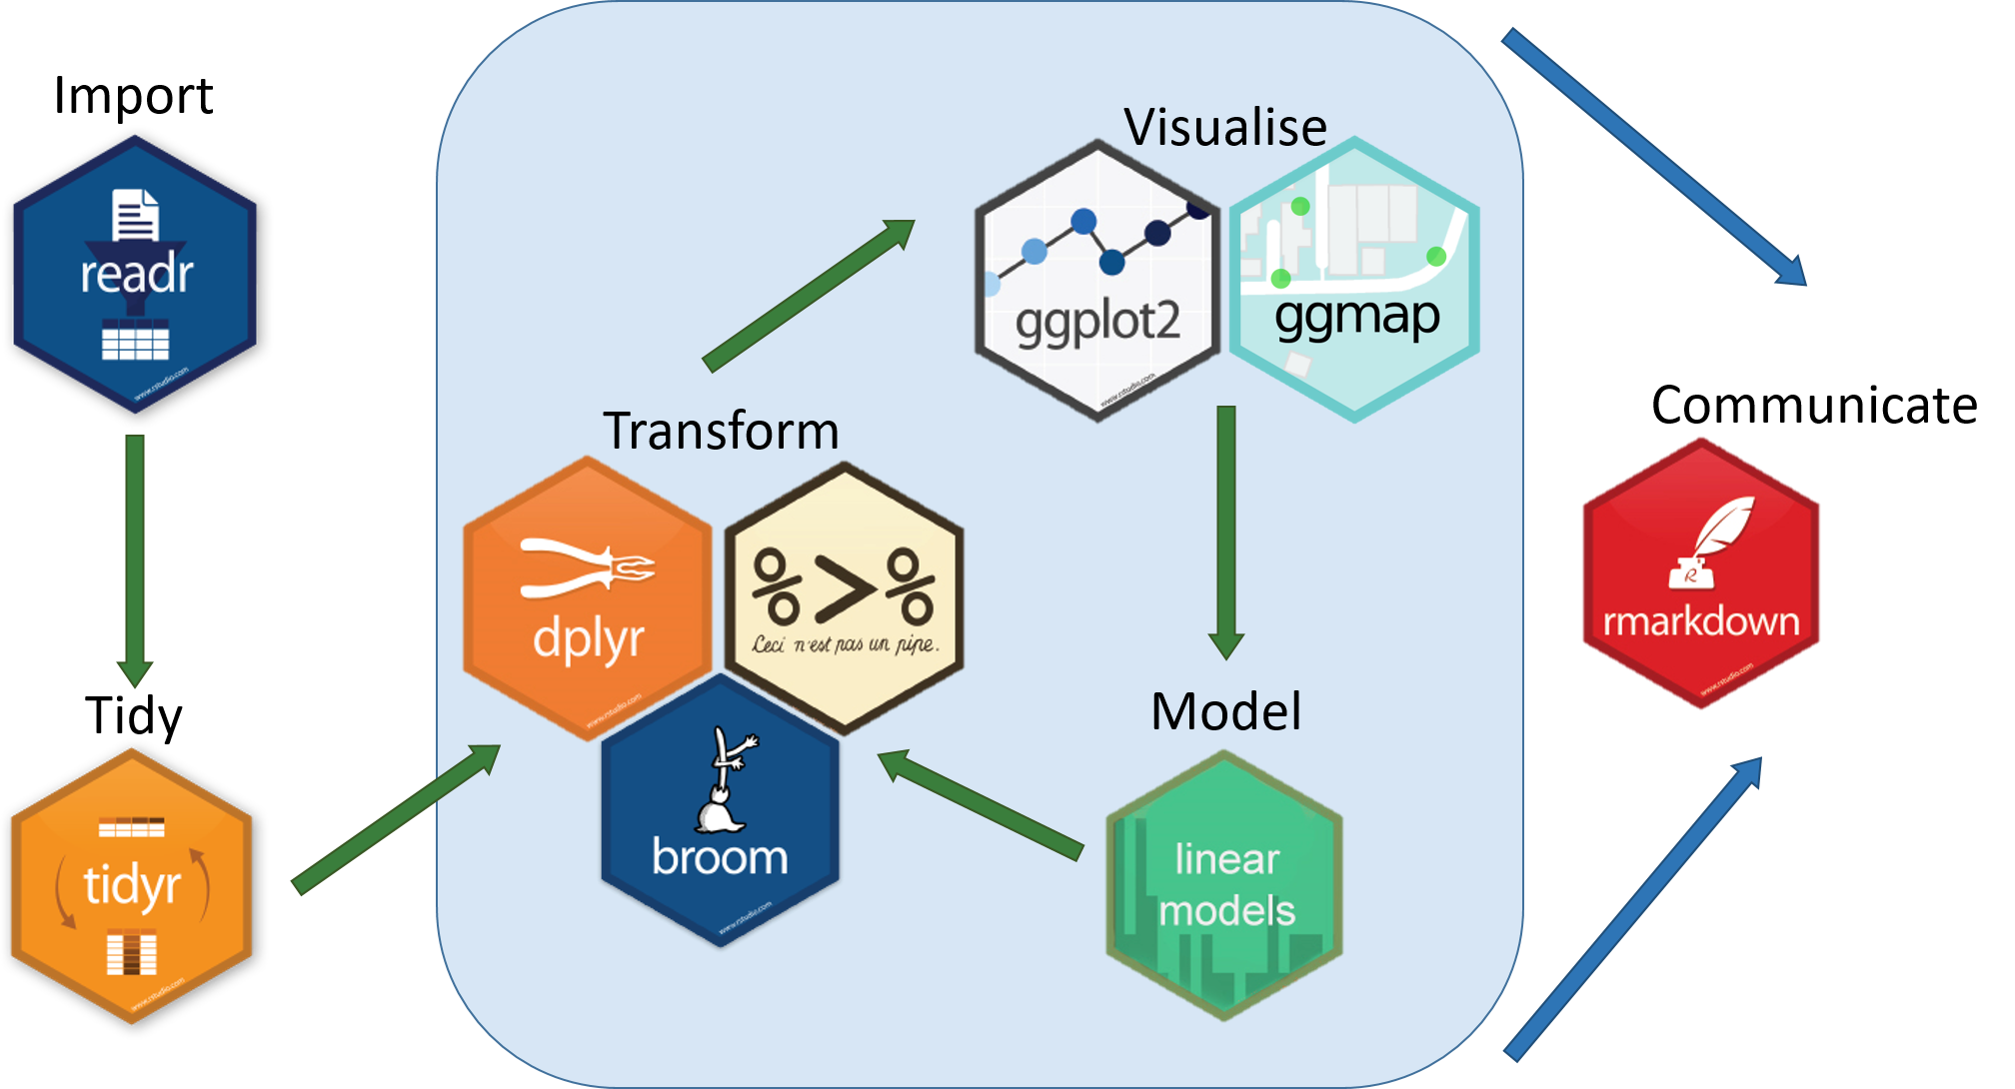
Tidymodels Schema
https://www.tidyverse.org/

Slide 11

Tidymodels Schema
https://www.tidyverse.org/

Slide 12
What We’re Going to Do:
Introduce a Data Problem
Flying Hour Challenge
Show the ‘old techniques’
imputation
modeling
prediction
model comparison
Show the new technique
tidymodels
Discuss Challenges

Slide 13
Libraries
library(tidyverse) library(janitor) library(Amelia) library(tidymodels) library(flextable)

Slide 14
Flying Hour Challenge
read_csv("01_data/mors_cleaned_ID.csv") %>% janitor::clean_names() %>% select(hours_flown, as_of_date,id,id2,id3,mc_percent) %>% head() %>% flextable() %>% autofit()
hours_flown | as_of_date | id | id2 | id3 | mc_percent
9.000 | 10/15/2011 | 1C | 216N | 7M | 1.000
14.000 | 10/15/2011 | 1C | 216N | 7M | 1.000
19.000 | 10/15/2011 | 1C | 216N | 7M | 0.975
20.000 | 10/15/2011 | 1C | 216N | 7M | 1.000
6.000 | 10/15/2011 | 1C | 216N | 7M | 1.000
13.000 | 10/15/2011 | 1C | 217N | 7M | 0.850

Slide 15
Skimr
skimr::skim(data) %>% knit_print()

Slide 16
Name | data
Number of rows | 74849
Number of columns | 56
_______________________
Column type frequency:
character | 7
numeric | 49
________________________
Group variables | None
Data summary

Slide 17
Variable type: character

Slide 18
skim_variable | n_missing | complete_rate | min | max | empty | n_unique | whitespace
as_of_date | 0 | 1.00 | 9 | 10 | 0 | 60 | 0
mth | 0 | 1.00 | 3 | 3 | 0 | 12 | 0
army_accept_date | 64 | 1.00 | 7 | 7 | 0 | 322 | 0
gain_loss | 67854 | 0.09 | 2 | 2 | 0 | 11 | 0
id | 0 | 1.00 | 2 | 3 | 0 | 14 | 0
id2 | 0 | 1.00 | 2 | 4 | 0 | 224 | 0
id3 | 0 | 1.00 | 2 | 2 | 0 | 9 | 0

Slide 19
Variable type: numeric

Slide 20
skim_variable | n_missing | complete_rate | mean | sd | p0 | p25 | p50 | p75 | p100 | hist
fy | 0 | 1.00 | 2013.98 | 1.41 | 2012.00 | 2013.00 | 2014.00 | 2015.00 | 2016.00 | ▇▇▇▇▇
fiscal_month | 0 | 1.00 | 6.53 | 3.45 | 1.00 | 4.00 | 7.00 | 10.00 | 12.00 | ▇▅▅▆▇
age_years_by_accept_date | 64 | 1.00 | 10.65 | 8.95 | -4.26 | 3.17 | 7.33 | 18.01 | 35.90 | ▇▇▃▃▁
on_hand_inventory | 0 | 1.00 | 1.00 | 0.00 | 1.00 | 1.00 | 1.00 | 1.00 | 1.00 | ▁▁▇▁▁
qty_reported_for_readiness | 0 | 1.00 | 0.94 | 0.24 | 0.00 | 1.00 | 1.00 | 1.00 | 1.00 | ▁▁▁▁▇
poss_hrs | 0 | 1.00 | 683.26 | 181.20 | 0.00 | 720.00 | 744.00 | 744.00 | 744.00 | ▁▁▁▁▇
mc_hrs | 0 | 1.00 | 529.85 | 255.99 | 0.00 | 421.00 | 655.00 | 720.00 | 744.00 | ▂▁▁▂▇
mc_percent | 4872 | 0.93 | 0.78 | 0.30 | 0.00 | 0.69 | 0.92 | 0.99 | 1.00 | ▁▁▁▂▇
da_2_year_mc_hist_avg | 0 | 1.00 | 0.73 | 0.04 | 0.67 | 0.71 | 0.71 | 0.72 | 0.81 | ▁▇▁▁▂
avail_hours_days | 0 | 1.00 | 484.35 | 271.25 | 0.00 | 294.00 | 608.00 | 710.00 | 744.00 | ▃▁▁▂▇
fmc_percent | 4872 | 0.93 | 0.71 | 0.34 | 0.00 | 0.53 | 0.86 | 0.98 | 1.00 | ▂▁▁▂▇
da_2_year_fmc_hist_avg | 0 | 1.00 | 0.66 | 0.05 | 0.54 | 0.63 | 0.64 | 0.69 | 0.75 | ▂▁▇▂▃
nmcs_days_hrs | 0 | 1.00 | 16.92 | 76.10 | 0.00 | 0.00 | 0.00 | 0.00 | 744.00 | ▇▁▁▁▁
nmcs_percent | 4872 | 0.93 | 0.02 | 0.11 | 0.00 | 0.00 | 0.00 | 0.00 | 1.00 | ▇▁▁▁▁
da_2_year_nmcs_hist_avg | 0 | 1.00 | 0.05 | 0.01 | 0.03 | 0.04 | 0.05 | 0.07 | 0.07 | ▃▃▇▁▅
nmcs_org_days_hrs | 0 | 1.00 | 0.00 | 0.00 | 0.00 | 0.00 | 0.00 | 0.00 | 0.00 | ▁▁▇▁▁
nmcs_org_percent | 4872 | 0.93 | 0.00 | 0.00 | 0.00 | 0.00 | 0.00 | 0.00 | 0.00 | ▁▁▇▁▁
nmcs_spt_days_hrs | 0 | 1.00 | 0.00 | 0.00 | 0.00 | 0.00 | 0.00 | 0.00 | 0.00 | ▁▁▇▁▁
nmcs_spt_percent | 4872 | 0.93 | 0.00 | 0.00 | 0.00 | 0.00 | 0.00 | 0.00 | 0.00 | ▁▁▇▁▁
nmcm_days_hrs | 0 | 1.00 | 136.49 | 204.75 | 0.00 | 0.00 | 40.00 | 173.00 | 744.00 | ▇▁▁▁▁
nmcm_percent | 4872 | 0.93 | 0.20 | 0.29 | 0.00 | 0.00 | 0.07 | 0.26 | 1.00 | ▇▂▁▁▁
da_2_year_nmcm_hist_avg | 0 | 1.00 | 0.17 | 0.02 | 0.12 | 0.16 | 0.17 | 0.18 | 0.19 | ▁▃▂▆▇
nmcm_org_days_hrs | 0 | 1.00 | 90.39 | 153.45 | 0.00 | 0.00 | 24.00 | 108.00 | 744.00 | ▇▁▁▁▁
nmcm_org_percent | 4872 | 0.93 | 0.13 | 0.21 | 0.00 | 0.00 | 0.04 | 0.16 | 1.00 | ▇▁▁▁▁
nmcm_spt_days_hrs | 0 | 1.00 | 10.11 | 70.74 | 0.00 | 0.00 | 0.00 | 0.00 | 744.00 | ▇▁▁▁▁
nmcm_spt_percent | 4872 | 0.93 | 0.01 | 0.10 | 0.00 | 0.00 | 0.00 | 0.00 | 1.00 | ▇▁▁▁▁
nmcm_equip_days_hrs | 0 | 1.00 | 0.00 | 0.00 | 0.00 | 0.00 | 0.00 | 0.00 | 0.00 | ▁▁▇▁▁
nmcm_equip_percent | 4872 | 0.93 | 0.00 | 0.00 | 0.00 | 0.00 | 0.00 | 0.00 | 0.00 | ▁▁▇▁▁
nmcm_depot_days_hrs | 0 | 1.00 | 36.00 | 142.93 | 0.00 | 0.00 | 0.00 | 0.00 | 744.00 | ▇▁▁▁▁
nmcm_depot_percent | 4872 | 0.93 | 0.05 | 0.20 | 0.00 | 0.00 | 0.00 | 0.00 | 1.00 | ▇▁▁▁▁
pmc_days_hrs | 0 | 1.00 | 45.50 | 136.38 | 0.00 | 0.00 | 0.00 | 0.00 | 744.00 | ▇▁▁▁▁
pmc_percent | 4872 | 0.93 | 0.07 | 0.19 | 0.00 | 0.00 | 0.00 | 0.00 | 1.00 | ▇▁▁▁▁
pmcs_days_hrs | 0 | 1.00 | 11.84 | 71.51 | 0.00 | 0.00 | 0.00 | 0.00 | 744.00 | ▇▁▁▁▁
pmcs_percent | 4872 | 0.93 | 0.02 | 0.10 | 0.00 | 0.00 | 0.00 | 0.00 | 1.00 | ▇▁▁▁▁
pmcs_org_days_hrs | 0 | 1.00 | 0.00 | 0.00 | 0.00 | 0.00 | 0.00 | 0.00 | 0.00 | ▁▁▇▁▁
pmcs_org_percent | 4872 | 0.93 | 0.00 | 0.00 | 0.00 | 0.00 | 0.00 | 0.00 | 0.00 | ▁▁▇▁▁
pmcs_spt_days_hrs | 0 | 1.00 | 0.00 | 0.00 | 0.00 | 0.00 | 0.00 | 0.00 | 0.00 | ▁▁▇▁▁
pmcs_spt_percent | 4872 | 0.93 | 0.00 | 0.00 | 0.00 | 0.00 | 0.00 | 0.00 | 0.00 | ▁▁▇▁▁
pmcm_days_hrs | 0 | 1.00 | 33.66 | 115.05 | 0.00 | 0.00 | 0.00 | 0.00 | 744.00 | ▇▁▁▁▁
pmcm_percent | 4872 | 0.93 | 0.05 | 0.16 | 0.00 | 0.00 | 0.00 | 0.00 | 1.00 | ▇▁▁▁▁
pmcm_org_days_hrs | 0 | 1.00 | 0.00 | 0.00 | 0.00 | 0.00 | 0.00 | 0.00 | 0.00 | ▁▁▇▁▁
pmcm_org_percent | 4872 | 0.93 | 0.00 | 0.00 | 0.00 | 0.00 | 0.00 | 0.00 | 0.00 | ▁▁▇▁▁
pmcm_spt_days_hrs | 0 | 1.00 | 0.00 | 0.00 | 0.00 | 0.00 | 0.00 | 0.00 | 0.00 | ▁▁▇▁▁
pmcm_spt_percent | 4872 | 0.93 | 0.00 | 0.00 | 0.00 | 0.00 | 0.00 | 0.00 | 0.00 | ▁▁▇▁▁
total_airframe_hrs | 0 | 1.00 | 3376.86 | 2465.83 | 0.00 | 787.70 | 3807.40 | 5374.50 | 14405.60 | ▇▇▃▁▁
hours_flown | 0 | 1.00 | 19.24 | 23.96 | 0.00 | 2.00 | 12.00 | 26.00 | 215.00 | ▇▁▁▁▁
hours_to_phase | 0 | 1.00 | 197.08 | 135.07 | 0.00 | 82.00 | 194.00 | 304.00 | 722.00 | ▇▇▅▁▁
landings | 0 | 1.00 | 43.23 | 51.96 | 0.00 | 4.00 | 29.00 | 62.00 | 610.00 | ▇▁▁▁▁
auto_rotate | 0 | 1.00 | 0.06 | 0.78 | 0.00 | 0.00 | 0.00 | 0.00 | 90.00 | ▇▁▁▁▁

