Slide 1
MORS Emerging Techniques Tidymodels
MAJ Dusty Turner

Slide 2
R Markdown
This is an R Markdown presentation. Markdown is a simple formatting syntax for authoring HTML, PDF, and MS Word documents. For more details on using R Markdown see http://rmarkdown.rstudio.com.
When you click the Knit button a document will be generated that includes both content as well as the output of any embedded R code chunks within the document.

Slide 3
Slide with Bullets
Bullet 1
Bullet 2
Bullet 3

Slide 4
Slide with R Output
summary(cars)
## speed dist ## Min. : 4.0 Min. : 2.00 ## 1st Qu.:12.0 1st Qu.: 26.00 ## Median :15.0 Median : 36.00 ## Mean :15.4 Mean : 42.98 ## 3rd Qu.:19.0 3rd Qu.: 56.00 ## Max. :25.0 Max. :120.00
cars
## speed dist ## 1 4 2 ## 2 4 10 ## 3 7 4 ## 4 7 22 ## 5 8 16 ## 6 9 10 ## 7 10 18 ## 8 10 26 ## 9 10 34 ## 10 11 17 ## 11 11 28 ## 12 12 14 ## 13 12 20 ## 14 12 24 ## 15 12 28 ## 16 13 26 ## 17 13 34 ## 18 13 34 ## 19 13 46 ## 20 14 26 ## 21 14 36 ## 22 14 60 ## 23 14 80 ## 24 15 20 ## 25 15 26 ## 26 15 54 ## 27 16 32 ## 28 16 40 ## 29 17 32 ## 30 17 40 ## 31 17 50 ## 32 18 42 ## 33 18 56 ## 34 18 76 ## 35 18 84 ## 36 19 36 ## 37 19 46 ## 38 19 68 ## 39 20 32 ## 40 20 48 ## 41 20 52 ## 42 20 56 ## 43 20 64 ## 44 22 66 ## 45 23 54 ## 46 24 70 ## 47 24 92 ## 48 24 93 ## 49 24 120 ## 50 25 85

Slide 5
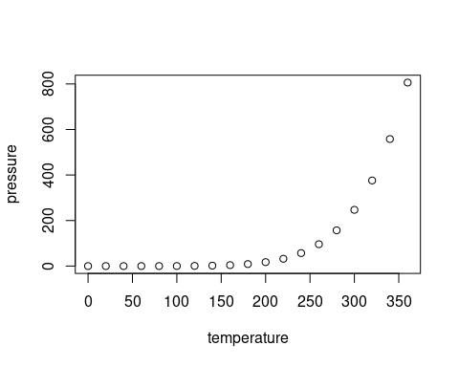
Slide with Plot

