Slide 1
MORS Emerging Techniques Tidymodels
MAJ Dusty Turner | Max Kuhn

Slide 2

Slide to Delete
Follow Along!

Slide 3
Who am I?
Army
Combat Engineer
Platoon Leader / XO / Company Commander
Geospatial / Sapper / Route Clearance
Hawaii / White Sands Missile Range / Iraq / Afghanistan
Education
West Point ’07
Operations Research, BS
Missouri University of Science and Technology ’12
Engineering Management, MS
THE Ohio State ’16
Integrated Systems Engineering, MS
Applied Statistics, Graduate Minor
Data Science
R User Since ’14
Catch me on Twitter @dtdusty
http://dusty-turner.netlify.com/

Slide 4
What am I assuming about you?
Data Science Background
Moderate R Background
Pretty much a ‘super nerd’
www.tenor.com

Slide 5

What are we going to talk about?
Lets talk about
Modeling in R the old way (caret)
Modeling in R the (very) new way (tidymodels)
Lets also weave in an example (Flying Hour Challlenge)

Slide 6
Background: Out with “The Old”
The Caret Package
Classification And REgression Training
Functionality
Inpute Missing Data
Split Test/Train/Validate Set
Supports a Multitude of Modeling Techniques
Supports Cross Validation
Drawbacks
Requires unique syntax to support each package / imputation technique
Not ‘tidy’ compatible

Slide 7
Background: In with “The New”
The tidymodels package
Released in October 2019
Functionality
Inpute Missing Data
Split Test/Train/Validate Set
Supports a Multitude of Modeling Techniques
Supports Cross Validation
Supports model performance measurements
Advantages
Streamlines syntax for all model types / packages
‘tidy’ compatible
Easy to compare model performance

Slide 8

More details of tidymodels
From the documentation:
“tidymodels is a ’’meta-package” for modeling and statistical analysis that share the underlying design philosophy, grammar, and data structures of the tidyverse."
https://github.com/tidymodels/tidymodels
install.packages("tidymodels")
Author is Max Kuhn of RStudio @topepo
Max Kuhn at West Point Fall 2018

Slide 9
The Modeling Process

Slide 10
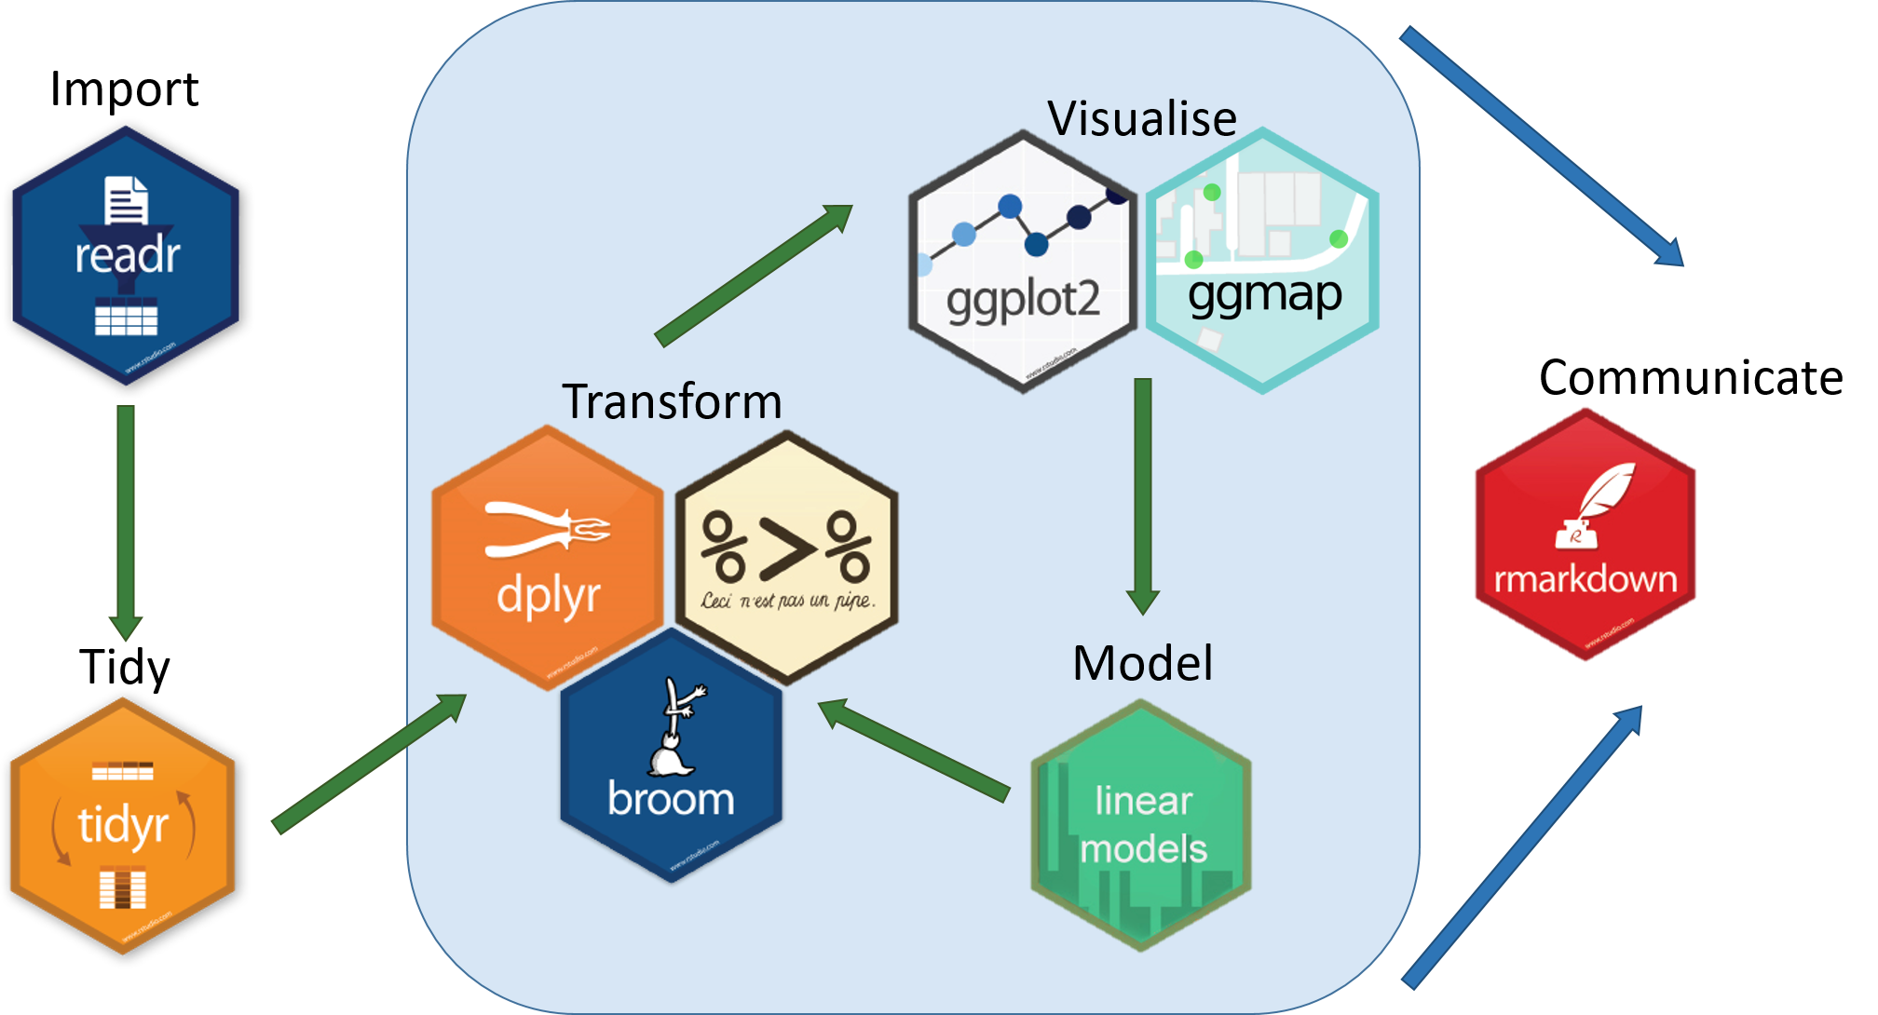
Tidyverse Schema
https://www.tidyverse.org/

Slide 11

Tidymodels Schema
https://www.tidyverse.org/

Slide 12
What We’re Going to Do:
Introduce a Data Problem
Flying Hour Challenge
Show the ‘old techniques’
imputation
modeling
prediction
model comparison
Show the new technique
tidymodels
Discuss Challenges

Slide 13
Libraries
library(tidyverse) library(janitor) library(tidymodels) library(flextable) library(lubridate)

Slide 14
Flying Hour Challenge
read_csv("01_data/mors_cleaned_ID.csv") %>% janitor::clean_names() %>% mutate(as_of_date = mdy(as_of_date)) %>% select(hours_flown, as_of_date,id,id2,id3,mc_percent) %>% head(10) %>% flextable() %>% autofit()
hours_flown | as_of_date | id | id2 | id3 | mc_percent
9.000 | 2011-10-15 | 1C | 216N | 7M | 1.000
14.000 | 2011-10-15 | 1C | 216N | 7M | 1.000
19.000 | 2011-10-15 | 1C | 216N | 7M | 0.975
20.000 | 2011-10-15 | 1C | 216N | 7M | 1.000
6.000 | 2011-10-15 | 1C | 216N | 7M | 1.000
13.000 | 2011-10-15 | 1C | 217N | 7M | 0.850
3.000 | 2011-10-15 | 1C | 217N | 7M | 0.512
143.000 | 2011-10-15 | 14C | 79N | 1M | 0.912
30.000 | 2011-10-15 | 14C | 79N | 9M | 0.915
47.000 | 2011-10-15 | 14C | 79N | 6M | 1.000

Slide 15
Skimr Numeric Variables
variable | missing | n | mean | sd | p0 | p50 | p100 | hist
fy | 0.000 | 74849.000 | 2013.980 | 1.410 | 2012.000 | 2014.000 | 2016.000 | ▇▇▁▇▁▇▁▇
fiscal_month | 0.000 | 74849.000 | 6.530 | 3.450 | 1.000 | 7.000 | 12.000 | ▇▃▇▃▃▇▅▇
age_years_by_accept_date | 64.000 | 74849.000 | 10.650 | 8.950 | -4.260 | 7.330 | 35.900 | ▁▇▅▂▃▂▂▁
on_hand_inventory | 0.000 | 74849.000 | 1.000 | 0.000 | 1.000 | 1.000 | 1.000 | ▁▁▁▇▁▁▁▁
qty_reported_for_readiness | 0.000 | 74849.000 | 0.940 | 0.240 | 0.000 | 1.000 | 1.000 | ▁▁▁▁▁▁▁▇
poss_hrs | 0.000 | 74849.000 | 683.260 | 181.200 | 0.000 | 744.000 | 744.000 | ▁▁▁▁▁▁▁▇
mc_hrs | 0.000 | 74849.000 | 529.850 | 255.990 | 0.000 | 655.000 | 744.000 | ▂▁▁▁▁▁▂▇
mc_percent | 4872.000 | 74849.000 | 0.780 | 0.300 | 0.000 | 0.920 | 1.000 | ▁▁▁▁▁▁▂▇
da_2_year_mc_hist_avg | 0.000 | 74849.000 | 0.730 | 0.040 | 0.670 | 0.710 | 0.810 | ▁▁▇▁▁▁▂▁
avail_hours_days | 0.000 | 74849.000 | 484.350 | 271.250 | 0.000 | 608.000 | 744.000 | ▃▁▁▁▁▂▃▇
fmc_percent | 4872.000 | 74849.000 | 0.710 | 0.340 | 0.000 | 0.860 | 1.000 | ▂▁▁▁▁▂▂▇
da_2_year_fmc_hist_avg | 0.000 | 74849.000 | 0.660 | 0.050 | 0.540 | 0.640 | 0.750 | ▂▁▁▇▃▂▂▃
nmcs_days_hrs | 0.000 | 74849.000 | 16.920 | 76.100 | 0.000 | 0.000 | 744.000 | ▇▁▁▁▁▁▁▁
nmcs_percent | 4872.000 | 74849.000 | 0.020 | 0.110 | 0.000 | 0.000 | 1.000 | ▇▁▁▁▁▁▁▁
da_2_year_nmcs_hist_avg | 0.000 | 74849.000 | 0.050 | 0.010 | 0.030 | 0.050 | 0.070 | ▃▃▁▇▁▁▁▅

Slide 16
Skimr Character Variables
variable | missing | complete | n | min | max | empty | n_unique
as_of_date | 0.000 | 74849.000 | 74849.000 | 9.000 | 10.000 | 0.000 | 60.000
mth | 0.000 | 74849.000 | 74849.000 | 3.000 | 3.000 | 0.000 | 12.000
army_accept_date | 64.000 | 74785.000 | 74849.000 | 7.000 | 7.000 | 0.000 | 322.000
gain_loss | 67854.000 | 6995.000 | 74849.000 | 2.000 | 2.000 | 0.000 | 11.000
id | 0.000 | 74849.000 | 74849.000 | 2.000 | 3.000 | 0.000 | 14.000
id2 | 0.000 | 74849.000 | 74849.000 | 2.000 | 4.000 | 0.000 | 224.000
id3 | 0.000 | 74849.000 | 74849.000 | 2.000 | 2.000 | 0.000 | 9.000

Slide 17
Data Issues
name | NotMissing | Missing
gain_loss | 6995 | 67854
fmc_percent | 69977 | 4872
mc_percent | 69977 | 4872
nmcm_depot_percent | 69977 | 4872
nmcm_equip_percent | 69977 | 4872
nmcm_org_percent | 69977 | 4872
nmcm_percent | 69977 | 4872
nmcm_spt_percent | 69977 | 4872
nmcs_org_percent | 69977 | 4872
nmcs_percent | 69977 | 4872
nmcs_spt_percent | 69977 | 4872
pmc_percent | 69977 | 4872
pmcm_org_percent | 69977 | 4872
pmcm_percent | 69977 | 4872
pmcm_spt_percent | 69977 | 4872
pmcs_org_percent | 69977 | 4872
pmcs_percent | 69977 | 4872
pmcs_spt_percent | 69977 | 4872
age_years_by_accept_date | 74785 | 64
army_accept_date | 74785 | 64
as_of_date | 74849
auto_rotate | 74849

Slide 18
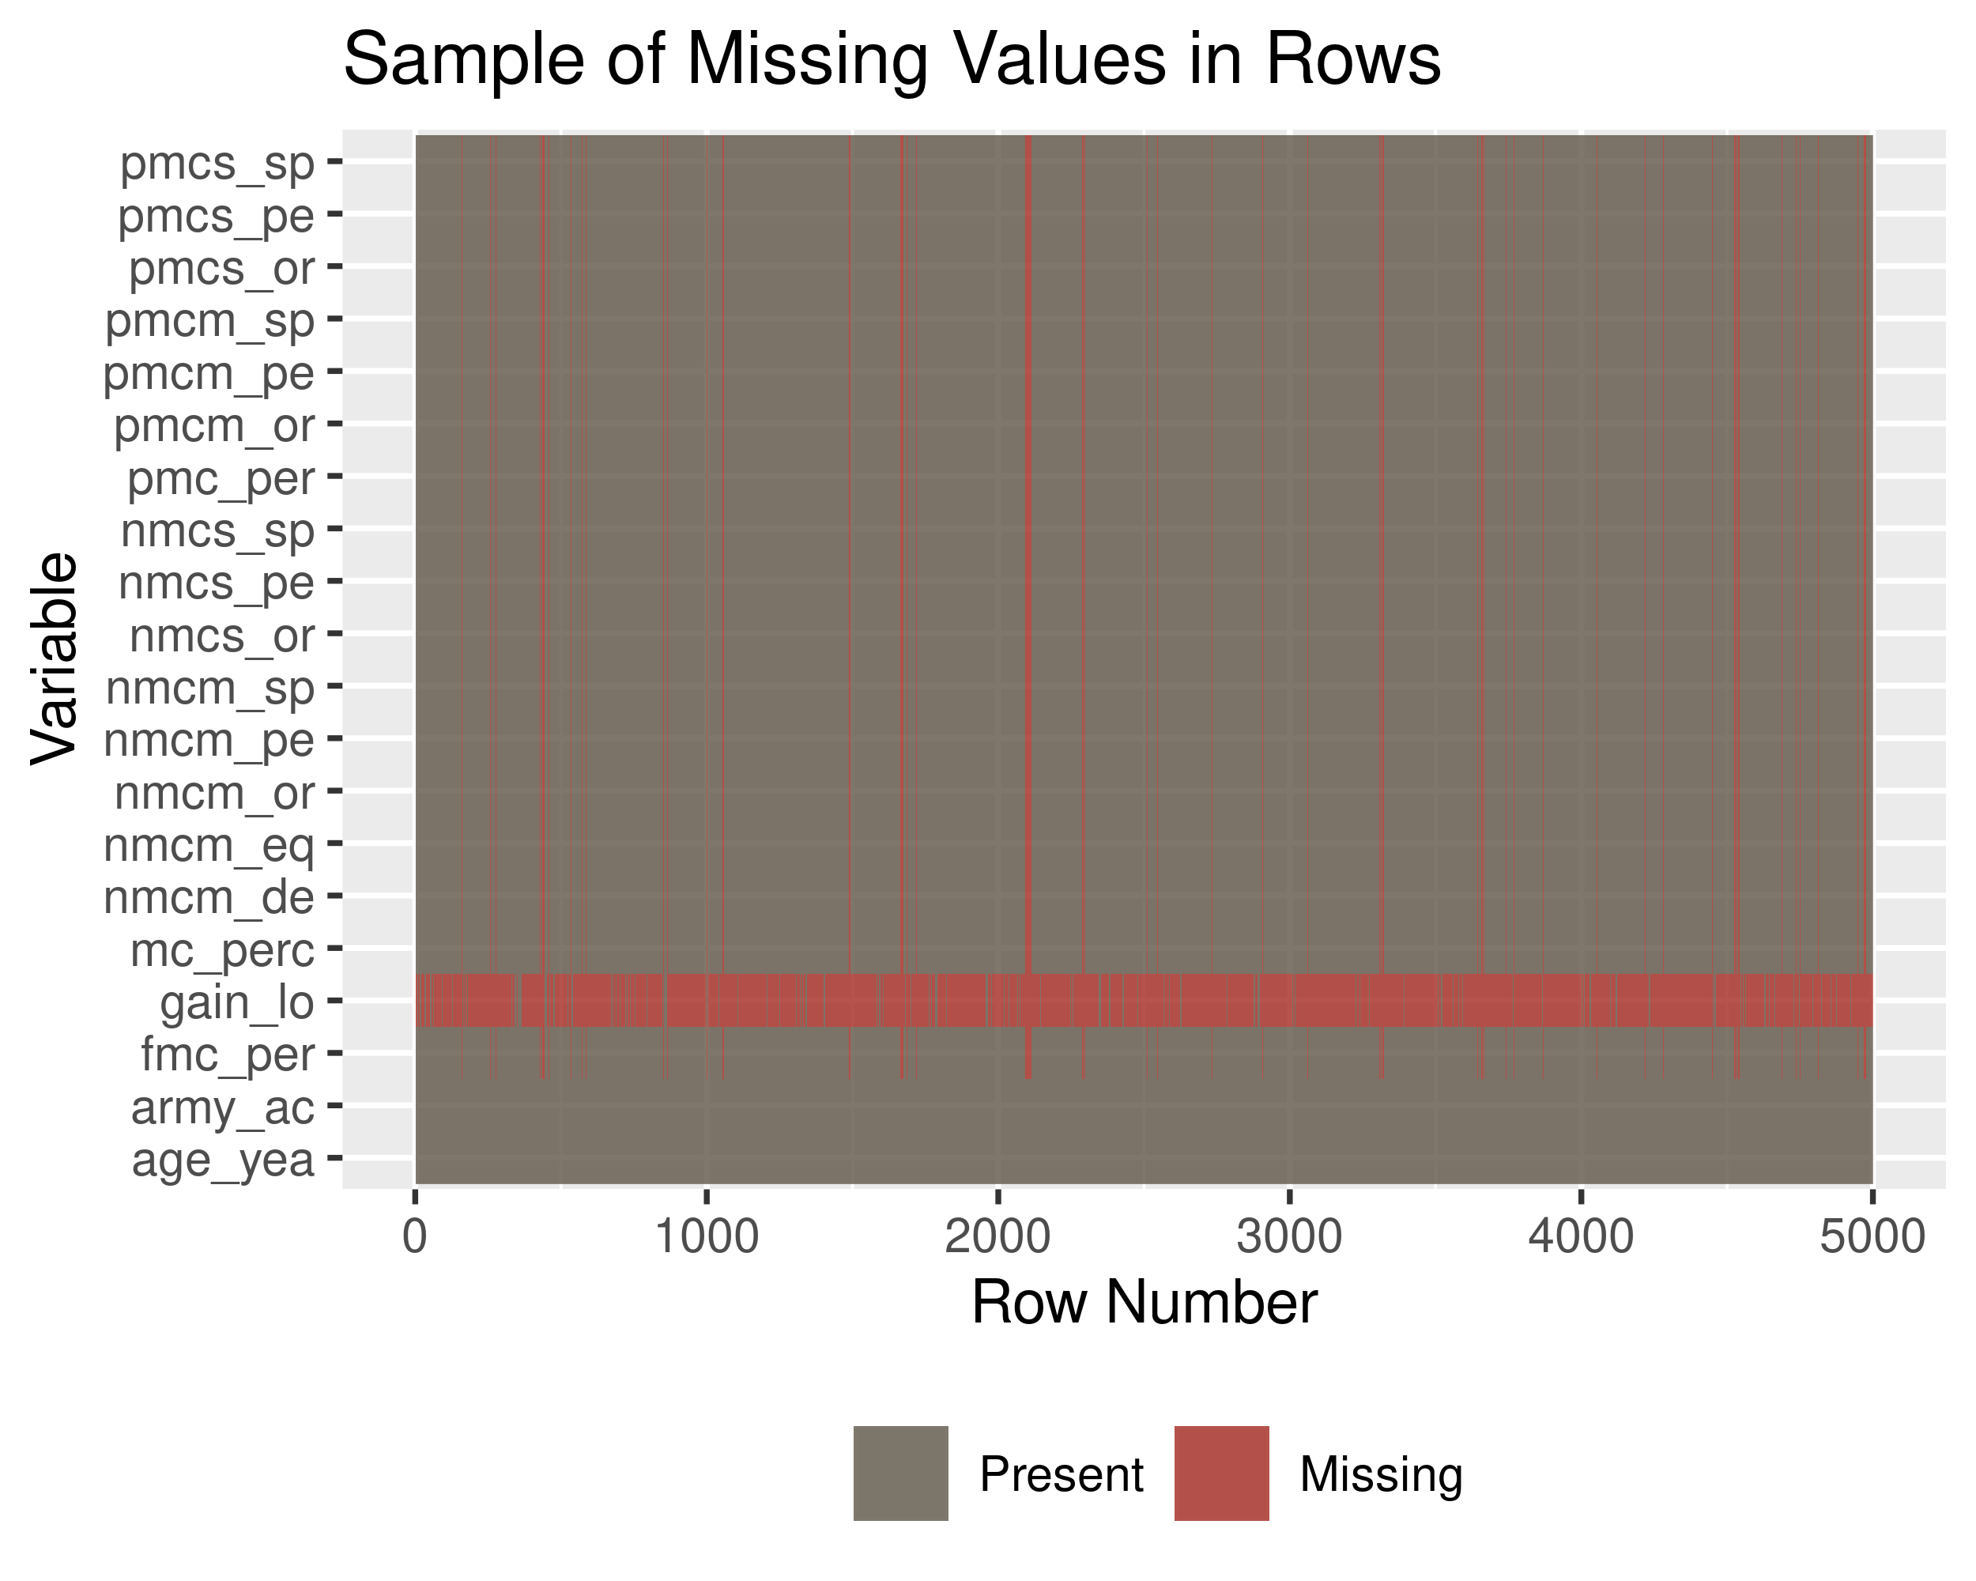
Plot View

Slide 19
Caret Piece
library(caret) maybedata = read_csv("01_data/mors_cleaned_ID.csv") %>% janitor::clean_names() %>% # sample_n(1000) %>% select(-c(gain_loss,nmcs_org_percent, nmcs_spt_percent, nmcm_equip_percent, pmcs_org_percent, pmcs_spt_percent, pmcm_org_percent, pmcm_spt_percent,on_hand_inventory,nmcs_org_days_hrs, nmcs_org_percent, nmcs_spt_days_hrs, nmcm_equip_days_hrs, pmcs_org_days_hrs, pmcs_spt_days_hrs, pmcm_org_days_hrs, pmcm_spt_days_hrs, army_accept_date,id,id2,id3)) %>% mutate(as_of_date = mdy(as_of_date)) maybedata %>% Amelia::missmap()

Slide 20
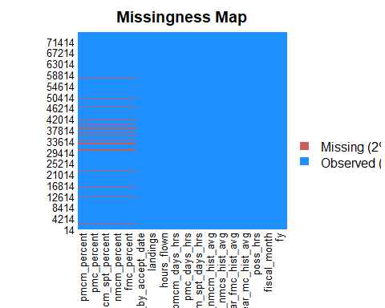

Slide 21
ncol(maybedata)
## [1] 36
# preprocessvalues = preProcess(caretraw[,-36], method = c("medianImpute","nzv")) preprocessvalues = preProcess(maybedata[,-33], method = c("medianImpute","nzv")) # caretimpute = predict(preprocessvalues, caretraw) caretimpute = predict(preprocessvalues, maybedata) Amelia::missmap(caretimpute)

Slide 22
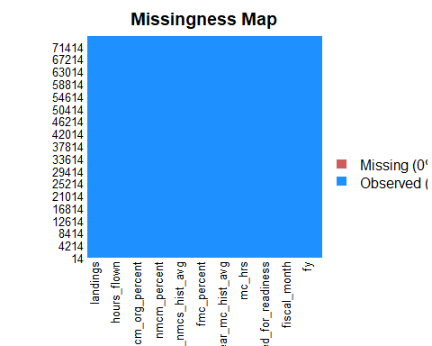

Slide 23
trainIndex <- createDataPartition(caretimpute$hours_flown, p = .7) dataTrain <- caretimpute[trainIndex$Resample1,] dataTest <- caretimpute[-trainIndex$Resample1,] fitControl <- trainControl(method = "none") # str(dataTrain) # summary(lm(hours_flown~.,data = dataTrain)) caretlm <- train(hours_flown ~ ., data = dataTrain, method = "lm", trControl = fitControl) caretrf <- train(hours_flown ~ ., data = sample_n(dataTrain,5000), method = "rf", trControl = fitControl) caretglm <- train(hours_flown ~ ., data = dataTrain, method = "glmnet", trControl = fitControl) lm.pred = predict(caretlm, dataTest) rf.pred = predict(caretrf, dataTest) glm.pred = predict(caretglm, dataTest) postResample(pred = lm.pred, dataTest$hours_flown)
## RMSE Rsquared MAE ## 12.3007294 0.7430058 7.4015395
postResample(pred = rf.pred, dataTest$hours_flown)
## RMSE Rsquared MAE ## 11.1524182 0.8053457 6.6355657
postResample(pred = glm.pred, dataTest$hours_flown)
## RMSE Rsquared MAE ## 12.3302408 0.7423889 7.3338741
caretlm
## Linear Regression ## ## 52396 samples ## 21 predictor ## ## No pre-processing ## Resampling: None

Slide 24
Split, Prepare, and Inpute Data
data = maybedata data_split = data %>% initial_split(prop = .7) # data_split %>% # training() # data_split %>% # testing() flight_recipe = data_split %>% training() %>% recipe(hours_flown ~ .) %>% recipes::step_meanimpute( age_years_by_accept_date, fmc_percent,nmcs_percent, mc_percent,nmcm_org_percent, nmcm_percent,nmcm_spt_percent, nmcm_depot_percent,pmcs_percent,pmc_percent, pmcm_percent ) %>% step_corr( age_years_by_accept_date, fmc_percent,nmcs_percent,mc_percent,nmcm_org_percent, nmcm_percent,nmcm_spt_percent, nmcm_depot_percent,pmcs_percent,pmc_percent, pmcm_percent ) %>% step_center( age_years_by_accept_date, fmc_percent,nmcs_percent,nmcm_org_percent, nmcm_percent,nmcm_spt_percent, nmcm_depot_percent,pmcs_percent,pmc_percent, pmcm_percent ) %>% step_scale( age_years_by_accept_date, fmc_percent,nmcs_percent,nmcm_org_percent, nmcm_percent,nmcm_spt_percent, nmcm_depot_percent,pmcs_percent, pmcm_percent ) %>% prep()

Slide 25
Build Models
flight_testing = flight_recipe %>% bake(training(data_split)) flight_training = juice(flight_recipe) flight_ranger = rand_forest(trees = 50, mode = "regression") %>% set_engine("ranger") %>% fit(hours_flown ~ ., data = flight_training) flight_rf = rand_forest(trees = 10, mode = "regression") %>% set_engine("randomForest") %>% fit(hours_flown ~ ., data = flight_training) flight_lm = linear_reg(mode = "regression") %>% set_engine("lm") %>% fit(hours_flown ~ ., data = flight_training) flight_lasso = linear_reg(mode = "regression") %>% set_engine("glmnet") %>% fit(hours_flown ~ ., data = flight_training)

Slide 26
Make Predictions and Test Models
flight_testing %>% select(hours_flown) %>% bind_cols( predict(flight_ranger, flight_testing) %>% rename(ranger_pred = .pred), predict(flight_rf, flight_testing) %>% rename(rf_pred = .pred), predict(flight_lm, flight_testing) %>% rename(lm_pred = .pred), predict(flight_lasso, flight_testing, penalty = 10) %>% rename(lasso_pred = .pred), ) %>% pivot_longer(cols = -hours_flown) %>% rename(model = name, prediction = value) %>% group_by(model) %>% metrics(truth = hours_flown, estimate = prediction) %>% select(-.estimator) %>% pivot_wider(names_from = .metric, values_from = .estimate) %>% arrange(rmse)
## # A tibble: 4 x 4 ## model rmse rsq mae ## <chr> <dbl> <dbl> <dbl> ## 1 rf_pred 4.44 0.967 2.40 ## 2 ranger_pred 4.82 0.966 2.87 ## 3 lm_pred 12.0 0.748 7.39 ## 4 lasso_pred 16.5 0.700 10.8
cross_data = vfold_cv(flight_training, v = 10) cross_data
## # 10-fold cross-validation ## # A tibble: 10 x 2 ## splits id ## <named list> <chr> ## 1 <split [47.2K/5.2K]> Fold01 ## 2 <split [47.2K/5.2K]> Fold02 ## 3 <split [47.2K/5.2K]> Fold03 ## 4 <split [47.2K/5.2K]> Fold04 ## 5 <split [47.2K/5.2K]> Fold05 ## 6 <split [47.2K/5.2K]> Fold06 ## 7 <split [47.2K/5.2K]> Fold07 ## 8 <split [47.2K/5.2K]> Fold08 ## 9 <split [47.2K/5.2K]> Fold09 ## 10 <split [47.2K/5.2K]> Fold10
Not quite there yet

