Slide 1
Title Template
MAJ Dusty Turner

Slide 2
What We’re Going to Do:
Introduce a Data Problem
Flying Hour Challenge
Show the ‘old technique’
Show the new technique
Discuss Challenges

Slide 4
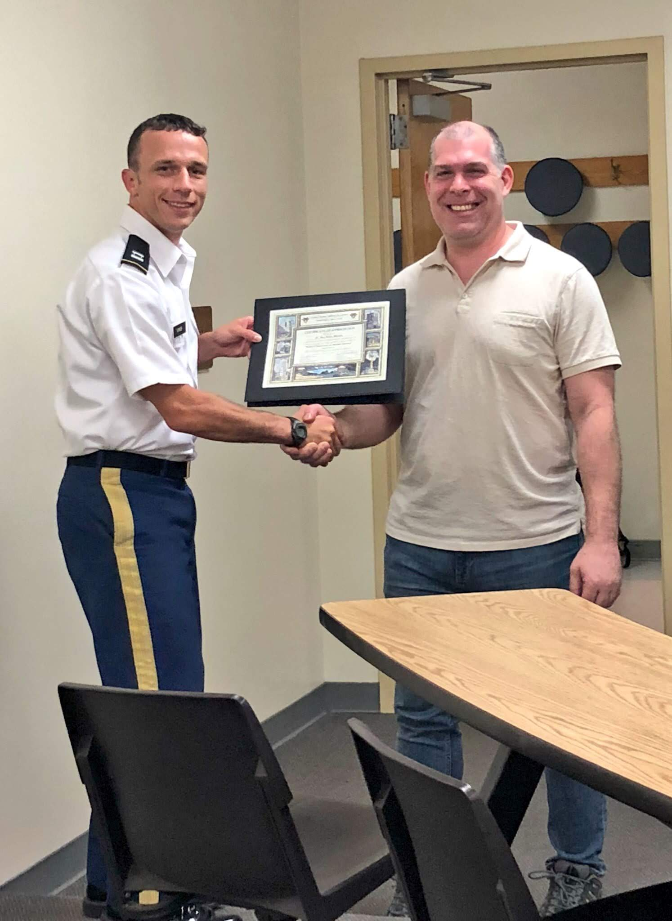
Tidymodels
“tidymodels is a ’’meta-package” for modeling and statistical analysis that share the underlying design philosophy, grammar, and data structures of the tidyverse."
https://github.com/tidymodels/tidymodels
install.packages("tidymodels")
Max Kuhn at West Point Fall 2018

