Slide 1
MORS Emerging Techniques Tidymodels
MAJ Dusty Turner | Max Kuhn

Slide 2

Slide to Delete
Follow Along!

Slide 3
Who am I?
Army
Combat Engineer
Platoon Leader / XO / Company Commander
Geospatial / Sapper / Route Clearance
Hawaii / White Sands Missile Range / Iraq / Afghanistan
Education
West Point ’07
Operations Research, BS
Missouri University of Science and Technology ’12
Engineering Management, MS
THE Ohio State ’16
Integrated Systems Engineering, MS
Applied Statistics, Graduate Minor
Data Science
R User Since ’14
Catch me on Twitter @dtdusty
http://dusty-turner.netlify.com/

Slide 4
What am I assuming about you?
Data Science Background
Moderate R Background
Pretty much a ‘super nerd’
www.tenor.com

Slide 5

What are we going to talk about?
Lets talk about
…modeling in R the old way (caret)
…modeling in R the (very) new way (tidymodels)
…an example (Flying Hour Challlenge)

Slide 6
Background: Out with “The Old”
The Caret Package
Classification And REgression Training
Functionality
Inpute Missing Data
Split Test/Train/Validate Set
Supports a Multitude of Modeling Techniques
Supports Cross Validation
Drawbacks
Requires unique syntax to support each package / imputation technique
Not ‘tidy’ compatible

Slide 7
Background: In with “The New”
The tidymodels package
Released in October 2019
Functionality
Inpute Missing Data
Split Test/Train/Validate Set
Supports a Multitude of Modeling Techniques
Supports Cross Validation
Supports model performance measurements
Advantages
Streamlines syntax for all model types / packages
‘tidy’ compatible
Easy to compare model performance

Slide 8
More details of tidymodels
From the documentation:
“tidymodels is a ’’meta-package” for modeling and statistical analysis that share the underlying design philosophy, grammar, and data structures of the tidyverse."
Imports the following packages:
broom: takes messy output and makes them ‘tidy’ compatible
infer: modern approach to statistical inference
recipes: general data processor with a modern interface that incorporate feature engineering, imputation, and other help tools
yardstick: contains tools for evaluating models (e.g. accuracy, RMSE, etc.)
tidypredict: translates some model prediction equations to SQL for high-performance computing
tidyposterior: used to compare models using resampling and Bayesian analysis
tidytext: contains tidy tools for quantitative text analysis
https://github.com/tidymodels/tidymodels
install.packages("tidymodels")

Slide 9

More details of tidymodels
Author is Max Kuhn of RStudio @topepo
Kuhn, M., & Johnson, K. (2013). Applied predictive modeling. New York: Springer.

Slide 10
Where Does This Fit In The Modeling Process?

Slide 11
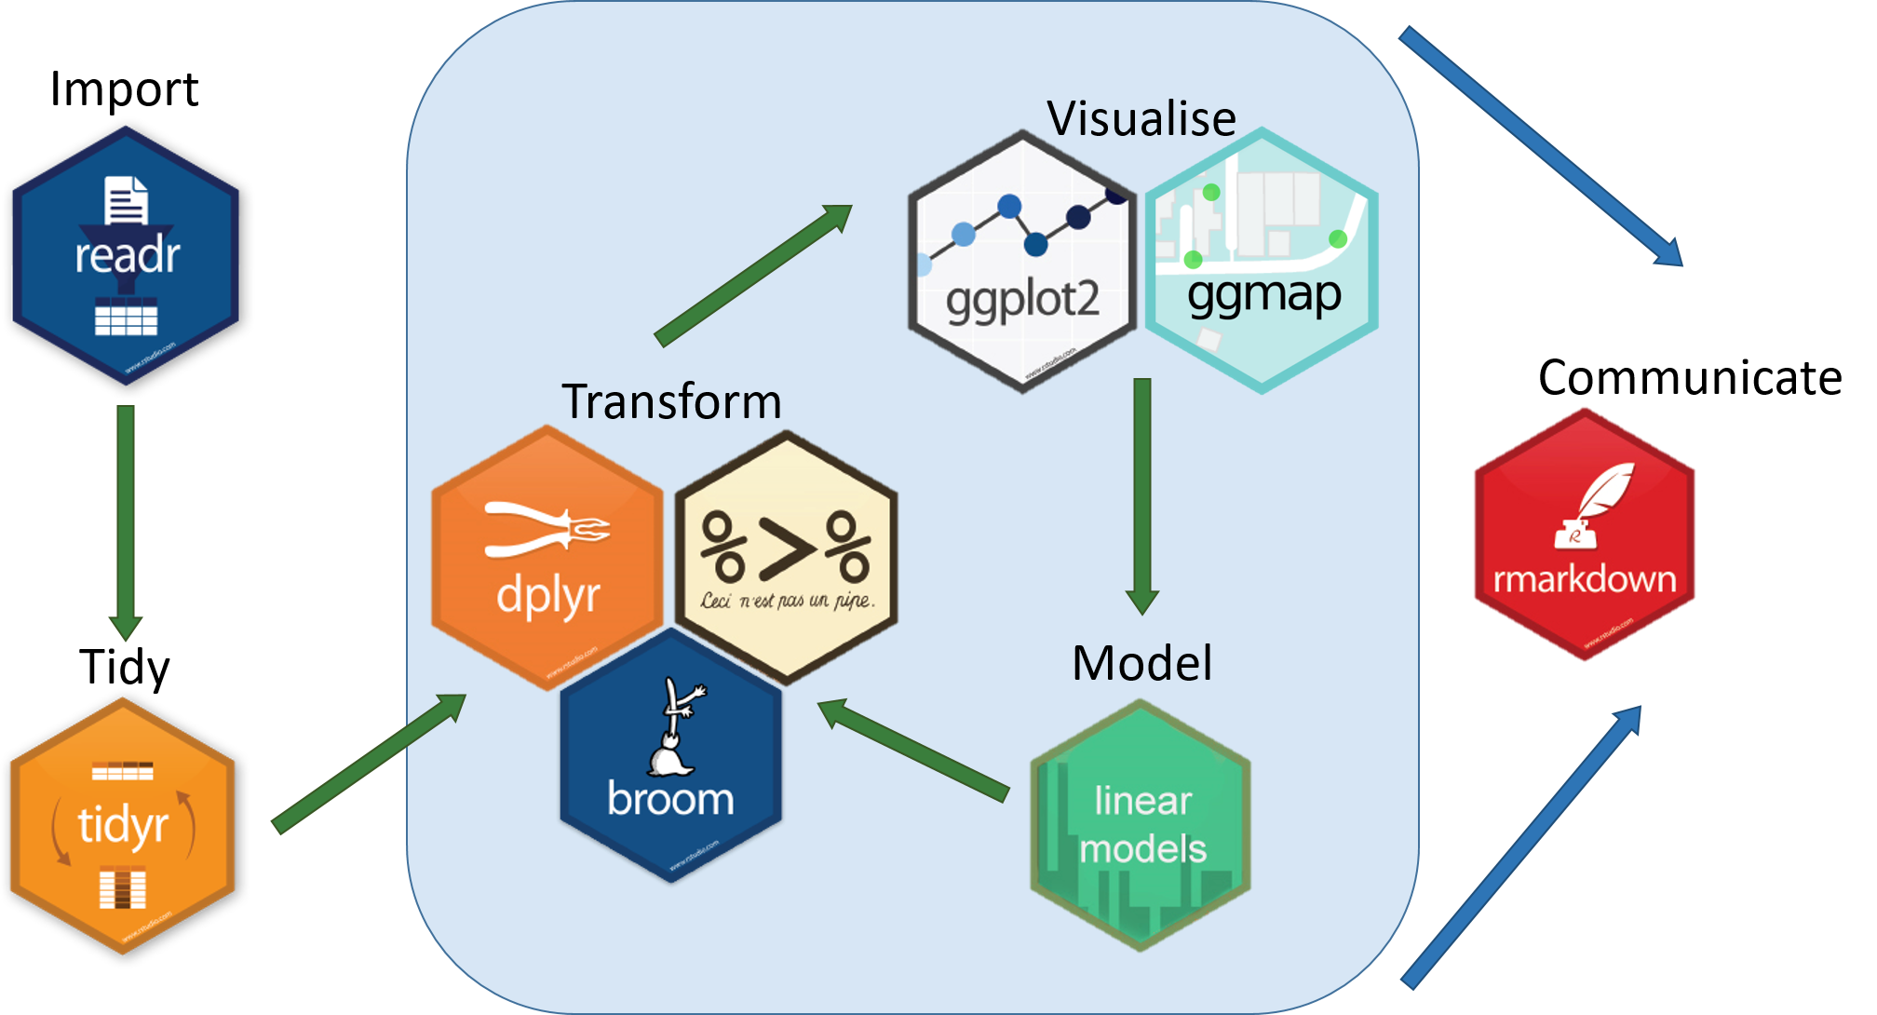
Tidyverse Schema
https://www.tidyverse.org/

Slide 12

Tidymodels Schema
https://www.tidyverse.org/

Slide 13
What We’re Going to Do:
Introduce a Data Problem
Flying Hour Challenge
Show the ‘old techniques’
caret
Show the new technique
tidymodels
Discuss Challenges

Slide 14
Libraries
library(tidyverse) library(tidymodels) library(caret)

Slide 15
Flying Hour Challenge - Inspect the Data
read_csv("01_data/mors_cleaned_ID_simplify.csv") %>% janitor::clean_names() %>% select(hours_flown, as_of_date,mc_percent,poss_hrs,fmc_percent,age_years_by_accept_date) %>% head(10) %>% flextable() %>% autofit()
hours_flown | as_of_date | mc_percent | poss_hrs | fmc_percent | age_years_by_accept_date
9.000 | 10/15/2011 | 1.000 | 720.000 | 1.000 | 25.762
14.000 | 10/15/2011 | 1.000 | 720.000 | 1.000 | 25.762
19.000 | 10/15/2011 | 0.975 | 720.000 | 0.975 | 25.762
20.000 | 10/15/2011 | 1.000 | 720.000 | 1.000 | 25.433
6.000 | 10/15/2011 | 1.000 | 720.000 | 1.000 | 27.433
13.000 | 10/15/2011 | 0.850 | 720.000 | 0.850 | 24.515
3.000 | 10/15/2011 | 0.512 | 720.000 | 0.512 | 24.348
143.000 | 10/15/2011 | 0.912 | 720.000 | 0.912 | 6.419
30.000 | 10/15/2011 | 0.915 | 720.000 | 0.915 | 0.830
47.000 | 10/15/2011 | 1.000 | 720.000 | 1.000 | 0.912

Slide 16
Skimr Numeric Variables
variable | missing | n | mean | sd | p0 | p50 | p100 | hist
fy | 0.000 | 74849.000 | 2013.980 | 1.410 | 2012.000 | 2014.000 | 2016.000 | ▇▇▁▇▁▇▁▇
fiscal_month | 0.000 | 74849.000 | 6.530 | 3.450 | 1.000 | 7.000 | 12.000 | ▇▃▇▃▃▇▅▇
age_years_by_accept_date | 64.000 | 74849.000 | 10.650 | 8.950 | -4.260 | 7.330 | 35.900 | ▁▇▅▂▃▂▂▁
qty_reported_for_readiness | 0.000 | 74849.000 | 0.940 | 0.240 | 0.000 | 1.000 | 1.000 | ▁▁▁▁▁▁▁▇
poss_hrs | 0.000 | 74849.000 | 683.260 | 181.200 | 0.000 | 744.000 | 744.000 | ▁▁▁▁▁▁▁▇
mc_hrs | 0.000 | 74849.000 | 529.850 | 255.990 | 0.000 | 655.000 | 744.000 | ▂▁▁▁▁▁▂▇
mc_percent | 4872.000 | 74849.000 | 0.780 | 0.300 | 0.000 | 0.920 | 1.000 | ▁▁▁▁▁▁▂▇
da_2_year_mc_hist_avg | 0.000 | 74849.000 | 0.730 | 0.040 | 0.670 | 0.710 | 0.810 | ▁▁▇▁▁▁▂▁
avail_hours_days | 0.000 | 74849.000 | 484.350 | 271.250 | 0.000 | 608.000 | 744.000 | ▃▁▁▁▁▂▃▇
fmc_percent | 4872.000 | 74849.000 | 0.710 | 0.340 | 0.000 | 0.860 | 1.000 | ▂▁▁▁▁▂▂▇
da_2_year_fmc_hist_avg | 0.000 | 74849.000 | 0.660 | 0.050 | 0.540 | 0.640 | 0.750 | ▂▁▁▇▃▂▂▃
nmcs_days_hrs | 0.000 | 74849.000 | 16.920 | 76.100 | 0.000 | 0.000 | 744.000 | ▇▁▁▁▁▁▁▁
nmcs_percent | 4872.000 | 74849.000 | 0.020 | 0.110 | 0.000 | 0.000 | 1.000 | ▇▁▁▁▁▁▁▁
da_2_year_nmcs_hist_avg | 0.000 | 74849.000 | 0.050 | 0.010 | 0.030 | 0.050 | 0.070 | ▃▃▁▇▁▁▁▅
nmcm_days_hrs | 0.000 | 74849.000 | 136.490 | 204.750 | 0.000 | 40.000 | 744.000 | ▇▂▁▁▁▁▁▁

Slide 17
Skimr Character and Date Variables
Character Variables
Date Variables
skimr::skim(rawdata) %>% filter(type=="Date") %>% select(-type) %>% pivot_wider(id_cols = variable, names_from = stat) %>% flextable() %>% autofit()
variable | missing | complete | n | min | max | empty | n_unique
as_of_date | 0.000 | 74849.000 | 74849.000 | 9.000 | 10.000 | 0.000 | 60.000
mth | 0.000 | 74849.000 | 74849.000 | 3.000 | 3.000 | 0.000 | 12.000
variable

Slide 18
Flying Hour Challenge - Data Processing
ensure correct data type
rawdata = read_csv("01_data/mors_cleaned_ID_simplify.csv") %>% janitor::clean_names() %>% mutate(as_of_date = lubridate::mdy(as_of_date))
remove near zero variance
nearZeroVar()
linear dependencies
findLinearCombos()
handle NAs (next slide)

Slide 19
Handle NAs
name | NotMissing | Missing
fmc_percent | 69977 | 4872
mc_percent | 69977 | 4872
nmcm_depot_percent | 69977 | 4872
nmcm_percent | 69977 | 4872
nmcm_spt_percent | 69977 | 4872
nmcs_percent | 69977 | 4872
pmc_percent | 69977 | 4872
pmcm_percent | 69977 | 4872
pmcs_percent | 69977 | 4872
age_years_by_accept_date | 74785 | 64
as_of_date | 74849
avail_hours_days | 74849

Slide 20
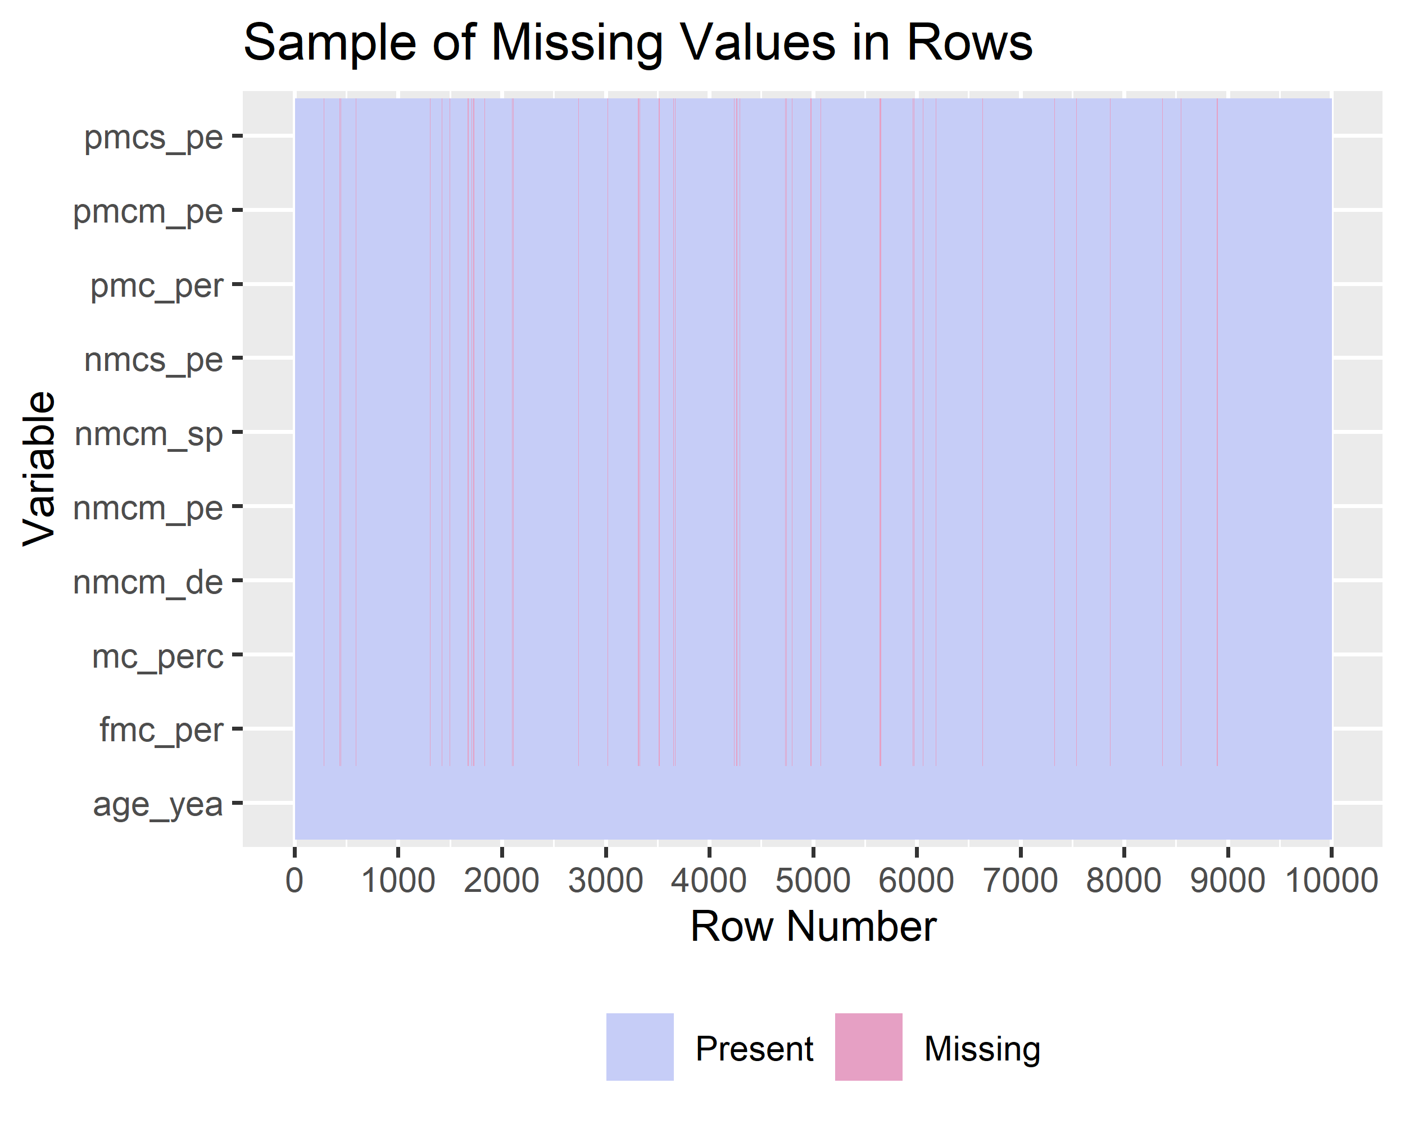
Plot View

Slide 21
Caret: Classification And REgression Training

Slide 22


Slide 23
Caret: Preprocess
preprocessvalues = preProcess(rawdata[,-33], method = c("medianImpute","nzv", "center", "scale"))
caretimpute = predict(preprocessvalues, rawdata)

Slide 24
Caret: Split in Train/Testing
trainIndex = createDataPartition(caretimpute$hours_flown, p = .7) dataTrain = caretimpute[trainIndex$Resample1,] dataTest = caretimpute[-trainIndex$Resample1,]

Slide 25
Caret: Build Models
caretlm = train(hours_flown ~ ., data = dataTrain, method = "lm", trControl = trainControl(method = "none")) caretrf = train(hours_flown ~ ., data = sample_n(dataTrain,5000), method = "rf", trControl = trainControl(method = "none")) # caretranger = train(hours_flown ~ ., data = sample_n(dataTrain,5000), # method = "ranger", # trControl = trainControl(method = "none")) caretglm = train(hours_flown ~ ., data = dataTrain, method = "glmnet", trControl = trainControl(method = "none"))

Slide 26
Caret: Predict and Evaluate
Predict
lm.pred = predict(caretlm, dataTest) rf.pred = predict(caretrf, dataTest) glm.pred = predict(caretglm, dataTest)
Evaluate Models
Model | RMSE | Rsquared | MAE
GLM | 0.511 | 0.744 | 0.308
LM | 0.510 | 0.744 | 0.311
RF | 0.464 | 0.803 | 0.276

Slide 27
Tidymodels

Slide 28


Slide 29
Tidymodels: Split
data_split = rawdata %>% initial_split(prop = .7) data_split
## <52395/22454/74849>

Slide 30
Tidymodels: Preprocess
flight_recipe = data_split %>% training() %>% recipe(hours_flown ~ .) %>% recipes::step_meanimpute( age_years_by_accept_date, fmc_percent,nmcs_percent, mc_percent, nmcm_percent,nmcm_spt_percent, nmcm_depot_percent,pmcs_percent,pmc_percent, pmcm_percent ) %>% step_corr( age_years_by_accept_date, fmc_percent,nmcs_percent,mc_percent, nmcm_percent,nmcm_spt_percent, nmcm_depot_percent,pmcs_percent,pmc_percent, pmcm_percent ) %>% step_center( age_years_by_accept_date, fmc_percent,nmcs_percent, nmcm_percent,nmcm_spt_percent, nmcm_depot_percent,pmcs_percent,pmc_percent, pmcm_percent ) %>% step_scale( age_years_by_accept_date, fmc_percent,nmcs_percent, nmcm_percent,nmcm_spt_percent, nmcm_depot_percent,pmcs_percent, pmcm_percent ) %>% prep()

Slide 31
Tidymodels: Preprocess
flight_recipe
## Data Recipe ## ## Inputs: ## ## role #variables ## outcome 1 ## predictor 33 ## ## Training data contained 52395 data points and 3458 incomplete rows. ## ## Operations: ## ## Mean Imputation for age_years_by_accept_date, ... [trained] ## Correlation filter removed mc_percent [trained] ## Centering for age_years_by_accept_date, ... [trained] ## Scaling for age_years_by_accept_date, ... [trained]

Slide 32
Tidymodels: Prepare Training and Testing Data
Juice Training Data
flight_training = juice(flight_recipe)
Bake Testing Data
flight_testing = flight_recipe %>% bake(training(data_split))

Slide 33
Tidymodels: Build Models
flight_lm = linear_reg(mode = "regression") %>% set_engine("lm") %>% fit(hours_flown ~ ., data = flight_training) flight_rf = rand_forest(trees = 10, mode = "regression") %>% set_engine("randomForest") %>% fit(hours_flown ~ ., data = flight_training) flight_ranger = rand_forest(trees = 50, mode = "regression") %>% set_engine("ranger") %>% fit(hours_flown ~ ., data = flight_training) flight_glm = linear_reg(mode = "regression") %>% set_engine("glmnet") %>% fit(hours_flown ~ ., data = flight_training)

Slide 34
Tidymodels: Side Note
Models Currently Available
lm
tree-based
survival analysis
bayesian

Slide 35
Tidymodels: Predictions and Evaluate
flight_testing %>% select(hours_flown) %>% bind_cols( predict(flight_lm, flight_testing) %>% rename(lm_pred = .pred), predict(flight_rf, flight_testing) %>% rename(rf_pred = .pred), predict(flight_ranger, flight_testing) %>% rename(ranger_pred = .pred), predict(flight_glm, flight_testing, penalty = 10) %>% rename(lasso_glm = .pred), ) %>% pivot_longer(cols = -hours_flown) %>% rename(model = name, prediction = value) %>% group_by(model) %>% metrics(truth = hours_flown, estimate = prediction) %>% select(-.estimator) %>% pivot_wider(names_from = .metric, values_from = .estimate) %>% arrange(rmse)
## # A tibble: 4 x 4 ## model rmse rsq mae ## <chr> <dbl> <dbl> <dbl> ## 1 rf_pred 4.49 0.966 2.40 ## 2 ranger_pred 4.74 0.967 2.78 ## 3 lm_pred 12.1 0.744 7.46 ## 4 lasso_glm 16.6 0.695 10.9

Slide 36
Tidymodels: The Next Fronteir
Further incorporation of model metrics (cross validation).
cross_data = vfold_cv(flight_training, v = 10) cross_data
## # 10-fold cross-validation ## # A tibble: 10 x 2 ## splits id ## <named list> <chr> ## 1 <split [47.2K/5.2K]> Fold01 ## 2 <split [47.2K/5.2K]> Fold02 ## 3 <split [47.2K/5.2K]> Fold03 ## 4 <split [47.2K/5.2K]> Fold04 ## 5 <split [47.2K/5.2K]> Fold05 ## 6 <split [47.2K/5.2K]> Fold06 ## 7 <split [47.2K/5.2K]> Fold07 ## 8 <split [47.2K/5.2K]> Fold08 ## 9 <split [47.2K/5.2K]> Fold09 ## 10 <split [47.2K/5.2K]> Fold10
Not quite there yet

Slide 37
In Summary
caret
65,800 hits on Google Scholar
Proven to be successful
Clunky syntax
tidymodels
122 hits on Google Scholar
Streamlined ‘tidy’ syntax
Still in development
Backing of R Studio

Slide 38
Thanks!
MAJ Dusty Turner
Twitter: @dtdusty
Eamil: dusty.s.turner.mil@mail.mil
Github dusty-turner
Personal Website https://dusty-turner.netlify.com/
Max Kuhn
Twitter @topepo
Github topepo

Slide 39

QR Dusty Contact

Slide 40
QR Presentation

