Slide 1
Title Template
MAJ Dusty Turner

Slide 2
What We’re Going to Do:
name | NotMissing | Missing
gain_loss | 6995 | 67854
fmc_percent | 69977 | 4872
mc_percent | 69977 | 4872
nmcm_depot_percent | 69977 | 4872
nmcm_equip_percent | 69977 | 4872
nmcm_org_percent | 69977 | 4872
nmcm_percent | 69977 | 4872
nmcm_spt_percent | 69977 | 4872
nmcs_org_percent | 69977 | 4872
nmcs_percent | 69977 | 4872
nmcs_spt_percent | 69977 | 4872
pmc_percent | 69977 | 4872
pmcm_org_percent | 69977 | 4872
pmcm_percent | 69977 | 4872
pmcm_spt_percent | 69977 | 4872
pmcs_org_percent | 69977 | 4872
pmcs_percent | 69977 | 4872
pmcs_spt_percent | 69977 | 4872
age_years_by_accept_date | 74785 | 64
army_accept_date | 74785 | 64
as_of_date | 74849 | NA
auto_rotate | 74849 | NA
Introduce a Data Problem
Flying Hour Challenge
Show the ‘old technique’
Show the new technique
Discuss Challenges

Slide 4
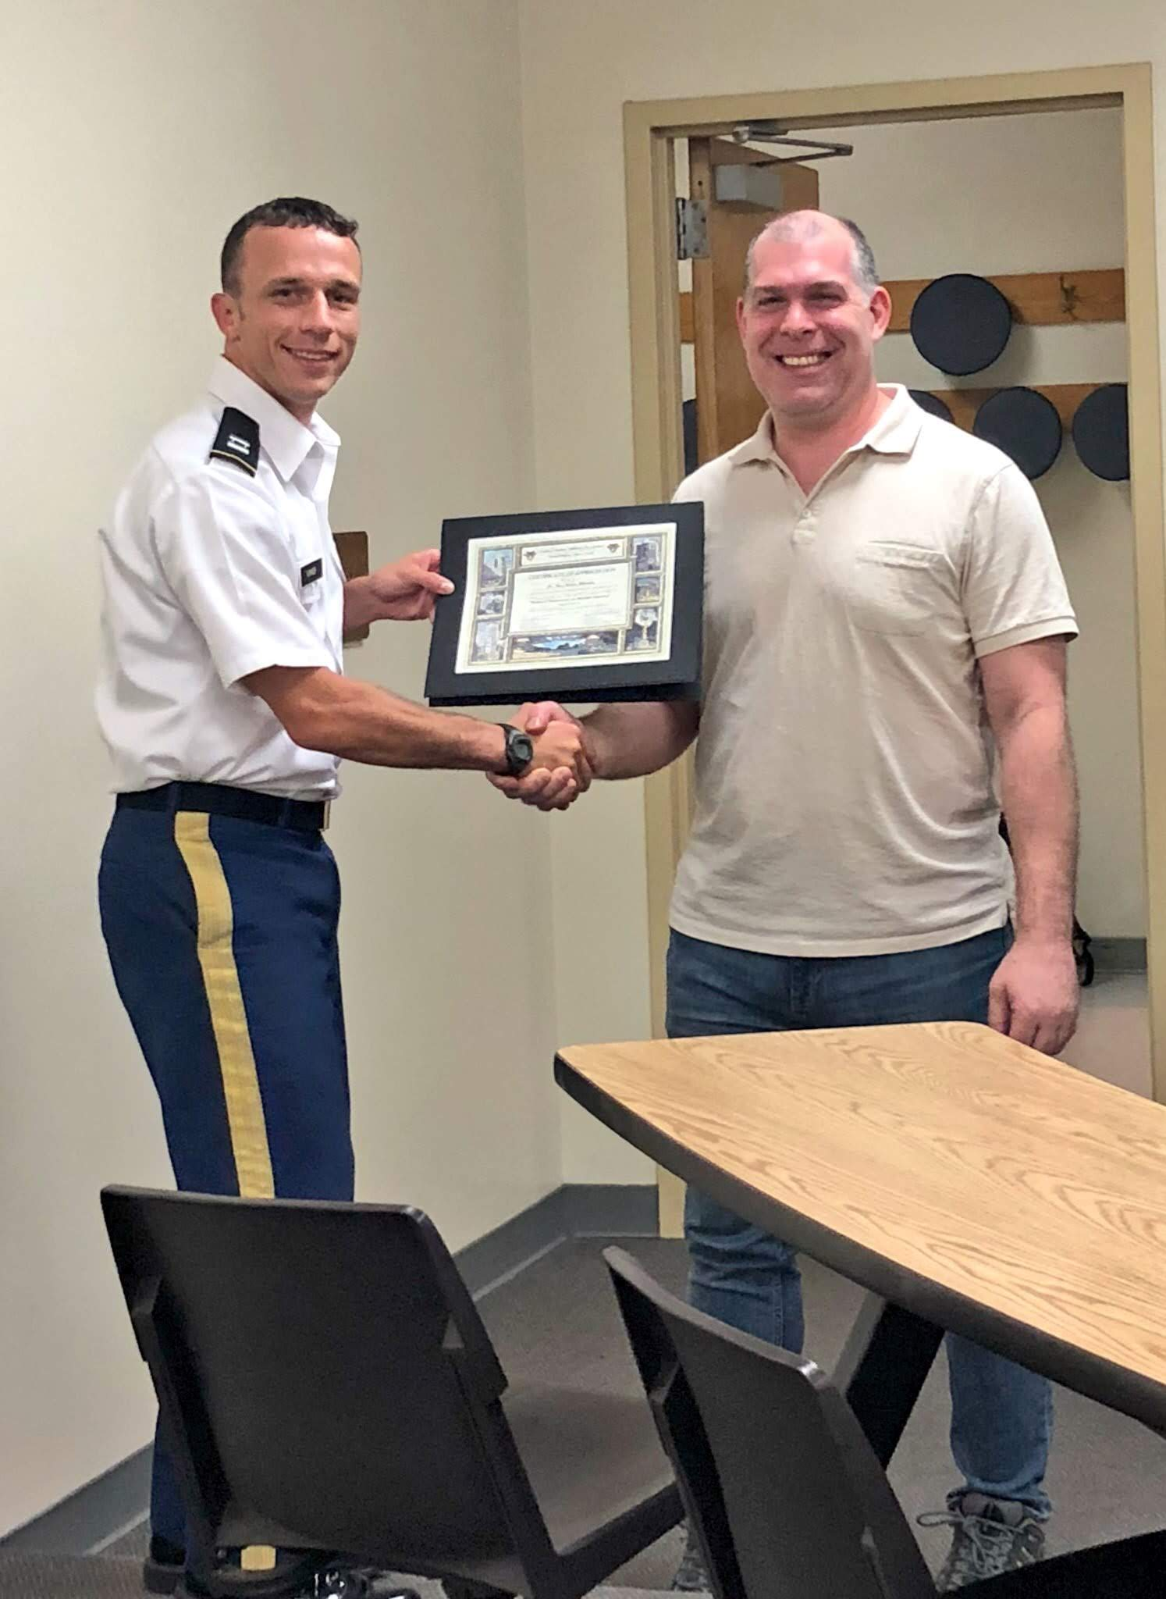
Tidymodels
“tidymodels is a ’’meta-package” for modeling and statistical analysis that share the underlying design philosophy, grammar, and data structures of the tidyverse."
https://github.com/tidymodels/tidymodels
install.packages("tidymodels")
Max Kuhn at West Point Fall 2018

