Slide 1
CE 3372 Water Systems Design
pipeline HYDRAULICS examples : Part 2

Slide 2
Linking systems
A hydraulic system can be analysed as a set of linked components to make an otherwise complicated system easier to analyze.
Idea is to break system into independent parts, analyze the parts then reassemble to answer questions about the whole system
Best illustrated by an example

Slide 3
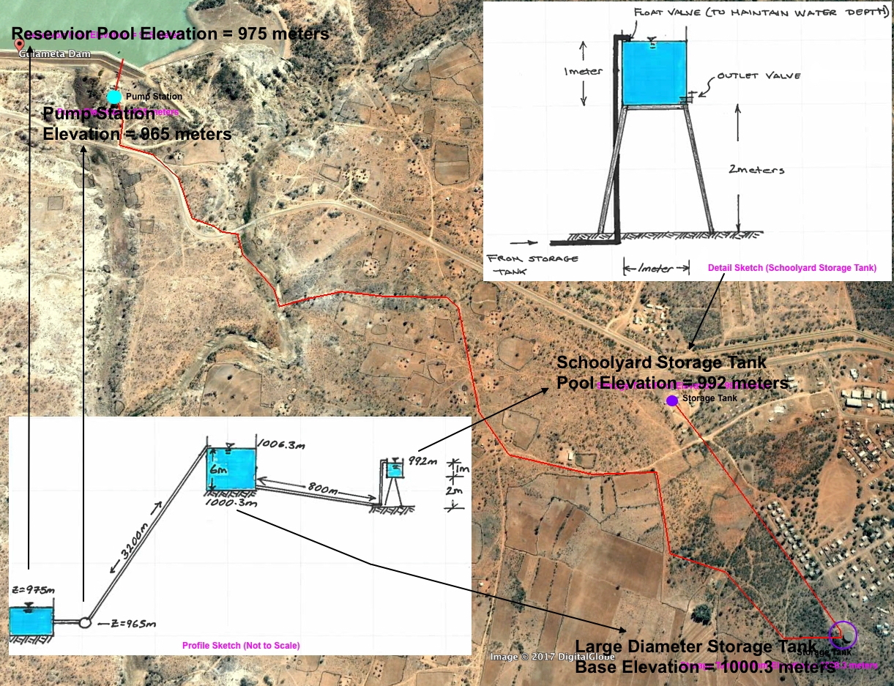
Linking systems
Notes:
The figure is an aerial image of a pipeline system with preliminary engineering sketches of the system (lower left panel) and a detail sketch of the terminal small storage tank (upper right panel). The 3,200 meter long pipeline lifts 25C water ( rho= 997 kg=m3,nu= 8.94 E-7 m2/s) from a treatment plant on the downstream face of Gulameta Dam through a 127 millimeter high-density polyethylene (HDPE) pipe (ks =0:0015 mm) to a large diameter at-grade cylindrical storage tank. A secondary, 800 meter long pipeline carries water from the large diameter storage tank to a small,
cylindrical (D = 1 meter), elevated storage tank at the village school. Both storage tanks have float valves to prevent overflow and maintain the indicated water poolelevations.

Slide 4
Linking systems
Analyze proposed system to determine anticipated behavior
Float valve fails at school
Outlet valve accidently left open
Pump operation under worst failure mode
Pump fails, time until system fails
Float valve limited
Oultet valve limited

Slide 5
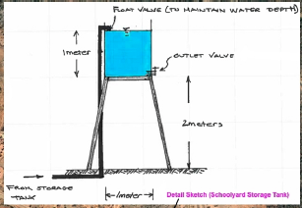
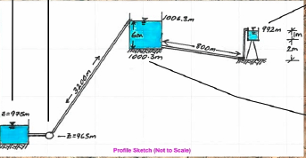
Linking systems
Float valve fails at school
Upstream head = 1006.3 m (pump working, supply tank stays full)
Downstream head = 992 m (pool elevation at schoolyard tank overflow)
Notes:
Assume the float valve at the schoolyard fails in the open position, and the schoolyard tank overows.
2 bends, K =1.5 each
1 inlet K =0.5
Upstream valve K =0.15
Float valve K = 70 (assume ball valve type)
127mm HDPE

Slide 6
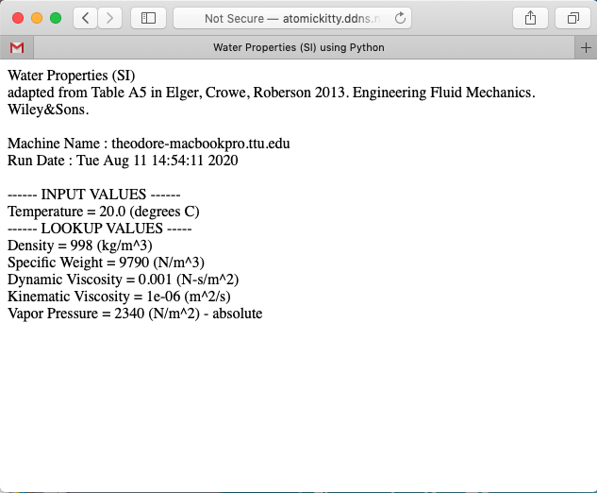
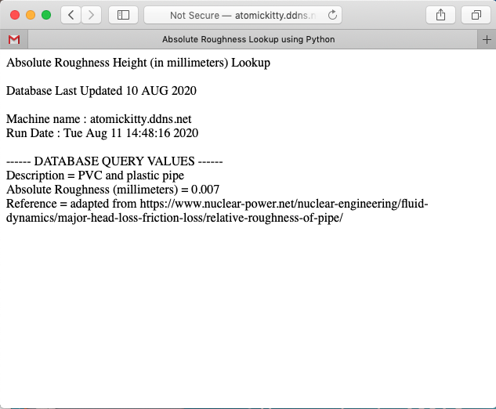
Linking systems
Float valve fails at school
Z₁= 1006.3 m ; Z₂ = 992 m
2 bends, K =1.5 each
1 inlet K =0.5
Upstream valve K =0.15
Float valve K = 70
Viscosity = 1.0 E-06sq.m/s
Ks (HDPE) = 0.007mm 0.000007m
Notes:
Assume the float valve at the schoolyard fails in the open position, and the schoolyard tank overows.
2 bends, K =1.5 each
1 inlet K =0.5
Upstream valve K =0.15
Float valve K = 70 (assume ball valve type)
127mm HDPE

Slide 7
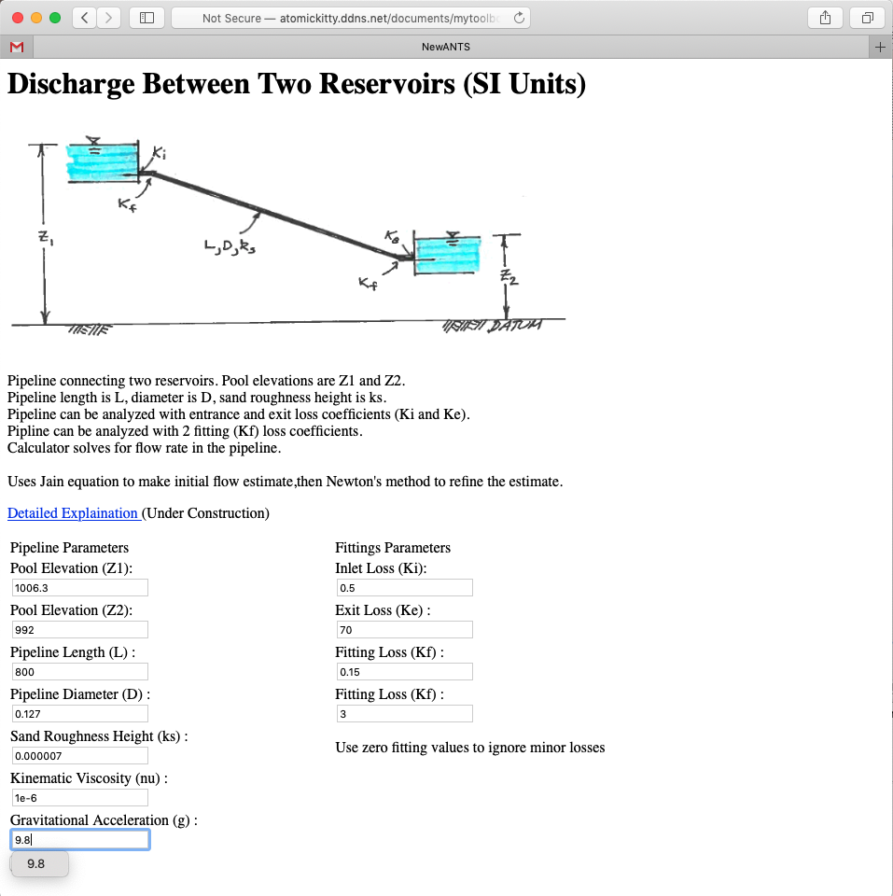
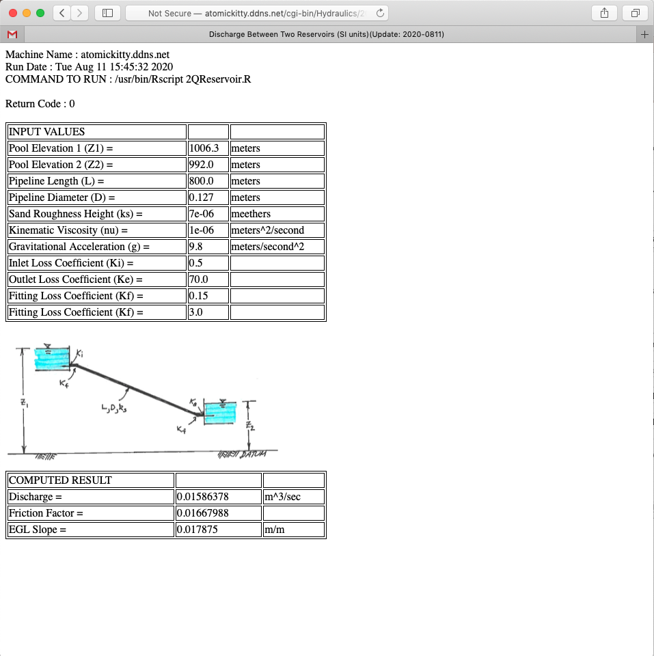
Linking systems
Hydraulic Model
~ 16 liters/second
Notes:
Assume the float valve at the schoolyard fails in the open position, and the schoolyard tank overows.
2 bends, K =1.5 each
1 inlet K =0.5
Upstream valve K =0.15
Float valve K = 70 (assume ball valve type)
127mm HDPE

