Slide 1
CE 3372 Water Systems Design
Pumps and Lift Stations – PART 3 (FALL 2020)

Slide 2
Suction Requirements
The most common cause of pumping failure is poor suction conditions
Cavitation occurs when liquid pressure is reduced to the vapor pressure of the liquid
For piping system with a pump, cavitation occurs when P_{abs} at the inflow falls below the vapor pressure of the water
Notes:
They implode in such a great force and high heat and causes a lot of damage to pump
Reduce pump and impeller capacity

Slide 3
Suction Requirements
Liquid must enter the pump eye under pressure; this pressure is called the Net Positive Suction Head available (NPSH_{a}).
A centrifugal pump cannot lift water unless it is primed
the first stage impellers must be located below the static HGL in the suction pit at pump start-up
Notes:
They implode in such a great force and high heat and causes a lot of damage

Slide 4
Suction Requirements
The manufacturer supplies a value for the minimum pressure the pump needs to operate.
This pressure is the Net Positive Suction Head required (NPSH_{r}).
For proper pump operation (w/o cavitation)
NPSH_{a}> NPSH_{r}
Notes:
Draw NPSH example.
Required is by manufacturer
NPSHr must be maintained or exceeded!!
over all operating conditions, including start-up and shut-down.

Slide 5
Suction Requirements
Available suction is computed from
Absolute vapor pressure at liquid pumping temperature
Frictional head loss in inlet piping
Static elevation of the liquid above the pump inlet eye
Absolute pressure at liquid surface in suction pit
Notes:
VP cause of temperature
NPSH is pressure req at the suction of a pump to prevent cavitation
h_{s} (static suction head): it is the difference in elevation between the suction liquid level and the centerline of the pump impeller.

Slide 6
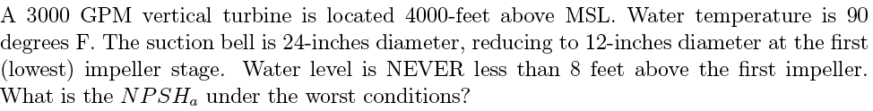
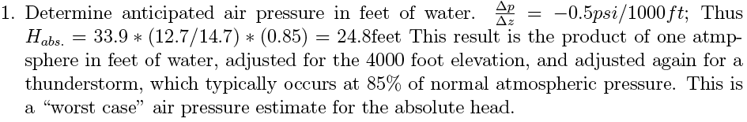
Suction Requirements
Example
Notes:
MSL = mean sea level
Air pressure drops as you go up.
33.9 pressure = 1 atm water at standard
14.7 psi will hold up 33 feet of water. (12.7/14.7psi) is a ratio
85% real big thunderstorm. Atm is 85% of normal

Slide 7
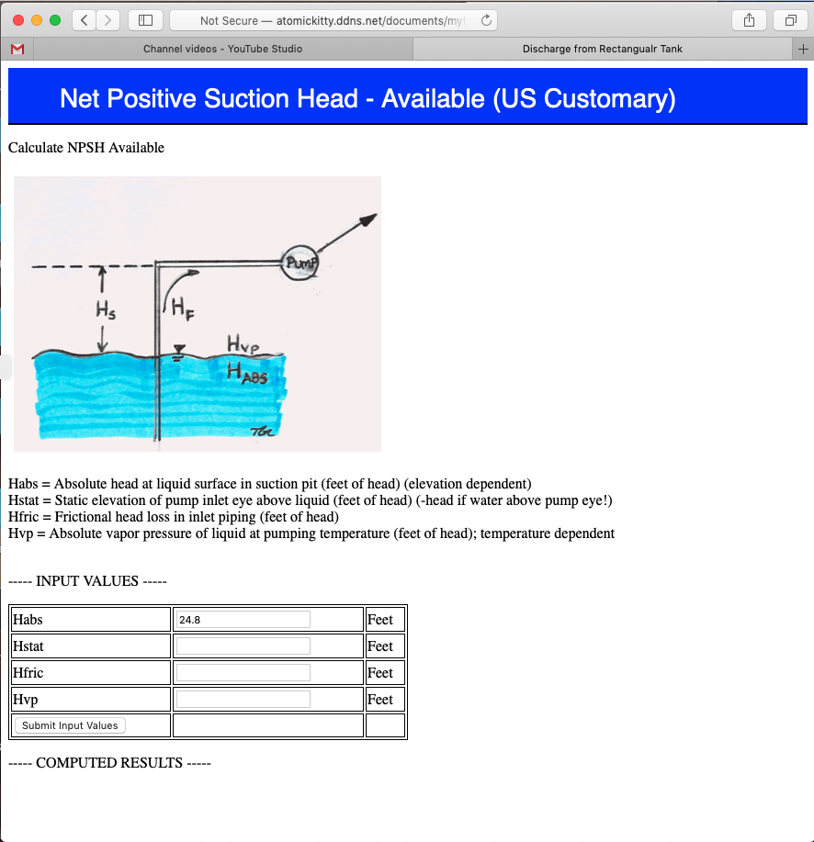
http://atomickitty.ddns.net/documents/mytoolbox-server/Hydraulics/NPSHCalculatorUS/NPSHCalculatorUS.html
Notes:
MSL = mean sea level
Air pressure drops as you go up.
33.9 pressure = 1 atm water at standard
14.7 psi will hold up 33 feet of water. (12.7/14.7psi) is a ratio
85% real big thunderstorm. Atm is 85% of normal

Slide 8
Suction Requirements
Example

Slide 9

http://atomickitty.ddns.net/documents/mytoolbox-server/Hydraulics/NPSHCalculatorUS/NPSHCalculatorUS.html
Notes:
MSL = mean sea level
Air pressure drops as you go up.
33.9 pressure = 1 atm water at standard
14.7 psi will hold up 33 feet of water. (12.7/14.7psi) is a ratio
85% real big thunderstorm. Atm is 85% of normal

Slide 10
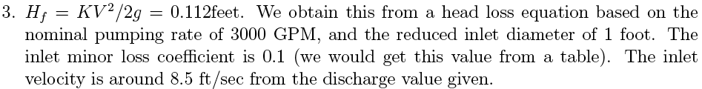
Suction Requirements
Example

Slide 11

http://atomickitty.ddns.net/documents/mytoolbox-server/Hydraulics/NPSHCalculatorUS/NPSHCalculatorUS.html
Notes:
MSL = mean sea level
Air pressure drops as you go up.
33.9 pressure = 1 atm water at standard
14.7 psi will hold up 33 feet of water. (12.7/14.7psi) is a ratio
85% real big thunderstorm. Atm is 85% of normal

Slide 12
Suction Requirements
Example

Slide 13

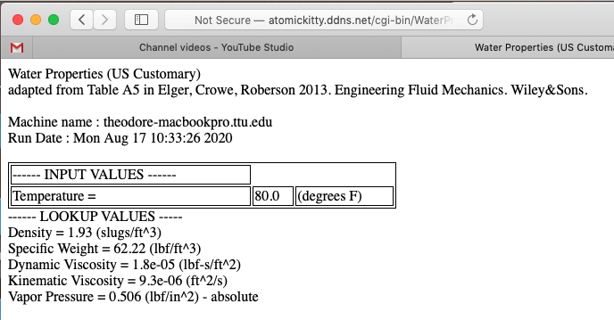

Notes:
MSL = mean sea level
Air pressure drops as you go up.
33.9 pressure = 1 atm water at standard
14.7 psi will hold up 33 feet of water. (12.7/14.7psi) is a ratio
85% real big thunderstorm. Atm is 85% of normal

Slide 14
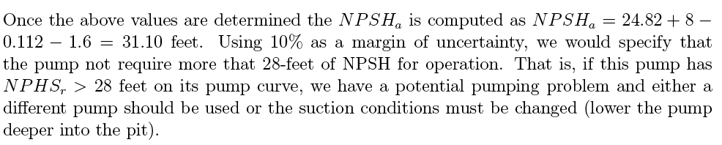
Suction Requirements
Example

Slide 15
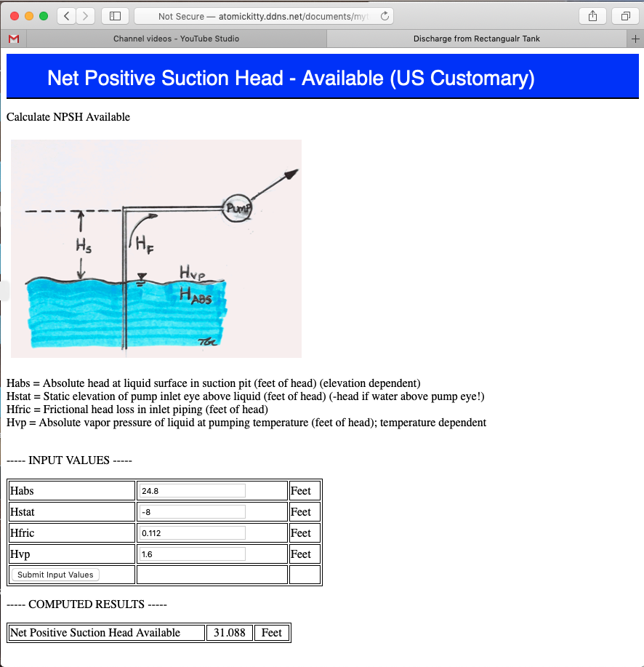
http://atomickitty.ddns.net/documents/mytoolbox-server/Hydraulics/NPSHCalculatorUS/NPSHCalculatorUS.html
Notes:
MSL = mean sea level
Air pressure drops as you go up.
33.9 pressure = 1 atm water at standard
14.7 psi will hold up 33 feet of water. (12.7/14.7psi) is a ratio
85% real big thunderstorm. Atm is 85% of normal

