Slide 1
CE 3372 Water Systems Design
DRINKING WATER storage Part 2 (FALL 2020)

Slide 2
Storage
Purpose of storage reservoirs
Types of reservoirs
Calculating storage requirements

Slide 3
Storage Reservoirs
Equalizing or Operating Storage
Equalize pumping rate into reservoirs
Provide storage for peak demand times
Provide system pressure without booster pumping
Fire and emergency pressures
Types
Surface reservoirs
Standpipes
Elevated tanks

Slide 4
Storage Compartments
Service storage
Emergency storage
Fire Storage
Service
Emergency
Fire

Slide 5
Flow-equalization
Flow-equalization storage is sufficient storage to account for peak demands in the system without having to exceed supply capacity.
A desirable volume is 1-2 days of average daily demand.

Slide 6
Fire storage
Fire storage is sufficient storage to allow the system to meet routine uses plus substantial fire flow.
The desirable volume is based on expected fire flow rates multiplied by the required fire flow duration.

Slide 7
emergency storage
Emergency storage to allow the system to operate without external supply sources for a period of time to allow for repairs or other unusual circumstances.
Without emergency storage, every upset will lead to a ”boil-water” order or substantial interruption of service — these kinds of interruptions should be rare if the system is well engineered.
A desirable volume is 1-2 days of average daily demand.

Slide 8
How much?
Engineering would tend to choose for the larger volumes
Economics will argue for the smaller volumes
The engineer will have to balance these competing choices in a design.

Slide 9
Residence time
Additionally, residence times in any storage reservoir for TREATED water should not exceed a reasonable amount disinfection residual contact time.
For chlorine/chloramine disinfection time is on the order of 6-10 days
Hydraulic retention time of any such reservoir should be no longer than 8 days (as a reasonable rule of thumb).

Slide 10
Hydraulic Retention Time
Hydraulic retention time is the ratio of storage volume to average discharge through the reservoir

Slide 11
Operating Storage
Determine hourly demand for design day
Calculate cumulative draft
Plot cumulative draft vs. time (24 hr)
Draw diagonal line representing constant pumping
Read required storage as sum of two maximum ordinates

Slide 12
Mass Diagram (24-hr pumping)

Slide 13
Mass Diagram (12-hr Pumping)

Slide 14
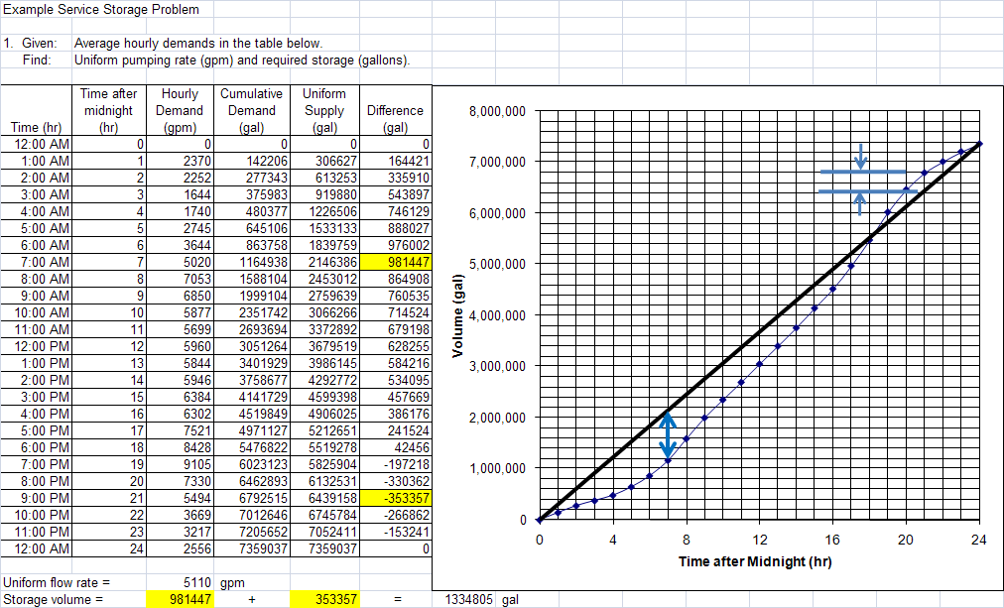

Slide 15
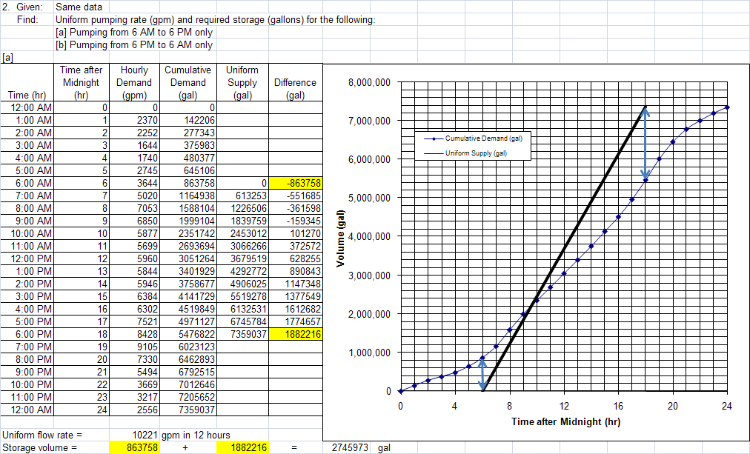

Slide 16
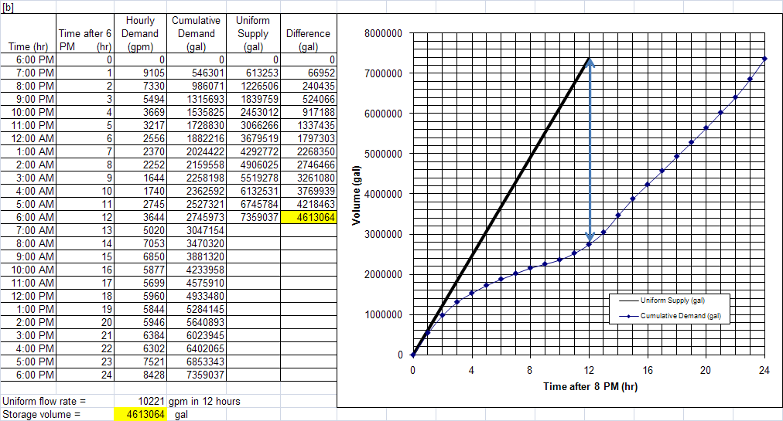

Slide 17
Flow Equalization
The engineer needs to decide which demand to use:
Daily
Peak
These volumes are added to that needed for emergency and fire flow.
Determines the tank volume required
Tank type (elevated, at-grade, buried) determines shape – elevation, diameter, min-level, max-level.
Elevated tanks have substantial structural considerations

