Slide 1
CE 3372 water systems design
Introduction L1-P1

Slide 2
Outline
Introduction
Web Server Introduction
History of Water Systems

Slide 3
Introduction
Mode: On-Line; asyncronous (pre-recorded) and syncronus (webinar-style + wiki).
Management: Content linked through a Learning Management System (Moodle), content is stored mostly on a conventional web server. Exercises, Quizzes, Exams are administered by the LMS
Teacher: Theodore G. Cleveland, Ph.D., P.E., M. ASCE, F. EWRI
Course Content (including syllabus): http://atomickitty.ddns.net/documents/university-courses/ce-3372/
Course LMS (jamesbond jamesbond#007): http://atomickitty.ddns.net/moodle/

Slide 4
SYLLABUS
The syllabus is posted on the class web site:
http://www.rtfmsp.com/moodle/
The moodle is a learning management system
You will need a userid and password – they are supplied by email

Slide 5
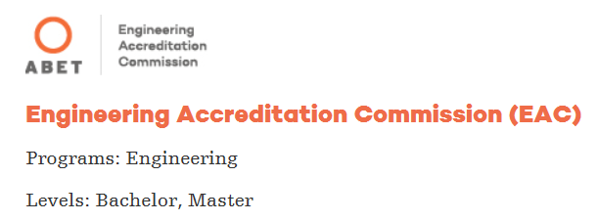
Accreditation Board for Engineering and Technology (ABET)
ABET is a nonprofit, non-governmental accrediting agency for programs in applied and natural science, computing, engineering and engineering technology and ABET is recognized as an accreditor by the Council for Higher Education Accreditation.
To date, over 3,700 programs at more than 750 colleges and universities in 30 countries have received ABET accreditation. Approximately 85,000 students graduate from ABET-accredited programs each year, and millions of graduates have received degrees from ABET-accredited programs since 1932.

Slide 6
Why ABET Accreditation:
Ensures that graduates have met the educational requirements necessary to enter the profession
Provides opportunities for the industry to guide the educational process to reflect current and future needs
Enhances the mobility of professionals
What Accreditation Means to…
1. Students
Be confident in your education—ABET accreditation is the trusted standard for employers worldwide.
2. Programs & Institutions
ABET accreditation demonstrates your commitment to delivering quality education.
3. Industry, Government & the World
Employers can trust that graduates of ABET-accredited programs are prepared to enter the workforce and make a positive contribution to the global society

Slide 7
Why assess student performance in courses?
To be an ABET accredited, the program must regularly use appropriate, documented processes for assessing and evaluating the extent to which the ABET student outcomes are being attained.
The results of these evaluations must be systematically utilized as input for continuously improving the program.
Evidence of achieving those outcomes are based on employers comments, senior exit surveys, industry assessment, and course performance

Slide 8
ABET Student Outcomes
Student outcomes are items that should be learned by the end of the class and are selected on a per course basis.
an ability to apply knowledge of mathematics, science, and engineering
an ability to design and conduct experiments, as well as to analyze and interpret data
an ability to design a system, component, or process to meet desired needs within realistic constraints such as economic, environmental, social, political, ethical, health and safety, manufacturability, and sustainability
an ability to function on multidisciplinary teams
an ability to identify, formulate, and solve engineering problems
an understanding of professional and ethical responsibility
an ability to communicate effectively
the broad education necessary to understand the impact of engineering solutions in a global, economic, environmental, and societal context
a recognition of the need for, and an ability to engage in life-long learning
a knowledge of contemporary issues
an ability to use the techniques, skills, and modern engineering tools necessary for engineering practice.

Slide 9
What do we expect of our graduates?
Program Educational Objectives (civil engineering):
Graduates will meet the expectations of employers of civil engineers.
Graduates will continue their professional development through graduate study if qualified and continuing education.
Program Educational Objectives (construction engineering):
Most graduates will become successful practitioners in construction engineering and relevant careers.
Most graduates will be involved in professional development activities to improve their professional skills and enhance their professional credentials.
Most graduates will contribute to their communities
Program Educational Objectives (environmental engineering):
Graduates will meet the expectations of employers of environmental engineers.
Graduates will continue their professional development through continuing education.
For further information visit the following link http://www.abet.org/accreditation/accreditation-criteria/criteria-for-accrediting-engineering-programs-2017-2018/#outcomes

Slide 10
WEB SITE TOUR
http://www.rtfmps.com/
General layout
Lectures/readings/video (indexed in each lecture)
Toolkit (has some useful calculation tools)
Programs (links to epanet, swmm, and some mapping tools)
Exercises (class exercises are accessible here and through lectures) and projects.
Exams (some past exams are supplied for study)

Slide 11
TYPES OF water systems
Types of systems
Control
Use
Environmental Restoration

Slide 12
Water Control Systems
Spatial and temporal distribution of surface runoff from rainfall events (drainage engineering)
Flood control
Storm water harvesting
Capacity is based on AREA served
hydrology dominated designs

Slide 13
Water Use Systems
Spatial and temporal distribution in support of human habitation
Water supply/treatment/distribution
Waste water collection/treatment/discharge
Capacity is based on POPULATION served
hydraulic dominated designs

Slide 14
Environmental Restoration Systems
Systems to manage spatial and temporal distribution in support of non-human habitation
Create “desirable” conditions
“Desirable” <= Policy <= Value Judgment

Slide 15
Brief History of Water Systems
This brief history is adapted from
“Historical Urban Water Systems” by Dr. Robert Pitt, Department of Civil and Environmental Engineering, University of Alabama, Tuscaloosa, AL 35487
As we proceed through the history, consider whether the picture is a water control, water use, or environmental restoration system.

Slide 16
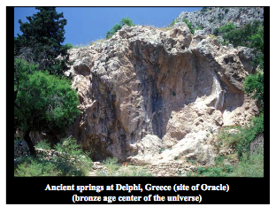
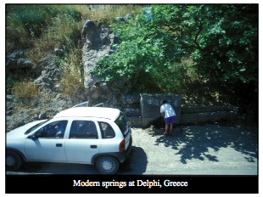
Brief History of Water Systems
Drinking Water

Slide 17
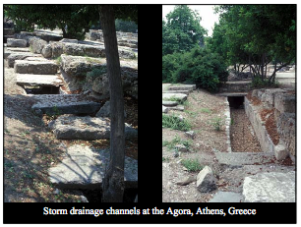
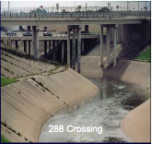
Brief History of Water Systems
Storm Water

Slide 18
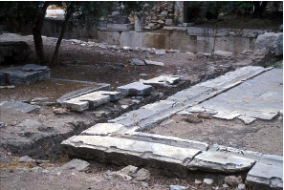
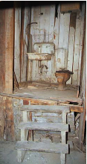
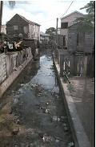
Brief History of Water Systems
Waste Water

Slide 19
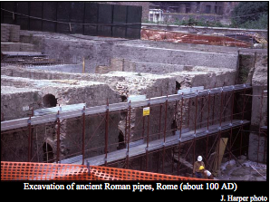
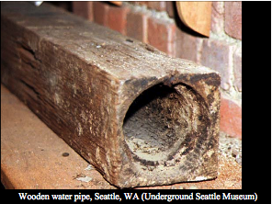
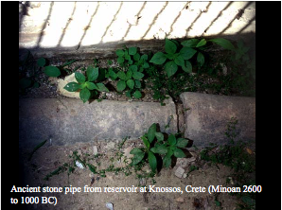
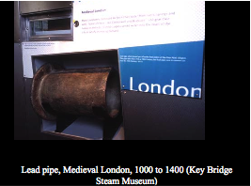
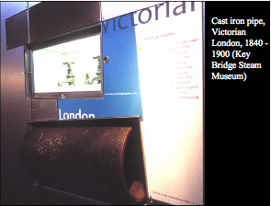
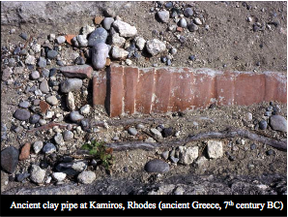
Brief History of Water Systems
Conduits

Slide 20
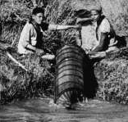
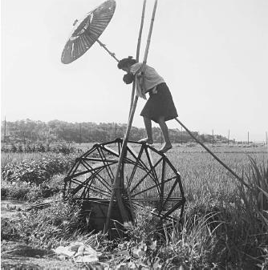
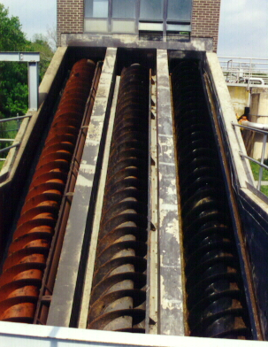
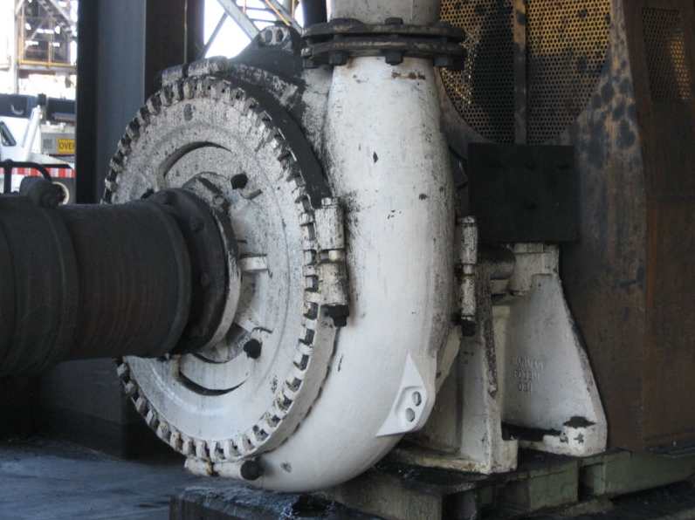
Brief History of Water Systems
Pumps

Slide 21
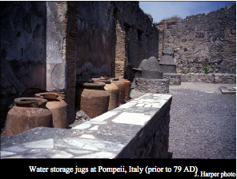
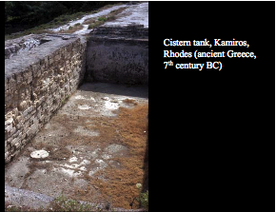
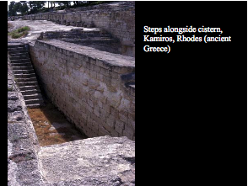
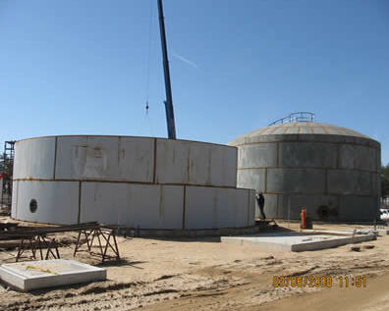
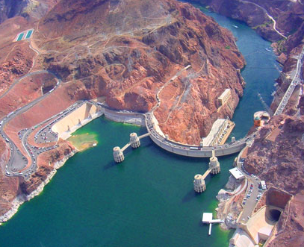
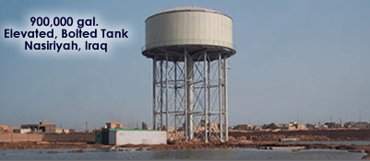
Brief History of Water Systems
Storage

Slide 22
Notable “BIG” Systems
Los Angeles Aqueduct http://www.history.com/topics/los-angeles-aqueduct
Central Valley Project https://en.wikipedia.org/wiki/Central_Valley_Project
Salt River Project https://en.wikipedia.org/wiki/Salt_River_Project
Tennessee Valley Authority (https://en.wikipedia.org/wiki/Tennessee_Valley_Authority)
Three Gorges Project (https://en.wikipedia.org/wiki/Three_Gorges_Dam)

Slide 23
Other interesting systems
Las Vegas Water Authority (https://www.reviewjournal.com/local/local-las-vegas/follow-a-gallon-of-water-from-lake-mead-to-a-las-vegas-tap/)
New York https://en.wikipedia.org/wiki/New_York_City_water_supply_system
Paris (FRANCE) https://parisianfields.com/2012/03/11/a-most-unusual-water-system/
Berlin (GERMANY) http://www.bwb.de/content/en/html/index.php

Slide 24
Next time
Design criteria
Codes
Manuals
Literature

