Slide 1
CE 3372 water systems design
DEMAND ESTIMATION Part 1 (fall 2020)

Slide 2
Water supply demands
Uses
Withdrawl
Removal from stream, lake, or aquifer to supply user(s) – water is moved to satisfy the use
Non-Withdrawl
On-site uses for navigation, recreation – water can stay in same location to satisfy use
Consumptive
Fraction of withdrawl that is no longer available for further use – incorporated into crops and animals (actual biomass); industrial processes (heat exchange)

Slide 3
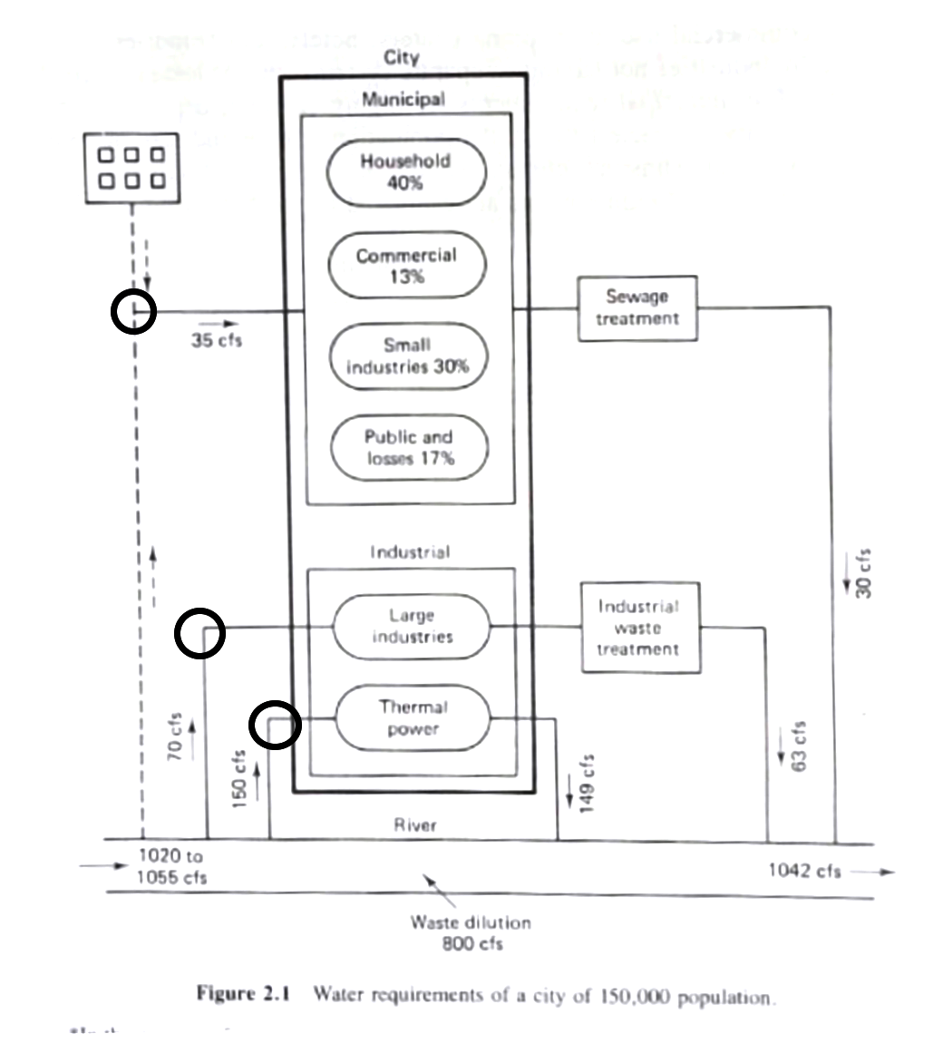
Water needs for a city
Consider some generic urban area
Municipal Requirements
Large Industrial Requirements
Waste Assimilation Requirements

Slide 4
Municipal requirements
The municipal requirements are related to the number of users by means of the simple relation:
Where V=volume, P=population, V/P = volume per person (used).

Slide 5
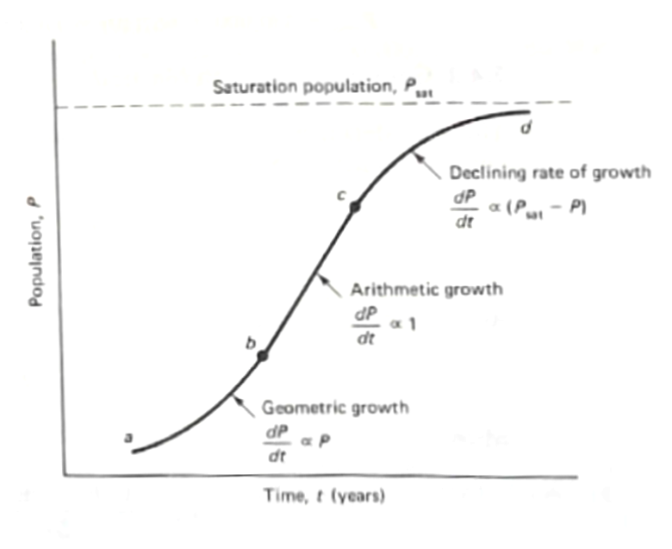
Population forecasting (graphical)
Short-term forecasting
Declining growth
Arithmetic growth
Geometric growth
Same arithmetic as substrate limited growth that you learn in Envriomental Engineering

Slide 6
GEOMETRIC growth (mathematical)
When the growth curve is in the exponential phase
Where K_{P} is the exponential growth constant

Slide 7
Arithmetic growth (mathematical)
When the growth curve is roughly a straight line, then
Where K_{A} is the slope of the growth curve

Slide 8
DECLINING growth (mathematical)
When the growth curve approaching the carrying capacity of the region
Where K_{D} is the declining rate constant

Slide 9
Longer-term Forecasting
Naturally, none of the constants are convienently tabulated and historical census data are used both for short term forecasts – the US Census Bureau makes estimates of census values between the every decade census.
If the region has been around awhile (in the population sense) then the plot might be strightforward to construct.
Longer term adds the ratio and correlation techniques and component techniques

Slide 10
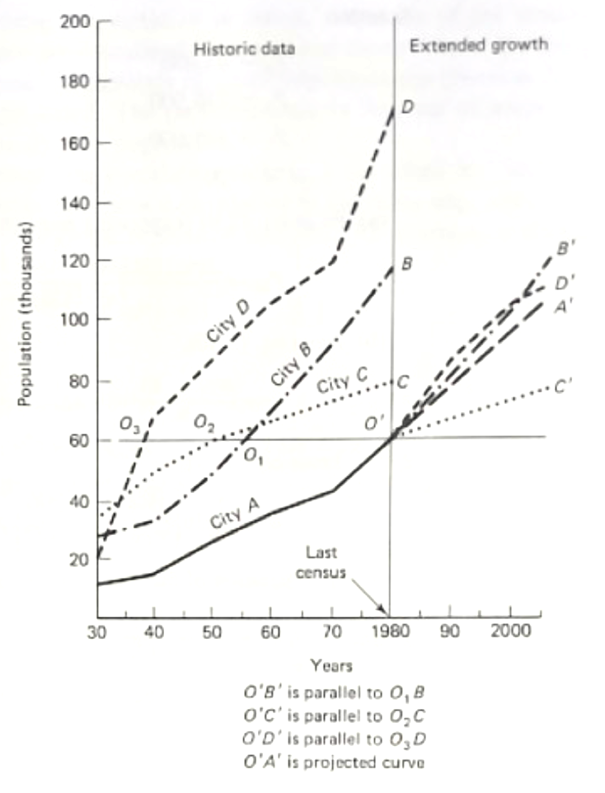
comparison forecasting
Geographically similar areas are used and projections are made by comparing these growth curves to the area of interest.
Uncertainty that area of interest may not progress similarily to past growth of comparision areas.

Slide 11
Forecasting (Ratio/correlation)
Ratio (transposition) method is based on the ratio of observed populations of two study areas.
Correlation method fits (ordinary least squares on the populations or log-populations) to generate a predictive equation based on a reference population.

Slide 12
Forecasting (component)
Formal model of a population that considers birth rate (B), death rate (D), net migration rate (M) over a forecasting interval
Non-trivial modeling activity
Nice introduction to the mathematics in: Frauenthal, J.C. 1980. Introduction to Population Modeling. Birkhäuser, Boston, Basel, Stuttgart 186p. ISBN 3-7643-3015-5

