Slide 1
CE 3372 water systems design
LeSSON 3: DEMAND ESTIMATION

Slide 2
outline
Water Demand(s)

Slide 3
Water supply demands
Uses
Withdrawl
Removal from stream, lake, or aquifer to supply user(s) – water is moved to satisfy the use
Non-Withdrawl
On-site uses for navigation, recreation – water can stay in same location to satisfy use
Consumptive
Fraction of withdrawl that is no longer available for further use – incorporated into crops and animals (actual biomass); industrial processes (heat exchange)

Slide 4
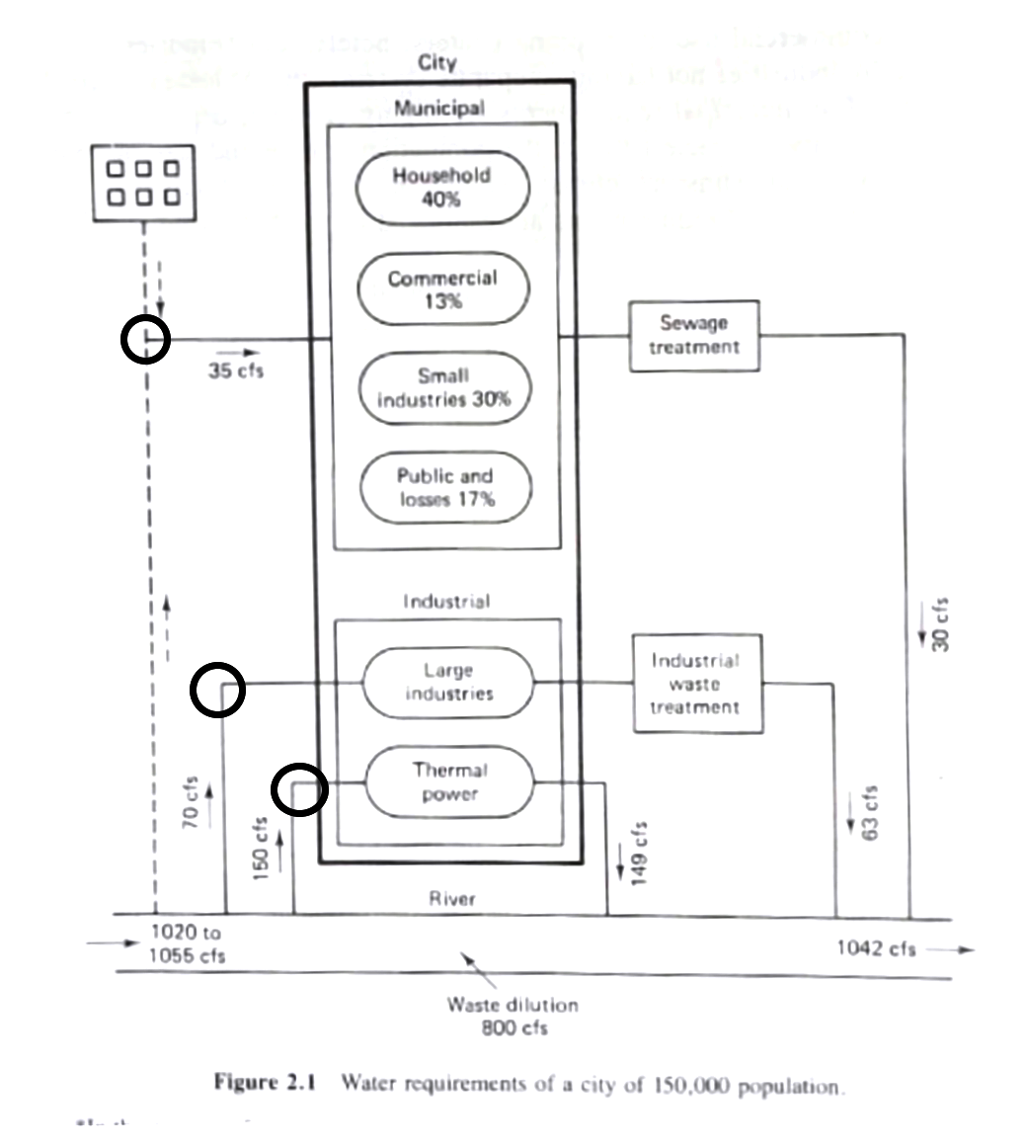
Water needs for a city
Consider some generic urban area
Municipal Requirements
Large Industrial Requirements
Waste Assimilation Requirements

Slide 5
Municipal requirements
The municipal requirements are related to the number of users by means of the simple relation:
Where V=volume, P=population, V/P = volume per person (used).

Slide 6
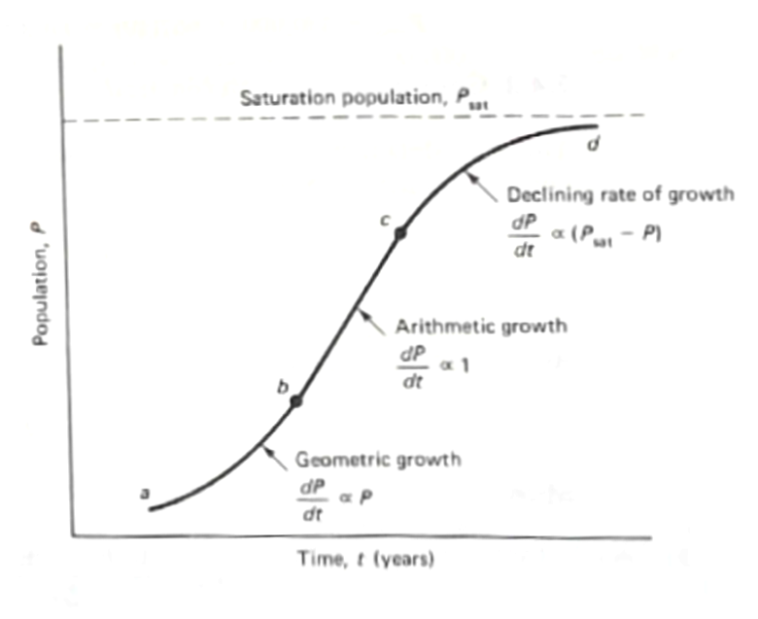
Population forecasting (graphical)
Short-term forecasting
Declining growth
Arithmetic growth
Geometric growth
Same arithmetic as substrate limited growth that you learn in Envriomental Engineering

Slide 7
GEOMETRIC growth (mathematical)
When the growth curve is in the exponential phase
Where K_{P} is the exponential growth constant

Slide 8
Arithmetic growth (mathematical)
When the growth curve is roughly a straight line, then
Where K_{A} is the slope of the growth curve

Slide 9
DECLINING growth (mathematical)
When the growth curve approaching the carrying capacity of the region
Where K_{D} is the declining rate constant

Slide 10
Longer-term Forecasting
Naturally, none of the constants are convienently tabulated and historical census data are used both for short term forecasts – the US Census Bureau makes estimates of census values between the every decade census.
If the region has been around awhile (in the population sense) then the plot might be strightforward to construct.
Longer term adds the ratio and correlation techniques and component techniques

Slide 11
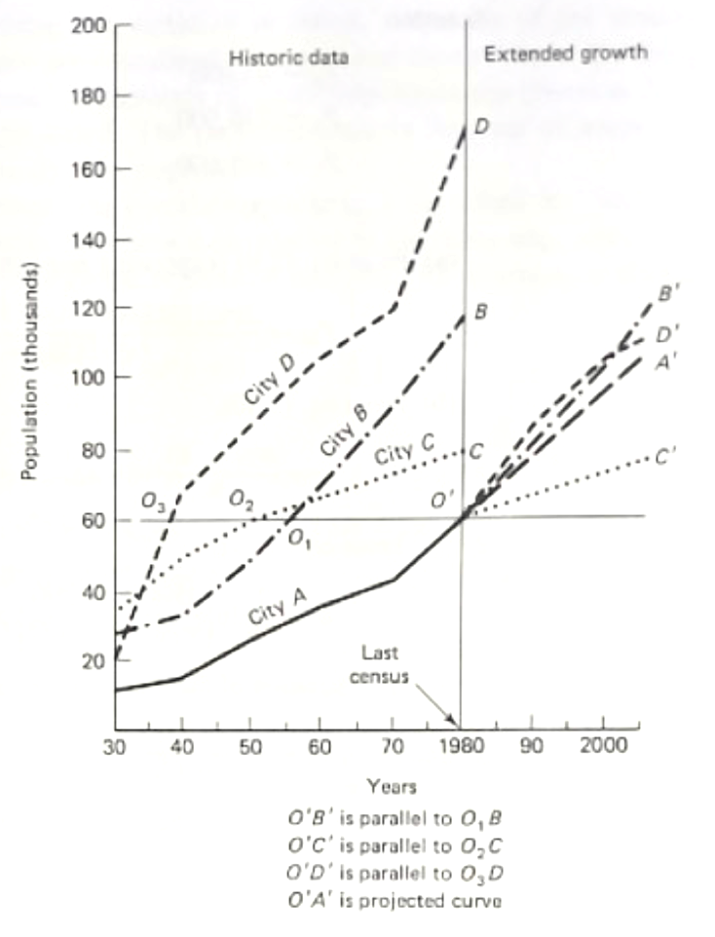
comparison forecasting
Geographically similar areas are used and projections are made by comparing these growth curves to the area of interest.
Uncertainty that area of interest may not progress similarily to past growth of comparision areas.

Slide 12
Forecasting (Ratio/correlation)
Ratio (transposition) method is based on the ratio of observed populations of two study areas.
Correlation method fits (ordinary least squares on the populations or log-populations) to generate a predictive equation based on a reference population.

Slide 13
Forecasting (component)
Formal model of a population that considers birth rate (B), death rate (D), net migration rate (M) over a forecasting interval
Non-trivial modeling activity
Nice introduction to the mathematics in: Frauenthal, J.C. 1980. Introduction to Population Modeling. Birkhäuser, Boston, Basel, Stuttgart 186p. ISBN 3-7643-3015-5

Slide 14
Water usage
The forcasting helps establish the target population to be served, next the use per person needs to be established.
Components include:
Avergae Daily Demand (by user category)
Hourly Variation
Fire Demand

Slide 15
Per capita water usage – design life
Design life varies by system component (or statute).
Maintenance/replacement needs to be planned for components that will fail within the overall design (service) life

Slide 16
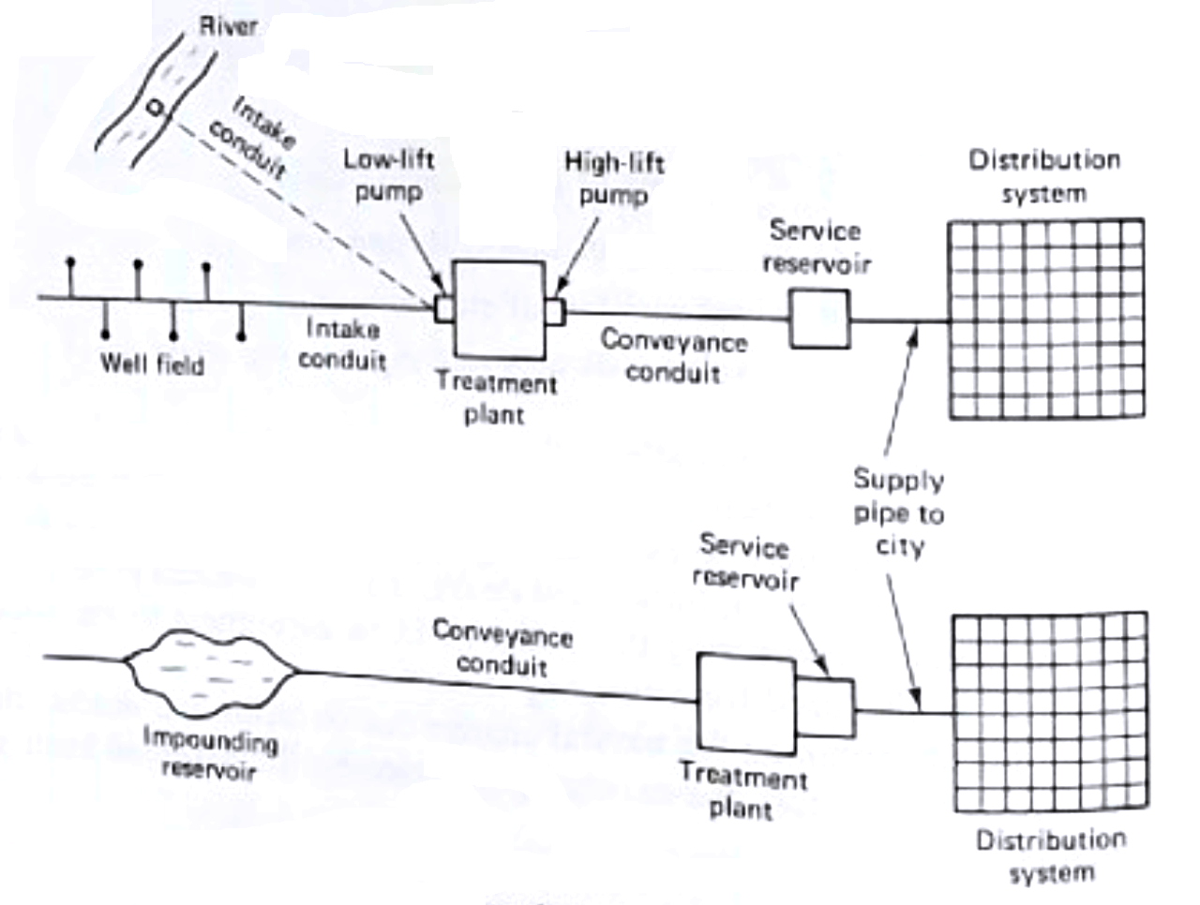
Major components
Components differ by system type.
For example consider the two systems in the figure – there are some common components, however each system will have unique components to consider.

Slide 17
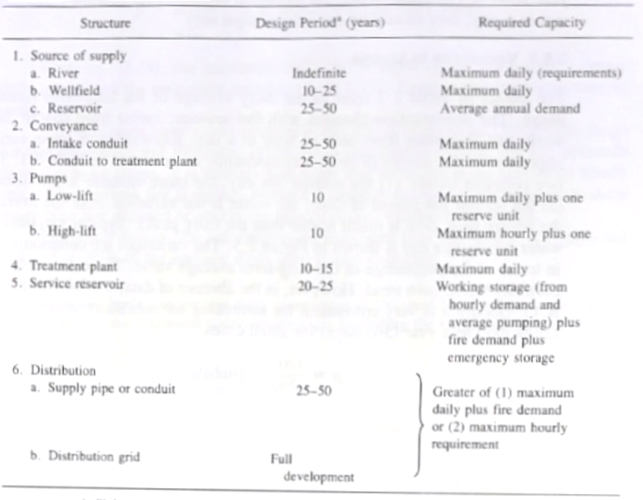

Slide 18
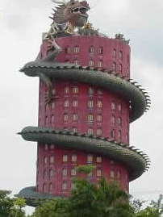
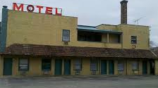
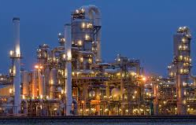
Average daily usage
Residential
Water for drinking, landscape, swimming, fires, street cleaning, etc.
Usually two demand peaks (morning and evening)
Commercial
Motels, hotels, offices, shopping centers
Usually less peak demand and less varied than residential
Industrial
Water for fabrication, cooling, petroleum refining, etc.
Water use depends on type of industry
Notes:
When industrial requirements are relatively important (major user) they are usually considered separately

Slide 19
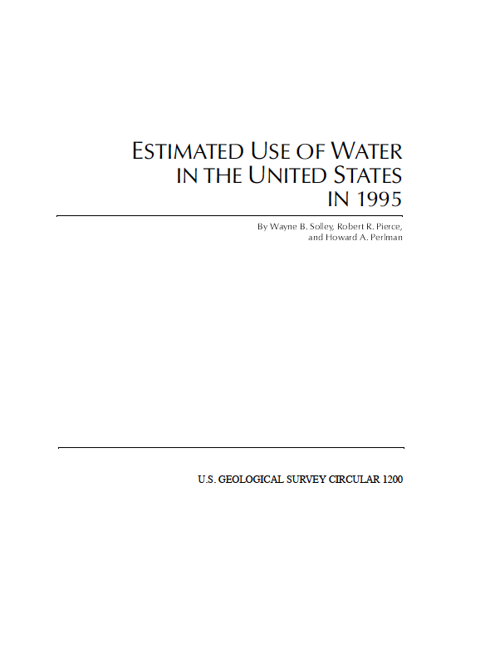
Average daily usage
Estimation tools:
USGS Circular 1200
Authorative sources
Approximation (for preliminary design)
Per-connection calculation

Slide 20
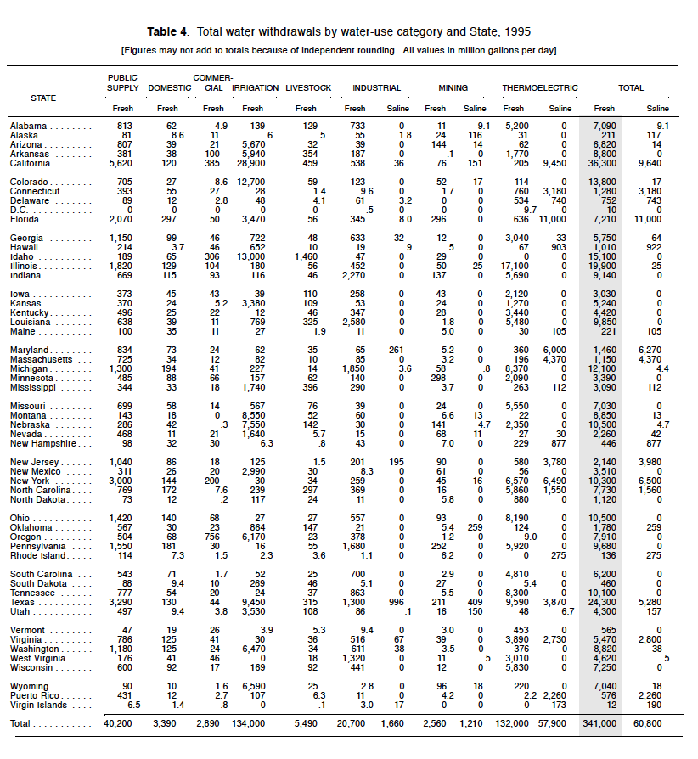
USGS Circular 1200
Contains maps and tables by location
Useful gross estimate tool

Slide 21
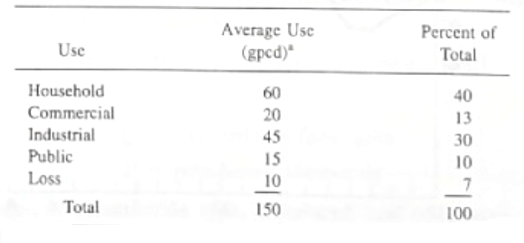
Average daily use (approximations)
Water Distribution Systems "Water Distribution Systems" in Land Development Handbook, Ed. S.O. Dewberry, Dewberry Inc., McGraw-Hill -- has tables similar to:

Slide 22
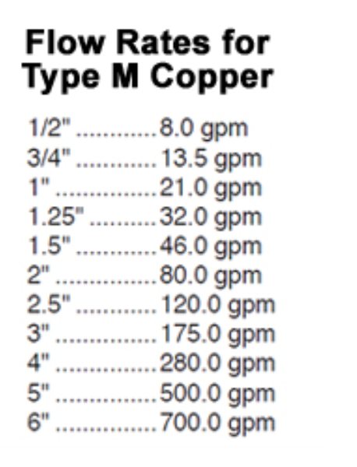
Per-connection (Plumber Estimate)
How Much Water Can You Actually Get?
Flow Rates are measured in gallons per minute (gpm).
For our purposes, we will talk about the amount of water that you can get through a pipe at a velocity of 8 feet per second (a standard velocity used to engineer a plumbing system).
Plumbing diameter will limit the flow rate you can get – the larger the pipe, the more water you can get. A home with 1″ plumbing can use substantially more water than a home with 3/4″ plumbing.
Inside home
Meter to house

Slide 23
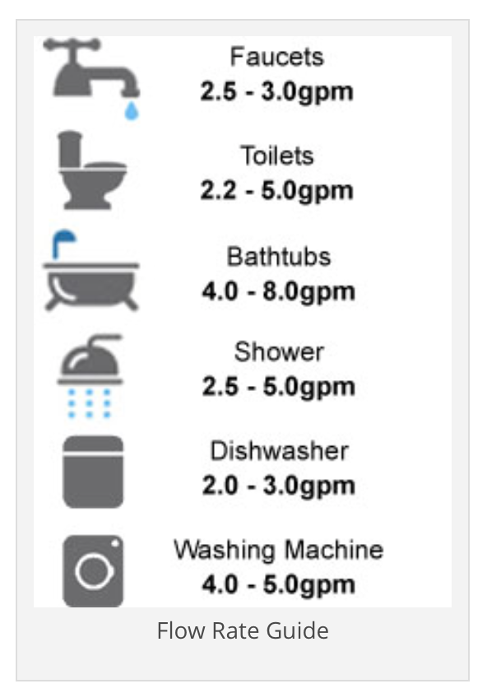
Per-connection (Plumber Estimate)
1. Think about the maximum number of fixtures and appliances you might operate at the same time.
2. Look at the chart to see how many gallons per minute each device requires.
3. Add up the flow rates for all the devices you selected.
You just figured out the PEAK FLOW RATE that you need.
Now, think about your continual water use, or water use that may run for more than 10 minutes. Add up the fixtures again, and you just calculated your SERVICE FLOW RATE.

Slide 24
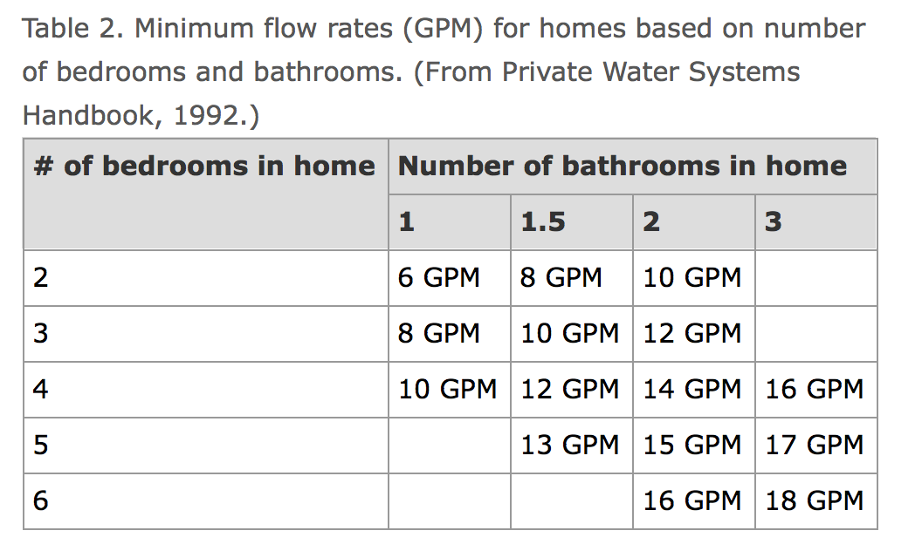
Per-connection (Rural Estimate)
http://extension.psu.edu/natural-resources/water/drinking-water/best-practices/water-system-planning-estimating-water-use

Slide 25
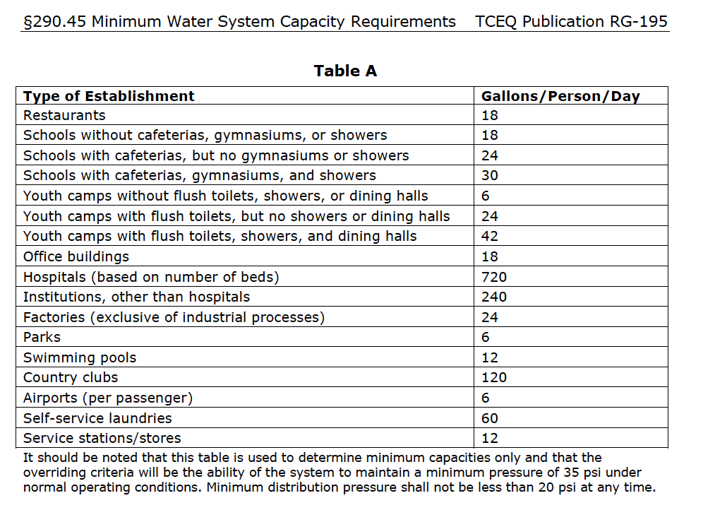
Per-connection (TCEQ)

Slide 26
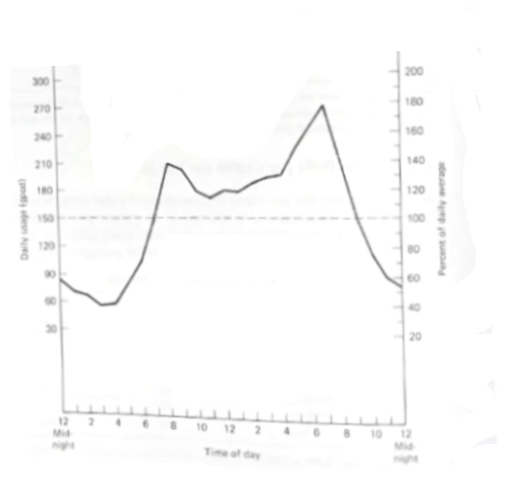
Usage variation (within a day)
The average estimates are for long-duration (years) usage.
Use changes with seasons, days within a week, and special cases (the big flush at half-time during the Superbowl)

Slide 27
Usage variation (within a day)
In absence of any supporting data one can employ a rule-of-thumb estimate
T is in units of days. The rule-of-thumb is intended for use over a time frame for 1 hours up to 365 days.

Slide 28
Fire demand
Fire usage on an annual basis is probably negligible, but when fire demand arises the rate of withdrawl is high.
Designers are required to design and build the system to be able to provide fire demand (hence service reservoirs will have excess capacity expressly to supply fire flow!)

Slide 29
Fire demand
Required flow rates are by:
Statute (consider the requirement in the Houston IDM for a fire hydrant)
Insurance organizations, for example:

Slide 30
Industrial demand
Large industries usually supply their own water
If the community will supply the industry, then industrial requirements will need to be estimated.
Industry | Average Water Usage
Thermal Power | 80 gal/kWh
Steel Production | 35,000 gal/ton
Paper Production | 50,000 gal/ton
Textile Production | 140,000 gal/ton
Carbon (Coke) Production | 3,600 gal/ton
Petroleum Refining | 770 gal/barrel

Slide 31
Waste assimilation demand
Treated (or even untreated) wastewater is eventually discharged back into the environment and this demand for assimilative capacity needs to be estimated.
Many methods are employed – TMDL, DO Sag, and similar modeling approaches.
Preliminary values can be estimated by a simple linear relationship

Slide 32
Irrigation demand
Irrigation (Agricultural) – outside scope of this class but use categories are:
Biomass (how much is bound in the actual crop)
Evapotranspiration – Consumptive
Farm Losses
Conveyance Losses

Slide 33
other demands
Hydropower
Run-of-river
Storage release
Navigation
Regulation of river
Artificial canal
Lock-and-Dam

