Slide 1
CE 3372 Water Systems Design
Lecture 17: Storm Drain Design Example

Slide 2
Storm Drain Design Example
Similar to earlier examples, but more extensive in scope.
The example is intended as a workshop
Module 13

Slide 3
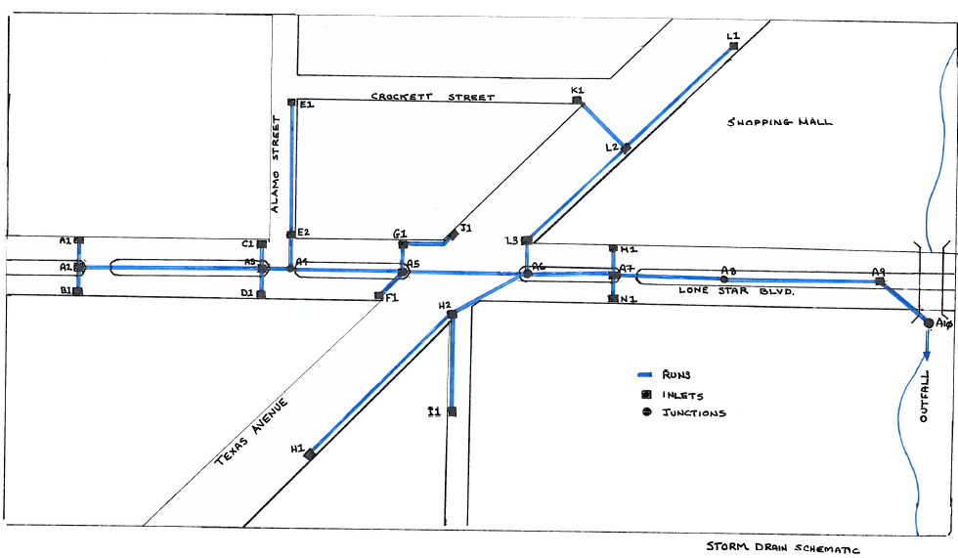
Problem Statement
Working schematic is provided as a Z-fold

Slide 4
Problem Statement
At node A8 outflow from the shopping mall is accepted into the storm drain system.
The storm drain outfalls into a channel just downstream of a culvert, which accomodates flow from a 2266 acre watershed.
Hydrology and inlet data on TAB1 in spreadsheet
Design the system, determine hydraulic grade line

Slide 5
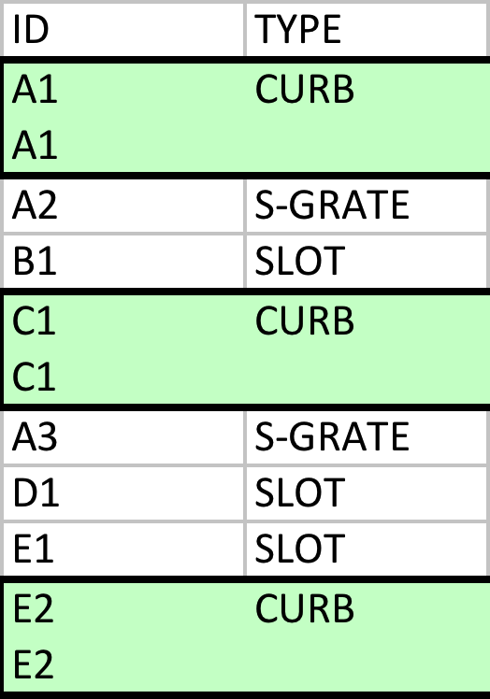
General Information

Slide 6
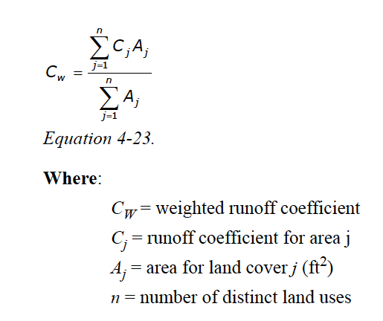
Estimate Runoff
Prepare system plan and trial layout
Initial runoff calculations – use rational equation
C values are composite where applicable
Can be in acres, just don’t mix units

Slide 7
Estimate Inlet Capture
On grade
Sag
Compute spreadwidth after capture

Slide 8
Size Conduits
Accumulate CA as move downstream
Add conduit time (uses slope)
Compute required diameter
round up to commercial pipe size
Compute flow depth at upstream end each conduit
Compute velocity each conduit
Compute HGL from outfall and work upstream

Slide 9
Software
The illustration is performed in Excel. Appropriate for the example.
Complicated systems can be modeled in
Geopack-Drainage
WinSTORM (Deprecated)
SWMM
Sophisticated tool, useful for system hydraulics where backwater will be a substantial issue
HEC-RAS
Like SWMM, but not really good for storm sewers or looped systems

