Slide 1
CE 3372 Water Systems Design
Lecture 21: Hydraulics of open conduits gradually varied flow water surface profiles

Slide 2
Flow in Open Conduits
Gradually Varied Flow Hydraulics
Principles
Resistance Equations
Specific Energy
Subcritical, critical, supercritical and normal flow.

Slide 3
Description of Flow
Open channels are conduits whose upper boundary of flow is the liquid surface.
Canals, streams, bayous, rivers are common examples of open channels.
Storm sewers and sanitary sewers are typically operated as open channels.
In some parts of a sewer system these “channels” may be operated as pressurized pipes, either intentionally or accidentally.
The relevant hydraulic principles are the concept of friction, gravitational, and pressure forces. .

Slide 4
Description of Flow
For a given discharge, Q, the flow at any section can be described by the flow depth, cross section area, elevation, and mean section velocity.
The flow-depth relationship is non-unique, and knowledge of the flow type is relevant.

Slide 5
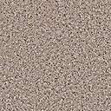
Open Channel Nomenclature
Flow depth is the depth of flow at a station (section) measured from the channel bottom.
y

Slide 6
Open Channel Nomenclature
Elevation of the channel bottom is the elevation at a station (section) measured from a reference datum (typically MSL).
y
z
Datum

Slide 7
Open Channel Nomenclature
Slope of the channel bottom is called the topographic slope (or channel slope).
y
z
S_{o}
Datum
1

Slide 8
Open Channel Nomenclature
Slope of the water surface is the slope of the HGL, or slope of WSE (water surface elevation).
HGL
S_{wse}
y
1
z
S_{o}
Datum
1

Slide 9
Open Channel Nomenclature
Slope of the energy grade line (EGL) is called the energy or friction slope.
EGL
HGL
V²/2g
S_{f}
1
Q=VA
S_{wse}
y
1
z
S_{o}
Datum
1

Slide 10
Open Channel Nomenclature
Like closed conduits, the various terms are part of mass, momentum, and energy balances.
Unlike closed conduits, geometry is flow dependent, and the pressure term is replaced with flow depth.

Slide 11
Open Channel Nomenclature
Open channel pressure head: y
Open channel velocity head: V²/2g
(or Q²/2gA²)
Open channel elevation head: z
Open channel total head: h=y+z+V²/2g
Channel slope: S_{o} = (z₁-z₂)/L
Typically positive in the down-gradient direction.
Friction slope: S_{f} = (h₁-h₂)/L

Slide 12
Uniform Flow
Uniform flow (normal flow; pg 104) is flow in a channel where the depth does not vary along the channel.
In uniform flow the slope of the water surface would be expected to be the same as the slope of the bottom surface.

Slide 13
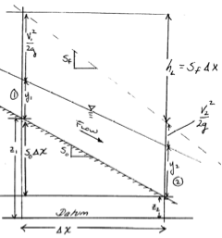
Uniform Flow
Uniform flow would occur when the two flow depths y1 and y2 are equal.
In that situation:
the velocity terms would also be equal.
the friction slope would be the same as the bottom slope.
Sketch of gradually varied flow.

Slide 14
Gradually Varied Flow
Gradually varied flow means that the change in flow depth moving upstream or downstream is gradual (i.e. NOT A WATERFALL!).
The water surface is the hydraulic grade line (HGL).
The energy surface is the energy grade line (EGL).

Slide 15
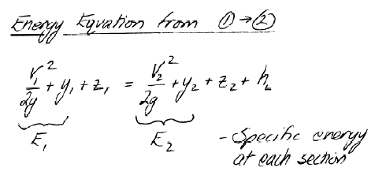
Gradually Varied Flow
Energy equation has two components, a specific energy and the elevation energy.
Sketch of gradually varied flow.

Slide 16
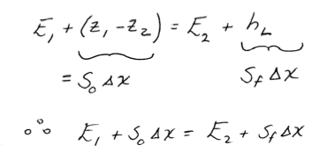
Gradually Varied Flow
Energy equation has two components, a specific energy and the elevation energy.
Sketch of gradually varied flow.

Slide 17
Gradually Varied Flow
Energy equation is used to relate flow, geometry and water surface elevation (in GVF)
The left hand side incorporating channel slope relates to the right hand side incorporating friction slope.

Slide 18
Gradually Varied Flow
Rearrange a bit
In the limit as the spatial dimension vanishes the result is.

Slide 19
Gradually Varied Flow
Energy Gradient:
Depth-Area-Energy
(From pp 119-123; considerable algebra is hidden )

Slide 20
Gradually Varied Flow
Make the substitution:
Rearrange
Discharge and
Section Geometry
Variation of
Water Surface Elevation
Discharge and
Section Geometry

Slide 21
Gradually Varied Flow
Basic equation of gradually varied flow
It relates slope of the hydraulic grade line to slope of the energy grade line and slope of the bottom grade line.
This equation is integrated to find shape of water surface (and hence how full a sewer will become)

Slide 22

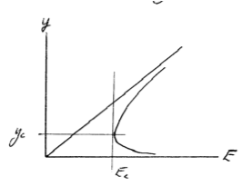
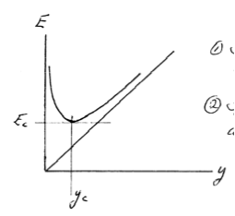
Gradually Varied Flow
Before getting to water surface profiles, critical flow/depth needs to be defined
Specific energy:
Function of depth.
Function of discharge.
Has a minimum at y_{c}.
Energy
Depth

Slide 23

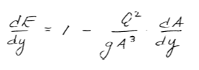
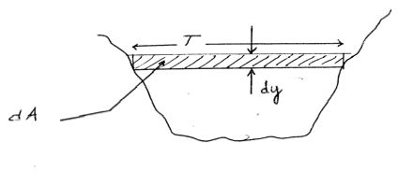

Critical Flow
Has a minimum at y_{c}.
Necessary and sufficient condition
for a minimum (gradient must vanish)
Variation of energy with respect to depth;
Discharge “form”
Depth-Area-Topwidth
relationship

Slide 24


Critical Flow
Has a minimum at y_{c}.
Right hand term is a squared Froude number. Critical flow occurs when Froude number is unity.
Froude number is the ratio of inertial (momentum) to gravitational forces
Variation of energy with respect to depth;
Discharge “form”, incorporating topwidth.
At critical depth the gradient is equal to zero, therefore:

Slide 25
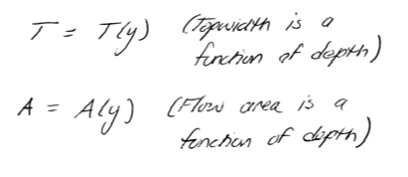
Depth-Area
The topwidth and area are depth dependent and geometry dependent functions:

Slide 26
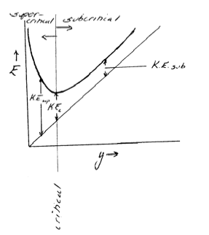
Super/Sub Critical Flow
Supercritical flow when KE > KE_{c.}
Subcritical flow when KE<KE_{c.}
Flow regime affects slope of energy gradient, which determines how one integrates to find HGL.

Slide 27
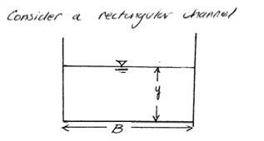


Finding Critical Depths
Depth-Area Function:
Depth-Topwidth Function:

Slide 28


Finding Critical Depths
Substitute functions
Solve for critical depth
Compare to Eq. 3.104, pg 123)

Slide 29
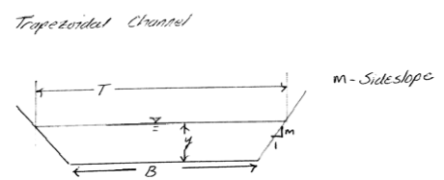


Finding Critical Depths
Depth-Area Function:
Depth-Topwidth Function:

Slide 30

Finding Critical Depths
Substitute functions
Solve for critical depth,
By trial-and-error is adequate.
Can use HEC-22 design charts.

Slide 31



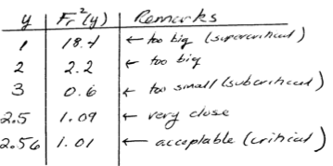
Finding Critical Depths
By trial-and-error:
Guess this values
Adjust from Fr

Slide 32
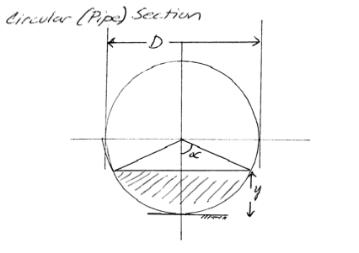



Finding Critical Depths
The most common sewer geometry
(see pp 236-238 for similar development)
Depth-Topwidth:
Depth-Area:
Remarks:
Some references use radius and not diameter.
If using radius, the half-angle formulas change.
DON’T mix formulations.
These formulas are easy to derive, be able to do so!

Slide 33

Finding Critical Depths
The most common sewer geometry
(see pp 236-238 for similar development)
Depth-Topwidth:
Depth-Area:
Depth-Froude Number:

Slide 34
Gradually Varied Flow
Energy equation has two components, a specific energy and the elevation energy.
Sketch of gradually varied flow.

Slide 35
Gradually Varied Flow
Equation relating slope of water surface, channel slope, and energy slope:
Discharge and
Section Geometry
Variation of
Water Surface Elevation
Discharge and
Section Geometry

Slide 36
Gradually Varied Flow
Procedure to find water surface profile is to integrate the depth taper with distance:

Slide 37
Channel Slopes and Profiles
SLOPE | DEPTH RELATIONSHIP
Steep | y_{n} < y_{c}
Critical | y_{n} = y_{c}
Mild | y_{n} > y_{c}
Horizontal | S₀ = 0
Adverse | S₀ < 0
PROFILE TYPE | DEPTH RELATIONSHIP
Type-1 | y > y_{c} AND y > y_{n}
Type -2 | y_{c} < y < y_{n} OR y_{n} < y < y_{n}
Type -3 | y < y_{c} AND y < y_{n}

Slide 38
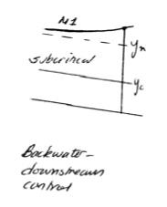
Flow Profiles
All flows approach normal depth
M1 profile.
Downstream control
Backwater curve
Flow approaching a “pool”
Integrate upstream

Slide 39
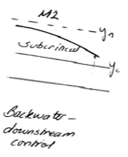
Flow Profiles
All flows approach normal depth
M2 profile.
Downstream control
Backwater curve
Flow accelerating over a change in slope
Integrate upstream

Slide 40
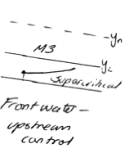
Flow Profiles
All flows approach normal depth
M3 profile.
Upstream control
Backwater curve
Decelerating from under a sluice gate.
Integrate downstream

Slide 41
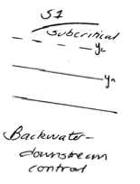
Flow Profiles
All flows approach normal depth
S1 profile.
Downstream control
Backwater curve
Integrate upstream

Slide 42
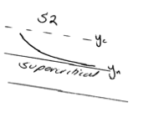
Flow Profiles
All flows approach normal depth
S2 profile.

Slide 43
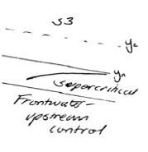
Flow Profiles
All flows approach normal depth
S3 profile.
Upstream control
Frontwater curve
Integrate downstream

Slide 44
Flow Profiles
Numerous other examples, see any hydraulics text (Henderson is good choice).
Flow profiles identify control points to start integration as well as direction to integrate.

Slide 45
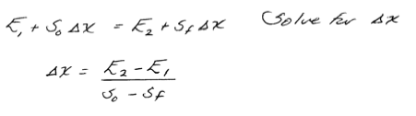
WSP Using Energy Equation
Variable Step Method
Choose y values, solve for space step between depths.
Non-uniform space steps.
Prisimatic channels only.

Slide 46
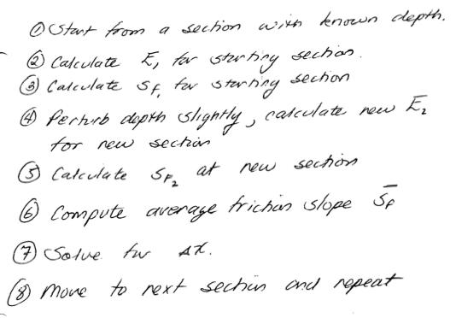
WSP Algorithm

Slide 47
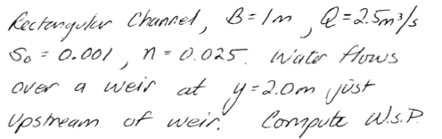
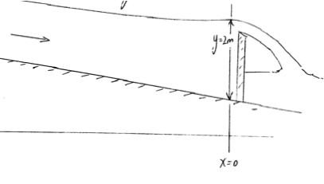
Example

Slide 48


Example
Energy/depth function
Friction slope function

Slide 49
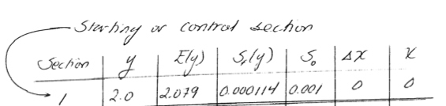

Example
Start at known section
Compute space step (upstream)
Enter into table and move upstream and repeat

Slide 50
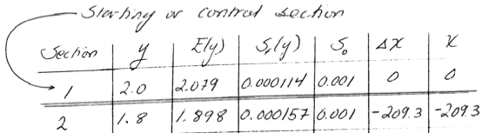

Example
Start at known section
Compute space step (upstream)

Slide 51
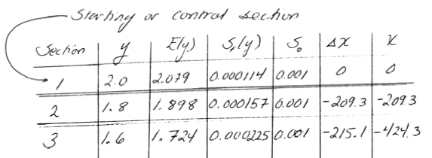
Example
Continue to build the table

Slide 52
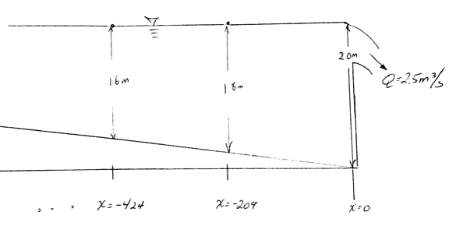
Example
Use tabular values and known bottom elevation to construct WSP.

Slide 53
WSP Fixed Step Method
Fixed step method rearranges the energy equation differently:
Right hand side and left hand side have the unknown “y” at section 2.
Implicit, non-linear difference equation.

Slide 54
Gradually Varied Flow
Apply WSP computation to a circular conduit
Sketch of gradually varied flow.

Slide 55
Depth-Area Relationship
The most common sewer geometry
(see pp 236-238 for similar development)
Depth-Topwidth:
Depth-Area:
Depth-Froude Number:

Slide 56
Variable Step Method
Compute WSE in circular pipeline on 0.001 slope.
Manning’s n=0.02
Q = 11 cms
D = 10 meters
Downstream control depth is 8 meters.

Slide 57
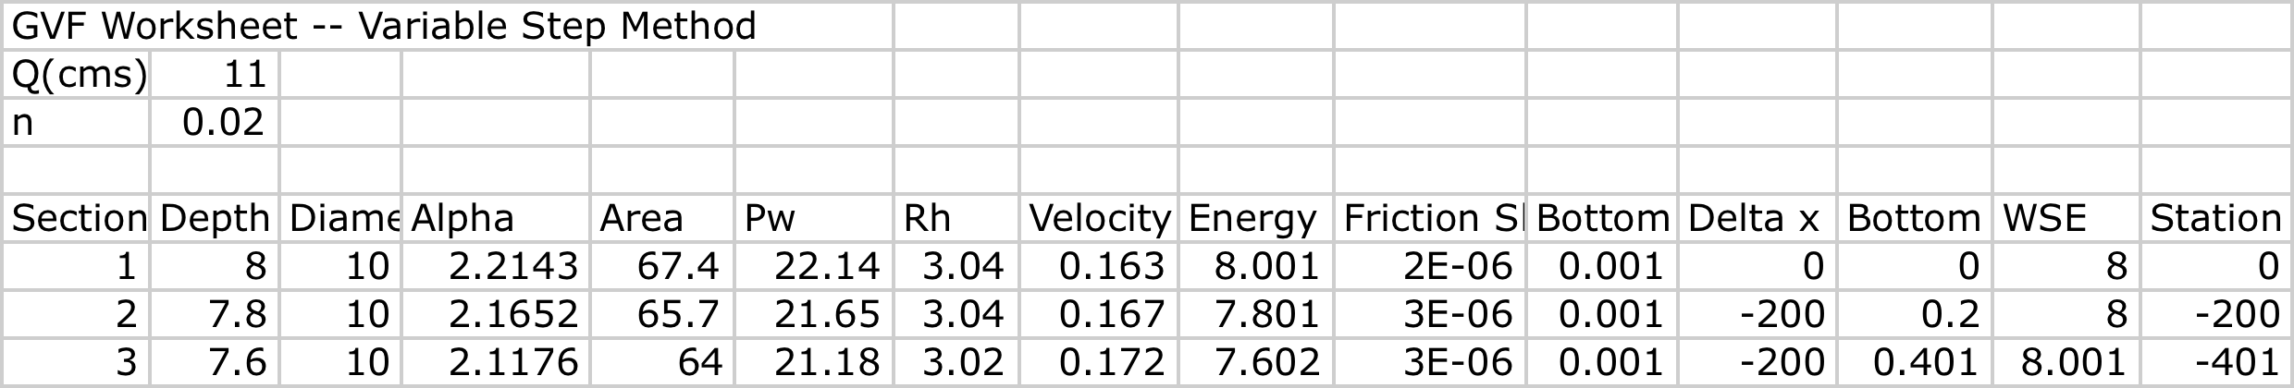
Variable Step Method
Use spreadsheet, start at downstream control.

Slide 58
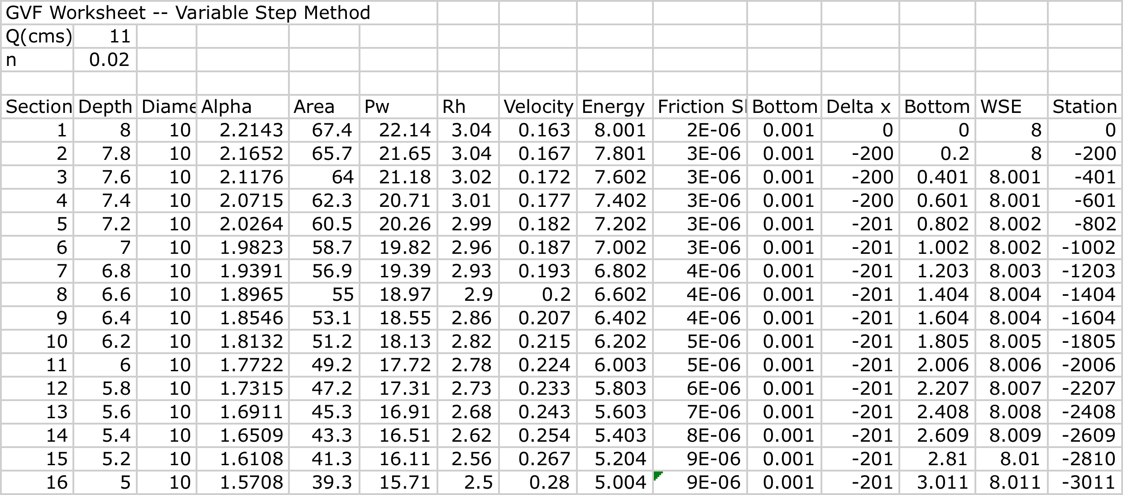
Variable Step Method
Compute Delta X, and move upstream to obtain station positions.

Slide 59
Variable Step Method
Use Station location, Bottom elevation and WSE to plot water surface profile.
Flow

Slide 60
Next Time
Repeat the problem using SWMM

