Slide 1
CE 3372 Water Systems Design
Lesson 21: detention/retention basin hydraulics

Slide 2
Purposes
Detention Basin
Mitigate peak discharge(s)
Provide water quality benefit

Slide 3
Junction (Node)
Ordinary junction connects hydraulic elements (links)
Junction attributes are:
Invert elevation (elevation of the bottom of the node)
Max elevation (elevation of top of node)
Set to land surface to plot profile grade line in SWMM
Set to land surface + added depth for dual (surface+subsurface drainage)
When program runs, depth at the node is computed, but there is no storage (node has zero area)

Slide 4
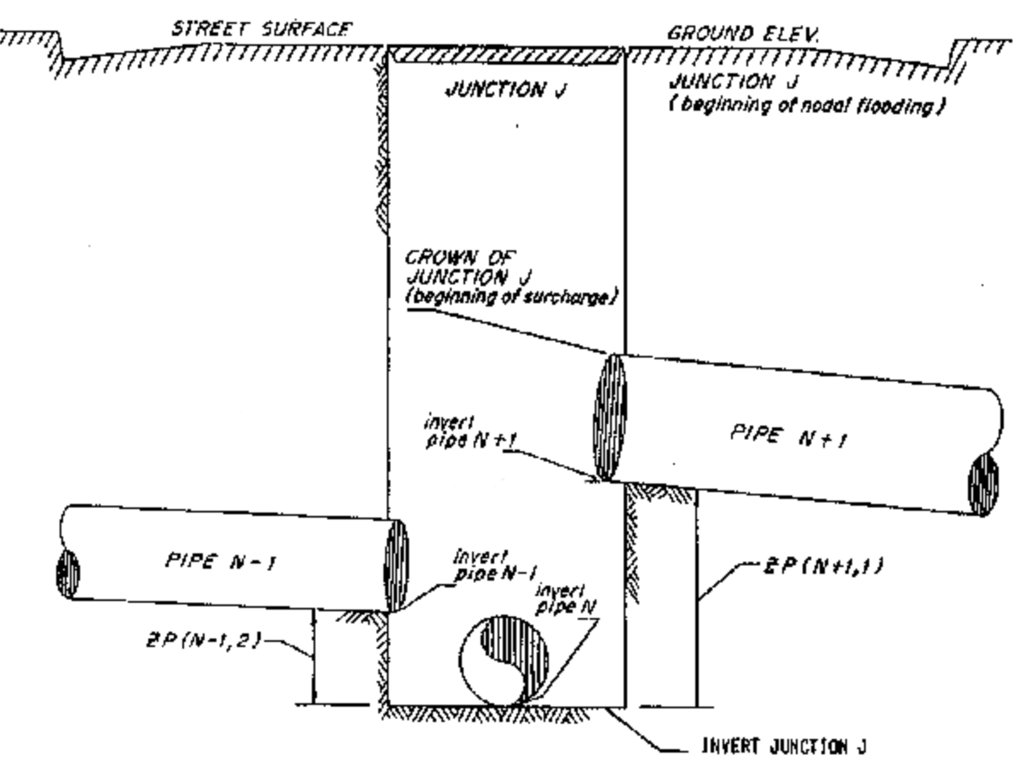
Junction (Node)
Ordinary junction just connects pipes N-1, N, and N+1

Slide 5
Junction (Node)
If flooding occurs, it is only considered when HGL is above node Max. Depth
Node not flooded; pipes are surcharged
Node flooded; pipes are surcharged

Slide 6
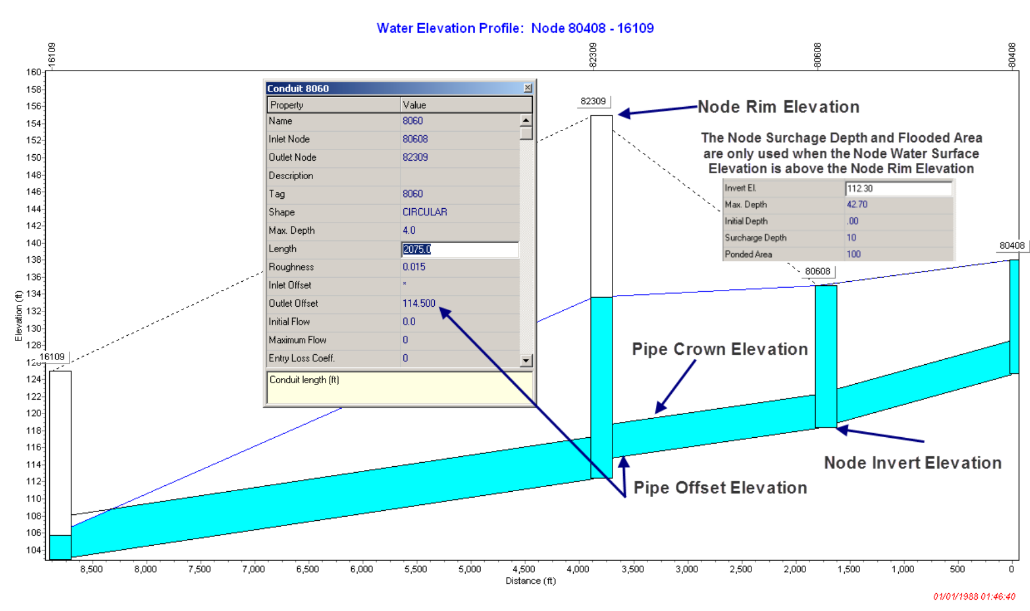
Flooding Ordinary Node

Slide 7
Junction (Node)
Flooded node attributes:
How deep is the flooding allowed (surcharge depth) above the top of the node
What is the ponded area during surcharge – treats the node as a vertical wall storage tank
Ponded Area
Ponded Depth
Invert Elevation + Max. Depth
Max. Depth
Invert Elevation

Slide 8
Storage Unit (Node)
A storage node explicitly considers storage in the node – including (if data are correctly supplied) the sub-grade portion of the node
Storage Node Attributes
Same as an ordinary node +
Depth-Area relationship
Tabular
Functional

Slide 9
Storage Unit (Node)
Useful for:
Detention ponds
Modeling multiple level inlet/outlet hydraulics
Riser inlet
Outlet that has portion through a pipe, a portion over a weir (or another pipe at different elevation)

Slide 10
Example
Consider a detention pond that drains a 5-acre parking lot, then discharges to a nearby receiving stream
Use SWMM to approximate the hydraulics
Sub-catchment, high CN (98) to represent the parking lot
1-inch/hour storm for 3 hours
All flow passes through the detention pond before exiting to a stream through a 6-inch pipe at the inverts, and a 1-foot pipe at 2-feet above basin bottom

Slide 11
Example
Schematic of the system
1 inch/hr for 3 hrs
Large Diameter Pipe to connect to outfall without surcharge
5 acre; CN=98
Detention Pond
1 foot pipe
6-inch pipe
Ordinary Node
Outfall

Slide 12
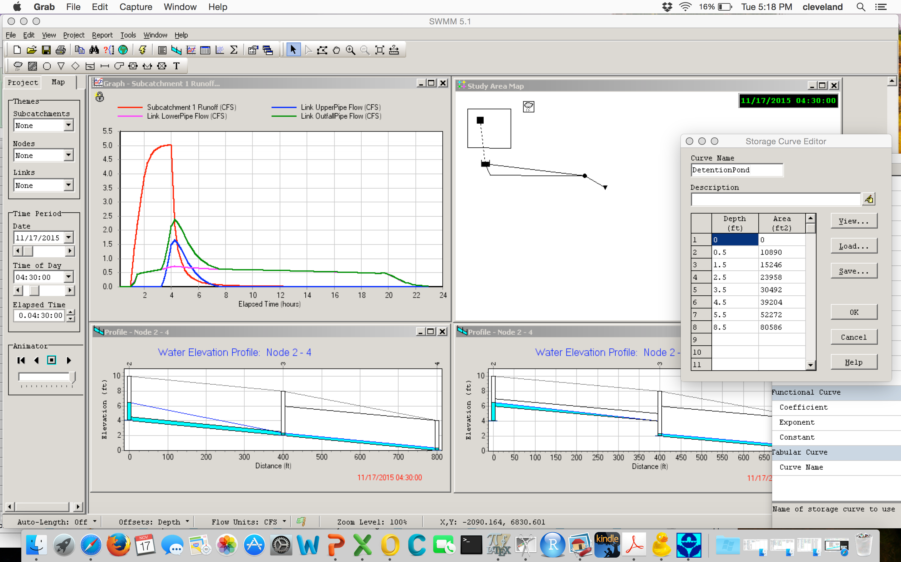
SWMM Model Run
Peak Q from the parking lot
Peak Q leaving the detention pond

Slide 13
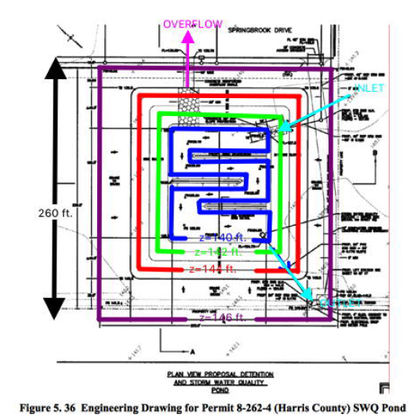
Exercise ES 15
Use SWMM to model a detention basin (Harris County Permit 8-262-4)

Slide 14
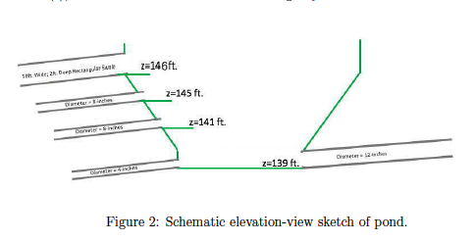
Exercise ES 15
Use SWMM to model a detention basin (Harris County Permit 8-262-4)

Slide 15
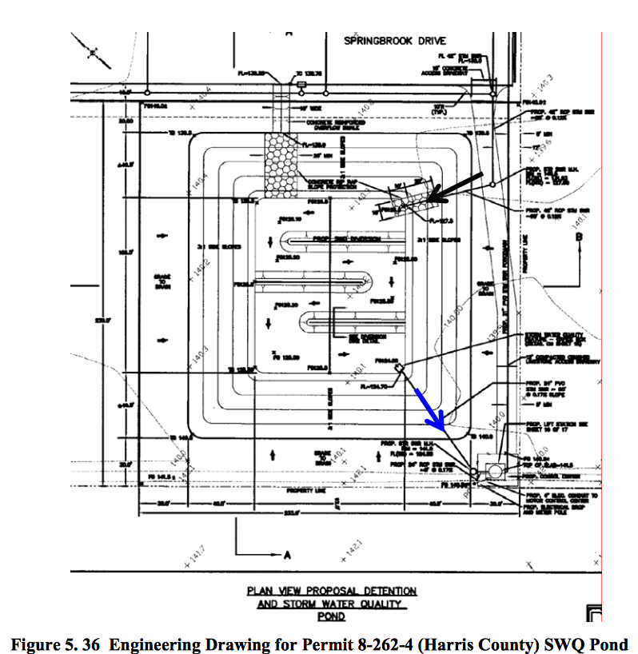
Detention Pond Drawing

Slide 16
Depth-Area
Use the drawing to determine the depth-area of the pond
Pick an elevation (depth)
Find pool area for that elevation (depth)
Record the depth and the area (in acres usually)

Slide 17
Depth-Elevation
Pool elevation = 140 ft.
Depth = 0.5 ft.
Pool Area = 0.25 acres

Slide 18
Depth-Elevation
Pool elevation = 141 ft.
Depth = 1.5 ft.
Pool Area = 0.35 acres

Slide 19
Depth-Elevation
Pool elevation = 142 ft.
Depth = 2.5 ft.
Pool Area = 0.55 acres

Slide 20
Depth-Elevation
Pool elevation = 143 ft.
Depth = 3.5 ft.
Pool Area = 0.70 acres

Slide 21
Depth-Elevation
Pool elevation = 144 ft.
Depth = 4.5 ft.
Pool Area = 0.90 acres

Slide 22
Depth-Elevation
Pool elevation = 145 ft.
Depth = 5.5 ft.
Pool Area = 1.20 acres

Slide 23
Depth-Elevation
Pool elevation = 148 ft.
Depth = 8.5 ft.
Pool Area = 1.85 acres
Any deeper and we are inundating off-site property

Slide 24
Enter information into swmm
Storage tabular element
Apply a rainfall (flow)
Simulate pond fill/drain and outflow hydrograph

