Slide 1
CE 3372 Water Systems Design
Lesson 17: Storm sewers Conduit design (size selection) by rational equation method Fall 2020

Slide 2
Purposes
Conduits convey Flow from one location to another
Pipes
Culverts
Open channels

Slide 3
Conduit design
Select size, material, and slope
Storm sewer – usually desire to operate with free surface (as an open channel)
Sanitary sewer – similar usually want a free surface
Size (diameter) is dictated by
Flow required
Burial depth relative to drop available

Slide 4
methods
A good preliminary design can be obtained using a combination of the rational equation and manning’s equation
Done without regard to downstream boundary conditions
Needs to be checked using a hydraulic model (like SWMM)

Slide 5

Preliminary design
Determine discharge in each pipe.
Size using manning’s equation (… in us customary)
Assumes full, but pipes will have free surface

Slide 6
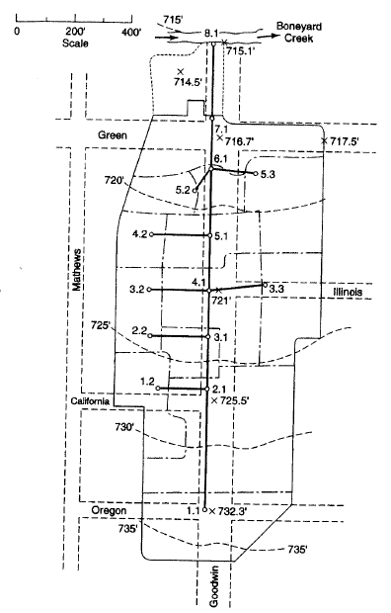
Preliminary design
Layout of system
Drainage area and Inlets
Pipes
Outfall
elevations

Slide 7
Preliminary design
Drainage areas and inlets
Determine inlet time of concentration
Determine drainage area runoff coefficient

Slide 8



Preliminary design
Pipes (Start upstream)
Select pipe size
Design guidelines
Discharge criteria
Velocity criteria
Determine pipe travel time
$$D=1.333{\left(\frac{Qn}{\sqrt{S}}\right)}^{3/8}$$
Adjust
$$V=\frac{1.49}{n}{\left(\frac{D}{4}\right)}^{2/3}\sqrt{S}$$
From criterion
$$t=\frac{distance}{V}$$
Notes:
$$V=\frac{1.49}{n}{(\frac{D}{4})}^{2/3}\sqrt{S}$$

Slide 9
Preliminary design
At most upstream inlet
Compute Q_{P}=CiA to the inlet from inlet time
Size pipe from this inlet to hold Q_{P}
ADD pipe travel time to inlet time
Move to next node
Notes:
$$V=\frac{1.49}{n}{(\frac{D}{4})}^{2/3}\sqrt{S}$$

Slide 10
Preliminary design
At NEXT upstream inlet
Compute Q_{P}=CiA to the inlet from inlet time
Size pipe from this inlet to hold Q_{P}
ADD pipe travel time to inlet time
Move to next node
Notes:
$$V=\frac{1.49}{n}{(\frac{D}{4})}^{2/3}\sqrt{S}$$

Slide 11

Preliminary design
AT JUNCTION AND INLET
Choose largest of:
Local inlet time
Upstream node+travel time
Compute Q_{p} LEAVING THE JUNCTION FROM:
SIZE next pipe from this q_{p}
$$Q_{p}=\left({CA}_{local}+\sum{{CA}_{upstream}}\right)i_{T_{c}}$$
local
Notes:
$$V=\frac{1.49}{n}{(\frac{D}{4})}^{2/3}\sqrt{S}$$

Slide 12
Preliminary design
Continue downstream in same fashion (from upstream to junction) until reach outlet
Accumulate CA values and Tc as move downstream
Checks include that all areas add up to total area
T_{c} should be increasing in value as move downstream
local
Notes:
$$V=\frac{1.49}{n}{(\frac{D}{4})}^{2/3}\sqrt{S}$$

Slide 13
Preliminary design
At outlet should have:
Pipe sizes
Pipe discharges
Next check hydraulics
SWMM – enter Q_{INLET} directly and check pipe hydraulics
SWMM – Approximate rational in SWMM to check a design hyetograph
Use SWMM results to adjust design and produce a HGL drawing
local
Notes:
$$V=\frac{1.49}{n}{(\frac{D}{4})}^{2/3}\sqrt{S}$$

Slide 14
Next Time
Introduction to SWMM
Used to perform hydraulic simulations
Similar interface to EPANET, more complicated tool

