Slide 1
CE 3372 Water Systems Design
Lesson 19: STORM SEWER DESIGN EXAMPLE (TANGLEWILDE STORM SEWER)

Slide 2
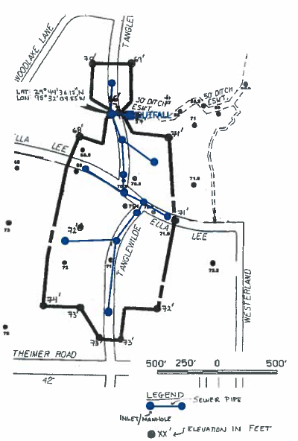
Design storm sewer for TANGLEWILDE
Method: Rational Equation Design Method to make initial design for subsequent hydraulics analysis
Identical study area as ES-13

Slide 3
Preparation steps
Apply (make) topographic map principles to identify drainage pattern(s)
Identify the individual drainage areas based on the topographic map and sewer system layout.
Determine the area of each contributing area, in acres. (ENGAUGE, PLANIMETER, etc)
Determine the rational runoff coefficient for each area (TABLE LOOKUP)

Slide 4
Preparation steps
Determine inlet time for surface portion of drainage system.
Determine rainfall intensity equation for Harris County.

Slide 5
Analysis steps
Apply the intensity equation to the various surface drainage areas, and the accumulating area to size the conduits.
Check invert elevations to fit into the useable vertical drop for the location
Size the inlets using appropriate inlet hydraulics equations.

Slide 6
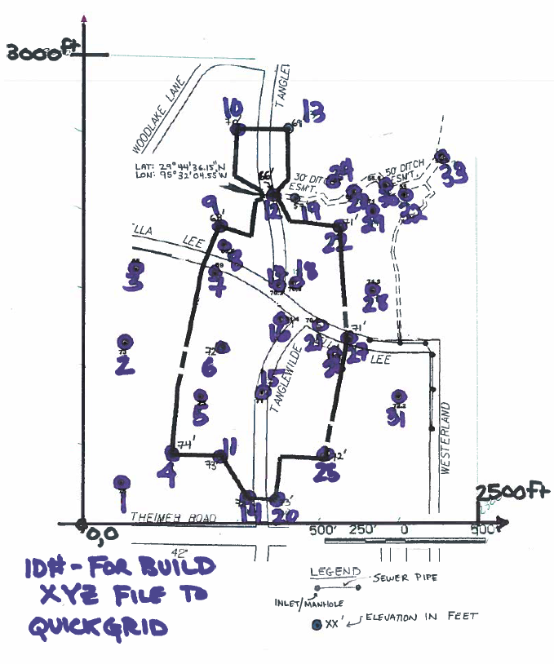
Topographic map
Locate the elevations and construct an XY coordinate system.

Slide 7
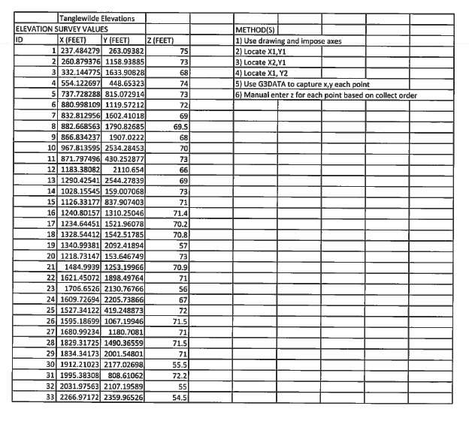
Topographic map
Use the XY-coordinate system and build an XYZ input file for topographic rendering.

Slide 8
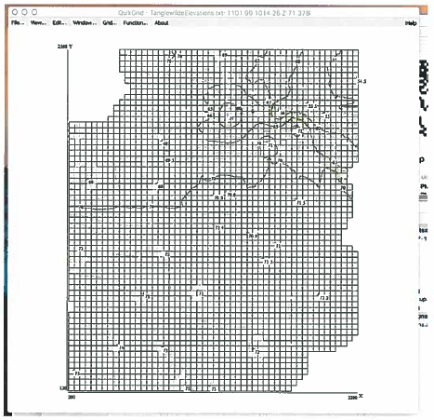
Topographic map
Render a topographic map using appropriate tools
By-hand; Excel, R-script
QuickGrid, Surfer, etc.
Arc GIS, qGIS, etc.
Adjust settings to build an overlay

Slide 9
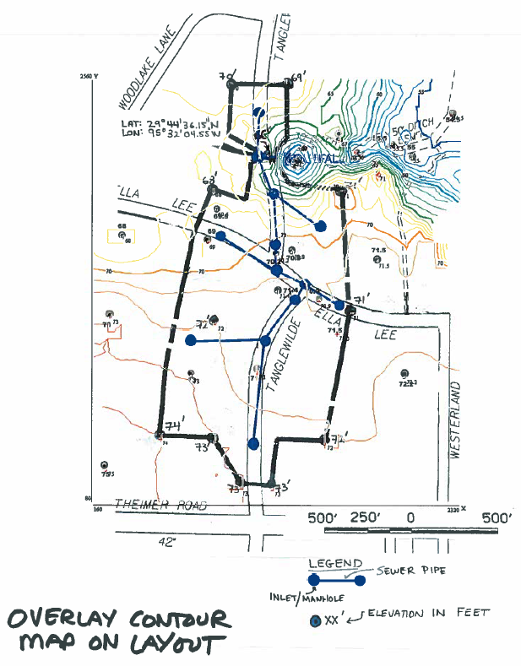
Topographic map
Overlay the map – use known data locations (in XY) to reference the overlay to the sewer drawing

Slide 10
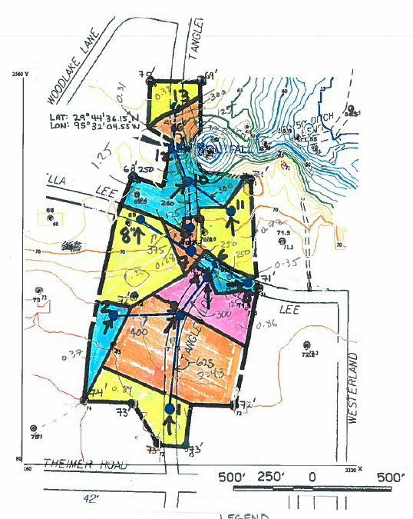
Determine drainage areas
Identify the individual drainage areas using the topographic rendering and the project layout drawing.
We will assume that drainage from outside the project area is collected elsewhere
The figure to the right is intended as a guide to the method – the areas listed are not topographically justified; that is left as an exercise!

Slide 11
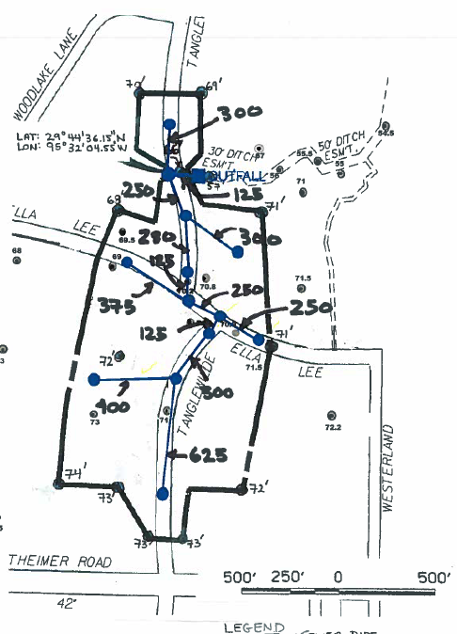
Determine pipe distances
Identify the pipes to be sized in the drainage network
Measure the pipe lengths

Slide 12
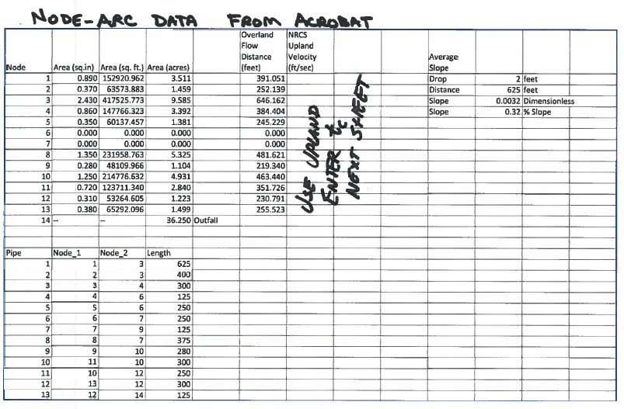
Tabulate preparatory results

Slide 13
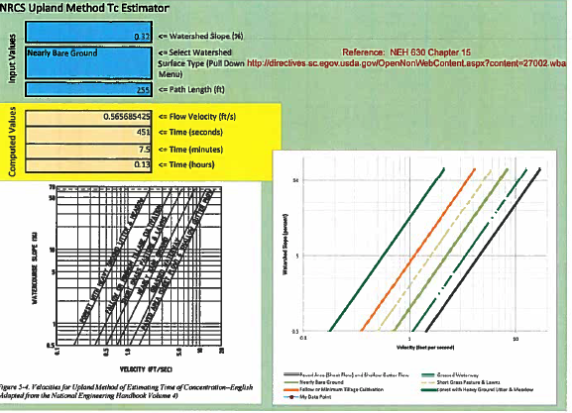
Determine Inlet times
Declare a travel distance on a drainage area to an inlet
Determine slope along that path
Apply a Tc estimation method
Repeat for each inlet

Slide 14
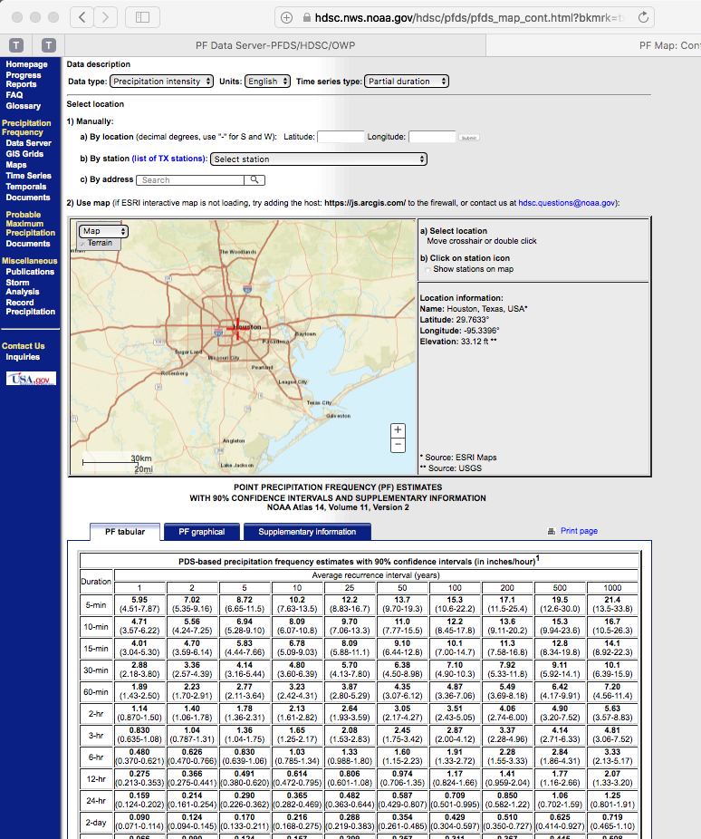

Develop an intensity equation
Locate the region on NOAA Atlas 14, Vol. 11 PFDS.
Download the .CSV table
Use solver to fit $I=\frac{B}{{(T_{c}+D)}^{E}}$

Slide 15
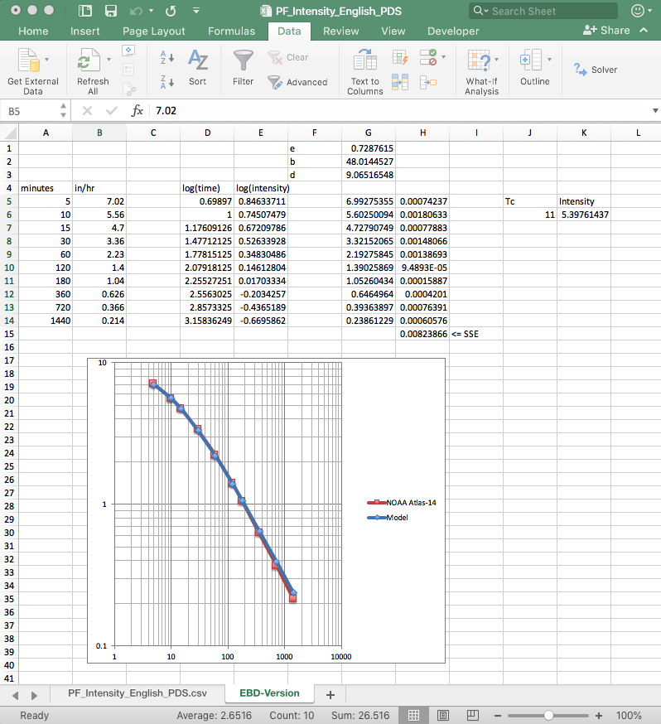

Develop an intensity equation
Solver results for (2-yr ARI) $I=\frac{48.01}{{(T_{c}+9.06)}^{0.73}}$
Use the above equation in the subsequent analysis
Note: The exercise requests a design for 5-yr ARI, so readers will have to conduct the fitting exercise on the 5-yr column from NOAA Atlas 14!

Slide 16
analysis
Apply the intensity equation as needed

