Slide 1
CE 3372 Water Systems Design
Lesson 24: sanitary sewer systems

Slide 2
Collection Systems
Collection systems (sewers) are used to collect wastewater and deliver it to a common location.
In the case of sanitary wastewater (sewage) that location is some kind of treatment facility, then onward to an outfall
For storm-water direct to an outfall to a receiving stream is typical.

Slide 3
Collection Systems
Collection systems play an important role in the control of water quality,
Concentrate certain kinds of potential non-point discharges into point discharges, which can be managed more efficiently.

Slide 4
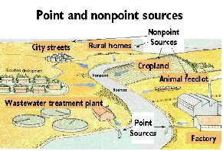
Sources
Point sources – you can point to them!
Non-point sources – distributed over an area.

Slide 5
Sewer Types
Sewers are an important class of open channels, typically subsurface, that are used to transport wastewater to its final release point back into the environment.
The design life of sewers is usually on the order of 50 years, so design must account for expansion and population growth.

Slide 6
Sewer Types
Sanitary sewer systems — individual discharges are collected, concentrated (in the volume sense), and delivered to a treatment plant for further processing.
Storm sewer systems — individual discharges are collected, concentrated, and delivered to a receiving water.
Combined sewer system (CSS) — A sanitary system designed to also collect storm-water. New combined systems are not built in the USA; older cities that were comparatively large in the 1880’s represent the remaining combined systems.

Slide 7
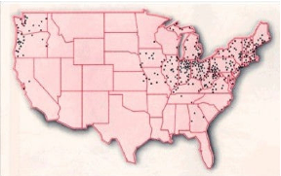
Sewer Types
Combined sewer systems in USA:

Slide 8
Sewer Types
The categories share similar hydraulics, namely that of open channel flow, and topologically are similar (comprised of pipes, boxes, junctions, and lift stations) so many design principles are interchangeable, although the sewer’s purposes are different.

Slide 9
Sewer Types
A sanitary system is to protect public health by isolating wastes from the environment until they can be treated and the reclaimed water released.

Slide 10
Sewer Types
A storm system is to protect public health by removing nuisance flooding and keeping infrastructure serviceable during all but the most severe weather
recently (last two decades) storm sewer systems have been called upon to confer water quality benefit, as they are the collectors that capture non-point pollution.

Slide 11
Sanitary Sewer Design
Sanitary sewers are pipeline systems underground that collect and transmit sewage from distributed sources to a central location.
The pipes are typically operated as open channels, that is the pipes are not supposed to flow full, and gravity is the driving force.
In some portions of the system, the sewage has to be lifted to maintain flow towards the central plant
these locations are called “lift stations”, and sewage on the discharge side of the pump flows in a pipe called a “force main” until the pipe returns to open flow, it is then just a sewage pipe.

Slide 12
Sanitary Sewer Design
The rules of design are governed by federal law, state law, and in most cases municipal law.
These various laws, codes, and guidelines prescribe materials, joints, labeling, etc.
Nearly all sewer systems must be engineered (i.e. a PE is involved with the design), or at least designed by a licensed professional (the professional may not be an engineer in smaller on-site systems, but the design will be stamped with that professional’s credentials.)

Slide 13
Sewage Characteristics
Sewage behaves hydraulically as water.
5 percent solids by mass is typically the upper limit of raw sewage
by volume the percentage is much smaller, perhaps as small as 0.05 percent.

Slide 14
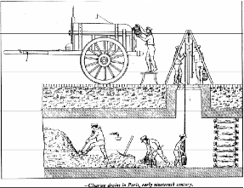
Sewage Characteristics
Solids collect in the system
Cleaning of sewers circa 1800’s. Cities like Paris, New York, London, etc. have large diameter sewers that probably still need personnel access.

Slide 15
Sewage Characteristics
The design engineer is concerned with the sewage quality insofar as it affects corrosion and safety to the maintenance personnel.
For example, in the Texas code, there is some discussion of corrosion and odor issues:

Slide 16
Sewage Characteristics
For example, in the Texas code, there is some discussion of corrosion and odor issues:
Corrosion potential:
If a pipe or an integral structural component of a pipe will deteriorate when subjected to corrosive internal conditions or if a pipe or component does not have a corrosive resistant liner installed by the pipe manufacturer, the report must demonstrate the structural integrity of a pipe during the minimum 50-year design life cycle.
A pipe must have an appropriate lining if the corrosion analysis indicates that corrosion will reduce the functional life of the pipe to less than 50 years.

Slide 17
Sewage Characteristics
For example, in the Texas code, there is some discussion of corrosion and odor issues:
Odor Control.
(a) An owner shall determine if odor control measures are necessary to prevent a wastewater collection system from becoming a nuisance, based upon the potential of the wastewater collection system to generate hydrogen sulfide.
(b) A potential odor determination must include the estimated flows immediately following construction and throughout a system’s 50-year expected life cycle.

Slide 18
Sewage Quantity
Sewage quantity is estimated in a similar fashion as water demand.
Small residential service area flows are estimated based on population or equivalent residential units and per-person contribution to wastewater generation.
Larger service area flows are estimated from land use (zoning), anticipated population, and similar nearby measured flows.
Sewage is not measured routinely, but short-term studies (2-months) are within the capabilities of most jurisdictions, flow measurement is by weirs, magmeters, and acoustic-Doppler profiling.

Slide 19
Sewage Quantity
For example, in Texas the design flow basis is:
An owner must design a wastewater collection system to handle the transport of the peak dry weather flow from the service area, plus infiltration and inflow.
The flow calculations must include the details of the average dry weather flow, the dry weather flow peaking factor, and the infiltration and inflow.
The flow calculations must include the flow expected in the facility immediately upon completion of construction and at the end of its 50-year life.

Slide 20
Sewage Quantity
Some further requirements are:
Capacity Analysis.
An owner must ensure that a wastewater collection system’s capacity is sufficient to serve the estimated future population, including institutional, industrial, and commercial flows.
An owner must include in the report the calculations that demonstrate that the hydraulic capacity of a collection system includes the peak flow of domes- tic sewage, peak flow of waste from industrial sites, and maximum infiltration rates.
A collection system must be designed to prevent a surcharge in any pipe at the expected peak flow.

Slide 21
Sewage Quantity
Some further requirements are:
Capacity Analysis.
The minimum diameter allowed for a gravity pipe is 6.0 inches.
Connecting storm water drains to a collection system is prohibited.
An owner may use the data from an existing collection system. In the absence of existing data, a design must use data from a similar system or as described below:
The sizing of pipe for a new collection system must be based on an engineering analysis of initial and future flows.
A new collection system design must be sized for the peak flow, which is based on the estimated daily sewage flow contribution as shown in Figure 4

Slide 22
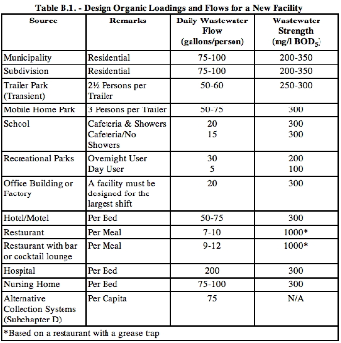
Sewage Quantity

Slide 23
Sewage Quantity
Some other ways to estimate sewage flow in Texas includes formulas such as the Equation below from the Texas Administrative Code based in number of bedrooms (an equivalent residential unit (ERU) approach).
where:
Q = flow in gallons per day ,
X = per capita wastewater production in gallons per day ,
B = number of bedrooms.

Slide 24
Sewage Quantity
Yet another equation in the code is:
where:
Q = flow in gallons per minute.
A = rate factor.
N = number of equivalent dwelling units served.
B = factor of safety.

Slide 25
Sewage Quantity
Yet another equation in the code is:
where:
Q = flow in gallons per minute.
A₁ = rate factor.
P = population served.
B = factor of safety.

Slide 26
Sewage Quantity
Other jurisdictions will have similar kinds of estimate guidelines.
One important note, the units of each of these equations, which have similar mathematical structure, are quite different. One produces estimates in gallons/day, while the other two are gallons/minute.

Slide 27
Modeling Sewers in SWMM
Collection system – pretty much the same as storm water
Treatment plant – uncommon but SWMM can be used to model hydraulics going through a plant
reactors == rectangular channels of appropriate length
sumps == storage nodes
pumps == pumps
could be useful for drawing HGL through a plant. Head losses between unit processes may take some trial-and-error to enter the head loss terms.

Slide 28
INFLOW AND INFILTRATION
Inflow is direct connections to sanitary sewers
Roof gutters
French drains
Such connections are not supposed to be allowed
Infiltration is leakage into sanitary sewers
Cracks in pipe; high water table
Leaks at joints
Leaks at junction boxes

Slide 29
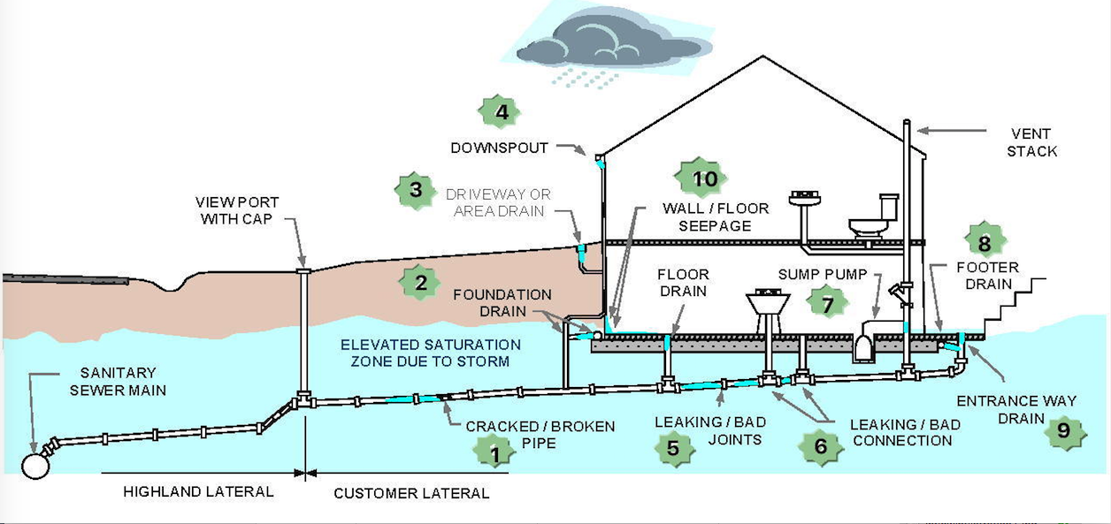
INFLOW AND INFILTRATION
Inflow
Infiltration

Slide 30
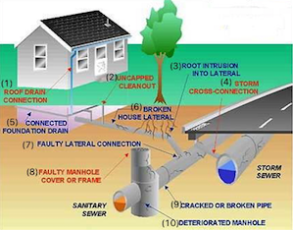
INFLOW AND INFILTRATION
Inflow (Red)
Infiltration (Blue)

