Slide 1
CE 3372 Water Systems Design
Lesson 20: DUAL Drainage system fall 2020

Slide 2
DUAL DRAINAGE CONCEPT
Simulating surface and sub-surface (sewer) flow
“Two” drainage networks connecting to same outfall.
Occupy same physical space

Slide 3
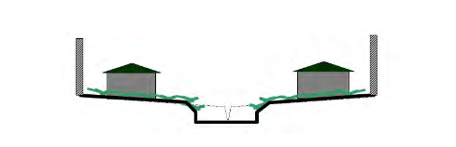
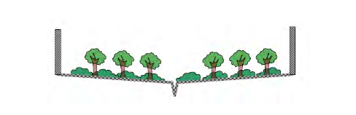
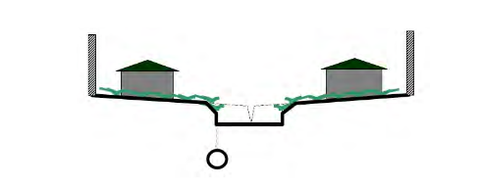
DUAL DRAINAGE CONCEPT
Cross sections
Street Cross Section: Street is a “conduit” in our hydraulics model
Storm Sewer Pipe

Slide 4
DUAL DRAINAGE CONCEPT
Nodes (Inlets)
Offset
Invert elevation

Slide 5
Goodwin street example (Continued)
Add to our SWMM model a surface drainage system
Using simplistic cross sectional geometry
Add street section along Goodwin

Slide 6
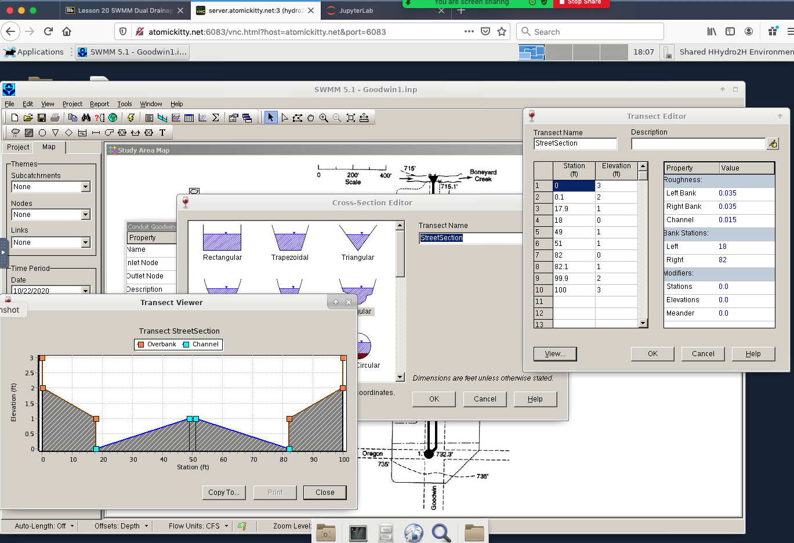
Goodwin street CROSS SECTION
Glass wall
Sidewalk
Street
Use IRREGULAR cross section

Slide 7
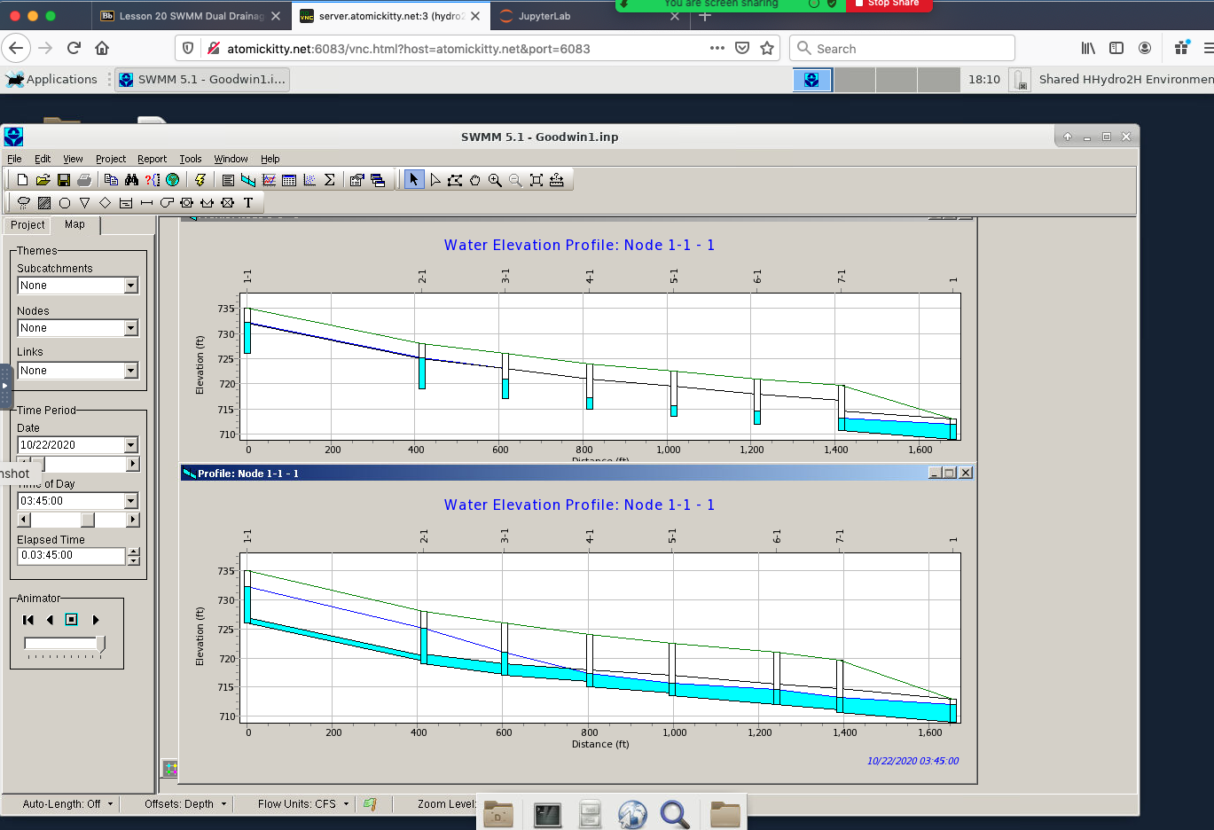
Goodwin street Dual drainage
Run simulation
Profiles
Manual to get the surface flow
Invert elevations same both drawings
Upper elevations (green lines) are same both drawings
HGL is dark blue line both drawings
Surface drainage system
Sewer drainage system

