Slide 1
CE 3372 Water Systems Design
Pipe hydraulics part 1(Fall 2020)

Slide 2
Flow characteristics
Water moves from higher to lower energy
Path of least resistance
Head is energy per unit weight of a fluid
Pumps are used to add energy to move water to a higher elevation or over a barrier
Gravity flow:
Change in elevation provides the required energy
Pressure flow:
Change in pressure provides the required energy

Slide 3
Flow rate
Flow of water creates friction/resistance; hence there is loss of energy along a flow path
Mean section velocity is related to cross sectional flow area and volumetric discharge

Slide 4
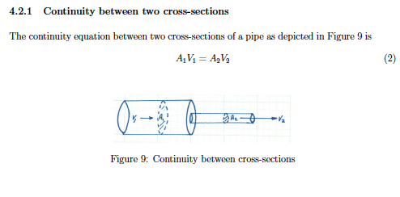
CONTINUNITY AT SECTIONS

Slide 5
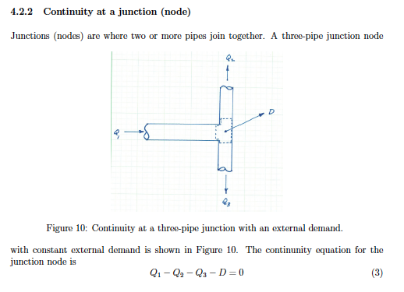
CONTINUNITY AT A JUNCTION

Slide 6
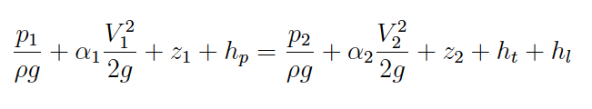
Energy Equation
The energy equation relates the total dynamic head at two points in a system, accounting for frictional losses and any added head from a pump.
h_{L} =
head lost to friction
h_{p} =
head supplied by a pump
h_{t} =
head recovered by a turbine

Slide 7
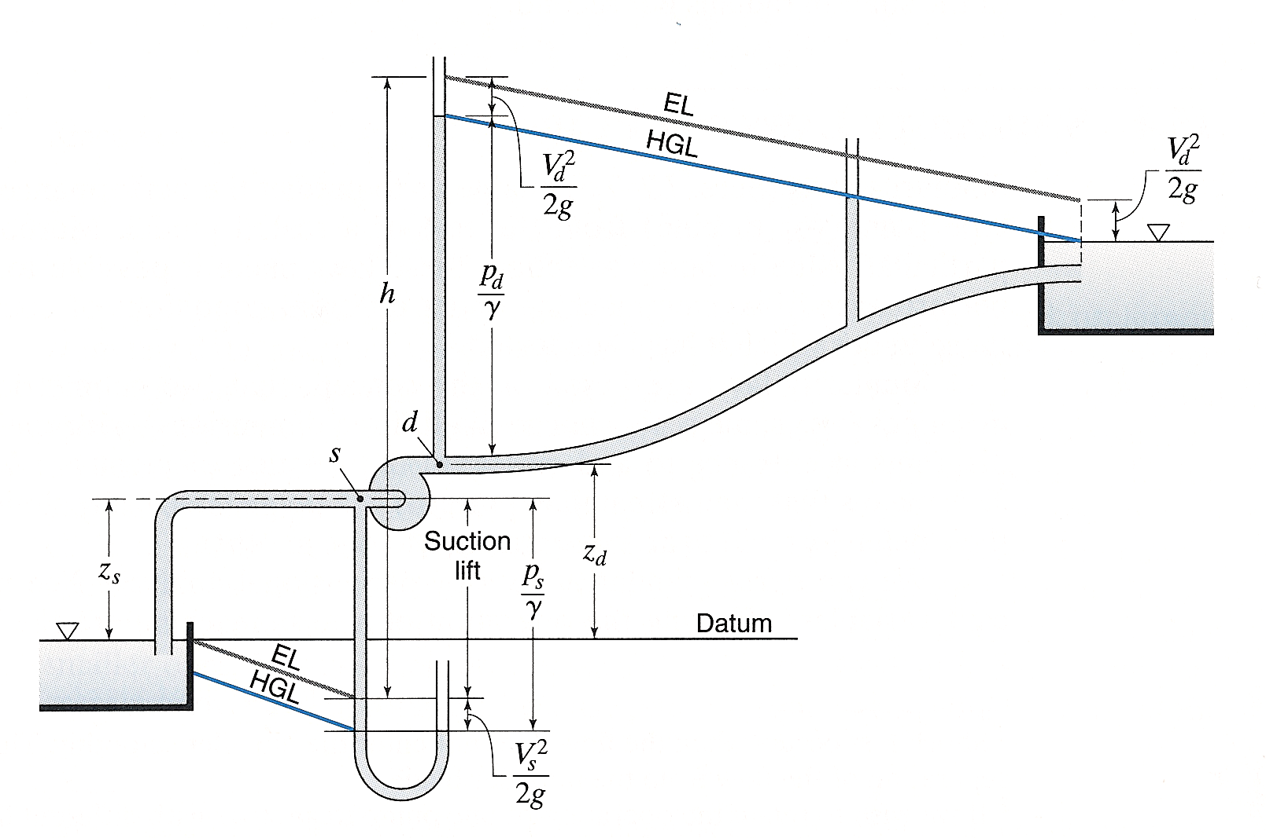
Energy Equation
2
1

Slide 8
Pipe flow
Energy loss is influenced by hydraulic and geometric properties
Hydraulic properties:
Material (roughness)
Components (valves, bends, tees, … )
Operating pressure
Geometric properties:
Length
Cross section (shape and area)

Slide 9
Hydraulic grade line
HGL is a line that represents the surface/profile of water flowing in partially full pipe
If pipe is under pressure, flowing full the HGL rises to where a free surface would exist if there were a piezometer installed in the pipeline

Slide 10
Energy grade line
EGL is a line that represents the elevation of energy head of water flowing in a conduit. It is the sum of the elevation, pressure, and velocity head at a location
Drawn above HGL at a distance equal to the velocity head

Slide 11
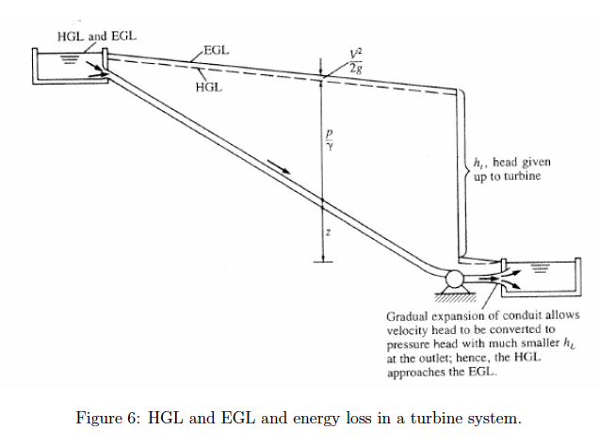
HGL/EGL

