Slide 1
CE 3372 Water Systems Design
Pipe hydraulics part 2 (Fall 2020)

Slide 2
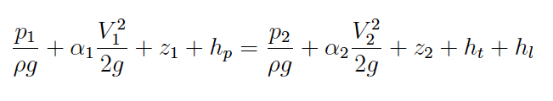
Energy Equation
The energy equation relates the total dynamic head at two points in a system, accounting for frictional losses and any added head from a pump.
h_{L} =
head lost to friction
h_{p} =
head supplied by a pump
h_{t} =
head recovered by a turbine

Slide 3
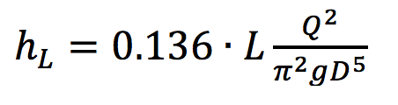
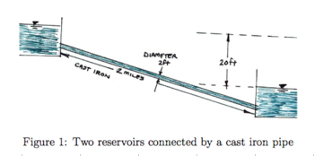
Energy equation application
Estimate discharge between two reservoirs:
Head Loss is given as
Notes:
Do analysis in class – build tool in class. Direct application of energy equation.

Slide 4
HEAD LOSS MODELS
Head Loss Models (for losses in pipes)
Darcy-Weisbach
Moody Chart
Jain Equations
Hazen-Williams
Chezy-Manning
Fitting (Minor) Losses

Slide 5
Pipeline system
Head Loss Model
Pump Curve

Slide 6
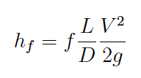
Darcy-Weisbach loss model for pipe loss
Frictional loss proportional to
Length, Velocity**2
Inversely proportional to
Cross sectional area
Loss coefficient (f) depends on
Reynolds number (fluid and flow properties)
Roughness height (pipe material properties)

Slide 7
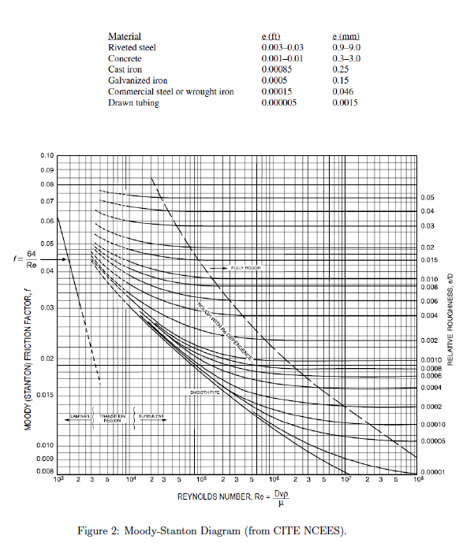
Moody Chart
Moody-Stanton chart is a tool to estimate the friction factor in the DW head loss model
Used for the pipe loss component of friction

Slide 8
Examples
Three “classical” examples using Moody Chart
Head loss for given discharge, diameter, material
Discharge given head loss, diameter, material
Diameter given discharge, head loss, material

Slide 9
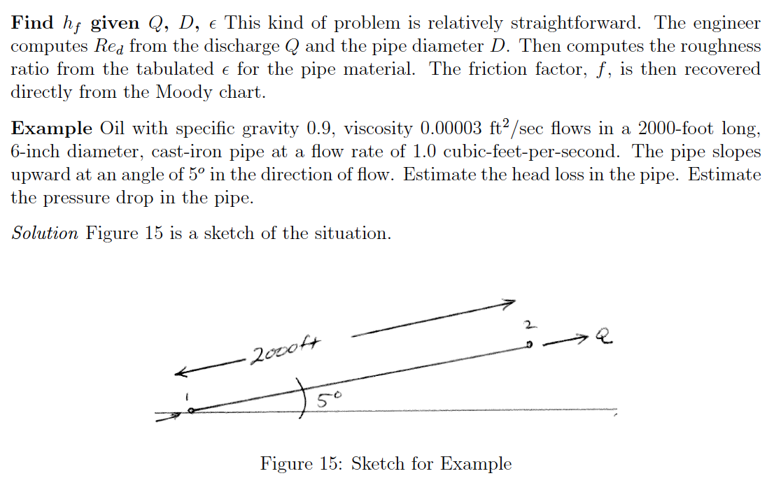
Example 1
Head loss for given discharge, diameter, material

Slide 10
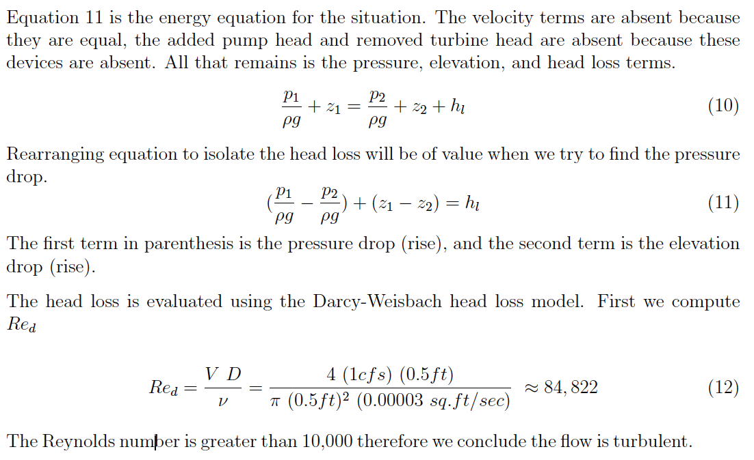
Example 1
Head loss for given discharge, diameter, material

Slide 11
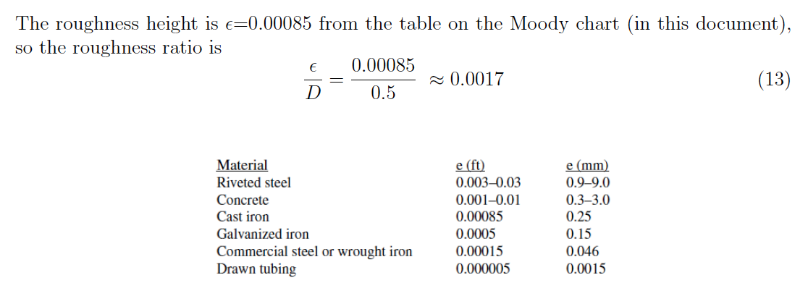
Example 1
Head loss for given discharge, diameter, material

Slide 12
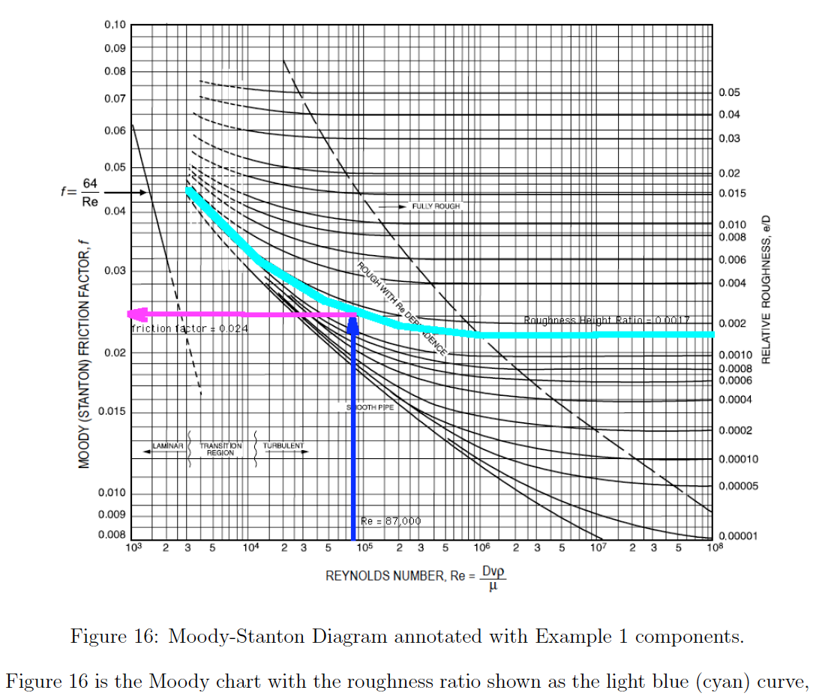
Example 1
Head loss for given discharge, diameter, material

Slide 13
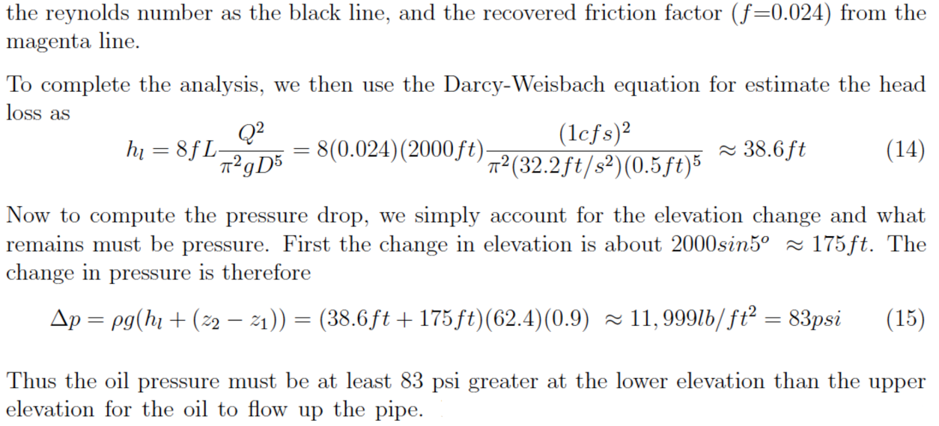
Example 1
Head loss for given discharge, diameter, material

Slide 14
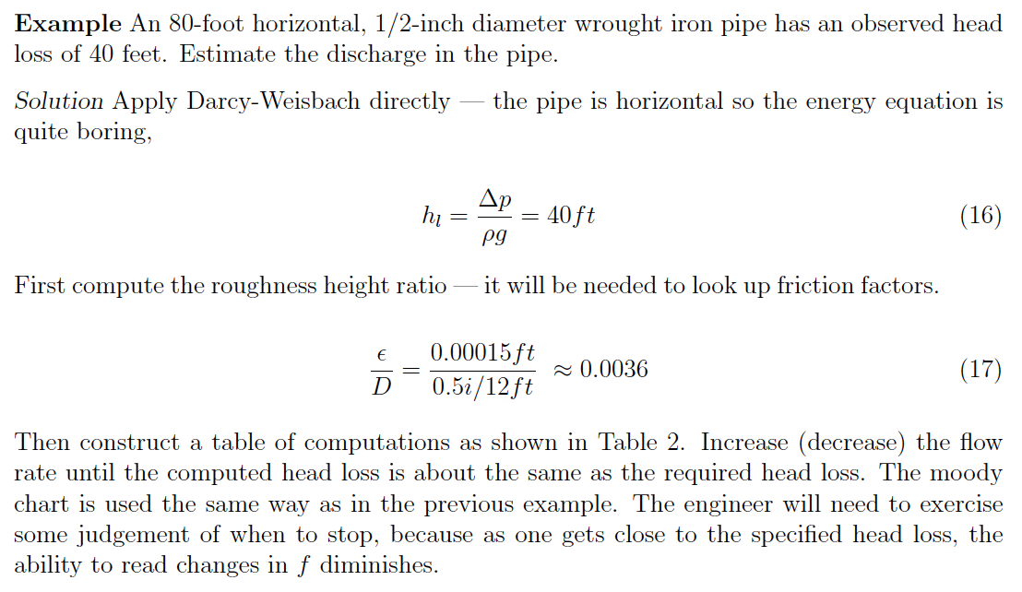
Example 2
Discharge given head loss, diameter, material

Slide 15
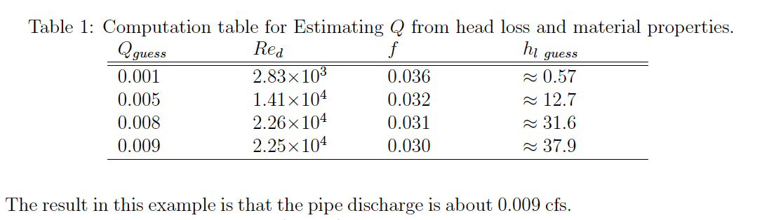
Example 2
Discharge given head loss, diameter, material

Slide 16
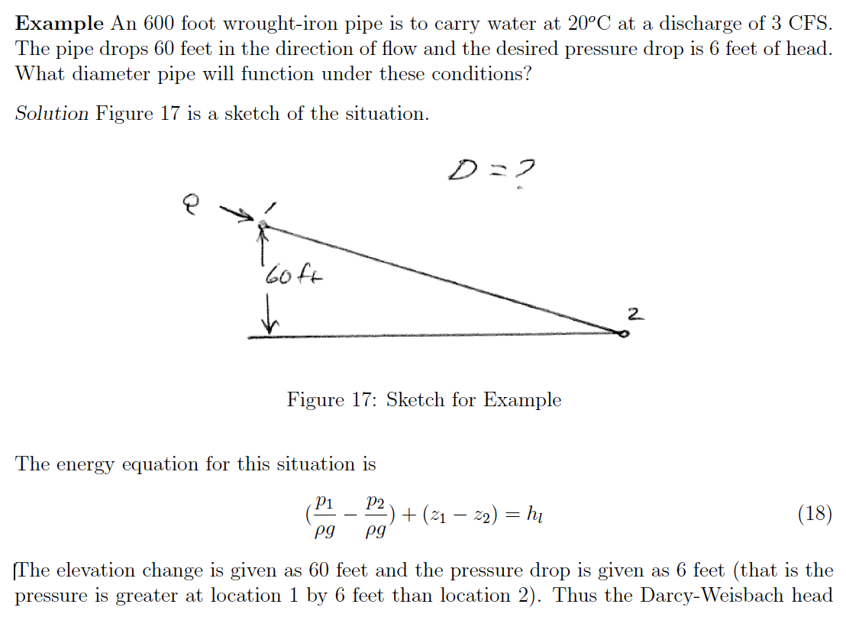
Example 3
Diameter given discharge, head loss, material

Slide 17
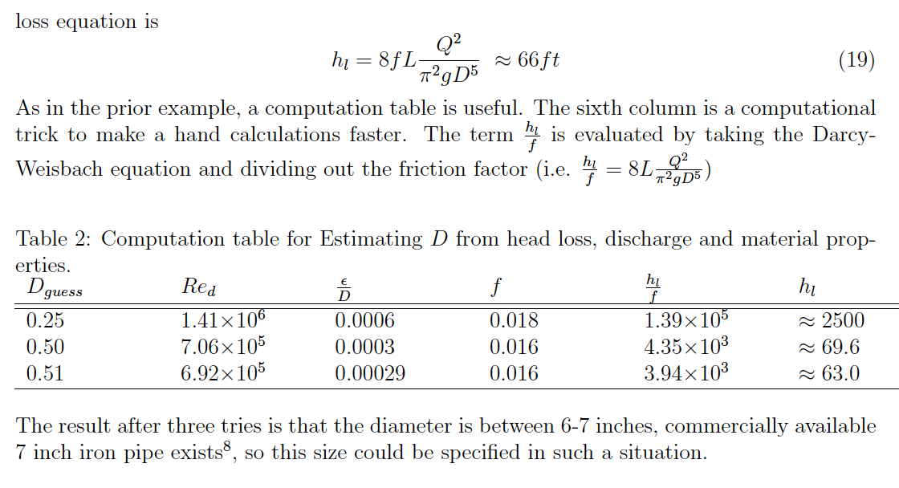
Example 3
Diameter given discharge, head loss, material

Slide 18


Direct (Jain) Equations
An alternative to the Moody chart are regression equations that allow direct computation of discharge, diameter, or friction factor.

Slide 19
Jain equations – Computational thinking/data science application
Build a Computational Tool (e.g JupyterLab as in ENGR 1330)
State the programming problem
Known (Inputs)
Unknown (Outputs)
Governing Equation(s)
Test the tool

Slide 20
Jain equations
Link to On-Line Tool
A similar tool (to the Jupyter Notebook just developed) is available online at:
http://atomickitty.ddns.net/documents/mytoolbox-server/Hydraulics/QGivenHeadLoss/QGivenHeadLoss.html

Slide 22
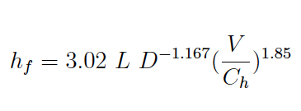
Hazen-Williams
Frictional loss proportional to
Length, Velocity^(1.8)
Inversely proportional to
Cross section area (as hydraulic radius)
Loss coefficient (Ch) depends on
Pipe material and finish
Turbulent flow only (Re>4000)
WATER ONLY!

Slide 23
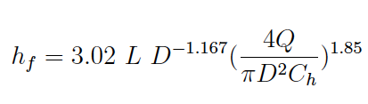
Hazen-Williams
HW Head Loss
Discharge Form

Slide 24
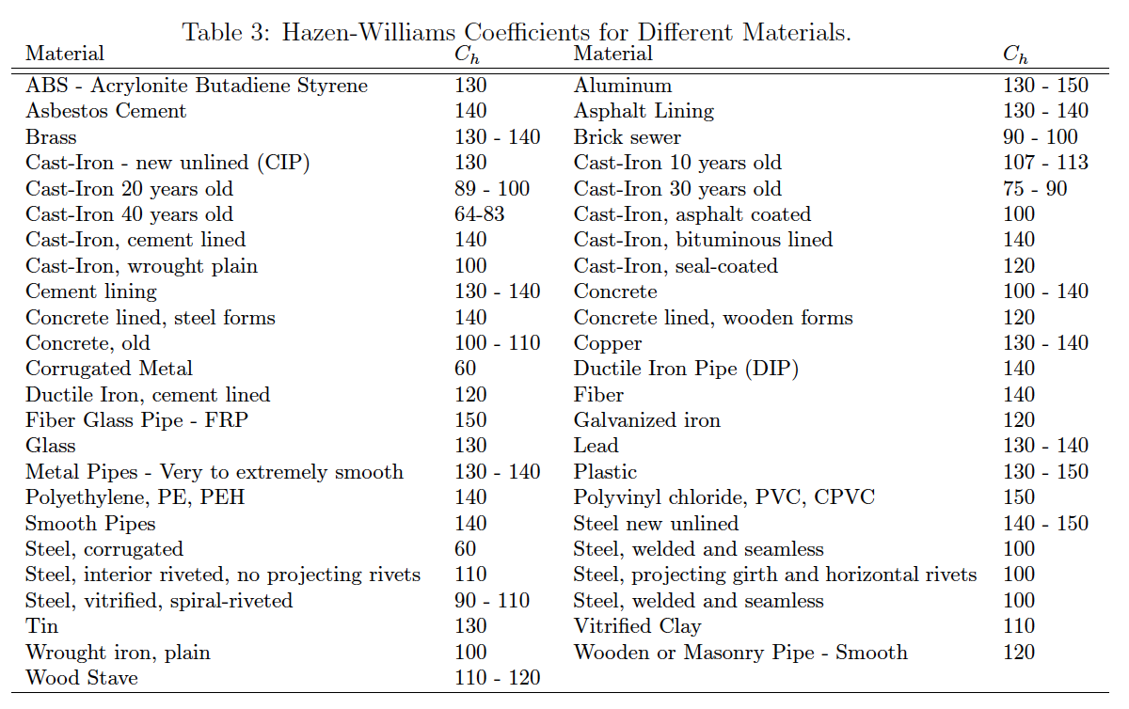
Hazen-williams
Hazen-Williams C-factor

Slide 25
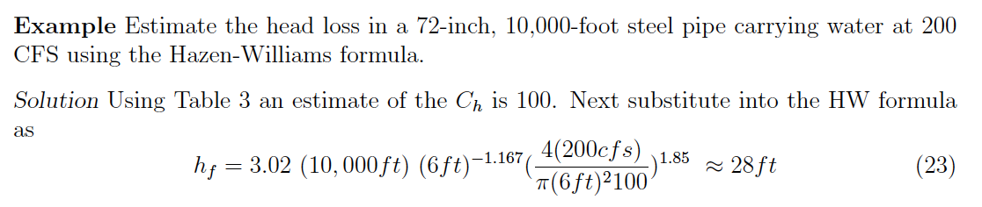
Example using hazen-williams formula

Slide 26

Hydraulic Radius
HW is often presented as a velocity equation using the hydraulic radius

Slide 27
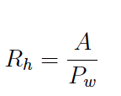
Hydraulic Radius
The hydraulic radius is the ratio of cross section flow area to wetted perimeter

Slide 28
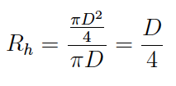
Hydraulic Radius
For circular pipe, full flow (no free surface)
AREA
PERIMETER
D

Slide 29
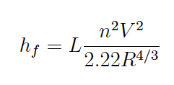
Chezy-Manning
Frictional loss proportional to
Length, Velocity^2
Inversely proportional to
Cross section area (as hydraulic radius)
Loss coefficient depends on
Material, finish

Slide 30
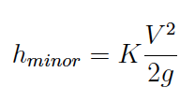
Fitting (Minor) Losses
Fittings, joints, elbows, inlets, outlets cause additional head loss.
Called “minor” loss not because of magnitude, but because they occur over short distances.
Typical loss model is

Slide 31
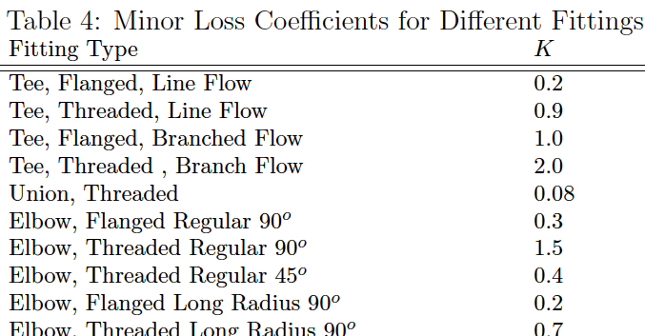
Fitting (Minor) Losses
The loss coefficients are tabulated for different kinds of fittings

Slide 32
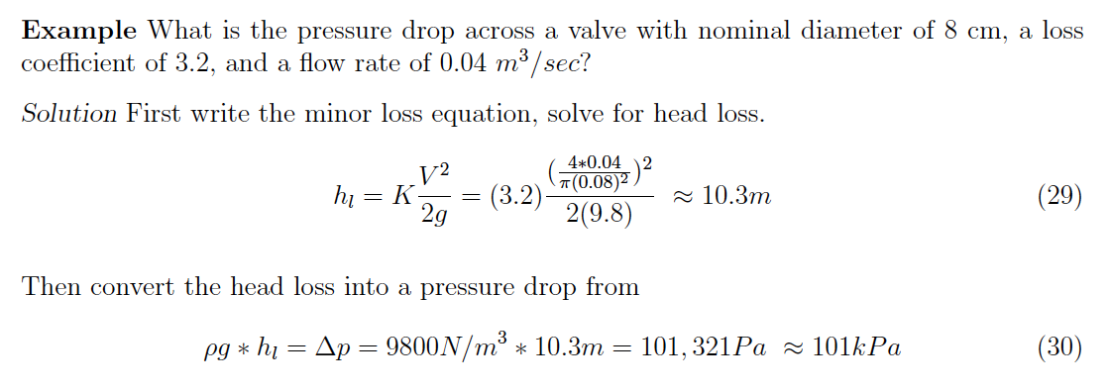
Example – fitting (minor) losses

Slide 33
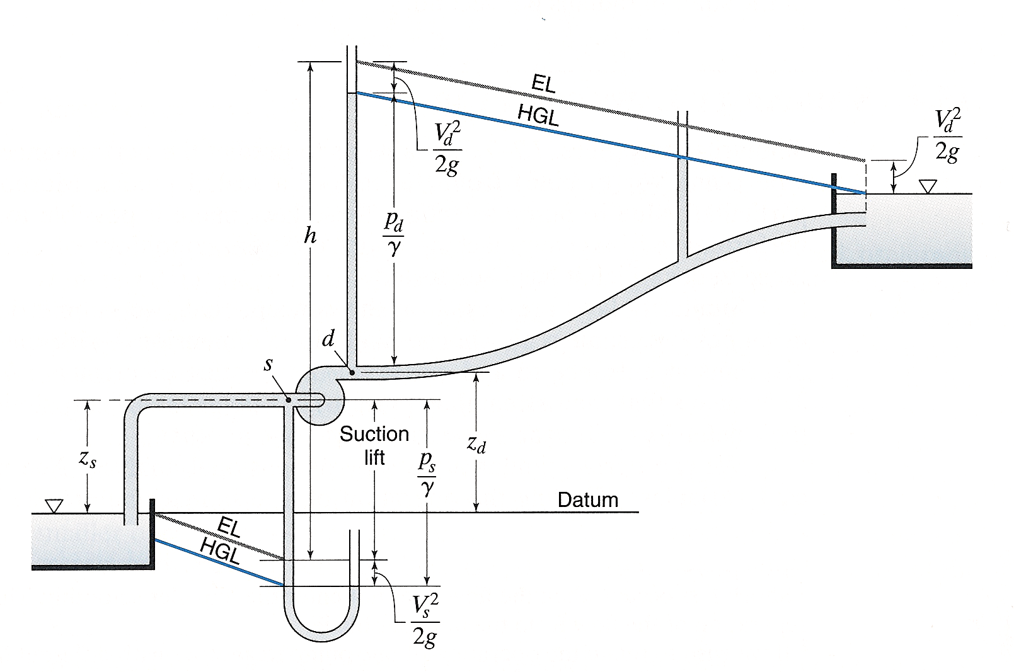
Pipeline system
Length_2
Length_1
2
=Length_1 + Length_2
Elbow
Exit
1
Inlet
Head Loss Model
Pump Curve

